Slide 1
A multimodal evaluation model for improving pedagogical outcomes
Md Shafiqul Islam
Supervisor Dr Md. Mizanur Rahoman
26 May , 2025

Slide 2

Introduction
Importance of evaluating teaching performance in higher education
Traditional reliance on student feedback — subjective and limited
Emergence of systems using AI/ML
Objective: Compare reliability and validity between traditional and multimodal methods

Slide 3
Research problem and objectives
Problem
Objectives
Student feedback suffers from bias and lacks depth
Evaluate reliability and validity of both methods
Only auditory or visual systems are not enough
Analyze correlation between student feedback and multimodal evaluation

Slide 4
Add the issues
Literary review
Student feedback
Auditory Evaluation
Common but biased by non-academic factors Subjective & biased
Captures vocal tone, emotion, prosody Sensitive to Noise & Accent
Vision-Based Systems
Linguistic/NLP
Track movement, gestures, classroom interaction Lacks Context
Analyze instructional clarity, sentiment, question quality Misses Non-Verbal Cues

Slide 5
Methodology
Sampling
Instructor/Teacher/Students
Data collection
Likert-scale, Audio, Video, Text
Data processing
YOLOv5 + HRNet, PRAAT, BERT
Data Analysis
Correlation, regression, thematic coding
Results

Slide 6
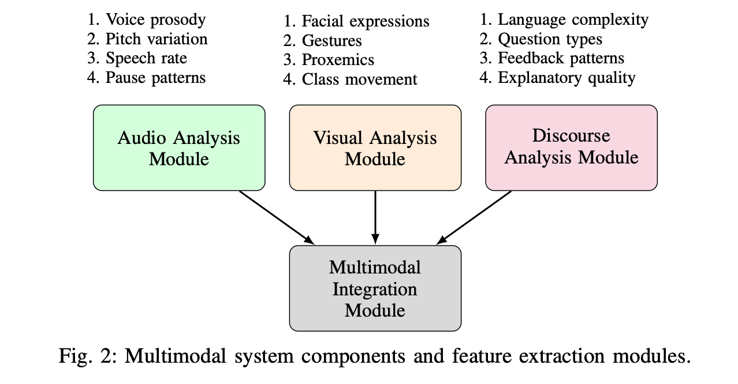
Methodology
This study employs a mixed-methods comparative design

Slide 7
Experimental setup
Hardwares
Softwares
RTX 3060 + 32 GB RAM For faster processing
PRAAT For audio processing
OpenPose/HRNet For pose estimation
Python + hugginface For analysis and modeling

Slide 8
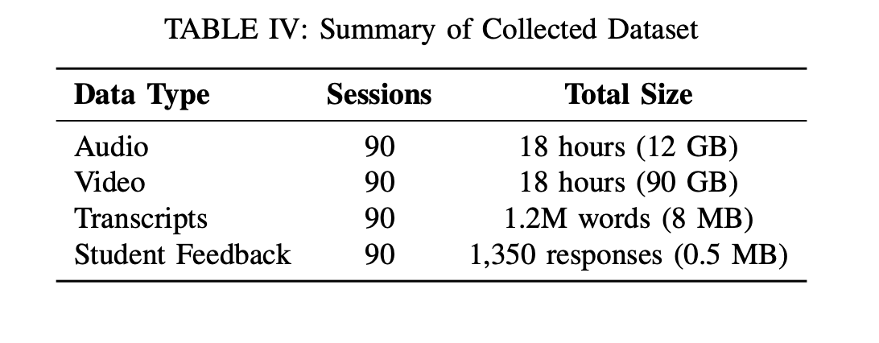
Data collection summery
Audio recordings WAV, 44.1Hz
Video recordings MP4, 1080p
Transcripts TXT
Student feedback CSV

Slide 9
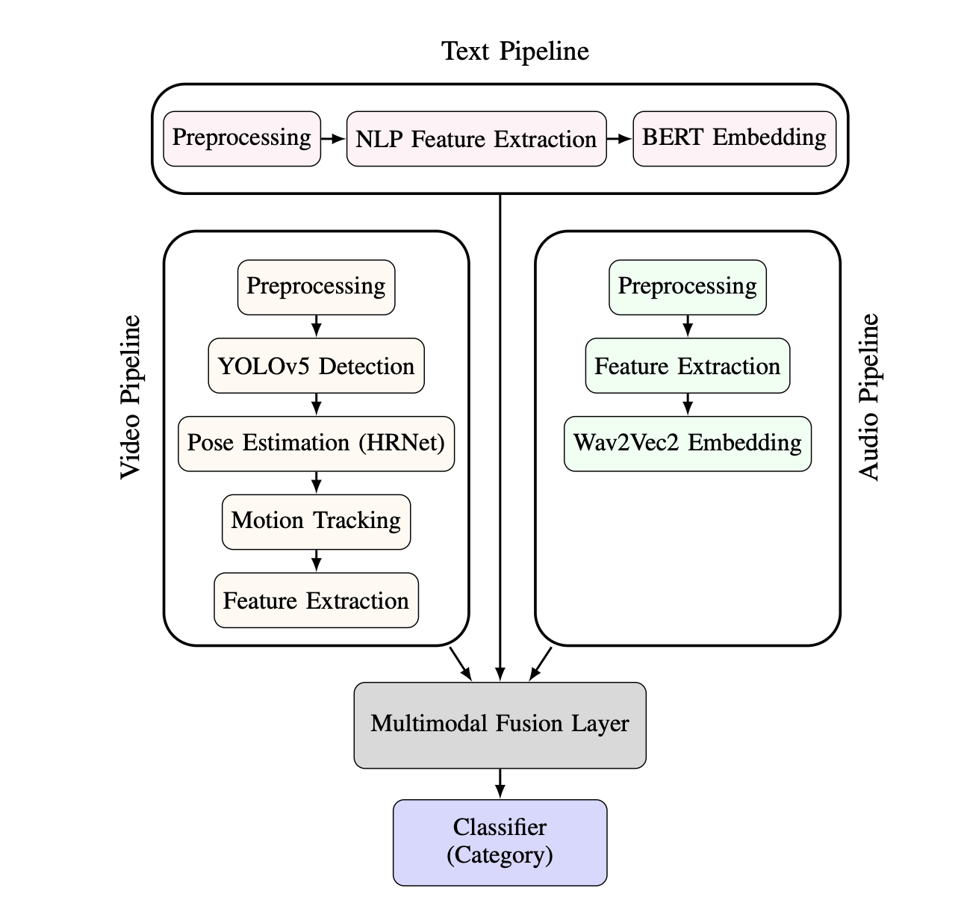
Multimodal evaluation system
Audio Speech rate, pitch, emotion using Wav2Vec2
Video Pose estimation, gesture tracking (YOLOv5, HRNet)
Text feedback Sentiment analysis, question type (BERT/DistilBERT)

Slide 10
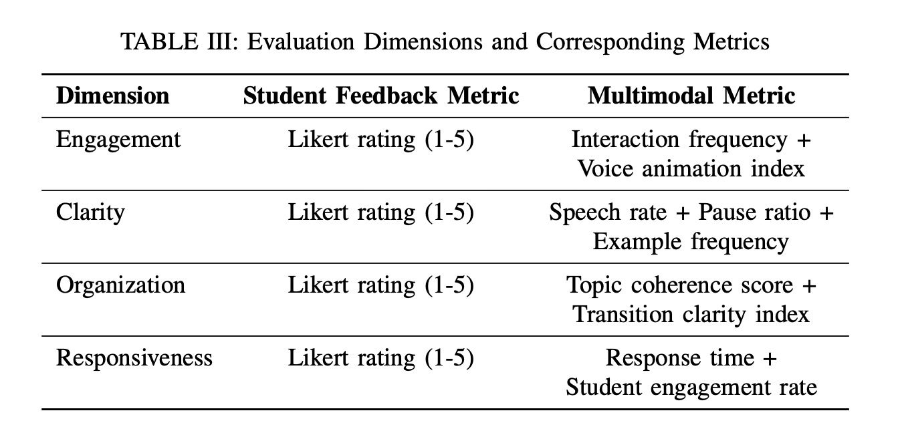
Evaluation metrics
We evaluated engagement, clarity, responsiveness, and overall effectiveness by comparing student feedback with multimodal features such as gestures, speech patterns, response timing, and combined audio-visual-text data.

Slide 11
Results
To be continued …

Slide 12
Comparison and analysis
To be continued …

Slide 13
Discussion and future works
To be continued …

Slide 14
THANK YOU

