Slide 1
Music retrieval a boolean retrieval approach
Sandro Junior Della Rovere

Slide 2
Implement a Boolean Retrieval system
2

Slide 3
Implement a Boolean Retrieval system
Retrieval of songs
2

Slide 4
Implement a Boolean Retrieval system
Retrieval of songs
Boolean queries on the song lyrics
2

Slide 5
Implement a Boolean Retrieval system
Retrieval of songs
Boolean queries on the song lyrics
«american AND idiot»
2

Slide 6
Implement a Boolean Retrieval system
Retrieval of songs
Boolean queries on the song lyrics
«american AND idiot»
American Idiot (Green Day)
Irresponsible Hate Anthem (Marilyn Manson)
…
2

Slide 7
What it takes to build a boolean retrieval system

Slide 8
What it takes to build a boolean retrieval system
collection
The «Spotify Milllion Song Dataset»:
57.650 songs in the English language
Data attributes: Title, Artist, Link, Lyrics

Slide 9
What it takes to build a boolean retrieval system
collection
The «Spotify Milllion Song Dataset»:
57.650 songs in the English language
Data attributes: Title, Artist, Link, Lyrics
Inverted index
A data structure on which the search is performed:
A dictionary of Terms in the collection
Each term points to a Posting List

Slide 10
What it takes to build a boolean retrieval system
collection
The «Spotify Milllion Song Dataset»:
57.650 songs in the English language
Data attributes: Title, Artist, Link, Lyrics
Inverted index
A data structure on which the search is performed:
A dictionary of Terms in the collection
Each term points to a Posting List
Query engine
A program to run boolean queries on the IR system
AND/OR/NOT queries
Complex queries

Slide 11
What it takes to build a boolean retrieval system
collection
The «Spotify Milllion Song Dataset»:
57.650 songs in the English language
Data attributes: Title, Artist, Link, Lyrics
Inverted index
A data structure on which the search is performed:
A dictionary of Terms in the collection
Each term points to a Posting List
Query engine
A program to run boolean queries on the IR system
AND/OR/NOT queries
Complex queries
Evaluation
Some way to evaluate the effectiveness of the system

Slide 12
Proposed solution

Slide 13
Proposed solution
OBJECT ORIENTED
The system has been implemented in the python programming language.
The implementation follows the object-oriended paradigm, with classes representing the main components of the system.

Slide 14
Proposed solution
OBJECT ORIENTED
The system has been implemented in the python programming language.
The implementation follows the object-oriended paradigm, with classes representing the main components of the system.
BUT ALSO FUNCTIONAL…
The query engine and the evaluation part have been implemented in a functional programming fashion, due to the algorithmic nature of these parts.

Slide 15
Proposed solution
OBJECT ORIENTED
LIBRARIES
The system has been implemented in the python programming language.
The implementation follows the object-oriended paradigm, with classes representing the main components of the system.
Pandas
Numpy
NLTK
String
Re
Functools
Pickle
Matplotlib
Seaborn
BUT ALSO FUNCTIONAL…
The query engine and the evaluation part have been implemented in a functional programming fashion, due to the algorithmic nature of these parts.

Slide 16
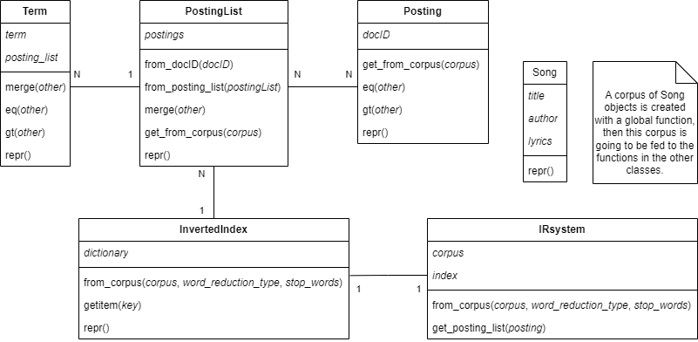
Proposed solution

Slide 17
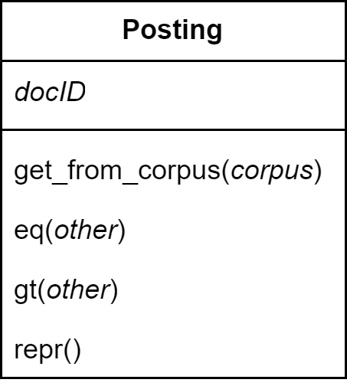
Proposed solution

Slide 18
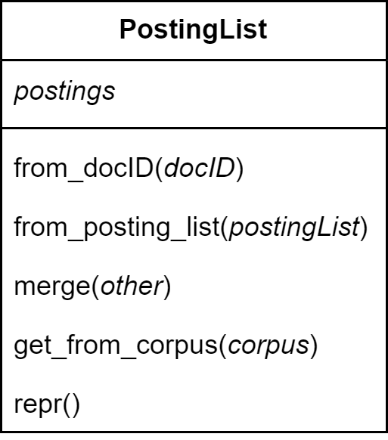
Proposed solution

Slide 19
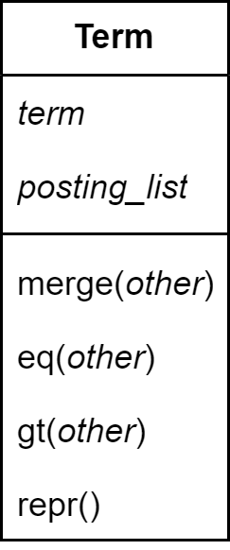
Proposed solution

Slide 20
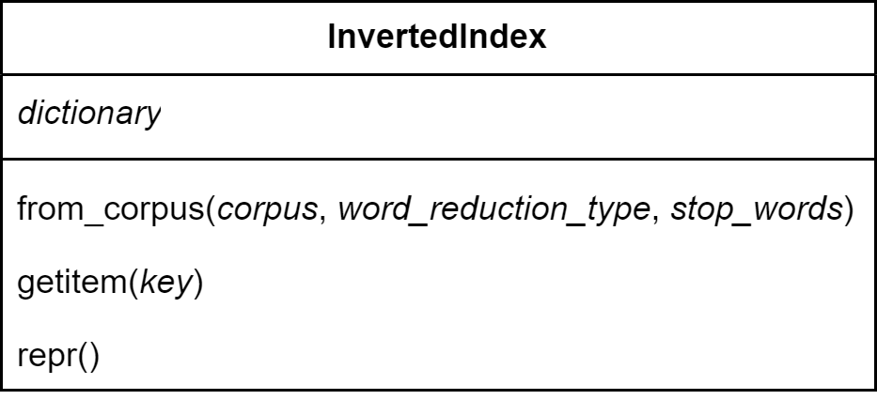
Proposed solution

Slide 21
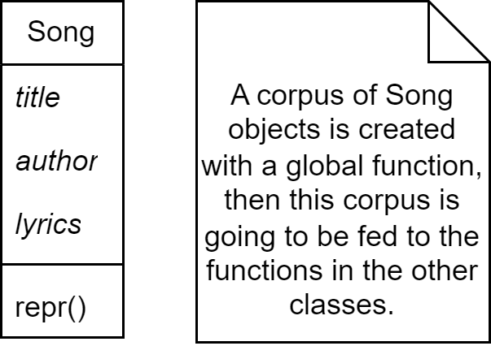
Proposed solution

Slide 22
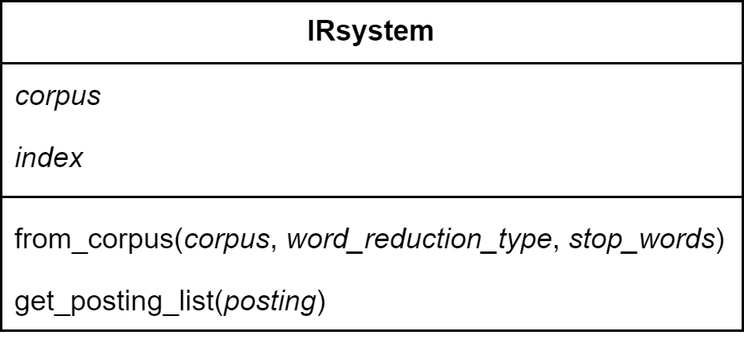
Proposed solution

Slide 23
Proposed solution
QUERY ENGINE

Slide 24
Proposed solution
QUERY ENGINE (query, word_reduction_type = ‘stemming_porter’, stopword = True, _print = True)

Slide 25
Proposed solution
QUERY ENGINE (query, word_reduction_type = ‘stemming_porter’, stopword = True, _print = True)
Initialize an empty set for the answer to the query

Slide 26
Proposed solution
QUERY ENGINE (query, word_reduction_type = ‘stemming_porter’, stopword = True, _print = True)
Initialize an empty set for the answer to the query
Split the text based on where the boolean operators are

Slide 27
Proposed solution
QUERY ENGINE (query, word_reduction_type = ‘stemming_porter’, stopword = True, _print = True)
Initialize an empty set for the answer to the query
Split the text based on where the boolean operators are
«american idiot NOT media» → {«american idiot», «AND» «media»}

Slide 28
Proposed solution
QUERY ENGINE (query, word_reduction_type = ‘stemming_porter’, stopword = True, _print = True)
Initialize an empty set for the answer to the query
Split the text based on where the boolean operators are
«american idiot NOT media» → {«american idiot», «AND» «media»}
Preprocess the words (not the boolean operators)

Slide 29
Proposed solution
QUERY ENGINE (query, word_reduction_type = ‘stemming_porter’, stopword = True, _print = True)
Initialize an empty set for the answer to the query
Split the text based on where the boolean operators are
«american idiot NOT media» → {«american idiot», «AND» «media»}
Preprocess the words (not the boolean operators)
If stopword == False, remove stopwords

Slide 30
Proposed solution
QUERY ENGINE (query, word_reduction_type = ‘stemming_porter’, stopword = True, _print = True)
Initialize an empty set for the answer to the query
Split the text based on where the boolean operators are
«american idiot NOT media» → {«american idiot», «AND» «media»}
Preprocess the words (not the boolean operators)
If stopword == False, remove stopwords
Stem/Lemmatize based on the value of word_reduction_type

Slide 31
Proposed solution
QUERY ENGINE (query, word_reduction_type = ‘stemming_porter’, stopword = True, _print = True)
Initialize an empty set for the answer to the query
Split the text based on where the boolean operators are
«american idiot NOT media» → {«american idiot», «AND» «media»}
Preprocess the words (not the boolean operators)
If stopword == False, remove stopwords
Stem/Lemmatize based on the value of word_reduction_type
Call function get_posting_list() from the IRsystem class to retrieve the posting list of the first word in the query, add it to the answer set

Slide 32
Proposed solution
QUERY ENGINE (query, word_reduction_type = ‘stemming_porter’, stopword = True, _print = True)
Initialize an empty set for the answer to the query
Split the text based on where the boolean operators are
«american idiot NOT media» → {«american idiot», «AND» «media»}
Preprocess the words (not the boolean operators)
If stopword == False, remove stopwords
Stem/Lemmatize based on the value of word_reduction_type
Call function get_posting_list() from the IRsystem class to retrieve the posting list of the first word in the query, add it to the answer set
Loop through the remaining words in the query

Slide 33
Proposed solution
QUERY ENGINE (query, word_reduction_type = ‘stemming_porter’, stopword = True, _print = True)
Initialize an empty set for the answer to the query
Split the text based on where the boolean operators are
«american idiot NOT media» → {«american idiot», «AND» «media»}
Preprocess the words (not the boolean operators)
If stopword == False, remove stopwords
Stem/Lemmatize based on the value of word_reduction_type
Call function get_posting_list() from the IRsystem class to retrieve the posting list of the first word in the query, add it to the answer set
Loop through the remaining words in the query
If the word is «AND», intersect the answer set with the posting list of the next word

Slide 34
Proposed solution
QUERY ENGINE (query, word_reduction_type = ‘stemming_porter’, stopword = True, _print = True)
Initialize an empty set for the answer to the query
Split the text based on where the boolean operators are
«american idiot NOT media» → {«american idiot», «AND» «media»}
Preprocess the words (not the boolean operators)
If stopword == False, remove stopwords
Stem/Lemmatize based on the value of word_reduction_type
Call function get_posting_list() from the IRsystem class to retrieve the posting list of the first word in the query, add it to the answer set
Loop through the remaining words in the query
If the word is «AND», intersect the answer set with the posting list of the next word
If the word is «OR», unite the answer set with the posting list of the next word

Slide 35
Proposed solution
QUERY ENGINE (query, word_reduction_type = ‘stemming_porter’, stopword = True, _print = True)
Initialize an empty set for the answer to the query
Split the text based on where the boolean operators are
«american idiot NOT media» → {«american idiot», «AND» «media»}
Preprocess the words (not the boolean operators)
If stopword == False, remove stopwords
Stem/Lemmatize based on the value of word_reduction_type
Call function get_posting_list() from the IRsystem class to retrieve the posting list of the first word in the query, add it to the answer set
Loop through the remaining words in the query
If the word is «AND», intersect the answer set with the posting list of the next word
If the word is «OR», unite the answer set with the posting list of the next word
If the word is «NOT», subtract the posting list of the next word from the answer set
If _print == True print the answer, otherwise return it

Slide 36
Saving the inverted index on disk

Slide 37
Saving the inverted index on disk
The pickle library is used to dump the IRsystem object on disk

Slide 38
Saving the inverted index on disk
The pickle library is used to dump the IRsystem object on disk
So the whole system is saved, not just the index

Slide 39
Saving the inverted index on disk
The pickle library is used to dump the IRsystem object on disk
So the whole system is saved, not just the index
It’s the only way that has been found to dump custom objects on a file

Slide 40
Saving the inverted index on disk
The pickle library is used to dump the IRsystem object on disk
So the whole system is saved, not just the index
It’s the only way that has been found to dump custom objects on a file
… other libraries exist for specific data types …

Slide 41
Saving the inverted index on disk
The pickle library is used to dump the IRsystem object on disk
So the whole system is saved, not just the index
It’s the only way that has been found to dump custom objects on a file
… other libraries exist for specific data types …
… the alternative is to write a function to do it

Slide 42
Saving the inverted index on disk
The pickle library is used to dump the IRsystem object on disk
So the whole system is saved, not just the index
It’s the only way that has been found to dump custom objects on a file
… other libraries exist for specific data types …
… the alternative is to write a function to do it
6 IRsystems are created and saved, with all combinations of parameters

Slide 43
Saving the inverted index on disk
The pickle library is used to dump the IRsystem object on disk
So the whole system is saved, not just the index
It’s the only way that has been found to dump custom objects on a file
… other libraries exist for specific data types …
… the alternative is to write a function to do it
6 IRsystems are created and saved, with all combinations of parameters
word_reduction_type = ‘stemming_porter’, stopwords = True … word_reduction_type = ‘lemmatization’, stopwords = False

Slide 44
Saving the inverted index on disk
The pickle library is used to dump the IRsystem object on disk
So the whole system is saved, not just the index
It’s the only way that has been found to dump custom objects on a file
… other libraries exist for specific data types …
… the alternative is to write a function to do it
6 IRsystems are created and saved, with all combinations of parameters
word_reduction_type = ‘stemming_porter’, stopwords = True … word_reduction_type = ‘lemmatization’, stopwords = False
The whole process takes ~70’

Slide 45
Saving the inverted index on disk
The pickle library is used to dump the IRsystem object on disk
So the whole system is saved, not just the index
It’s the only way that has been found to dump custom objects on a file
… other libraries exist for specific data types …
… the alternative is to write a function to do it
6 IRsystems are created and saved, with all combinations of parameters
word_reduction_type = ‘stemming_porter’, stopwords = True … word_reduction_type = ‘lemmatization’, stopwords = False
The whole process takes ~70’
Each IRsystem takes approximately 10-12’ to be generated and saved

Slide 46
Saving the inverted index on disk
The pickle library is used to dump the IRsystem object on disk
So the whole system is saved, not just the index
It’s the only way that has been found to dump custom objects on a file
… other libraries exist for specific data types …
… the alternative is to write a function to do it
6 IRsystems are created and saved, with all combinations of parameters
word_reduction_type = ‘stemming_porter’, stopwords = True … word_reduction_type = ‘lemmatization’, stopwords = False
The whole process takes ~70’
Each IRsystem takes approximately 10-12’ to be generated and saved
Experimentally, it turns out that both the generation and saving take up ~6’

Slide 47
Saving the inverted index on disk
The pickle library is used to dump the IRsystem object on disk
So the whole system is saved, not just the index
It’s the only way that has been found to dump custom objects on a file
… other libraries exist for specific data types …
… the alternative is to write a function to do it
6 IRsystems are created and saved, with all combinations of parameters
word_reduction_type = ‘stemming_porter’, stopwords = True … word_reduction_type = ‘lemmatization’, stopwords = False
The whole process takes ~70’
Each IRsystem takes approximately 10-12’ to be generated and saved
Experimentally, it turns out that both the generation and saving take up ~6’
Loading an IRsystem from disk takes ~1’

Slide 48
… but does it work?

Slide 49
Correctness check

Slide 50
Correctness check
«american AND idiot»:

Slide 51
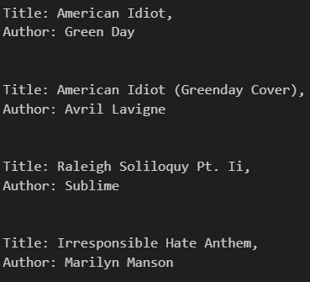
Correctness check
«american AND idiot»:

Slide 52
Correctness check
«american AND idiot NOT media»:

Slide 53
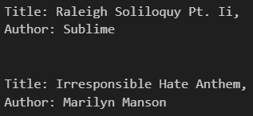
Correctness check
«american AND idiot NOT media»:

Slide 54
Correctness check
«american idiot OR work sucks»:

Slide 55
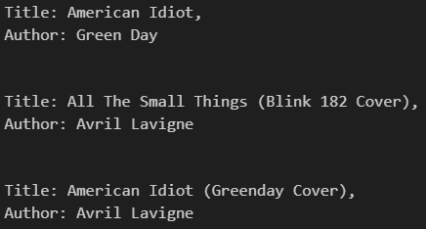
Correctness check
«american idiot OR work sucks»:

Slide 56
System evaluation

Slide 57
System evaluation
No reference dataset for the evaluation of the system …

Slide 58
System evaluation
No reference dataset for the evaluation of the system …
… so I had to make one of my own …

Slide 59
System evaluation
No reference dataset for the evaluation of the system …
… so I had to make one of my own …
IDEA:

Slide 60
System evaluation
No reference dataset for the evaluation of the system …
… so I had to make one of my own …
IDEA:
Sample some songs from the Spotify Million Song Dataset

Slide 61
System evaluation
No reference dataset for the evaluation of the system …
… so I had to make one of my own …
IDEA:
Sample some songs from the Spotify Million Song Dataset
For each song, compute the 5 most frequent words/biwords

Slide 62
System evaluation
No reference dataset for the evaluation of the system …
… so I had to make one of my own …
IDEA:
Sample some songs from the Spotify Million Song Dataset
For each song, compute the 5 most frequent words/biwords
A document is considered relevant if the query keyword is among the 5 most frequent ones in the song lyrics

Slide 63
System evaluation
No reference dataset for the evaluation of the system …
… so I had to make one of my own …
IDEA:
Sample some songs from the Spotify Million Song Dataset
For each song, compute the 5 most frequent words/biwords
A document is considered relevant if the query keyword is among the 5 most frequent ones in the song lyrics
Pick 3 random words from this list

Slide 64
System evaluation
No reference dataset for the evaluation of the system …
… so I had to make one of my own …
IDEA:
Sample some songs from the Spotify Million Song Dataset
For each song, compute the 5 most frequent words/biwords
A document is considered relevant if the query keyword is among the 5 most frequent ones in the song lyrics
Pick 3 random words from this list
Loop N times:

Slide 65
System evaluation
No reference dataset for the evaluation of the system …
… so I had to make one of my own …
IDEA:
Sample some songs from the Spotify Million Song Dataset
For each song, compute the 5 most frequent words/biwords
A document is considered relevant if the query keyword is among the 5 most frequent ones in the song lyrics
Pick 3 random words from this list
Loop N times: Randomly generate K queries (K random from 1 to 6), each one having one of the following structures (chosen at random):

Slide 66
System evaluation
No reference dataset for the evaluation of the system …
… so I had to make one of my own …
IDEA:
Sample some songs from the Spotify Million Song Dataset
For each song, compute the 5 most frequent words/biwords
A document is considered relevant if the query keyword is among the 5 most frequent ones in the song lyrics
Pick 3 random words from this list
Loop N times: Randomly generate K queries (K random from 1 to 6), each one having one of the following structures (chosen at random):
«word1 AND word2»

Slide 67
System evaluation
No reference dataset for the evaluation of the system …
… so I had to make one of my own …
IDEA:
Sample some songs from the Spotify Million Song Dataset
For each song, compute the 5 most frequent words/biwords
A document is considered relevant if the query keyword is among the 5 most frequent ones in the song lyrics
Pick 3 random words from this list
Loop N times: Randomly generate K queries (K random from 1 to 6), each one having one of the following structures (chosen at random):
«word1 AND word2»
«word1 OR word2»

Slide 68
System evaluation
No reference dataset for the evaluation of the system …
… so I had to make one of my own …
IDEA:
Sample some songs from the Spotify Million Song Dataset
For each song, compute the 5 most frequent words/biwords
A document is considered relevant if the query keyword is among the 5 most frequent ones in the song lyrics
Pick 3 random words from this list
Loop N times: Randomly generate K queries (K random from 1 to 6), each one having one of the following structures (chosen at random):
«word1 AND word2»
«word1 OR word2»
«NOT word1»

Slide 69
System evaluation
No reference dataset for the evaluation of the system …
… so I had to make one of my own …
IDEA:
Sample some songs from the Spotify Million Song Dataset
For each song, compute the 5 most frequent words/biwords
A document is considered relevant if the query keyword is among the 5 most frequent ones in the song lyrics
Pick 3 random words from this list
Loop N times: Randomly generate K queries (K random from 1 to 6), each one having one of the following structures (chosen at random):
«word1 AND word2»
«word1 OR word2»
«NOT word1»
«word1 AND word2 NOT word3»

Slide 70
System evaluation
No reference dataset for the evaluation of the system …
… so I had to make one of my own …
IDEA:
Sample some songs from the Spotify Million Song Dataset
For each song, compute the 5 most frequent words/biwords
A document is considered relevant if the query keyword is among the 5 most frequent ones in the song lyrics
Pick 3 random words from this list
Loop N times: Randomly generate K queries (K random from 1 to 6), each one having one of the following structures (chosen at random):
«word1 AND word2»
«word1 OR word2»
«NOT word1»
«word1 AND word2 NOT word3»
«word1 OR word2 NOT word3»

Slide 71
System evaluation
No reference dataset for the evaluation of the system …
… so I had to make one of my own …
IDEA:
Sample some songs from the Spotify Million Song Dataset
For each song, compute the 5 most frequent words/biwords
A document is considered relevant if the query keyword is among the 5 most frequent ones in the song lyrics
Pick 3 random words from this list
Loop N times: Randomly generate K queries (K random from 1 to 6), each one having one of the following structures (chosen at random):
«word1 AND word2»
«word1 OR word2»
«NOT word1»
«word1 AND word2 NOT word3»
«word1 OR word2 NOT word3»
«word1»

Slide 72
System evaluation
No reference dataset for the evaluation of the system …
… so I had to make one of my own …
IDEA:
Sample some songs from the Spotify Million Song Dataset
For each song, compute the 5 most frequent words/biwords
A document is considered relevant if the query keyword is among the 5 most frequent ones in the song lyrics
Pick 3 random words from this list
Loop N times: Randomly generate K queries (K random from 1 to 6), each one having one of the following structures (chosen at random):
«word1 AND word2»
«word1 OR word2»
«NOT word1»
«word1 AND word2 NOT word3»
«word1 OR word2 NOT word3»
«word1»
Each query is associated to its relevant documents

Slide 73
System evaluation
No reference dataset for the evaluation of the system …
… so I had to make one of my own …
IDEA:
Run the IR system on the generated queries

Slide 74
System evaluation
No reference dataset for the evaluation of the system …
… so I had to make one of my own …
IDEA:
Run the IR system on the generated queries
compute precision and recall for each query

Slide 75
System evaluation
No reference dataset for the evaluation of the system …
… so I had to make one of my own …
IDEA:
Run the IR system on the generated queries
compute precision and recall for each query
average them over all the queries

Slide 76
System evaluation
No reference dataset for the evaluation of the system …
… so I had to make one of my own …
IDEA:
Run the IR system on the generated queries
compute precision and recall for each query
average them over all the queries
Analyze the results

Slide 77
Evaluation of different irsystems

Slide 78
Evaluation of different queries

Slide 79
PANORAMICA DEL MERCATO
€ 3 Mrd
€ 1 Mrd
€ 2 Mrd
Libertà di inventare
Mercato selettivo inclusivo​
Mercato disponibile per il servizio
Opportunità di creare
Mercato completamente inclusivo
Mercato totalmente orientabile
Pochi concorrenti
Mercato mirato​
Mercato ottenibile per il servizio

Slide 80
Confronto di mercato
€ 3 Mrd
€ 2 Mrd
€ 1 Mrd
Opportunità di creare
Libertà di inventare
Pochi concorrenti
Mercato orientabile
Mercato disponibile per servizi
Mercato ottenibile

Slide 81
LA NOSTRA CONCORRENZA
CONTOSO
CONCORRENTI
Il nostro prodotto ha un prezzo inferiore a quello di altre aziende sul mercato​
Il design è semplice e facile da usare, rispetto ai design complessi dei concorrenti​
L'accessibilità è l'attrazione principale dei consumatori verso il nostro prodotto​
Società A Il prodotto è più costoso
Società B e C Il prodotto è costoso e poco pratico da usare
Società D ed E Il prodotto è conveniente, ma poco pratico da usare

Slide 82
La nostra concorrenza
Pratico
Contoso
Concorrente A
Conveniente
Costoso
Concorrente D
Concorrente C
Concorrente B
Concorrente E
Poco pratico

Slide 83
ANDAMENTO
Previsione per il successo
Metriche chiave
 | Clienti | Ordini | Ricavi lordi | Ricavi netti
20XX | 10 | 1100 | € 10.000 | € 7.000
20XX | 20 | 200 | € 20.000 | € 16.000
20XX | 30 | 300 | € 30.000 | € 25.000
20XX | 40 | 400 | € 40.000 | € 30.000
RICAVI PER ANNO

Slide 84
PIANO D'AZIONE BIENNALE
BOZZA DEI PROGETTI
RACCOGLIERE FEEDBACK
CONSEGNARE AL CLIENTE
20XX
GEN
FEB
MAR
APR
MAGGIO
GIU
LUG
AGO
SET
OTT
NOV
DIC
20XX
GEN
FEB
MAR
APR
MAGGIO
GIU
LUG
AGO
SET
OTT
NOV
DIC
ORGANIZZARE GRUPPI DI DISCUSSIONE
TESTARE IL DESIGN
LANCIO DEL DESIGN

Slide 85
DATI FINANZIARI
 | Anno 1 | Anno 2 | Anno 3
ENTRATE
Utenti | 50.000 | 400.000 | 1.600.000
Vendite | 500.000 | 4.000.000 | 16.000.000
Prezzo medio per vendita | 75 | 80 | 90
Ricavi al 15% | 5.625.000 | 48.000.000 | 216.000.000
PROFITTO LORDO | 5.625.000 | 48.000.000 | 216.000.000
Spese
Vendite e marketing | 5.062.500 | 38.400.000 | 151.200.000 | 70%
Servizio clienti | 1.687.500 | 9.600.000 | 21.600.000 | 10%
Sviluppo prodotti | 562.500 | 2.400.000 | 10.800.000 | 5%
Ricerca | 281.250 | 2.400.000 | 4.320.000 | 2%
TOTALE SPESE | 7.593.750 | 52.800.000 | 187.920.000

Slide 86




CONOSCI IL TEAM
DIEGO CONTICINI
LELIA GENOVESE
FRANCESCA BIANCHI
DIEGO SAGESE
Presidente
Amministratore delegato
Responsabile operativo
Vicepresidente reparto marketing

Slide 87








CONOSCI IL TEAM
DIEGO CONTICINI
LELIA GENOVESE
FRANCESCA BIANCHI
DIEGO SAGESE
Presidente
Amministratore delegato
Responsabile operativo
Vicepresidente reparto marketing
CARMELO BARESE
ALBERTO MAZZANTI
PUPETTA COSTA
LUCA UDINESI
Vicepresidente reparto prodotti
SEO Strategist
Progettatore del prodotto
Sviluppatore di contenuti

Slide 88
FINANZIAMENTI
€ 14.000
€ 12.000
€ 82.000
€ 32.000
INVESTIMENTI INFORMALI
PROPRIETÀ
AZIONI
CONTANTI
Importo ottenuto tramite altri investitori
Entrate ottenute da affitti immobiliari
Numero di azioni convertite in EUR
Denaro liquido disponibile

Slide 89
RIEPILOGO
Noi di Contoso diamo ai nostri clienti il 110%. Con la nostra architettura dati di nuova generazione, aiutiamo le organizzazioni a gestire virtualmente i flussi di lavoro agili. Abbiamo successo grazie alla nostra conoscenza del mercato e un team unico dietro il nostro prodotto. Come afferma il nostro CEO "L'efficienza verrà dalla trasformazione proattiva del modo in cui operiamo".

Slide 90
GRAZIE
Lelia Genovese
206-555-0146
lelia@contoso.com
www.contoso.com

