Slide 1
Optimizing Intersection Traffic
G. Alessio
D. Capone
S.J. Della Rovere

Slide 2
Our tasks
Reduce the waiting time of cars
Reduce size and amount of queues

Slide 3

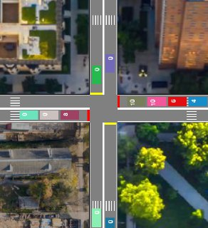
Environment
2-way intersection
User controls the frequency of car generation
Cars can go north, south, east or west

Slide 4
Environment - Assumptions
Cars have identical size and speed
At the intersection, cars can either go straight or turn right

Slide 5

MDP (VI)
Our solution
MDP (PI)
Fixed time

Slide 6
Stoplight agent - Fixed time
Green light lasts 20 seconds
Yellow light lasts 3 seconds
Stoplight keeps switching with these fixed time intervals
Notes:
Cars inside the intersection keep moving
Cars approaching the intersection stop

Slide 7
MDP
States: «EW», «NS»
Actions: «Maintain», «Change»

Slide 8

MDP – Reward function
µ_{t} is the average waiting time of stopped cars
n_{c} is the number of cars transiting where the stoplight is green

Slide 9
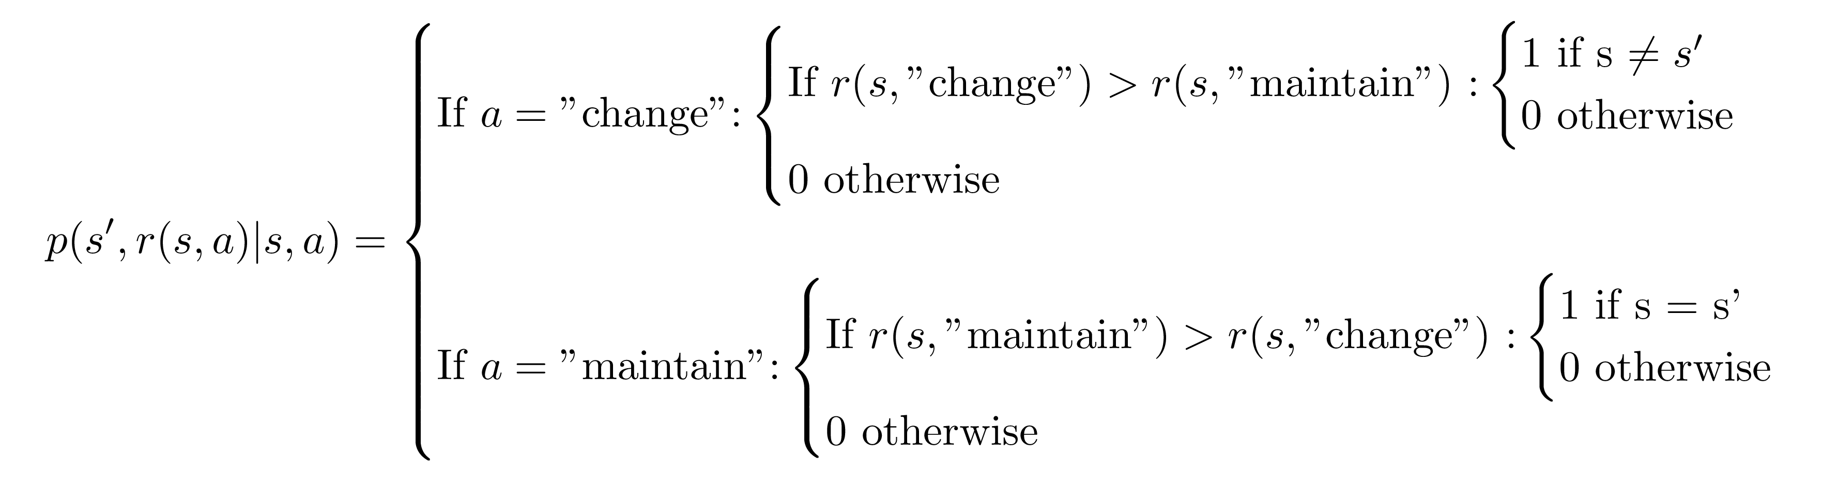
MDP – Transition probability

Slide 10

MDP – Initialization

Slide 11

MDP – Policy evaluation

Slide 12

MDP – Policy improvement

Slide 13

MDP – Policy iteration

Slide 14

MDP – Value iteration

Slide 15
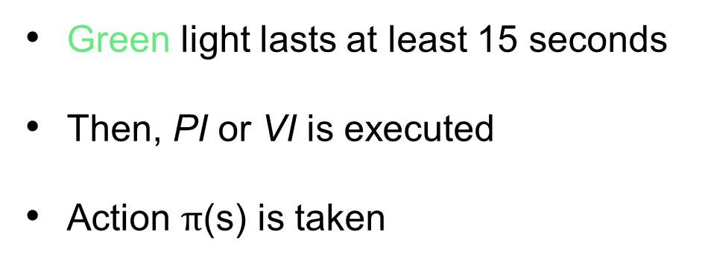
Stoplight agent – MDP
Green light lasts at least 15 seconds
Then, PI or VI is executed
Action $\text{π}\text{(}\text{s}\text{)}$ is taken

Slide 16
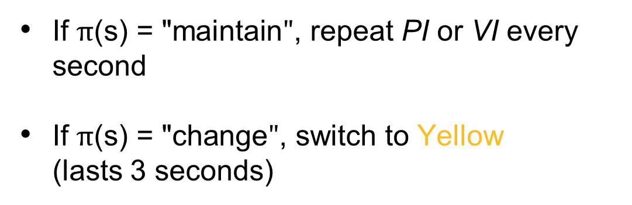
Stoplight agent – MDP
If $\text{π}\text{(}\text{s}\text{) = "}\text{maintain}"$, repeat PI or VI every second
If $\text{π}\text{(}\text{s}\text{) = "}\text{change}"$, switch to Yellow (lasts 3 seconds)

Slide 17
Demo

Slide 18

Simulation
All directions
North
|
South
All directions
No cars
East — West
5’
1’
2’
2’
5’

Slide 19
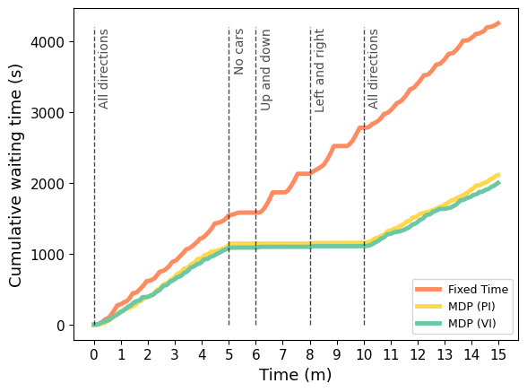
The fixed time agent makes people arrive late!

Slide 20
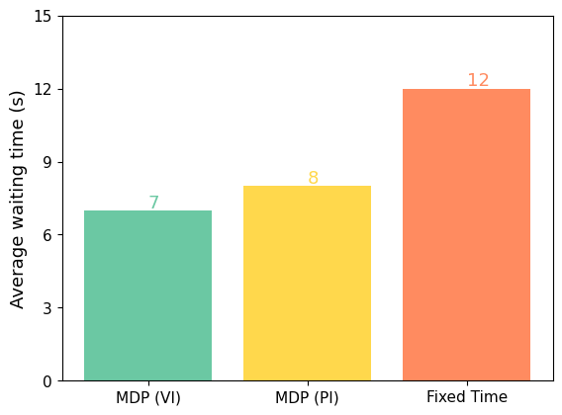
The fixed time agent makes people arrive late!

Slide 21
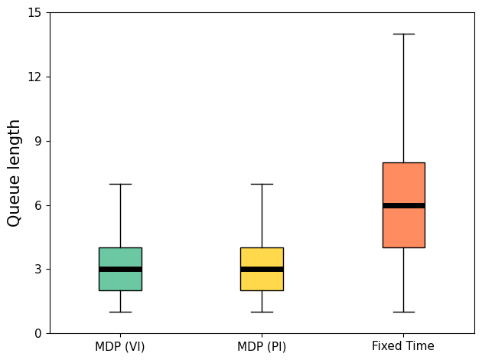
Queues might become annoying with the fixed time agent!

Slide 22
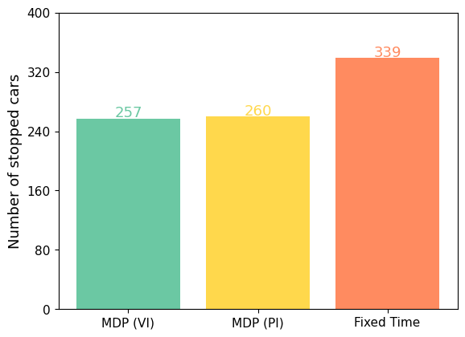
You press the break pedal less with an MDP powered stoplight!

Slide 23
Conclusions
The fixed-time agent performs worse, causing delays and annoying queues.
The other two methods show similar performance, offering advantages in terms of traffic flow.
Our solutions propose a simple yet effective implementation, that could be useful in a real world scenario.

