Slide 1
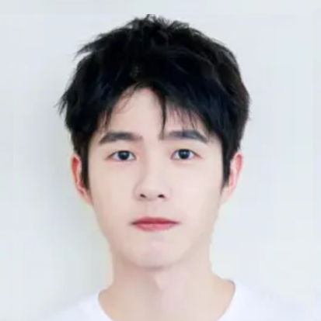
张忝苟
电子科技大学 | 计算机科学与技术
基本信息
男 19岁 汉族 共青团员
电话/微信：19937630986 邮箱：tiangou@std.uestc.edu.cn
电子科技大学 - 计算机科学与工程学院 - 计算机科学与技术（2018-2022）
个人简述
乐观善良、自律踏实的大三本科生，数理基础扎实，学习能力强，有良好项目基础和科研经历。
* 第四学期从材料转专业至计算机，已完成课程补修。
均分 94.63，GPA 3.96/4
专业排名 1/713（0.14%），综测排名1/713（0.14%）
科研经历
文武浩院士团队 移动通信方向
师从计算机学院文武浩院士，从事下一代移动通信技术的研究，目前尚在学习中。
广州市先进网络技术与应用重点实验室 网络传输优化方向
加入广州市先进网络技术与应用重点实验室 (GANKLab) ，师从钱行教授，分布式数据流处理中的网络传输优化。
已投稿网络传输方向论文2篇，其中1篇INFOCOM 2020已接收；1篇INFOCOM 2021拟投稿。
[Under Review ] Tiangou Zhang, Xing Qian, et al, Efficient Coflow Transmission for Distributed Stream Processing, INFOCOM 2021, CCF A
[Accepted ] Tiangou Zhang, Xing Qian, et al, TINA: A Fair Inter-datacenter Transmission Mechanism with Deadline Guarantee, INFOCOM 2020, CCF A
[Unsubmitted ] Tiangou Zhang, Xing Qian, et al, Deeper Exercise Monitoring for Smart Gym using Fused RFID and CV Data, INFOCOM 2021, CCF A
魔角石墨烯超晶格中的非常规超导性研究（大创项目）
独自主持大创项目一项，中期审查优秀（29/112），已顺利结题。
2021.02 至今
2019.10-2021.02
2019.12-2020.09
项目经历
上海商汤智能科技有限公司 算法实习生
参与商汤渐冻症智能看护系统研发，担任算法实习生，根据多光谱成像传感器、粘贴电极等监测到的生理指标，设计模型实现了对患者睡眠质量的精准分析。
北京字节跳动科技有限公司 前端实习生
参与字节某公益项目群的前端开发，实习考察获评优秀。
腾讯云开发暑期训练营 营员
小程序/云项目开发训练与实践，顺利结业（63/200）并获评优秀营员（10/200）。
2020.8-2020.12
2020.07-2020.08
2020.05-2020.05
荣誉奖项
国家奖学金、一等奖学金、四川省综合素质A证、优秀共青团员、体育/文艺类奖项若干 等
学生工作
电子科技大学群绿支教队 创始人/队长，成电放松洞大学生网络文化工作室 部长 等
语言与技能
语言：CET-6：590 IELTS：7
技能：出色的写作能力、良好的审美及优秀的设计能力、与人相处的能力（互评成绩班级排名1/29） 等

Slide 2
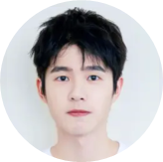
Tiangou Zhang
Information
Male Age 19
Tel/WeChat：199-3763-0986 E-mail：tiangou@std.uestc.edu.cn
University of Electronic Science and Technology of China (UESTC) (2018-2022)
School of Computer Science and Engineering - Computer Science and Technology
Weighted average 94.63, GPA: 3.96/4, ranking 1/713 (0.14%); Overall quality ranking 1/713 (0.14%)
Profile
Optimistic, kind and self-disciplined 3rd year undergraduates with a solid foundation in mathematics, strong learning ability, good project background and research experience.
* Changed major from ME (Materials & Energy) to CS in 4th semester, and completed course remediation.
Honors
National Scholarship, First-class Scholarship, Sichuan Comprehensive Quality A Certificate, Outstanding Communist Youth League Member, several awards in sports/arts, etc.
Research
Mobile Communications
Studying under Prof. Wenhao Wu, working in Mobile Comm, and still in the process of theoretical learning.
Network Transmission Optimization
Joined the Guangzhou Key Laboratory of Advanced Networks. Studying under Prof. Xing Qian.
1 paper accepted by INFOCOM 2020, 1 under review, and 1 to be submitted.
[Under Review ] Tiangou Zhang, Xing Qian, et al, Efficient Coflow Transmission for Distributed Stream Processing, INFOCOM 2021, CCF A
[Accepted ] Tiangou Zhang, Xing Qian, et al, TINA: A Fair Inter-datacenter Transmission Mechanism with Deadline Guarantee, INFOCOM 2020, CCF A
[Unsubmitted ] Tiangou Zhang, Xing Qian, et al, Deeper Exercise Monitoring for Smart Gym using Fused RFID and CV Data, INFOCOM 2021, CCF A
Unconventional superconductivity in magic-angle graphene superlattices
02/2021-now
10/2019-02/2021
12/2019-09/2020
Internship
SenseTime, Shanghai Algorithm Intern
Acted as an algorithm intern, participated in the development of SenseTime’s Progressive Care System, and designed models to achieve accurate analysis of patients’ sleep quality based on monitored indicators.
ByteDance, Beijing Front-end Intern
Acted as a front-end intern, participated in the development of a public welfare project group of ByteDance, and rated Excellent.
08/2020-12/2020
07/2020-08/2020
Projects
Summer Camp for Tencent Cloud Developer
Participated in cloud development of WeChat mini apps, and was awarded Outstanding Camper (5%).
05/2020
Experiences
QunGreen Volunteer Teaching Team founder/leader
UESTC RelaxingZone Online Culture Studio leader
07/2019-08/2019
09/2018-06/2020
Skills
English proficiency：CET-6: 590 IELTS: 7
Exceptional writing skills, Aesthetic excellence, Good with people (rank 1/29 in class mutual evaluation), etc.

