Slide 1
Cyber Threats and Security Controls Analysis for Urban Air Mobility Environments
January 2021

Slide 2
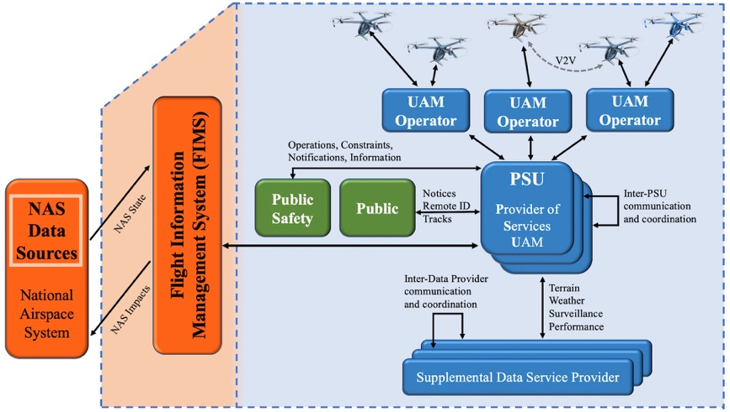
UAM Environment
The UAM environment has a service-oriented architecture where UAM operators and service providers work independently to mange aerial vehicles in the urban environment.
The UAM environment is derived from the Unmanned Traffic Management (UTM) concept of operations.
Providers of Services, UAM operators, and Supplemental Data Service Providers provide services to support flight operations within the UAM environment.
Various views of UAM flight information are provided to the public and public safety entities.
The FAA can coordinate flight information between the FAA controlled National Airspace System (NAS) and the UAM environments through the Flight Information Management System (FIMS)

Slide 3
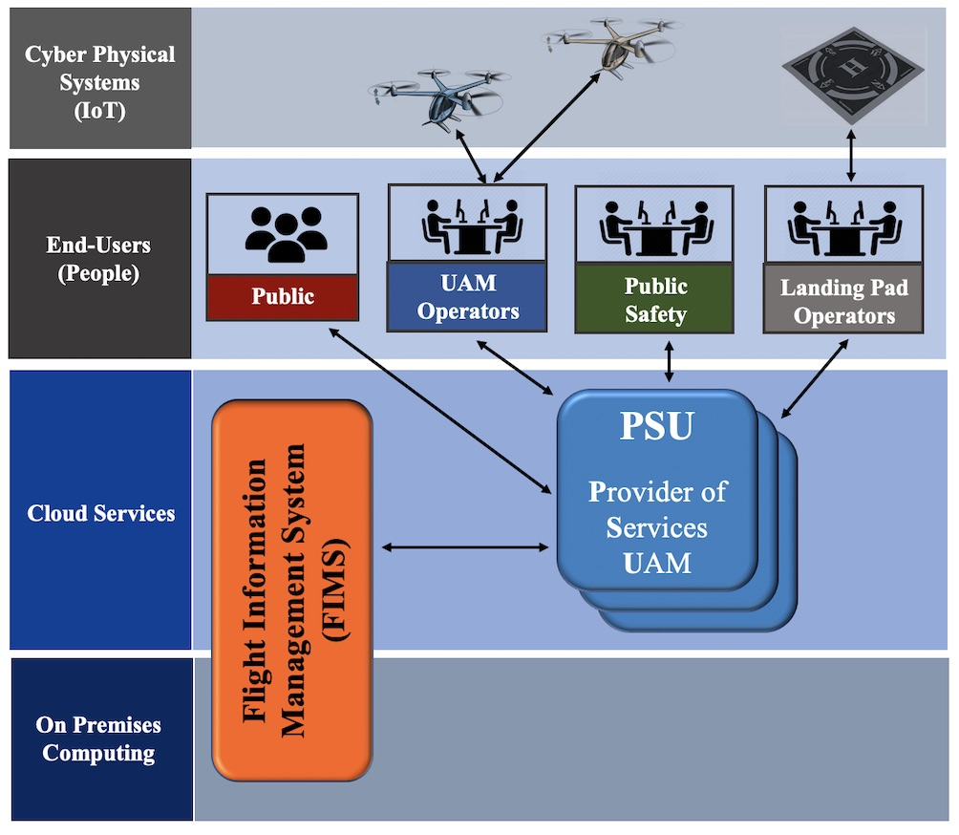
UAM Environment
UAM environments will consist of a wide range of diverse systems supporting flight missions
The UAM environment can be viewed from the perspective of four significant high-level components, end-users, cyber-physical systems, cloud services, and on-premise computing services.
Threats, vulnerabilities, weaknesses, and security controls for the UAM environment, are studied from these four components' perspective.
The applicable threats, vulnerabilities, and weaknesses of the UAM environment's four component areas will differ due to the cyber-physical, cloud, and on-premise architectures.

Slide 4
Identified Threats for UAM Environments
Cyber threats associated with End-Users are an ever-changing threat landscape
The MITRE Adversarial Tactics, Techniques, and Common Knowledge (ATT&CK) model and framework can be leveraged to analyze threats to UAM systems
Globally-accessible knowledge base of adversary tactics and techniques based on real-world observations of cyber security threats
Sample UAM Threats
Eavesdropping | The unauthorized interception or sniffing of a conversation, communication, or data transmission, leading to the loss of data confidentiality.
Man in the Middle Attacks (MITM) | Adversaries may attempt to position themselves between two or more networked devices using a man-in-the-middle (MiTM) technique to support follow-on attack behaviors such as Network Sniffing (leading to loss of confidentiality) or Transmitted Data Manipulation (leading to loss of data integrity).
Phishing Attacks | Adversaries may send deceptive email phishing messages, with the intent to to gain access to victim systems.
Distributed Denial of Service (DDoS) | A single system or multiple systems may be used to perform a Denial of Service (DoS) or Distributed Denial of Service (DDoS). The purpose of the attack is to degrade or block the availability of services to users.

Slide 5
NIST Computer Security Resource Center
National Institute of Standards and Technology (NIST) Computer Security Resource Center (CSRC)
NIST Special Publication 800-53 Security and Privacy Controls for Federal Information Systems and Organization
NIST Cybersecurity Framework

Slide 6
Cyber Security Framework
NIST Cybersecurity Framework (CSF) provides a common language for understanding, managing, and expressing cybersecurity risk
Identify – Manage cybersecurity risk for the UAM environment systems, people, assets, data, and capabilities.
Protect – Appropriate safeguards to ensure the delivery of critical services.
Detect – Identify the occurrence of a cybersecurity event.
Respond – Actions regarding a detected cybersecurity incident.
Recover – Timely recovery to normal operations to reduce the impact from a cybersecurity incident

Slide 7
NIST Special Publication 800-53
Security controls are safeguards/countermeasures for information systems
Protect the confidentiality, integrity, and availability of information
Satisfy a set of defined security requirements
Reflect the objectives of the information and system to be protected
All laws, executive orders, directives, regulations, policies, standards, guidance, and mission or business needs are considered
Security and privacy controls could change with changes to the system and should be removed, revised, and added as necessary

Slide 8
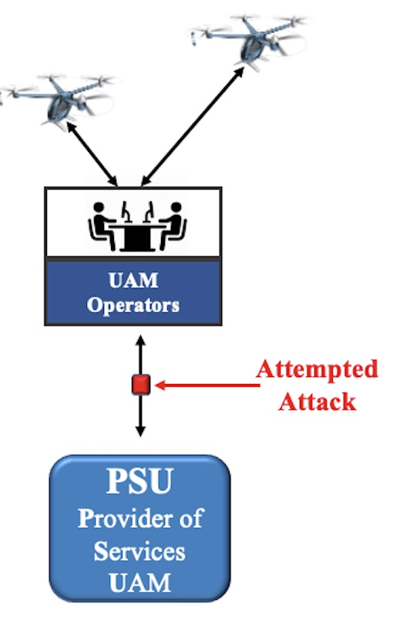
Safeguards and Countermeasures
Sample UAM Threats with Safeguards and Countermeasures
Eavesdropping | Encrypting data in transit is a safeguard against eavesdropping Cryptographic key exchange is required for encryption to work across organizations. As a result, methods to ensure safe keeping of the keys is critical as well.
Man in the Middle Attacks (MITM) | UAM environments comprise of highly automated systems using application programming interfaces (APIs), to enable data exchange. As new services are added, new APIs need to be developed and tested for vulnerabilities, that could lead to system access

Slide 9
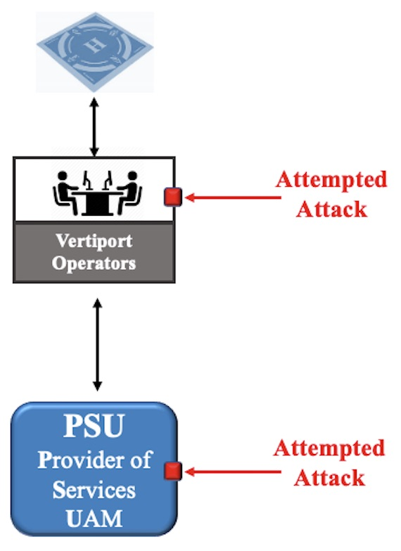
Safeguards and Countermeasures
Sample UAM Threats with Safeguards and Countermeasures
Phishing Attacks | Security controls such as cybersecurity literacy training and awareness need to be implemented. Practical exercises include social engineering attempts to collect information, gain unauthorized access, or simulate the adverse impact of opening malicious email attachments or invoking malicious web links
Distributed Denial of Service (DDoS) | Implementing the appropriate security detection methods for identifying DDoS attacks is critical to detecting the attack. Countermeasures, such as , implementing temporary automatic lockouts initiated by the systems, when the maximum number of attempts are exceeded.

