Slide 1

Man in the Middle Attack: Password Sniffing and Cracking
By Collin Donaldson

Slide 2
IA Day Reminder!
November 7th is Information Assurance Day.
There will be guest speakers giving presentations all day.
It is recommended you attend as many as possible.
Aside from learning new material and possibly receiving bonus points for your classes, there are always networking possibilities.

Slide 3
Disclaimer!
Hacking is only legal under the following circumstances:
You hack (penetration test) a device/network you own.
You gain explicit, documented permission from an individual, assumedly a friend.
You acquire an Ethical Hacker Certification and hack for a public or private sector organization with explicit permission to do so. This is the safest of the three methods.
Hacking is illegal in all other circumstances. Hackers can be charged with fines, misdemeanors, and/or felonies depending on severity and accounts of hacks. For these reasons I will not be demonstrating any live hacking attempts in the wild.
For more information
http://definitions.uslegal.com/c/computer-hacking/

Slide 4
Man in the Middle Attack (MITMA)
Definition: When two systems are communicating and a hacker intercepts their communications via active eavesdropping. Hacker must be able to control the data transfer without the user’s knowledge.
Similar to using XSS attacks to intercept cookies with user data in them.
We will intercept a network password as it travels via data packet from access point to access point.

Slide 5
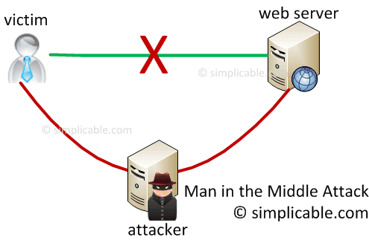

Slide 6
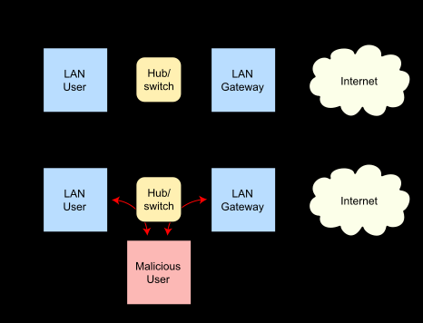
ARP Poisoning
ARP Poisoning is a technique whereby an attacker sends fake ("spoofed") Address Resolution Protocol (ARP) messages onto a Local Area Network.
Generally, the aim is to associate the attacker's MAC address with the IP address of another host (such as the default gateway), causing any traffic meant for that IP address to be sent to the attacker instead.

Slide 7
Cryptography: The Core of Passwords
Since ancient times people have sought to secure information , from the Caesar Cipher to AES 256 bit data encryption.
Main Methods:
Encryption: Converting plain text into text that can be read with a cipher, often using underlying mathematics such as derivatives.
Obfuscation: Making a message deliberately confusing , ambiguous, cryptic, etc. . (i.e. Hiding cryptographic keys in a file full of false keys and junk files)
Stenography: Hiding something in plain site (i.e. Hide a message as a comment deep inside a source file).

Slide 8
Password Sniffing
Definition: A password sniffer is a software application that scans and records passwords that are used or broadcasted on a computer or network interface. It listens to all incoming and outgoing network traffic and records any instance of a data packet that contains a password.
We will use a password sniffer to exploit network vulnerabilities similarly to how we used JavaScript and SQL to test for website and database vulnerabilities.

Slide 9
Password Cracking
Definition: Program that recovers passwords from data that have been stored in or transmitted by a computer system.
Can be used ethically (recover lost password, penetration testing, etc.) or maliciously (steal passwords, lock users out of their own accounts, etc.).

Slide 10
Types of Password Cracking
Dictionary: Uses a dictionary of terms to try and guess the password.
Pro: Quickly finds weak passwords and can be used to aid in finding complicated ones faster.
Cons: Limited by dictionary used and basic obfuscation can defeat it.
Cryptoanalysis: Uses cryptographic algorithms and rainbow tables to try and determine password.
Pro: Relatively fast and relatively high success rate
Con: Dependent on underlying algorithms, not guaranteed to work.
Brute Force: Systematically checks all possible values until the correct one is found.
Pro: Virtually guaranteed to work
Con: SLOW, vulnerable to obfuscation

Slide 11
Cain and Abel
We will use a password sniffing and cracking suite called Cain and Abel for this workshop. Cain is the sniffer, Able is the cracker.
It is a professional tool and it is safe to download, I guarantee it!
Download it from the following sources.
Original Source:
http://www.oxid.it/cain.html
Easier to download source:
http://www.majorgeeks.com/files/details/cain_and_abel.html
NOTE: You may have to temporarily disable your firewall and/or antivirus to run Cain and Abel.

Slide 12
Video Tutorial
http://www.youtube.com/watch?v=RyQL9AdxHqY
The one we will watch
Skip to 1:06
Overview and Password Sniffing/Cracking
These two cover ARP poisoning and Password Cracking/Sniffing two different ways
http://www.youtube.com/watch?v=5Ux6o0IKNX4
Skip to 2:37
http://www.youtube.com/watch?v=OtxEixSWL8E
Skip to 0:33

Slide 13
Steps to Try
Manually change your guest account password into something that would be found in the default dictionary i.e. “password”
Run a dictionary attack against your guest account
Complicate your password “password123”.
Run a dictionary search against it, if the password isn’t returned run a brute force against it.
Further complicate your password “p@$sword123”
Run a cryptanalysis attack against it.

