Slide 1


INDIAN INSTITUTE OF TECHNOLOGY, KHARAGHPUR DEPARTMENT OF INDUSTRIAL AND SYSTEMS ENGINEERING
OPTIMIZATION AND HEURISTIC METHODS PROJECT (IM39003)
Roll no : 19im30011
Name: kasturi gnanaguna sagar

Slide 2

Project 1: Optimizing Bank Lending Decisions Using Metaheuristics
Reference Paper : Metawa, N., Hassan, MK., Elhoseny, M. (2017) Genetic algorithm based model for optimizing bank lending decisions [Journal: Expert Systems with Application Expert Systems With Applications 80 (2017) 75–82

Slide 3
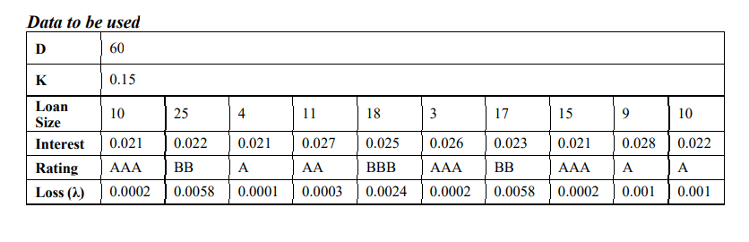
Introduction
A credit crunch is often caused by a sustained period of careless and inappropriate
lending.
The inability of banks to manage loan portfolios efficiently may result in a credit crunch.

Slide 4

Genetic algorithm fitness function
The GA’s fitness function (Fx) simply consists
loan revenue (ϑ)
loans cost (μ)
total transaction cost (ϖ)
cost of demand deposit (β).
The main objective is to maximize F(x)
T = (1 − K)D − L

Slide 5
Pseudo Code and Validation
1. Start
2. Initialize parameters - population size, stopping criteria (maximum number of iterations), probability
of crossover, probability of mutation, reproduction ratio
3. Initialize initial population by random generation
4. Repeat till termination condition is not reached
a. Evaluate Fitness - Calculate fitness of each individual in the population
b. Reproduction - Copy some of the top best individuals directly to the next generation
c. Roulette Selection - Select parents to create offsprings
d. Single Point Crossover - Perform single point crossover on the selected parents
e. Bitwise Mutation - Perform bitwise mutation on each of the created offsprings
f. Solution Validation - If a solution does not satisfy the constraint, replace it with a new valid
randomly generated solution which will satisfy the constraint
g. Update the new population with these offsprings, and continue doing these steps till the new
population has “population size” number of individuals
h. Replace the old population with this newly generated population
5. Return the best individual from the final population as the best solution
6. End

Slide 6
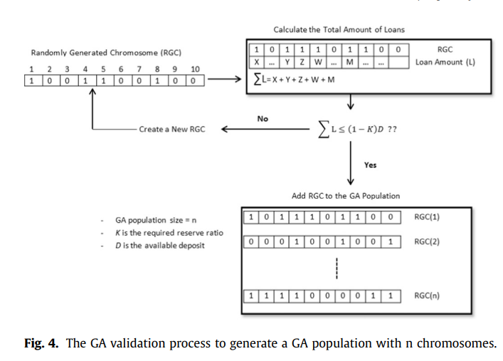

Slide 7
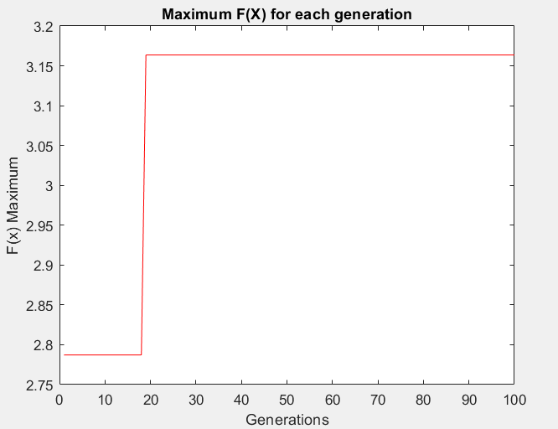
Results
Final Iteration
3.1854 | -20.218 | -21.5382 | -21.5042 | -21.501
Best fitness vs no of iteration

Slide 8
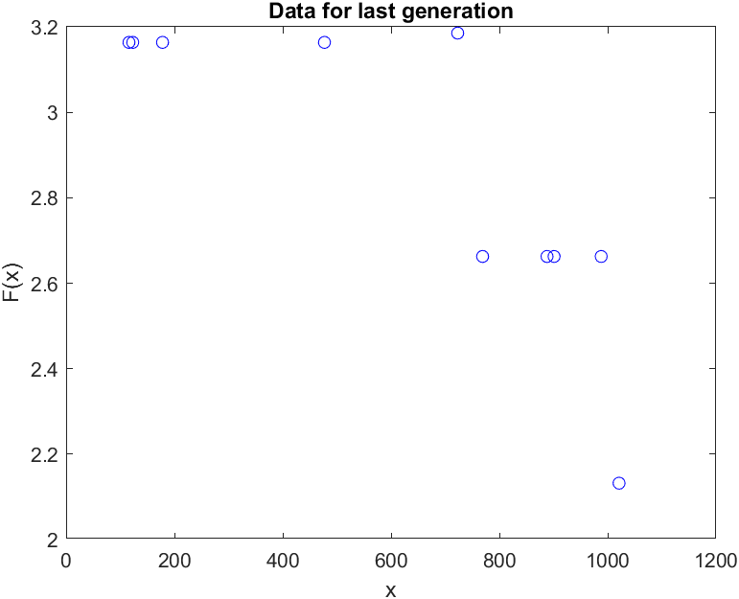
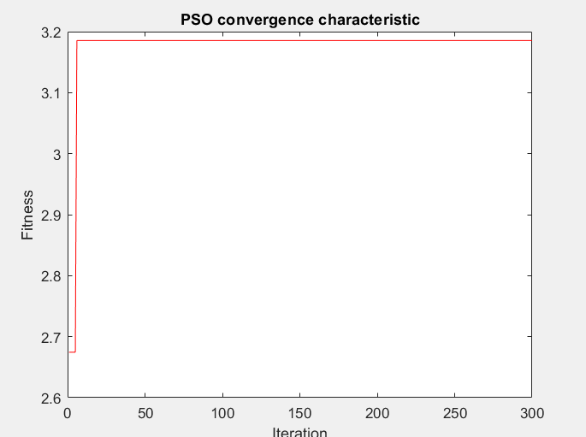
PSO Algorithm

Slide 9

Thank You!
This Photo by Unknown Author is licensed under CC BY-SA-NC

