Slide 1
Inline Crypto Engine in MEV
Intel MEV ICE IPSec Team

Slide 2
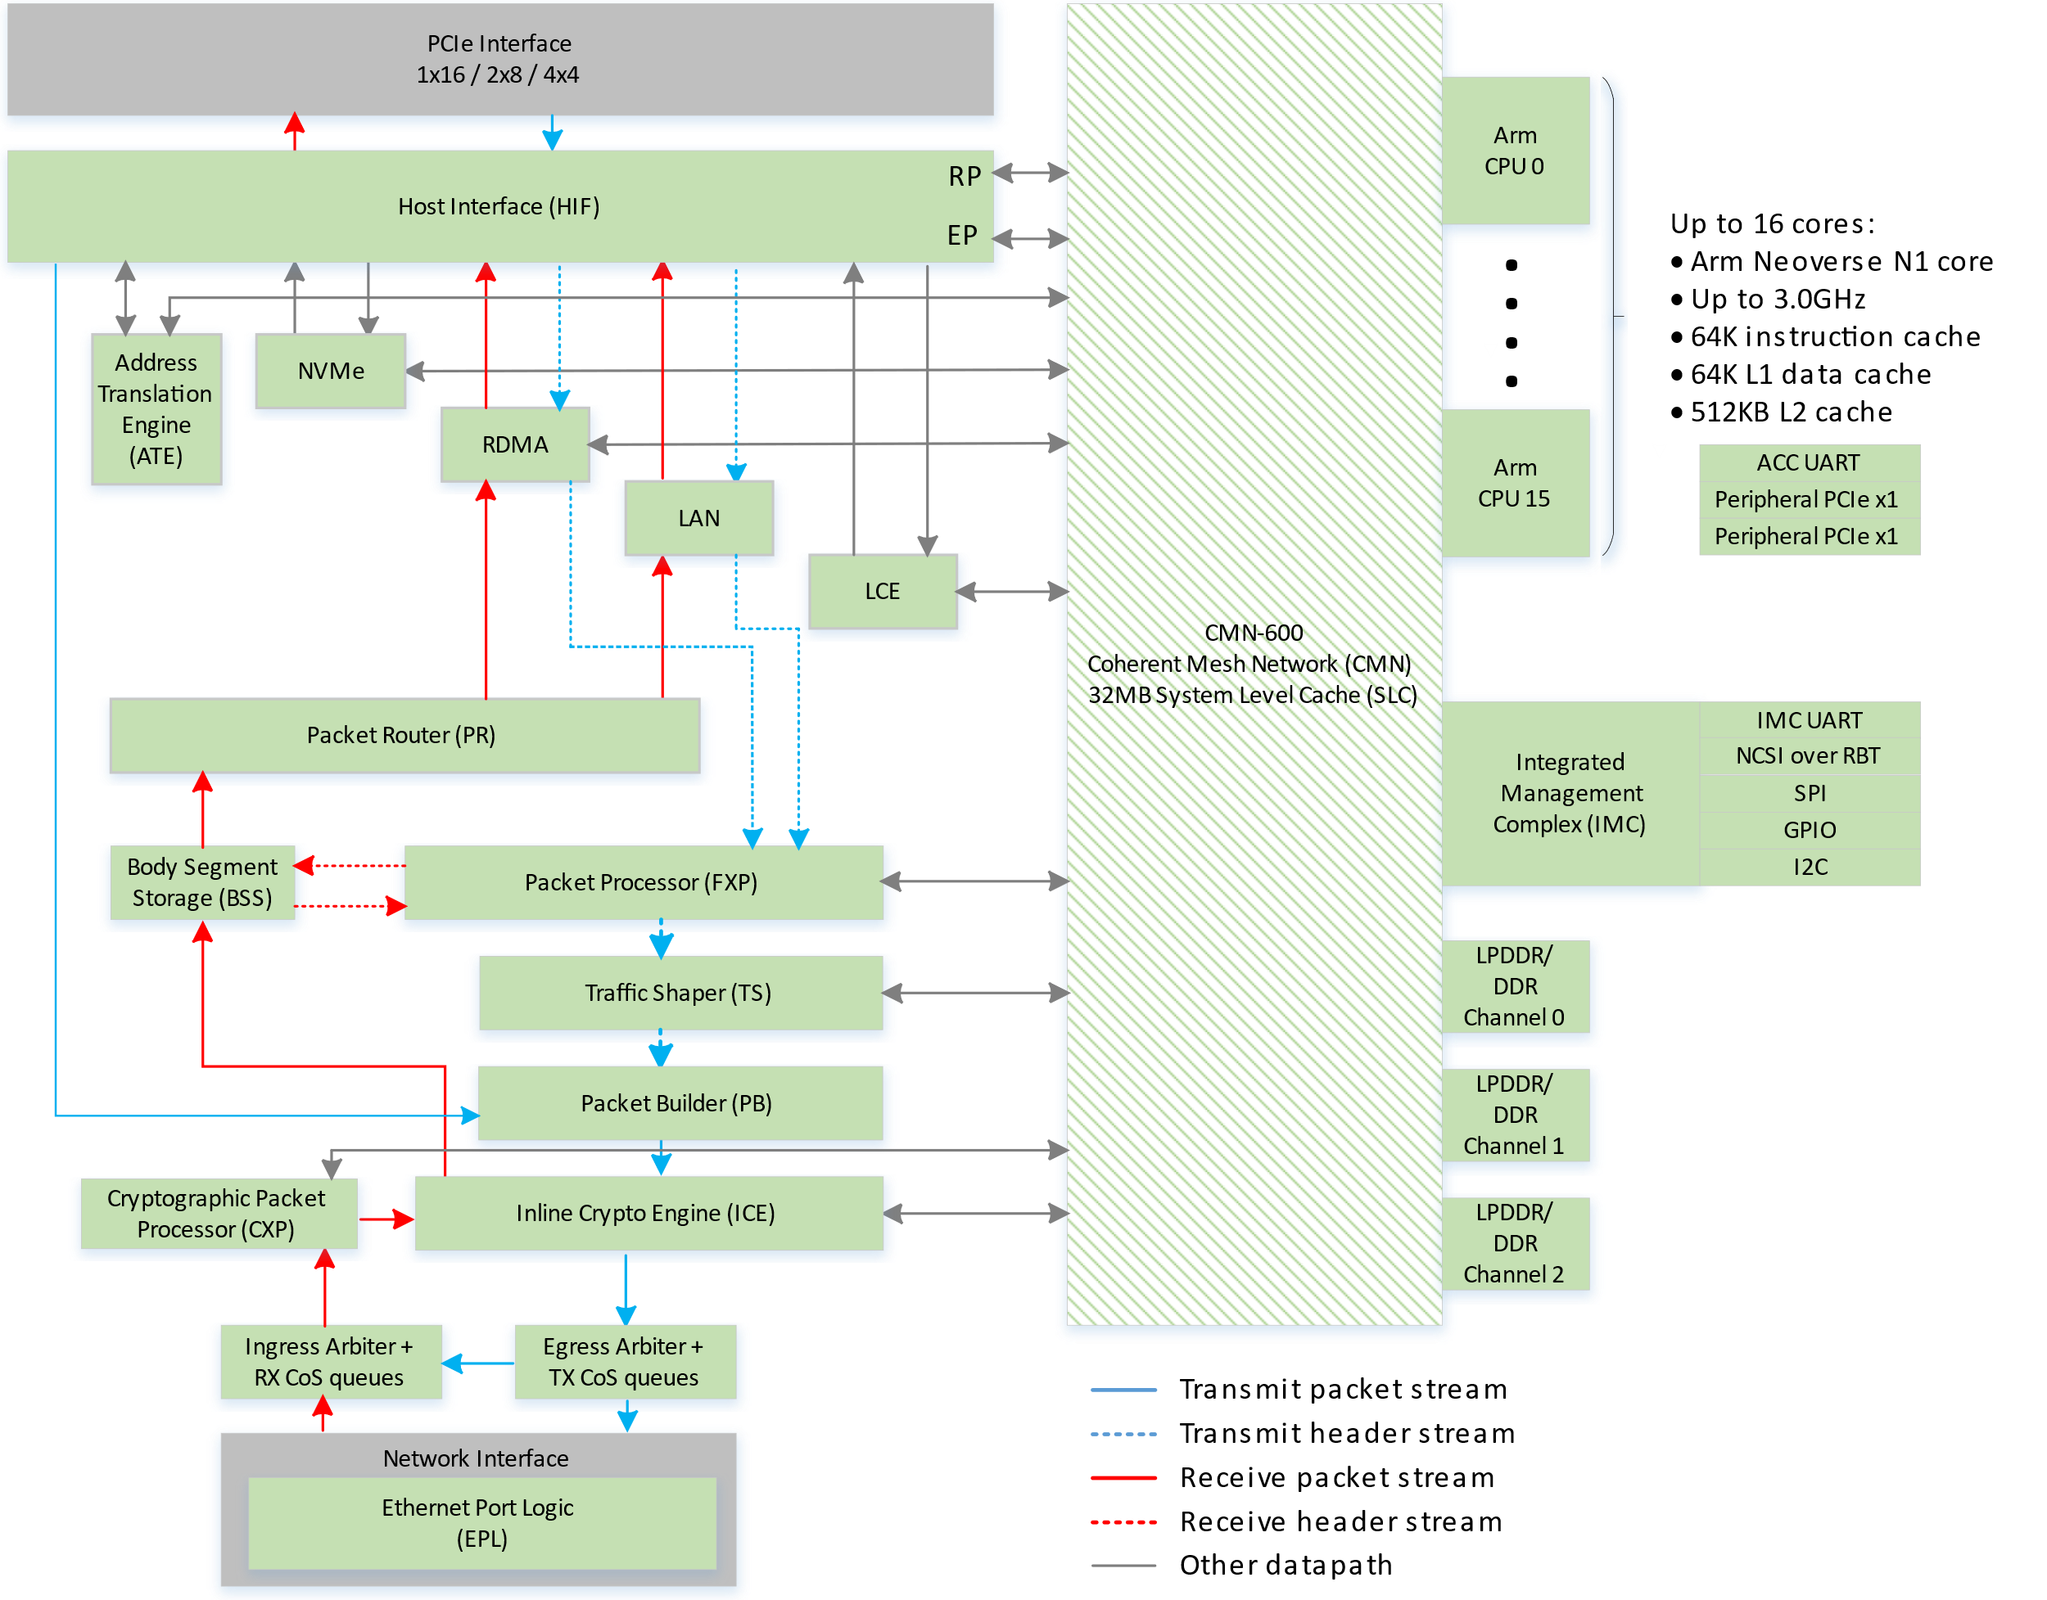
Overview
ICE(Inline crypto Engine) is responsible for processing packets (both ingress and egress directions) that require infrastructure crypto offload in MEV.
ICE is part of NSS pipeline along with FXP and CXP.
ICE supports IPsec full offload in MEV.
All the packets passes through NSS pipeline will pass through ICE.
For Control plane operations to store SADB, ICE has dedicated secure DRAM space.

Slide 3
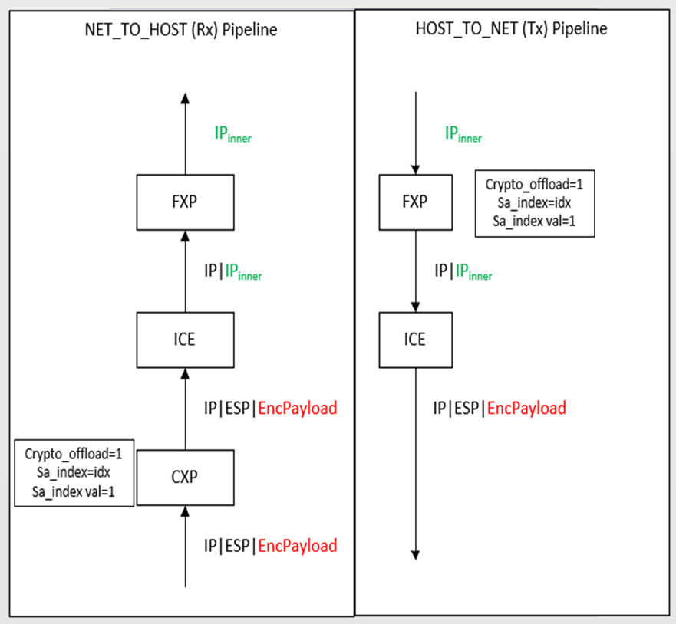
Overview Continue…
Data Plane:
ICE looks at the specific flags in the packet meta data to determine crypto offload.
If the specific packet meta data are not set, the packet will be processed as a clear packet without any modification.
ICE supports IPSec full termination for ESP protocol only.(No AH support).
Control Plane:
ICE stores the SADBs in a secure DRAM location. The control plane allocates the DRAM space and register with ICE before doing any SADB operation.
There are 256 PMAT (Private Memory Address Translation) registers are maintained within ICE for each direction. ICE supports 3 different DRAM page sizes(4K/2MB/32MB).
ICE can support 16M SAs in both egress and ingress direction with 16MB page size.
ICE uses CPFLib mailbox(ConfigQueue) mechanism to program SAs to ICE.
ICE also have internal cache to store SAs.

Slide 4
Data and Control Path Features
DATA PATH
Infrastructure Crypto only.
Supports full termination IPsec using AES{128,256}-GCM and AES{128,256}-GMAC.
Supports both tunnel and transport mode ESP IPsec.
Supports IV generation and insertion.
Anti-replay window sizes up to 128 packets.
Supports Auditing.
CONTROL PATH:
Supports SA add,read,delete operations from a control queue.
Supports 4K/2M/16M SA configurations per direction.
Supports internal SA cache mechanism for better performance.

Slide 5
Data Plane Flow

Slide 6
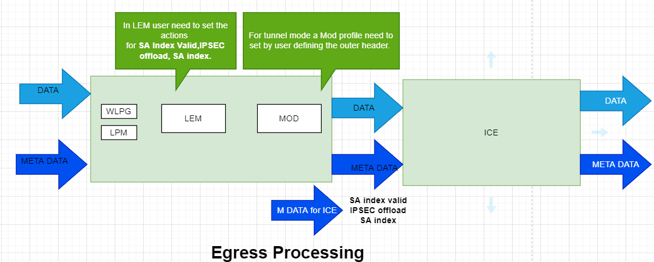
This diagram represents how data flow happens WRT to ICE in egress direction.
When packets are sent from LAN engine, the packets and its metadata are received in FXP.
The FXP classification blocks (e.g. LEM) match the packet header and sets the metadata required for ICE offload.
ICE checks those metadata fields and decides to encrypt the packet or bypass.

Slide 7
IPSec Processing Elements for HOST_TO_NET Tx Direction
Step | IPSec Table | Purpose | P4 & Fixed Function | MEV HW Block | Resulting Headers
​1 | ​IPsec Tx SPD Table (RFC2401 SPD) | An optional ACL table that​ identifies Tx traffic that requires IPsec protection. | P4 Match Action Table​ Key: Exact, LPM, Ternary fields Actions: Set packet metadata (CRYPTO_OFFLOAD) | FXP Classification: Exact: SEM/LEM LPM: LPM Ternary: WCM Action: Set metadata in classification block
2 | IPsec Tx SA Classification Table (RFC2401 Selectors) | Maps Tx packets to IPsec SA entries using the packet header fields. and packet metadata.​ Sets packet metadata to specify the SA index and to indicated that IPsec processing is required in packet metadata. In IPsec tunnel mode, add tunnel headers. | P4 Match Action Table Key: Exact, LPM, Ternary fields Action: Set packet metadata (SA INDEX) For tunnel mode, encapsulate tunnel IPV4 & Eth header | FXP Classification: Exact: SEM/LEM LPM: LPM Ternary: WCM Action: Set packet metadata in classification block Encapsulation: MOD
3 | IPsec Crypto Engine (RFC2401 SAD) | Encapsulates and encrypts IPsec ESP packets using the IPsec SA entry at the SA index specified in the packet metadata. | Fixed Function Key: SA Index Action: Insert ESP header and encrypt payload w/ SA fields | ICE Classification: SA Index: ICE Action: Insertion of crypto headers and encrypt & authentication operations in ICE
I-ETH
I-IP
Pay-load
O-ETH
O-IP
I-IP
Pay-load
O-ETH
O-IP
ESP
I-IP
Pay-load

Slide 8
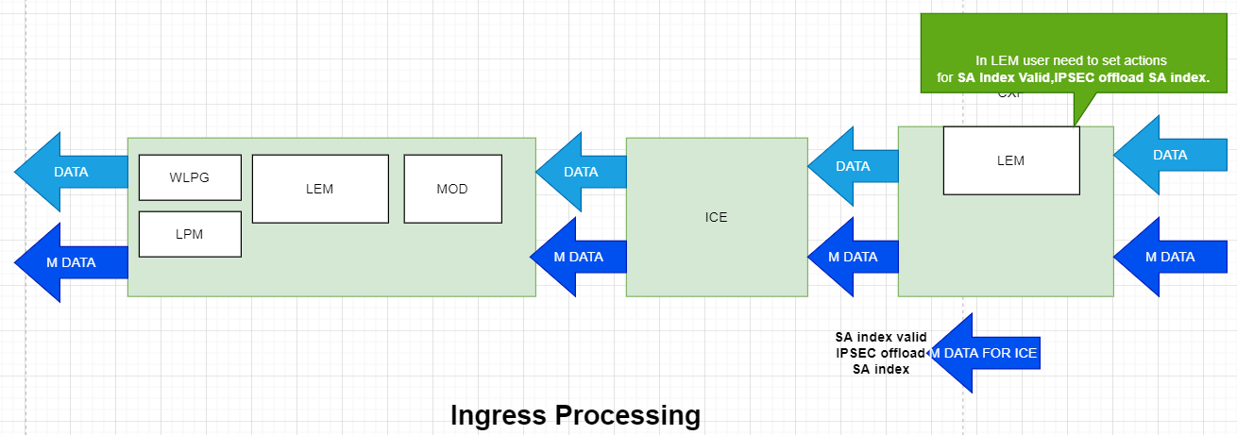
This diagram represent how packet flow happens to ICE in ingress direction.
Once the packets are received in CXP, based on the packet header and SPI, CXP sets the metadata for crypto offload.
Upon receiving the metadata, ICE will check the metadata and decides to decrypt or bypass the packet.

Slide 9
IPSec Processing Elements for NET_TO_HOST Rx Direction
Step | Table | Purpose | P4 & Fixed Function | MEV HW Block | Resulting Headers
​1 | IPsec Rx SA Classification Table​ (RFC2401 SAD) | Maps Rx IPsec packets to IPsec SA entries using the packet header fields.​ Sets packet metadata to specify the SA index and to indicated that IPsec processing is required. | P4 Match Action Table Key: Exact header fields + SPI Action: Set packet metadata (SA INDEX) | CXP Classification: Exact: LEM Action: Set packet metadata in classification block
2 | IPsec Crypto Engine (RFC2401 SAD) | Decrypts and decapsulates IPsec ESP packets using the IPsec SA entry at the SA index specified in the packet metadata. | Fixed Function Key: SA Index Action: Remove ESP header and decrypt & authenticate payload Set metadata (crypto_status, crypto_tag) | ICE Classification: SA Index: ICE Action: Deletion of crypto headers and decrypt & authentication operations in ICE
3 | IPsec Rx Post Decrypt Table (RFC2401 SPD validation) | Verifies that the crypto processing of the packet was successful (by checking packet metadata set by the engine). In IPsec tunnel mode: Removes the outer IP header. | P4 Match Action Table Key: Exact match on Crypto_tag Action: If tunnel mode, decapsulation of tunnel IPV4 & Eth header | FXP Classification: Exact: SEM/LEM Action: Set packet metadata in classification block Decapsulation: MOD
O-ETH
O-IP
ESP
I-IP
Pay-load
O-ETH
O-IP
I-IP
Pay-load
I-ETH
I-IP
Pay-load

Slide 10
Control Plane Flow

Slide 11
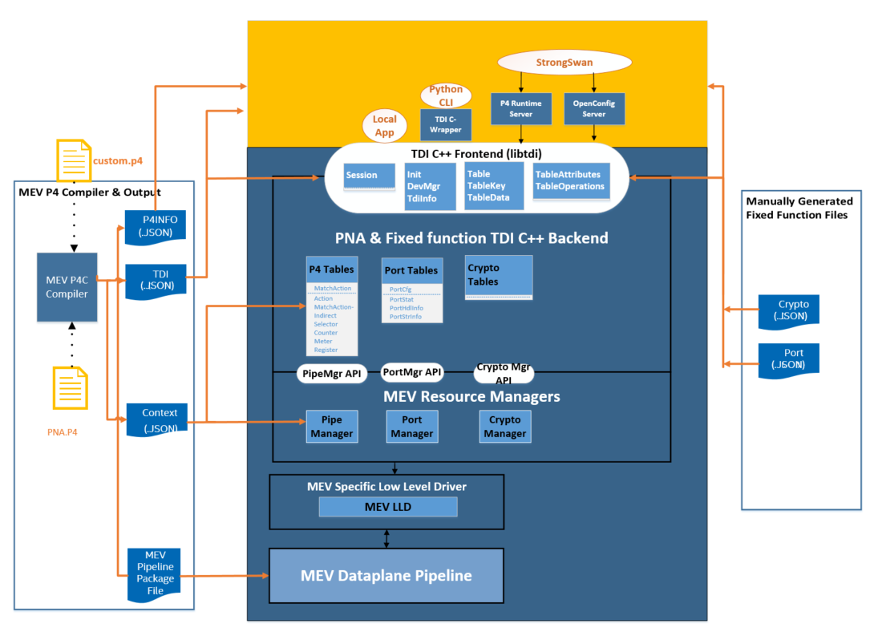
Crypto Configuration through TDI (Table Driven Interface)
Table Driven Interface (TDI) is a Target Agnostic Interface, present under opensource p4lang/tdi.
MEV TDI backend uses C++ polymorphism to implement different tables.
IPSec SPD & SAD classification tables are configured through P4 based TDI tables.
IPSec SAD database containing SA attributes are configured through fixed function (non-P4) TDI tables.
Every configuration entity is represented as P4(e.g MatchActionDirect) or non-P4 (Port, IPSec SAD configuration) tables.
tdi.json is a json-based contract between TDI frontend and user application on how these tables look.
Compiler generates a tdi.json for P4 entities.
Tdi.json for fixed function are hand-written for now.
TDI json parsing library present in p4lang/tdi parses both P4 and fixed function tdi.json files.
Notes:
In TDI backend, each TDI class implements table specific behavior for mapping key, data, and resource mgmt. used by the table or data.
The manager layer maps the key and data to the target LLD APIs with help from the context.json.
Context.json contains information related to tdi.json entries as well as P4 DPDK pipeline specific information.

Slide 12
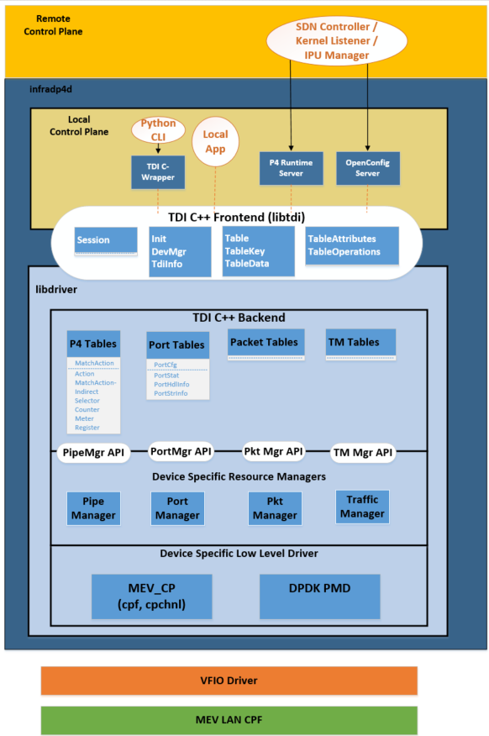
How does P4-DRIVER implement TDI?
TDI implementation layers
TDI C++ base class frontend
Referenced through submodule to TDI
TDI C++ class P4 PNA & Fixed function backend
Map TDI table key & data fields to bitarray based on target specific context.json
Table specific implementation
MEV target-specific resource manager libraries
Pipe Manager
Southbound interface for TDI P4 backend
Session implementation
Crypto Manager
Southbound interface for fixed function (e.g. IPSec SAD) backend
Port Manager
Southbound interface for Port/Vport backend
MEV LLD
Simple target access layer for MEV target
Notes:
In TDI backend, each TDI class implements table specific behavior for mapping key, data, and resource mgmt. used by the table or data.
The manager layer maps the key and data to the target LLD APIs with help from the context.json.
Context.json contains information related to tdi.json entries as well as P4 DPDK pipeline specific information.

Slide 13
IPSec Tunnel Mode TDI API Tables (HOST_TO_NET Tx Direction)
Step | IPSec Table | P4 & Fixed Function | TDI Table for Config
​1 | ​IPsec Tx SPD Table (RFC2401 4.4.1 SPD) | P4 Match Action Table​ Key: Exact, LPM, Ternary fields Actions: Set packet metadata (CRYPTO_OFFLOAD) | MatchActionDirect Table P4 Key fields: Exact, LPM, Ternary fields P4 Action: P4 action for protect P4 action for bypass Data: None
2 | IPsec Tx SA Classification Table (RFC2401 4.4.2 Selectors) | P4 Match Action Table Key: Exact, LPM, Ternary fields Action: Set packet metadata (SA INDEX) Encapsulate tunnel IPV4 & Eth header | MatchActionDirect Table P4 Key fields: Exact, LPM, Ternary fields P4 Action: P4 action for setting SA Index P4 action for bypass Data: SA Index value MatchActionDirect Table (for encap header data) P4 Key fields: MOD data pointer P4 Action: P4 action for encapsulate tunnel header Data: Tunnel IPV4 & Eth header fields (S-IP, D-IP, S-MAC, D-MAC, ..)
3 | IPsec Crypto Engine (RFC2401 4.4.3 SAD) | Fixed Function Key: SA Index Action: Insert ESP header and encrypt payload w/ SA fields | IPSec SAD Table Fixed Key fields: SA Index Fixed Action: HW fixed action to insert ESP header and encrypt & authenticate payload Data: Crypto_Tag, IPSec protocol, SPI, key, algorithm, IV, lifetime, …

Slide 14
IPSec Tunnel Mode TDI API Tables (NET_TO_HOST Rx Direction)
Step | Table | P4 & Fixed Function | TDI Table for Config
​1 | IPsec Rx SA Classification Table​ (RFC2401 4.4.3 SAD) | P4 Match Action Table Key: Exact header fields + SPI Action: Set packet metadata (SA INDEX) | MatchActionDirect Table P4 Key fields: Exact match header + SPI fields P4 Action: P4 action to set packet metadata P4 action for bypass Data: SA INDEX
2 | IPsec Crypto Engine (RFC2401 4.4.3 SAD) | Fixed Function Key: SA Index Action: Remove ESP header and decrypt & authenticate payload Set metadata (crypto_status, crypto_tag) | IPSec SAD Table Fixed Key fields: SA Index Fixed Action: HW fixed action to remove ESP header and decrypt & authenticate payload.. Data: Crypto_Tag, IPSec protocol, SPI, key, algorithm, IV, lifetime, anti-replay window
3 | IPsec Rx Post Decrypt Table (RFC2401 4.4.1 SPD) | P4 Match Action Table Key: Exact match on Crypto_tag Action: Decapsulation of tunnel IPV4 & Eth header | MatchActionDirect Table P4 Key fields: Exact match on crypto_tag P4 Action: P4 action for decapsulate tunnel IPV4 & Eth header (tunnel mode) P4 action for bypass (transport mode) Data: None

Slide 15
Reference IKE Integration

Slide 16
Reference IKE Integration
Opensource StrongSwan is used for reference IKE integration.
Utilizes gRPC interface for communication between StrongSwan and the P4-Driver on MEV ACC.
The capabilities demonstrated through StrongSwan integration are available for local IKE applications.

Slide 17
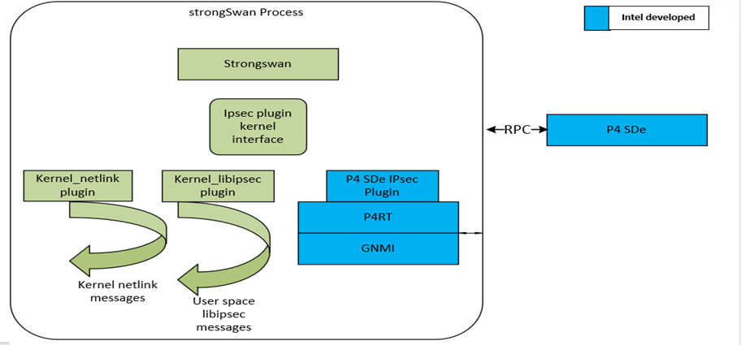
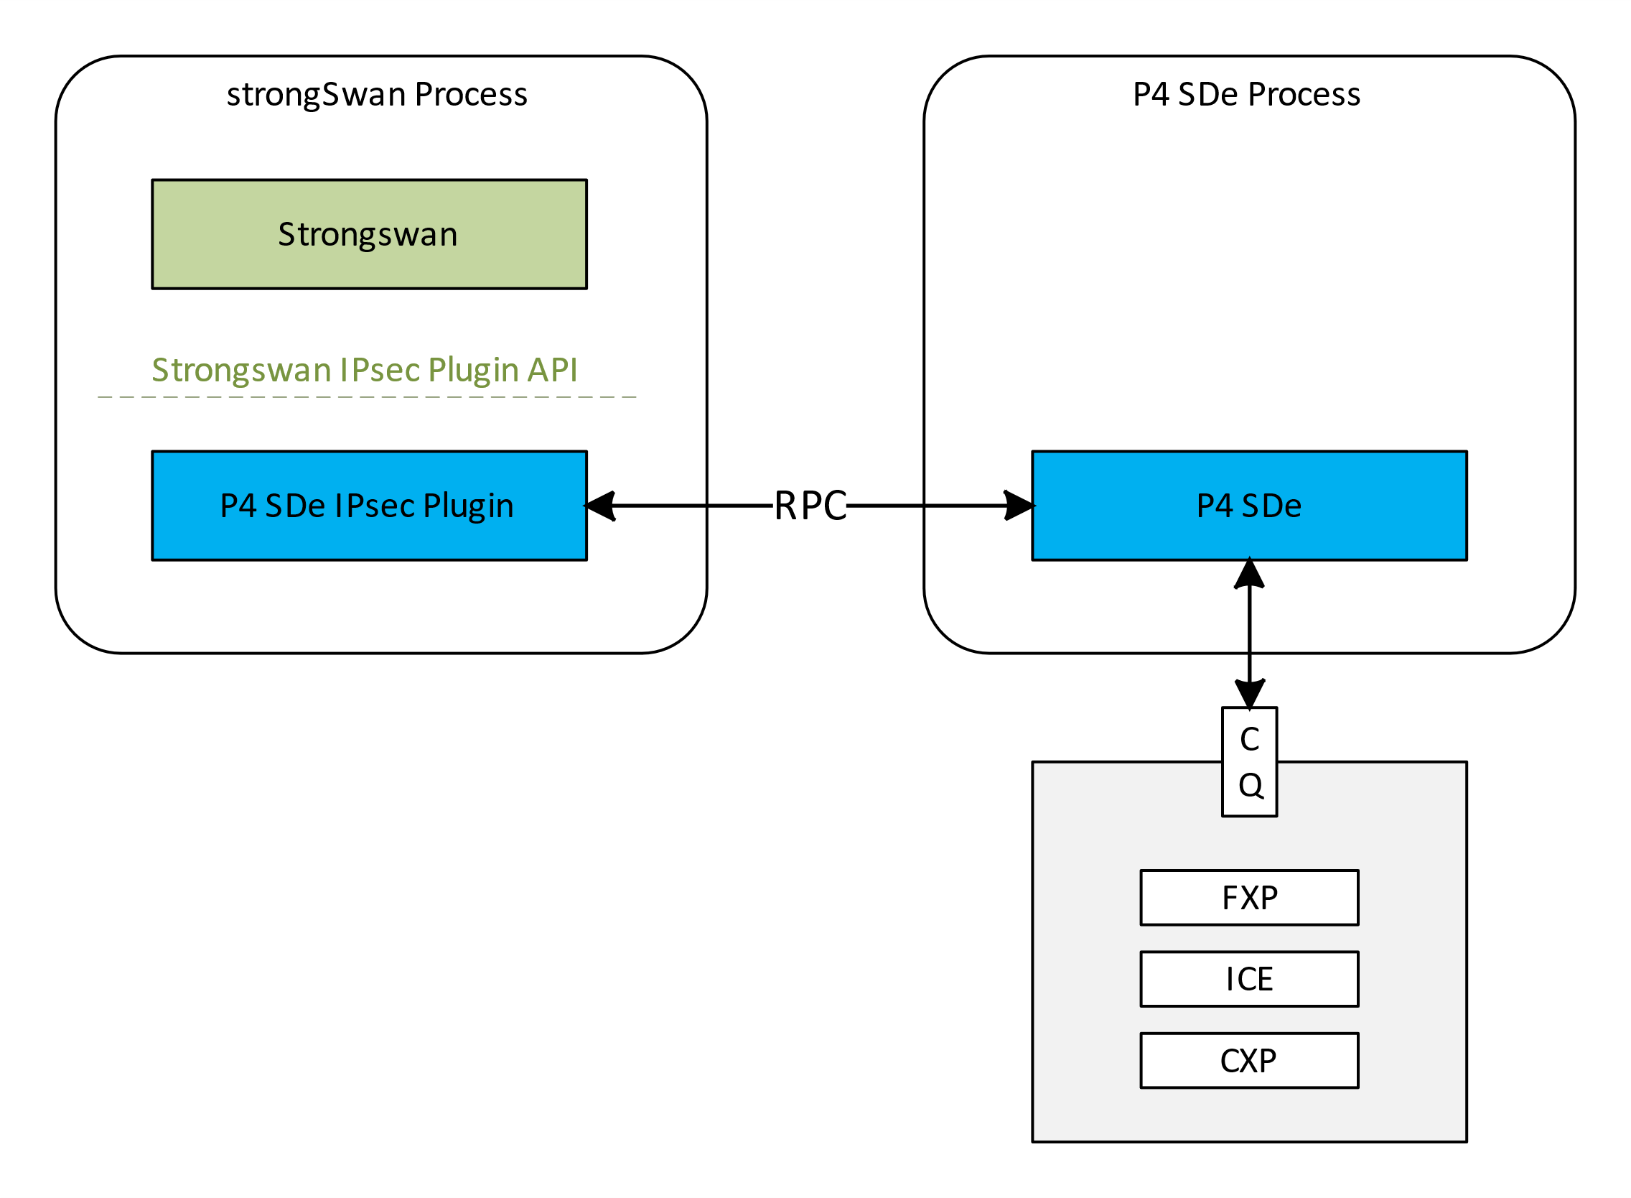
StrongSwan Integration
strongSwan is an open source IPsec VPN solution that implements the IKE protocol. For MEV-TS, strongSwan will be used as a reference model for integrating MEV-TS inline crypto with an IKE stack.
strongSwan supports a plugin interface for interfacing with IPsec backends and provides a set of existing plugins for interfacing for a variety of backend kernel space and user space IPsec stacks.
Some of the existing strongSwan plugins are kernel-netlink,kernel-libipsec.
In MEV-TS we will implement an Ipsec-Offload plugin which will use ICE as an ipsec backend.
A new IPsec plugin will be developed that adapts between the strongSwan IPsec Plugin API and the P4 SDe API for IPsec SA programming. When this plugin is installed & enabled, all other existing strongSwan IPsec plugins should be disabled. When the P4 SDe plugin is enabled, all IPsec SAs are intercepted and offloaded to hardware.

Slide 18
StrongSWAN-ICE flows
Southbound flows(StrongSWAN->ICE)
SPI
SA ADD
SA DELETE
Northbound flows(ICE->StrongSWAN)
Lifetime notifications
Audit-log for Anomalies.(auth failures etc…).

Slide 19
Thank You

