Slide 1
Intelligent Edge Security: AI Inference and Anomaly Detection on IPU
Sabeel Ansari
NEX CNSE

Slide 2
Market Opportunity
Evolving threat landscape: limitation of traditional approaches
Edge AI: AI moving from cloud datacenters to edge (e.g. robotics)
SASE (Secure Access Service Edge) and Edge AI converging
Rapid growth in edge security market
Market research reports put the TAM in range of $120B-$175B over next 8 years growing approx. 20% CAGR
Large enterprises expected to comprise 50% of market to protect against cybersecurity threats
Competition investing in this area to future proof
Ideas discussed in this presentation can be extended beyond IPU

Slide 3
Network Anomaly Detection – Problem Statement
Signature-based detection fails to identify novel attack vectors and zero-day exploits
Encrypted traffic remains opaque to conventional inspection methods
CPU resource consumption creates performance bottlenecks
Centralized security analysis introduces latency and potential points of failure
Alert quality challenges where false negatives can be catastrophic, and false positives lead to alert fatigue

Slide 4
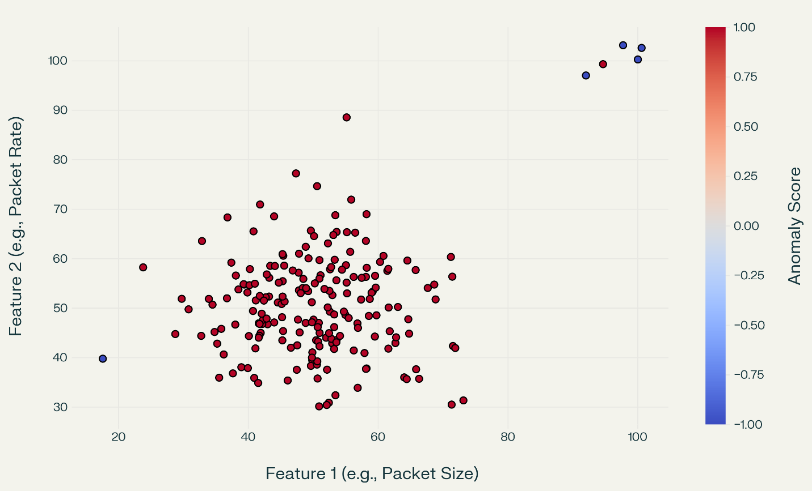
Solution: Edge AI-based anomaly detection on Intel IPUs
Real-time anomaly detection @ line rate without routing traffic to centralized infrastructure.
Detect and deter attacks at the edge
Identify sophisticated attacks by analyzing behavioral patterns rather than signatures
Process and block hijacking attempts
In root-port mode, IPU is root and pre-boot attacks can be deterred
Preserve CPU resources for critical workloads
Enhance security posture through isolation

Slide 5
Snort
Snort is widely adopted in industry. Invented in the late-90s, has gone through iterations Snort2 & Snort3
Provides three main features:
Packet sniffing
Packet logging
Network Intrusion Detection System (IDS) and Intrusion Prevention System (IPS)
Sourcefire, acquired by Cisco, maintains & open-sources the community rules for network IDS
Rules based, so works great for known attack vectors, but falls short on zero-day/novel exploits

Slide 6
SnortML
Cisco/Talos open-sourced SnortML in Mar 2024, an ML-based engine
SnortML has two components:
snort_ml_engine: pre-trained ML models instantiate classifiers based on models and made available for detection
snort_ml_inspector: subscribes to data by Snort service inspectors, passes data to classifiers, and acts on output of classifiers
One pre-trained model available: http_param_model
HTTP packet header inspection can provide defense against SQL injection/Log4j style attacks
Inference engine based on TensorFlow using Keras API
SnortML includes XNNPACK accelerator needed to run CPU-bound models at line rate

Slide 7
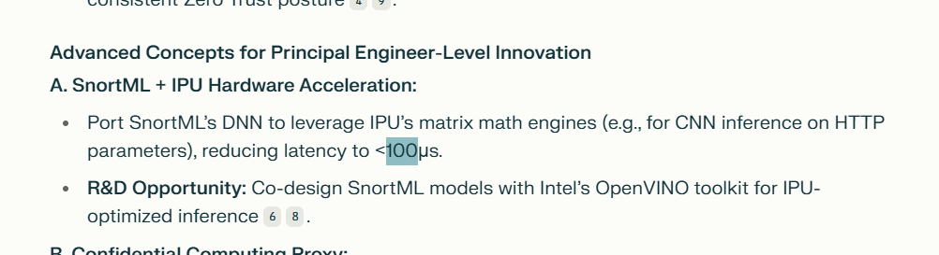
SnortML → latency
https://www.perplexity.ai/search/what-are-some-types-of-securit-vMTEAyFjTriDyBB5KXyMNg

Slide 8
Host
VM 2
IPU end-host mode
Host/CPU is root
IPU on PCIe bus
IPU root-port mode
IPU is root
No host/headless
VM 1
V0
V0
VF
VF
VF
PF
PCIe4 x16
Q
Q
Q
Q
Q
Peer System
LAN
ARM Compute Complex (ACC)
IMC
SnortML
IPU
mgmtd
OVS Bridge
ACC PR (Host VF)
ACC PR 0 (PHY_0)
Packet Processing Pipeline (FXP)
QSFP 0
QSFP 0
QSFP 1
QSFP 1

