Slide 1


Asterisk Password Vault

Slide 2












Slide 3
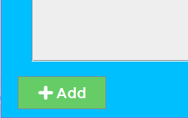
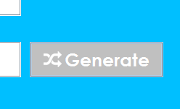
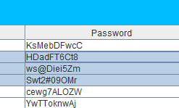
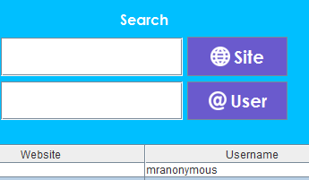
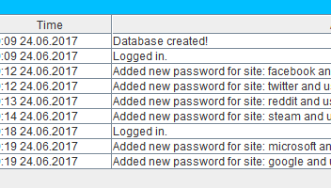
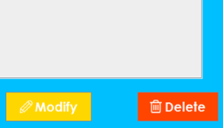
Welcome to Asterisk*
Glad to have you here!
Start by adding a password
Generate random passwords
Select single/multiple rows and copy
Find passwords by website or username
Log will keep all your activities
Select single/multiple rows and copy

Slide 4
