Slide 1
The Renju-Official Bot
by Sakuro

Slide 2
Building up this project
Visual Studio Code (my preferred editor)
Git (for source control)
GitHub (code for reference)
CSDN (code and passages for reference)
StackOverChange, Reddit… (forums for problem-solving)
ChatGPT (a simplier search engine)
GitHub Copilot (built-in AI assistant in VSC) (that’s why I used VSC ☺)

Slide 3
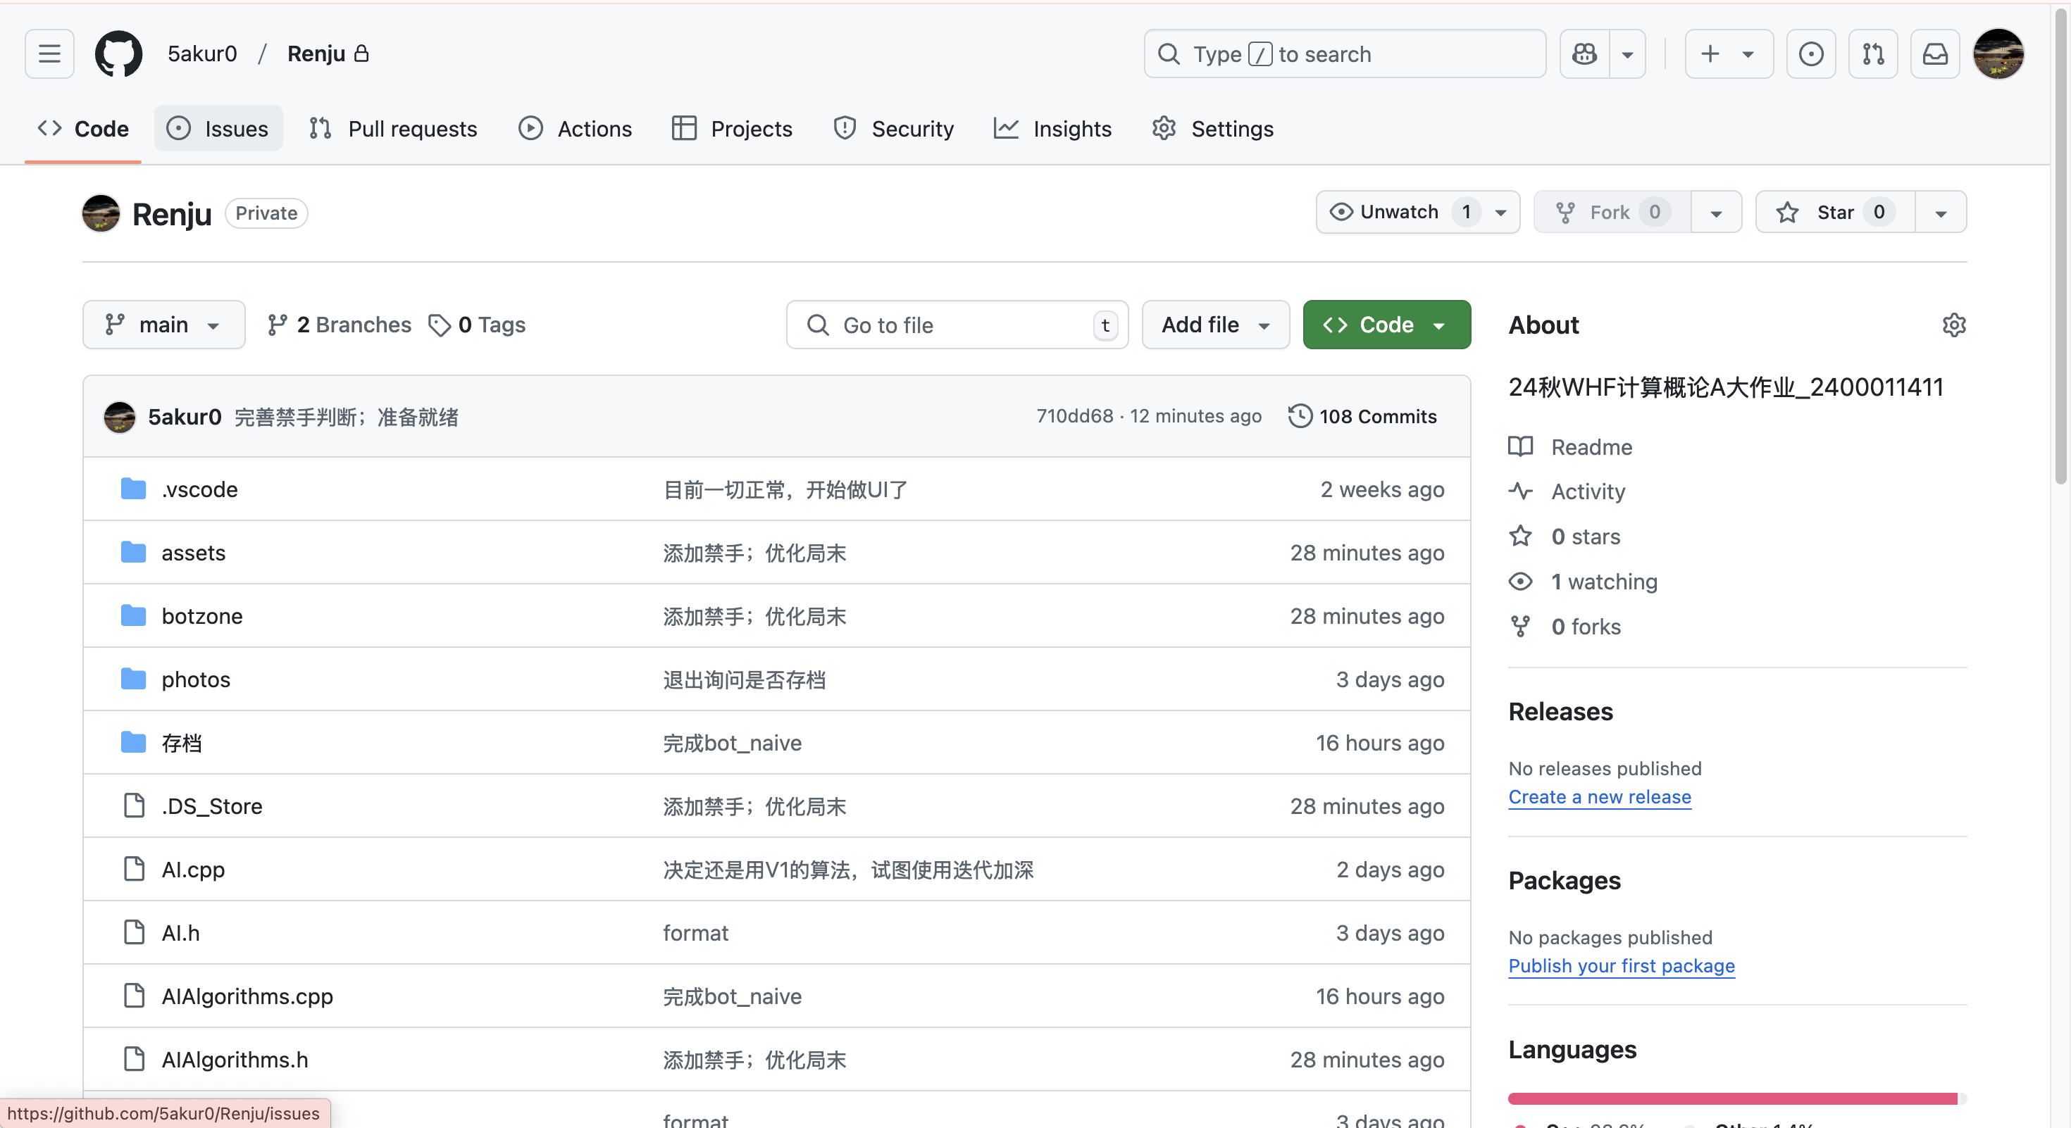
My Respository: https://github.com/5akur0/Renju

Slide 4
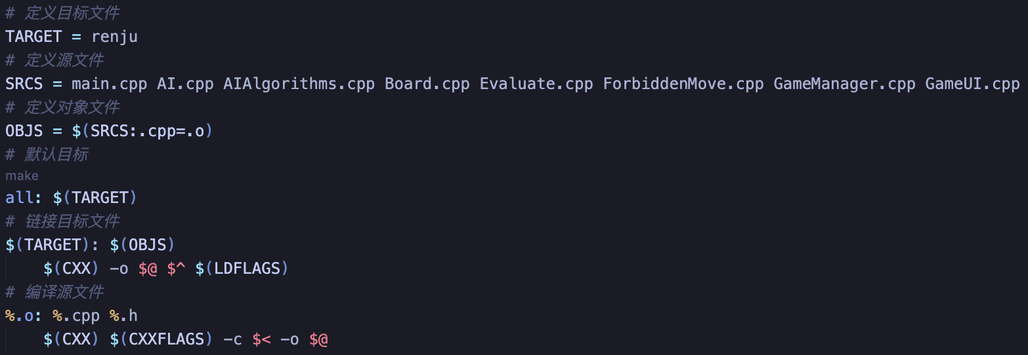
A brief Structure
main.cpp: Initialization, running UI.
AIAlgorithms.cpp: All about the algorithms.
AI.cpp: Representing the AI, using the algorithms.
Board.cpp: All about the game board.
Evaluate.cpp: Functions to evaluate a board.
ForbiddenMove.cpp: Referring GameJudge.cpp, judging forbidden moves.
GameManager.cpp: Manage things about the game.
GameUI.cpp: All about the UI.

Slide 5
My Implementation of:
The algorithm
The evaluation
The forbidden move judger
The UI

Slide 6
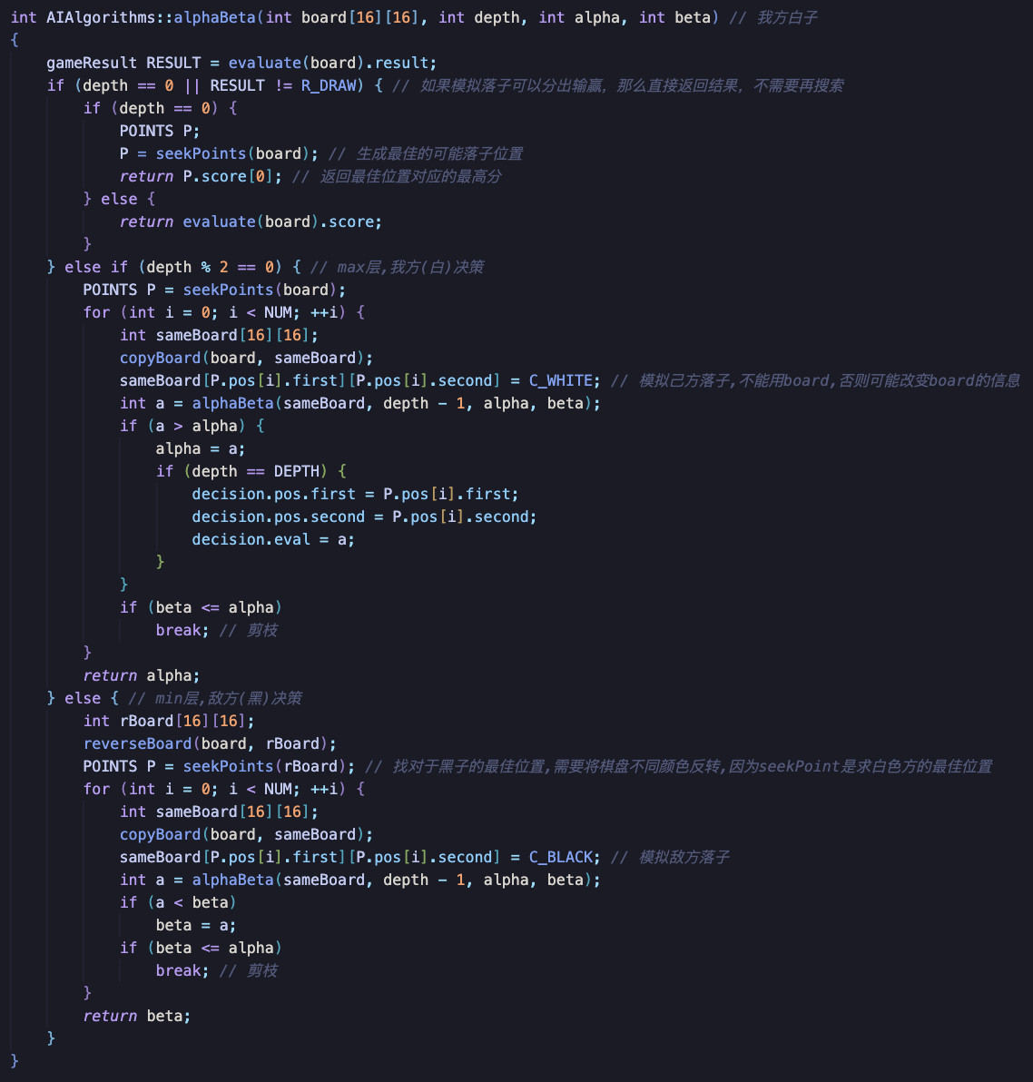

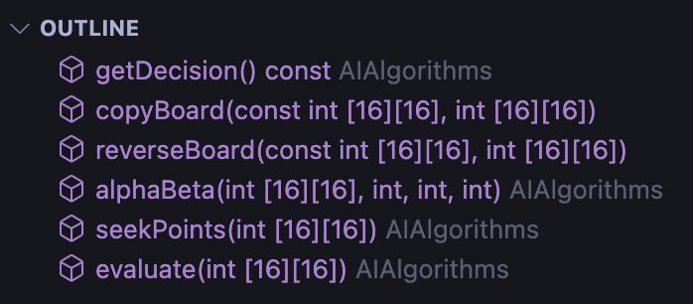
The algorithm
DFS
Mini-Max
Alpha-Beta Prunning

Slide 7
The evaluation
Scanning through the whole board.
Each specific pattern of six connected pieces is assigned a score.
Adding up.
Parameter tuning.
Making the bot more AGGRESIVE or PASSIVE?
I referred to some papers and CSDN.

Slide 8
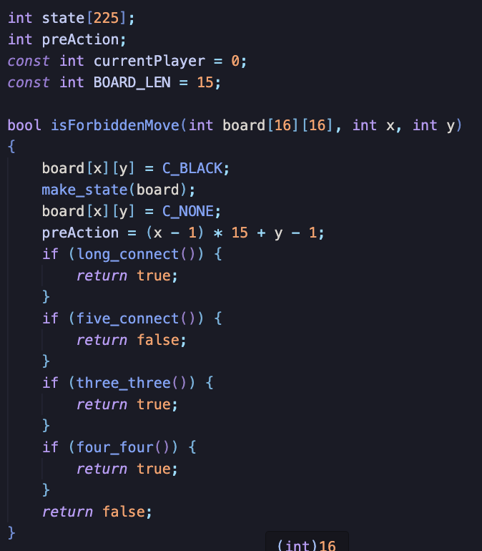
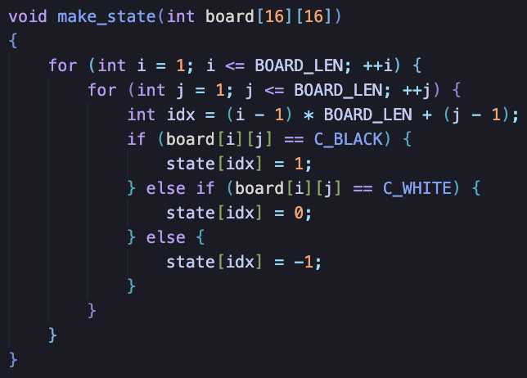
The forbidden move judger
Direct copy from Botzone.
Easy to implement.
Need some transits to fit my code ☺ .

Slide 9
The UI
GUI library: SDL.
A clean interface.
Heavy use of GitHub Copliot to boost efficiency.
Command line and GUI both available.
Some additional features.

Slide 10
Abolished or unimplemented Plans
Zobrist caching optimization: little speed improvement.
Iterative deepening: not so unnecessary for merely 4 layers.
Kill move: resulting in errors, cannot successfully implement.
Local evaluation: Not implemented.
Implementing these optimizations, expected to search for 6+ layers.
But that’s not the key.
My Botzone AI is smart enough but without the f-move judger ☹ .

Slide 11
Further Thinking (beyong my project)
Monti-Carlo?
NNs?
Coding more efficiently with AI?

