Slide 1
Module 5: Sampling
5.16: Inequity
Annie Collins
Data Sciences Institute, University of Toronto

Slide 2
Key Texts
James, A. (2008). Making Sense of Race and Racial Classification. In T. Zuberi & E. Bonilla-Silva (Eds.), White logic, white methods : Racism and methodology (pp. 31-45). Rowman & Littlefield Publishers.
Harnois, C. (2018). Analyzing race and ethnicity with the GSS. In Analyzing inequalities: An introduction to race, class, gender, and sexuality using the general social survey (pp. 65-96). SAGE Publications, Inc., https://dx.doi.org/
Ashok, S. (2016, August 27). The rise of the American ‘Others’. The Atlantic. https://www.theatlantic.com/politics/archive/2016/08/the-rise-of-the-others/497690/
Krause, H. (2021, August 27). We need to fill in the blanks in our social identity data. We All Count. https://weallcount.com/2021/08/27/we-need-to-fill-in-the-blanks-in-our-social-identity-data/
Krause, H. (2020, December 4). No one is an asterisk. We All Count. https://weallcount.com/2020/12/04/no-one-is-an-asterisk/
Krause, H. (2020, June 26). Proxy variables part 2: race. We All Count. https://weallcount.com/2020/06/26/proxy-variables-part-2-race/

Slide 3
Race in Surveys

Slide 4
Discussion Questions
What is race?
What may be contributing factors to how we perceive racial identity in others and ourselves?
How many races are there? What are they?
What are the differences between race, ethnicity, and nationality?
How might our definitions of racial categories change across time and space?

Slide 5
Race
What is race?
Race broadly refers to a group of humans that share common characteristics
Skin colour
Hair type
Facial features
Language
Religion
Cultural practice
Geographic origin
In the modern day, generally accepted to be a social construct with no biological validity
Notes:
https://www.britannica.com/topic/race-human/The-history-of-the-idea-of-race

Slide 6
Ethnicity
What is ethnicity?
Generally encompasses more than race
More often associated with cultural expression, cultural identity, and national/regional origin
Ethnicity can often specify subgroups within certain broader racial classifications
People who identify racially as “white” may identify ethnically as Turkish, Mexican, French Canadian, Ashkenazi Jew, etc. or a combination of multiple distinct ethnic groups
Notes:
https://www.livescience.com/difference-between-race-ethnicity.html: Ethnicity has been used to oppress different groups, as occurred during the Holocaust, or within interethnic conflict of the Rwandan genocide, where ethnicity was used to justify mass killings. Yet, ethnicity can also be a boon for people who feel like they're siloed into one racial group or another, because it offers a degree of agency, Ifekwunigwe said.

Slide 7
Race in Surveys
Data on race and ethnicity are needed to track demographic shifts in populations and inequalities between members of different groups
Desire to identify and quantify the influence of race without oversimplifying or essentializing
However, data on race can also be used to perpetuate inequalities in the wrong hands
How do we ask about and measure race?

Slide 8
Racial Classifications
“Because race is a socially constructed concept with no fixed reality, all classification efforts are fraught with imprecision. Classification schemas are always a set of imperfect choices made in response to a given set of political agendas and imperatives. The institutionalization of these choices over the long run always has the effect of ‘naturalizing’ particular understandings of race. That is why there generally has been a great deal of struggle associated with changes in census classification, and why it is necessary to interrogate change and continuities in categorization”
– Angela James, “Making Sense of Race and Racial Classification” in White Logic, White Methods: Racism and Methodology

Slide 9
Racial Classifications
Identification
Most surveys allow respondents to self-identify in response to questions about race
In the past, race has been indicated by researchers based on appearance or observed lifestyle
On the US census, race was recorded by surveyors until 1960
On the US General Social Survey, race was recorded through interviewer observation until 2000. Interviewers were instructed to ask respondents of their race only if they were in doubt.
Race versus ethnicity
Depending on the context of the study, one measure may be more informative than the other
Both can provide useful insight

Slide 10
Racial Classifications
Asking the question
What type of question should be used?
Open ended, “pick one”, “pick many”
How many options should be given? What are the options?
How can this data be analyzed?
Open ended: How can information be extracted from responses and meaningfully categorized and quantified?
“Pick one”: How can we properly account for mixed race individuals?
“Pick many”: How can we analyze many unique combinations of races, particularly those that pertain to small numbers of respondents? If we are looking for information about one race, to what extent do mixed race individuals enter into our analyses?

Slide 11
Case Study: France
In France, it is prohibited to collect data relating to the race or ethnic origin of a person through official government statistical programs, namely those conducted by the Institut national de la statistique et des études économiques and the Ministerial Statistical Departments
Article 1 of the Constitution states: “France shall be an indivisible, secular, democratic and social Republic. It shall ensure the equality of all citizens before the law, without distinction of origin, race or religion. It shall respect all beliefs.”
Notes:
https://www.insee.fr/en/information/2388586
https://www.conseil-constitutionnel.fr/en/decision/2007/2007557DC.htm
https://www.constituteproject.org/constitution/France_2008.pdf?lang=en

Slide 12
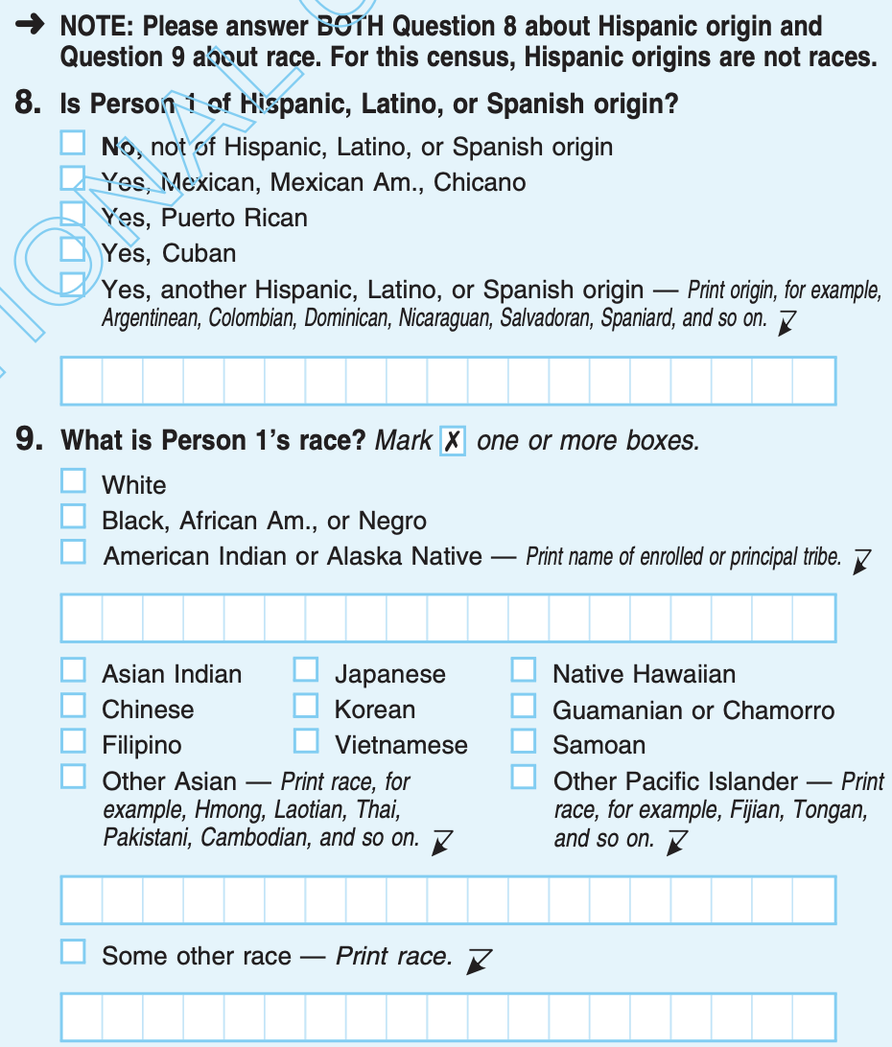
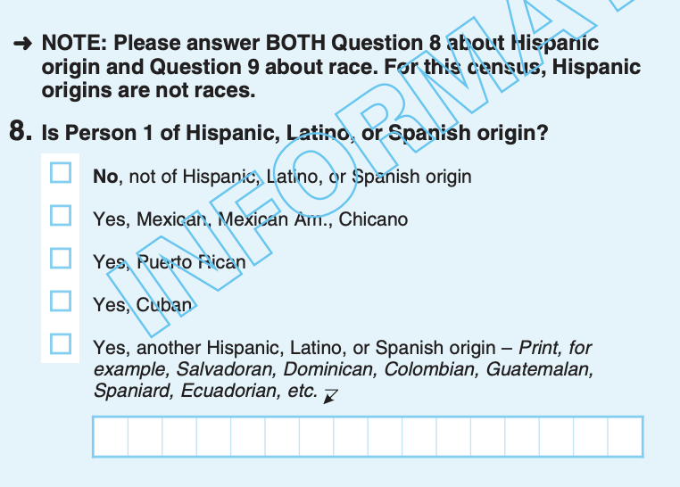
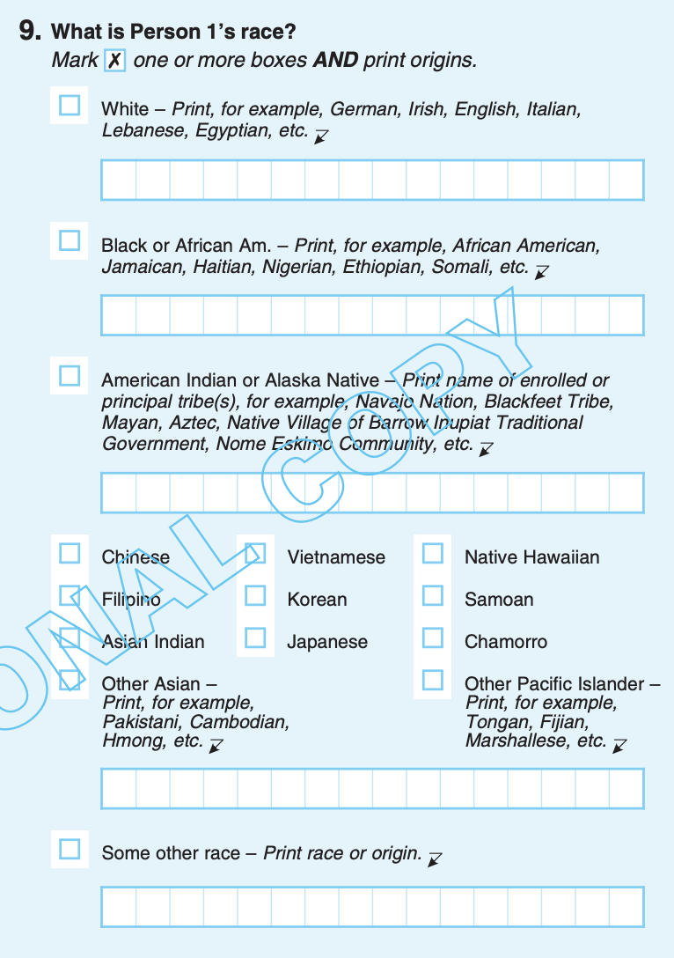
Case Study: US Census
2010
2020
Notes:
https://www.census.gov/programs-surveys/decennial-census/decade.2020.html

Slide 13
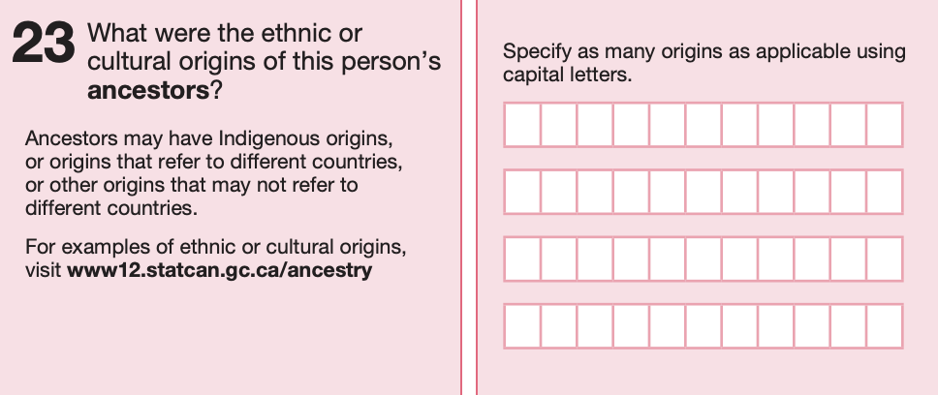
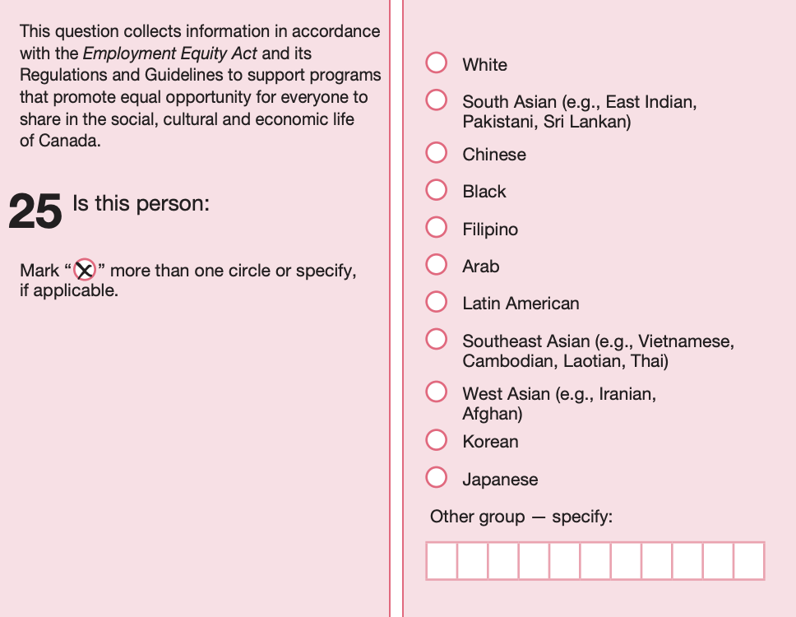
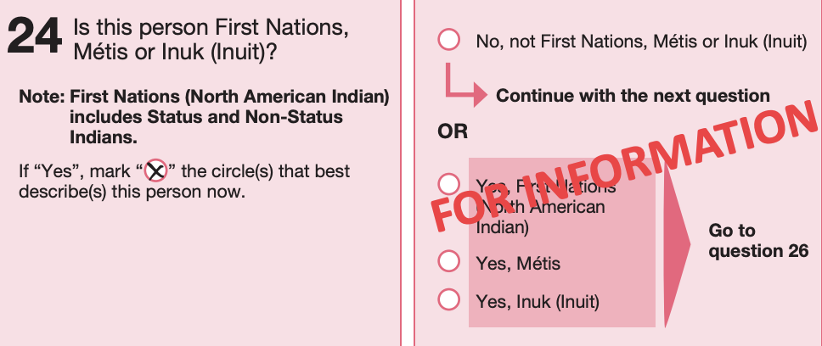
Case Study: Canadian Census
Notes:
2021
https://www23.statcan.gc.ca/imdb/p2SV.pl?Function=getSurvInstrumentList&Id=1283315
https://www12.statcan.gc.ca/census-recensement/2021/ref/questionnaire/index-eng.cfm
Note that the Canadian census never explicitly asks about an individual’s race. Data points from question 25 appear as “visible minority status”. Ethnicity and indigenous identity are similarly asked on the Canadian GSS.
How many options are there?
What are the options?
How do these compare to the US census? What might be the reason for the differences?

Slide 14
Equity Considerations in Collecting and Using Data about Race

Slide 15
Collecting and Using Data about Race
Use racial and ethnic categories that are meaningful for your target population
Different target populations may benefit from different categorizations for racial or ethnic identities in survey questions
For example, if you know your sample is predominantly Indigenous peoples, one “Indigenous” ethnic category will not provide much additional data
Use clusters or strata that are relevant to your target population
Test surveys in advance
Consult target population or available resources for best practices
Notes:
Often clusters or strata are geographic in nature. Show and discuss https://native-land.ca/ as an example of strata relevant to specific ethnic groups.

Slide 16
Collecting and Using Data about Race
Think critically about the “Other: Please specify” option
Allowing respondents to select “Other” as a racial/ethnic identity is useful for those who fall outside of set racial categories
High number of “Other” responses may indicate that options provided are too limited and may render analysis less useful
Responses to “Please specify” can indicate more categories or further clarification that should be provided
Notes:
https://www.theatlantic.com/politics/archive/2016/08/the-rise-of-the-others/497690/

Slide 17
Collecting and Using Data about Race
Allow respondents to self-identify
Race is complex and unlikely to be perceived fully accurately by an interviewer
Self-identification allows respondents agency over how their identity is reported in data sets

Slide 18
Collecting and Using Data about Race
Provide background on how questions about racial or ethnic identity were asked
All choices and considerations that have gone into creating questions concerning race should be communicated to data users
Consider the following examples from Krause (2020):
25% of students are Black
25% of students self-identified as Black from a list of “Black, Hispanic, White, Mixed Race, Asian, Indigenous, Other, Prefer Not To Say”, created by the University admissions department in consultation with a student advisory panel.
25% of students were counted by their teachers as Black from a provided choice of “White, Black, or Other”, suggested in a staff meeting.
Notes:
https://weallcount.com/2021/08/27/we-need-to-fill-in-the-blanks-in-our-social-identity-data/

Slide 19
Collecting and Using Data about Race
Where possible, report data for all racial and ethnic categories even when sample size is small
Often estimates for small sub-populations are supressed due to small sample size
Suppressing data for small sub-populations can perpetuate marginalization
Instead consider reporting sample size and reliability levels (standard deviation, coefficient of variation, confidence interval, etc.) so that results for all groups can be disseminated
Notes:
https://weallcount.com/2020/12/04/no-one-is-an-asterisk/

Slide 20
Collecting and Using Data about Race
Investigate the social circumstances for the differences between racial or ethnic groups in data sets
Race often serves as a proxy variable for a variety of social, cultural, historical, political, etc. circumstances that create inequalities
Providing broader context shifts responsibility from racialized groups to systems of oppression
Avoid simply controlling for race as a demographic variable
Notes:
https://weallcount.com/2020/06/26/proxy-variables-part-2-race/

Slide 21
References
Takezawa, Y. I. , Smedley, . Audrey and Wade, . Peter (2020, November 23). race. Encyclopedia Britannica. https://www.britannica.com/topic/race-human
Bryce, E. (2020, February 8). What’s the difference between race and ethnicity?. Live Science. https://www.livescience.com/difference-between-race-ethnicity.html
Institut national de la statistique et des études économiques (2016, September 9). Ethnic-based statistics. https://www.insee.fr/en/information/2388586
Conseil constitutionnel (2007, November 15). Decision no. 2007-557 DC of 15 November 2007. https://www.conseil-constitutionnel.fr/en/decision/2007/2007557DC.ht
U.S. Census Bureau (2020). 2020 Decennial Census Questionnaire. https://www.census.gov/programs-surveys/decennial-census/technical-documentation/questionnaires.2020_Census.html
U.S. Census Bureau (2010). 2010 Decennial Census Questionnaire. https://www.census.gov/programs-surveys/decennial-census/technical-documentation/questionnaires.2010_Census.html
Statistics Canada (2021). 2021 Census of Population, Form 2A-L. https://www23.statcan.gc.ca/imdb/p2SV.pl?Function=getSurvInstrumentList&Id=1283315

