Slide 1
Sampling
Privacy
Data Sciences Institute, University of Toronto

Slide 2
We will,
Review these slides to learn about privacy, ethics, and confidentiality
Work on Assignment 3 (due tomorrow!)

Slide 3
Before you read the other slides…
Based solely on your prior knowledge, how would you define:
Privacy
Anonymity
Confidentiality

Slide 4
Privacy and Confidentiality

Slide 5
Key Terminology
Data privacy = the ability to control when and where your personal data are shared
Informational Risk = potential for harm resulting from the disclosure and sharing of data
Personally identifying information (PII) = includes name, address, telephone number, age, gender, personal opinions or views

Slide 6
Key Terminology
Anonymization = process of removing PII from a dataset
Confidentiality = granted to respondents; only the researcher knows the identities of respondents
E.g. I interview Sam, I know Sam is Sam, but in my paper, I refer to Sam only as ‘Participant A’ or by a pseudonym
Anonymity = granted to respondents; identities of individual respondents not known to researcher
E.g. I create a survey, Sam fills out the survey anonymously online, I never know that Sam is the one who filled out the survey

Slide 7
Confidentiality Considerations
Data collection medium
In person – who might see the participants walking into the lab or interview location?
Digital – Is third party software safe?
Data storage
Password protected computer? Double-locked office and filing cabinet? Portable hard drive?
Cloud – Institutional OneDrive?
Who has access to the data?
Think about: shared offices, IT or other colleagues
Have to balance need for backups with reduced risk

Slide 8
Confidentiality Considerations
Retention and disposal schedule
How long will you keep data for? Why? Balance storage resources vs data needs
How will you dispose of data when retention period is done? (Shredding hard copies? Deleting digital files?)
Clarify limits on confidentiality
What if someone discloses something illegal?
Statements like ‘confidentiality is not absolute, a disclosure of personal information may occur if required by law’
If no confidentiality - why?
E.g. Respondents are key informants in their fields (world leaders, expert academics in niche areas)

Slide 9
Explore some real resources
Academic
U of T offers research support to ensure data security and confidentiality
https://research.utoronto.ca/data-security-standards-personally-identifiable-other-confidential-data-research
Public Sector
A privacy checklist!
https://www.ipc.on.ca/wp-content/uploads/2015/04/best-practices-for-protecting-individual-privacy-in-conducting-survey-research.pdf

Slide 10
Differential Privacy

Slide 11
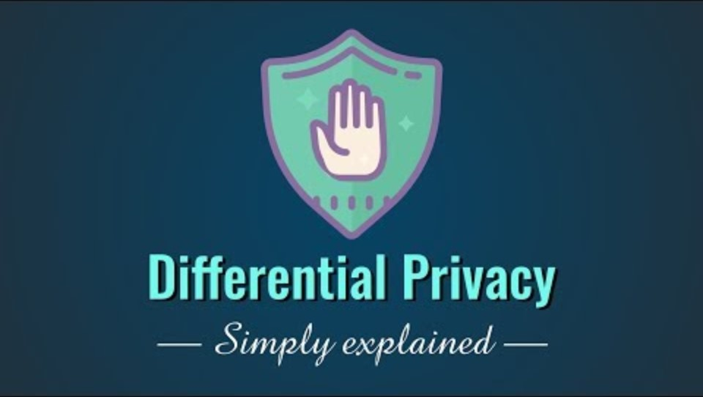
Differential Privacy
https://www.youtube.com/watch?v=gI0wk1CXlsQ

Slide 12
Differential Privacy
Objective: analyze and share information about a dataset without revealing information about any individual within the dataset
Differential privacy adds random noise to computations on our dataset
Randomness obscures the PII of any one individual respondent
Randomness means that all output is approximate
Generally used for aggregate statistics and modelling – counts, proportions, averages, linear regression, machine learning algorithms

Slide 13
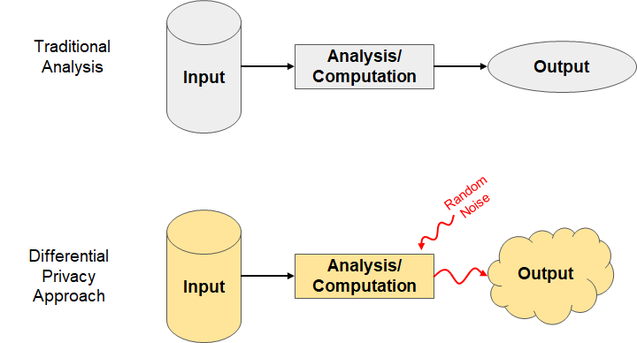
Based on Nissim et al

Slide 14
Example
Suppose John is invited to participate in a study about the relationship between socioeconomic factors and medical outcomes in the US. Participants are asked to complete a questionnaire covering topics related to their finances and medical history. John is concerned that information he provides, such as his HIV status, may be used against him if de-identified data is released and accessed by his insurance company. However, he recognizes that participating in the study would benefit the researchers and perhaps generate important results.

Slide 15
Example
John’s opt-out scenario refers to the case where John decides not to participate and the analysis is conducted without his health or financial data
Differential privacy ensures that:
Results of the study will stay approximately the same regardless of whether or not John participates
Output of the analysis will not disclose any information that is specific to John
Thus, John faces minimal additional informational risk by participating in the study

Slide 16
Privacy Loss Parameter
Estimates from a data set should remain approximately the same regardless of any one individuals’ data being included or excluded
Differential privacy allows a slight difference between actual analysis and any individual opt-out scenario
Privacy loss parameter, 𝝐, represents the additional informational risk that any individual would face beyond the risk incurred in the opt-out scenario
0 ≤ 𝝐 ≤ 1
Low 𝝐 = Low accuracy, stronger privacy protection
High 𝝐 = High accuracy, weaker privacy protection

Slide 17
Based on Nissim et al., Figure 3
Random Noise
Input
Output
“Real world” scenario
Analysis/
Computation
Difference of at most 𝝐%
Random Noise
Input without Individual X’s data
Individual X’s opt-out scenario
Output
Analysis/
Computation

Slide 18
John is concerned that a potential health insurance provider will deny him coverage in the future, if it learns certain information about his health, such as his HIV positive status, from a medical research database that health insurance providers can access via a differentially private mechanism.
If John believes his probability of being denied insurance coverage is at most 5% (due to various outside factors) if his information is not included in the medical research database, then adding his information to the database can increase this probability to, at most,
5% · (1 + 𝝐) = 5% · 1.01 = 5.05%.
Hence, the privacy loss parameter (𝝐 = 0.01, in this example) ensures that the probability that John is denied insurance coverage is almost the same, whether or not information about him appears in this medical research database.

Slide 19
How do we implement differential privacy?
Differential privacy adds uncertainty to data in the form of random noise
Suppose you are looking to measure the fraction p of some trait in a population. You have a sample of size n, and within this sample there are m individuals with the trait.
Without differential privacy, p = m/n.
With differential privacy, random noise Y is added to the computation to hide the contribution of a single individual.
Instead of m, we have m’ = m + Y.
Instead of p = m/n, we have p’ = m’/n = (m + Y)/n.

Slide 20
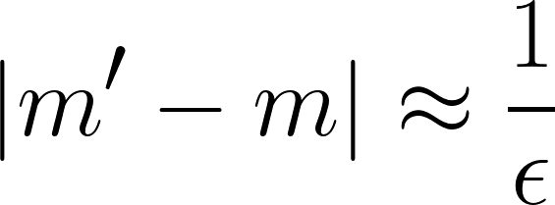
How do we implement differential privacy?
Magnitude of the random noise Y depends on 𝝐
𝝐 and Y are inversely proportional – smaller 𝝐 = larger Y = more noise
The relationship between the true and measured values of m can be described as,
Y is often sampled from the Laplace distribution (next slide!) with mean 0 and standard deviation √2/𝝐
Denoted Laplace(0, 1/𝝐)

Slide 21
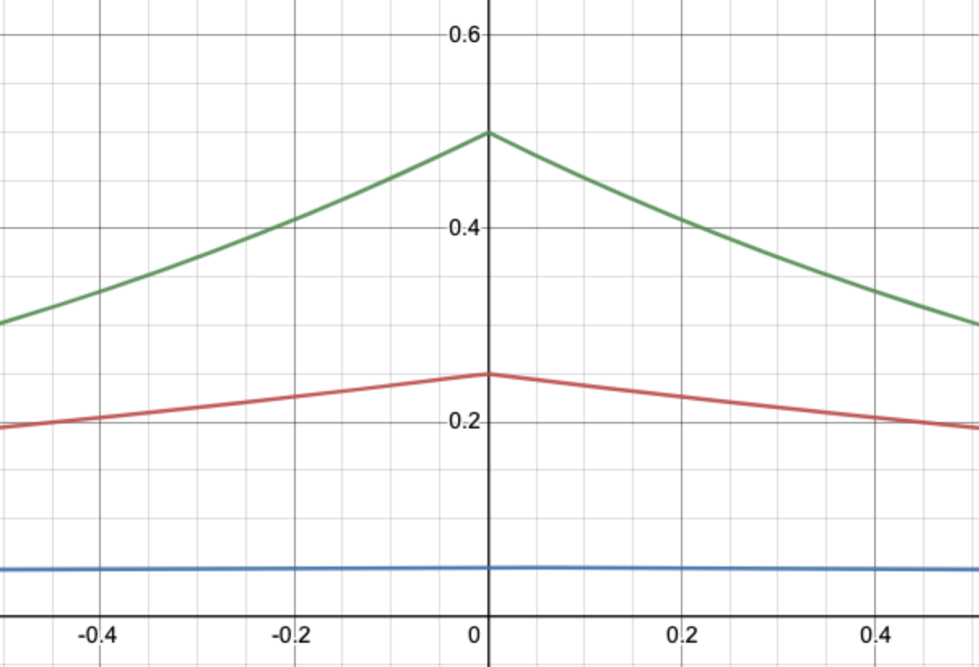
Laplace Distribution
Distribution is symmetric – differential privacy estimates are equally likely to be higher or lower than the true value
When 𝝐 = 1, there is a ~63% chance that -1 ≤ Y ≤ 1
m’ will likely be very close to m
High accuracy, low privacy
When 𝝐 = 0.1, there is a ~10% chance that -1 ≤ Y ≤ 1
m’ will likely not be very close to m
Low accuracy, high privacy
𝝐 = 1
Probability of being sampled
𝝐 = 0.5
𝝐 = 0.1
Value of Y

Slide 22
Practical Considerations with Differential Privacy
Accuracy
Large sample sizes/data sets are required for accurate estimates
Informational risk
Combining differentially private data sets or conducting multiple queries on the same differentially private data set increases informational risk
Total informational risk is bounded by the sum of the informational risk of any individual data set
For a combination of n differentially private data sets,
𝝐T = 𝝐1 + 𝝐2 + … + 𝝐n
Different types of analyses will require different balances of informational risk and accuracy

Slide 23
Ethical Considerations with Differential Privacy
Data sensitivity
Sensitivity is subjective
Assume that all data is potentially identifiable and potentially sensitive
Privacy concerns apply to all data sets to some degree
Data sharing
Data sharing increases informational risk
Access to data provides great benefit to other researchers and the general public
Do not ignore the potential benefits of data sharing

Slide 24
Based on Salganik (2018), Figure 6.6
Differential privacy
Release to public with no/limited anonymization
Benefit to society
No data sharing
Risk to participants

Slide 25
Resources - Differential Privacy
Check out https://privacytools.seas.harvard.edu/courses-educational-materials
Lots of lecture-length videos with technical insights
Deep-dives into differential privacy from a dedicated lab group!

