Slide 1
Sampling
Probability 101
Data Sciences Institute, University of Toronto

Slide 2
Today, we will...
Introduce essential probability concepts
Discuss statistical distributions (and why they matter!)
Use examples to build statistical intuition

Slide 3

Source
Textbook: Pitman, 1993, Probability, Springer, Chapters 1-3
Some graphics: Annie Collins

Slide 4
Mandatory Pre-Math Disclaimer
Time

Slide 5
Intro to Probability

Slide 6
Key Definitions
An outcome space is a set of all possible outcomes of some kind, represented by 𝛀.
For example, 𝛀 = {A, B, C,..., Z} is an outcome space containing all letters of the alphabet
An event is a subset of an outcome space.
There are often many possible events for a specific outcome space
Possible events for 𝛀 above could be vowels: {A, E, I, O, U} or letters before E: {A, B, C, D}
A probability is a function of an event describing how likely it is to occur

Slide 7

Equally Likely Outcomes
If all outcomes in a set 𝛀 are equally likely, the probability of event A is the number of outcomes in A divided by the total number of outcomes,
P(A) can be read as “the probability of A”.

Slide 8
Example: Rolling a die
For a six-sided die, the outcome space is,
𝛀 = {1, 2, 3, 4, 5, 6}
Some possible events and their probabilities are:
Description | Event | Probability
An even number is rolled | A = {2, 4, 6} | 3/6 = ½ = 0.5
A number less than 6 is rolled | B = {1, 2, 3, 4, 5} | ⅚ = 0.833…
A 6 is rolled | C = {6} | ⅙ = 0.166…

Slide 9
Types of Sets and Events
Event language | Set language | Set notation | Venn diagram
Outcome space | Universal set | 𝛀
Event | Subset of 𝛀 | A, B, C, etc.
Impossible event | Empty set | ∅
Not A, or the opposite of A | Complement of A | A^{C}
Either A or B or both | Union of A and B | A ⋃ B
Both A and B | Intersection of A and B | A ∩ B
A and B are mutually exclusive | A and B are disjoint | A ∩ B = ∅
If A, then B | A is a subset of B | A ⊆ B
A
A
B
A
B
A
B
A
B

Slide 10
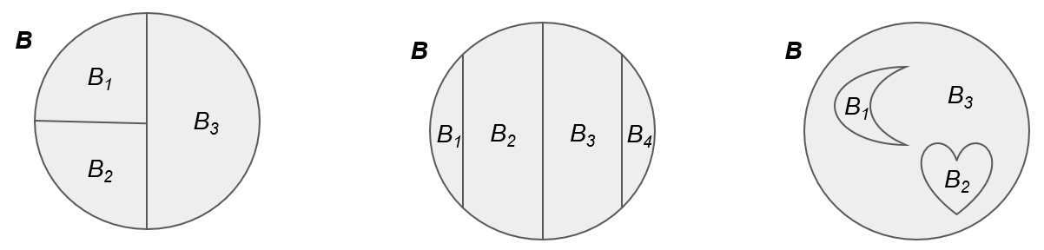
Partitions
An event B is partitioned into n events B1 , B2 ,..., Bn if
B = B1 ⋃ B2 ⋃ … ⋃ Bn – every outcome in B belongs to some event, none are left out
B1 , B2 ,..., Bn are mutually exclusive – if an outcome is in event Bi, it is not in any other event
Adapted from Pitman (1993), Figure 1

Slide 11
Rules of Probability
For an event B over an outcome space 𝛀,
Non-negativity: P(B) ≥ 0
Addition: If B1 , B2 ,..., Bn is a partition of B, then P(B) = P(B1) + P(B2) + … + P(Bn)
Total one: P(𝛀) = 1

Slide 12
Example: Drawing cards
Suppose you have a regular deck of cards. Let B represent the event “drawing a heart”. Let B₁ and B₂ be a partition of B, with B₁ = “drawing non-numeric heart card (J, Q, K, A)” and B₂ = “drawing a numeric heart card (2,…,10)”
B₁ and B₂ is a valid partition, since all heart cards are either numeric or non numeric, and a card cannot be both numeric and non-numeric (mutual exclusivity)
P(B) = 13/52 = 1/4 ≥ 0
P(B₁) + P(B₂) = 4/52 + 9/52 = 13/52 = 1/4 = P(B)
P(𝛀) = P(“draw any card in the deck”) = 1

Slide 13
Conditional Probability

Slide 14
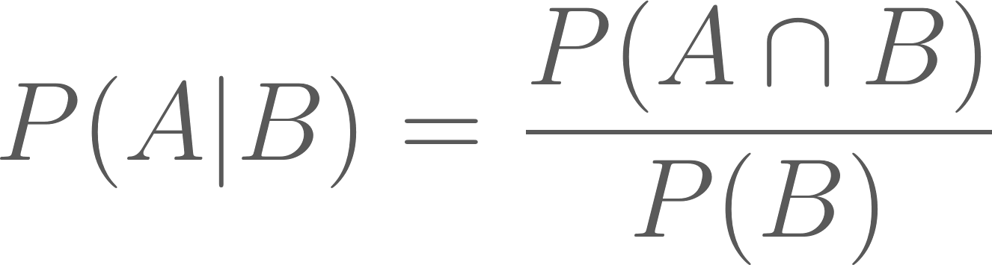
Conditional Probability
Conditional probability can be described as the probability that event A will happen given that event B has already happened
The notation for conditional probability is P(A|B), which can be read as “the probability of A given B”
The formula for conditional probability is,
As long as P(B) ≠ 0

Slide 15
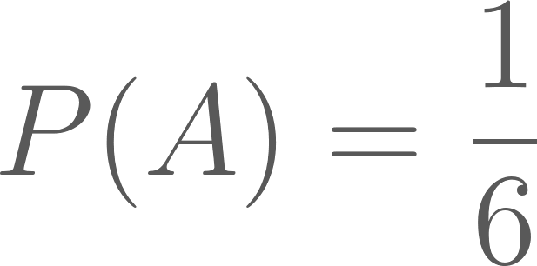
Example: Rolling a die
Suppose you roll a regular die, but haven’t yet looked at the result. Let event A be “rolling a 4”, and let event B be “rolling an even number”.
The probability that number you rolled is a 4 is,
Now suppose I look at the die and tell you that the number you rolled is even. Given this new information, the probability that the number you rolled is a 4 is,

Slide 16


Independence
If events A and B are independent, event A is not affected by the occurrence of event B.
This can be described mathematically as,
From the formula for conditional probability, we can then derive the following formula for independent events,
The same applies for any number of disjoint events.

Slide 17
Random Variables

Slide 18
Random Variables
Random variables are a way to describe a set of possible outcomes with a distribution of probabilities over the set of outcomes.
Usually denoted with capital letters: X, Y, Z, etc.
Random variables are similar to events
Events are a specific outcome or set of outcomes, while random variables describe possible outcomes and their various probabilities
An event “Number on the die is a five” or {5} or X = 5 is one possible outcome of the random variable X, “the number obtained by rolling a die”

Slide 19
Random Variables
The range of a random variable is all of the values it could possibly take. This can be continuous (0 ≤ X ≤ 10) or discrete (X ∈ {1, 2, 3}).
The distribution of random variable is determined by the probabilities of values within its range,
P(X = x) for x ∈ range of X

Slide 20
Example: Rolling two dice
Let X represent the sum of the faces showing on two rolled dice.
x | 2 | 3 | 4 | 5 | 6 | 7 | 8 | 9 | 10 | 11 | 12
Possible outcomes | 1+1 | 1+2, 2+1 | 1+3, 2+2, 3+1 | 1+4, 2+3, 3+2, 4+1 | 1+5, 2+4, 3+3, 4+2, 5+1 | 1+6, 2+5, 3+4, 4+3, 5+2, 6+1 | 2+6, 3+5, 4+4, 5+3, 6+2 | 3+6, 4+5, 5+4, 6+3 | 4+6, 5+5, 6+4 | 5+6, 6+5 | 6+6
P(X = x) | 1/36 | 1/18 | 1/12 | 1/9 | 5/36 | 1/6 | 5/36 | 1/9 | 1/12 | 1/18 | 1/36

Slide 21
Indicator Variables
Indicator variables, denoted I_{A} , are specific type of random variable that take the value 0 or 1 to indicate a the occurrence of a given event A.
Some examples of indicator variables may be votes in a two-party election (with event A being a vote for a particular candidate), votes for or against a bill, satisfied versus not satisfied reviews for a product, etc.

Slide 22
Distributions

Slide 23
Distributions
A probability distribution is a statistical function that describes the probabilities of all possible events in an outcome space.
Distributions can be discrete (if the outcome space is distinct events, like rolling a die) or continuous (if the outcome space is a range of values, like choosing any real number between 1 and 10).
Some features of interests for distributions may be their mean, variance, mode, skew, etc.

Slide 24
Binomial Distribution
The binomial distribution concerns sequences of events with two possible outcomes: success and failure.
Success occurs with probability p, and failure occurs with probability q = 1 - p. Trials defined this way are called Bernoulli trials.
The binomial distribution helps determine the probability of getting k successes in n independent trials (with replacement)

Slide 25
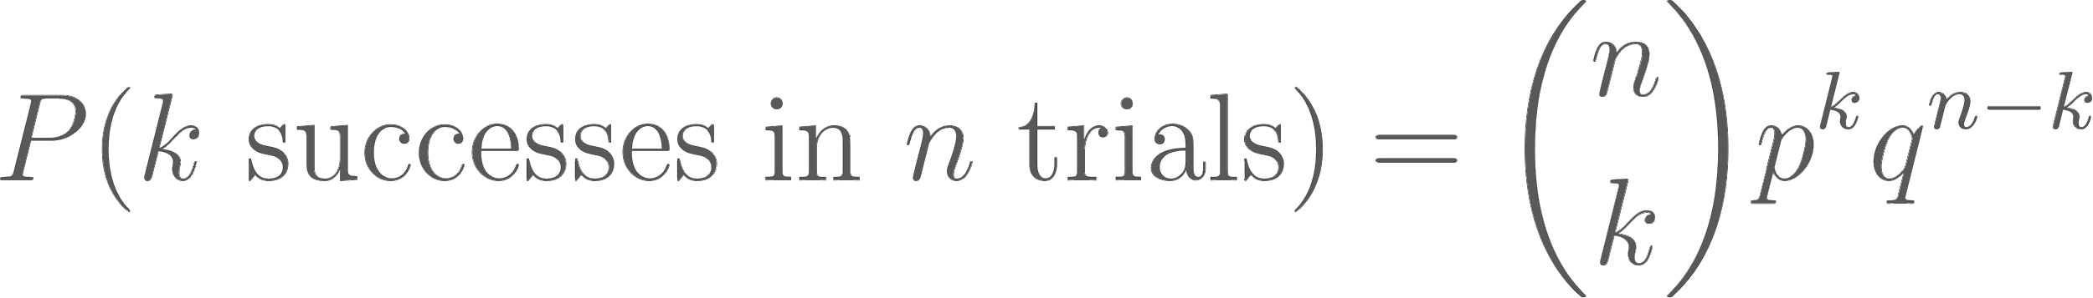

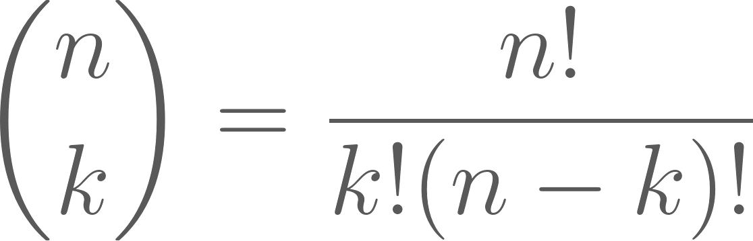
Binomial Distribution Formula
For n independent trials with probability p of success and probability q = 1 - p of failure, the probability of k success in n independent trials (with replacement) is,
is called “n choose k” and describes the number of possible combinations of k successes and n - k failures:

Slide 26
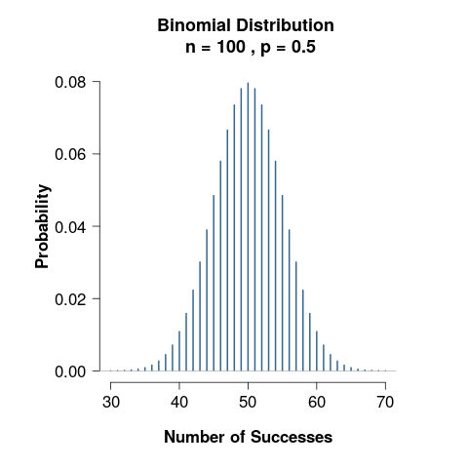
Binomial Distribution
For a large number of trials n, we expect the number of successes to be about np.
For n = 100 and p = 0.5, the distribution of number of successes is centered around 50 (the most likely) and the total number of successes gets less likely as the numbers get farther from 50.

Slide 27
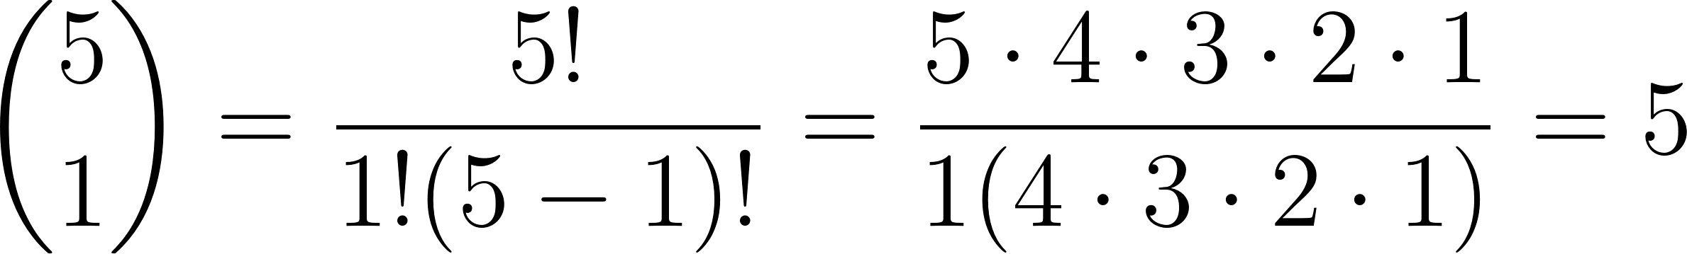
Example: Drawing cards
Suppose you draw n = 5 cards from a standard deck, and your desired outcome is drawing a club.
Then p = 13/52 = ¼ and q = 1 - p = 1 - ¼ = ¾.
For k = 1 success, the possible combinations of cards drawn are:
{♣▯▯▯▯}, {▯♣▯▯▯}, {▯▯♣▯▯}, {▯▯▯♣▯}, {▯▯▯▯♣}
Mathematically this can be represented as,
Notes:
NOTE: As an exercise, go through 5 choose 2 and the logic behind the equation.

Slide 28
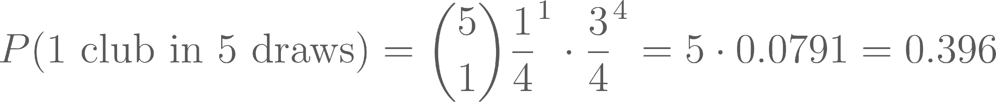
Example: Drawing cards (cont.)
Since the trials are independent, the probability of getting 1 success in 5 trials is the product of the probability of getting a club on one trial and the probability of getting non-clubs on four trials.
Putting the two calculations together, we have,

Slide 29
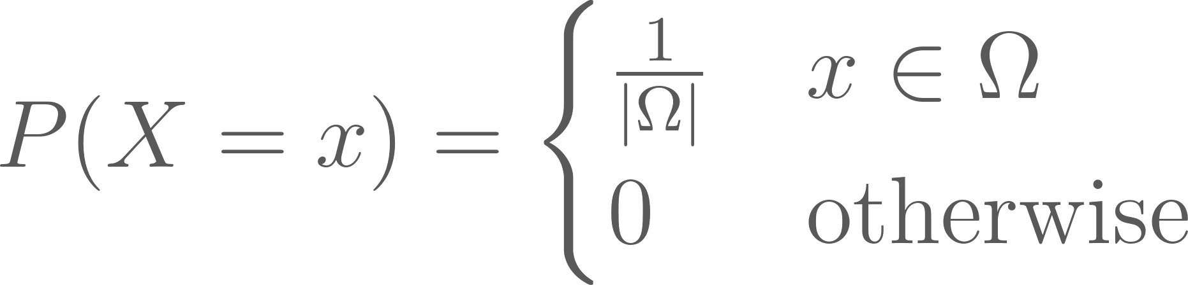
Uniform Distribution
The uniform distribution describes a situation in which every outcome on a certain set or interval is equally likely.
This can be represented mathematically as,

Slide 30
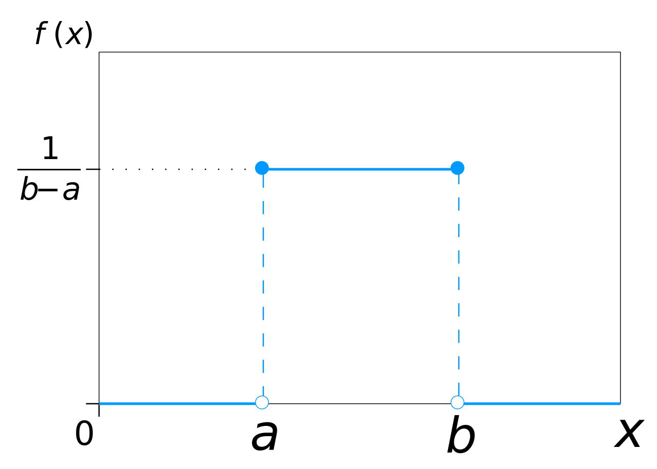
Uniform Distribution
Examples
Rolling a die
Drawing any card from a normal deck
Choosing a random number between 1 and 100
Choosing a random student in a classroom
Image retrieved from https://commons.wikimedia.org/wiki/File:Uniform_Distribution_PDF_SVG.svg

Slide 31
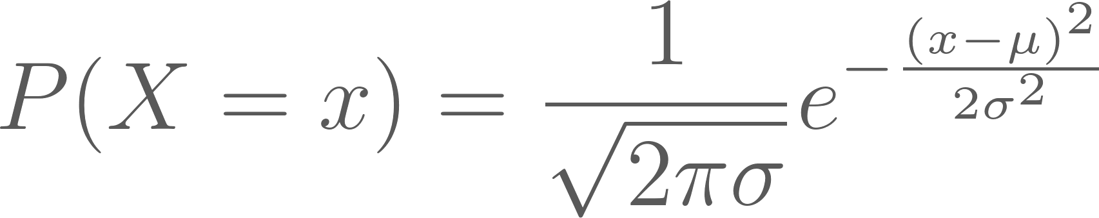
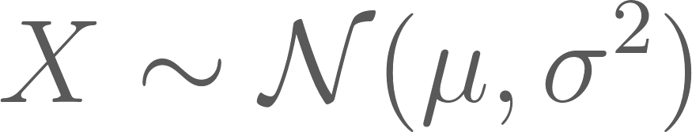
Normal Distribution
The normal distribution is one of the most common and important distributions
It is represented by the equation,
where 𝜇 is the mean of X and 𝜎 is the standard deviation.
A random variable X following a normal distribution is often denoted,

Slide 32
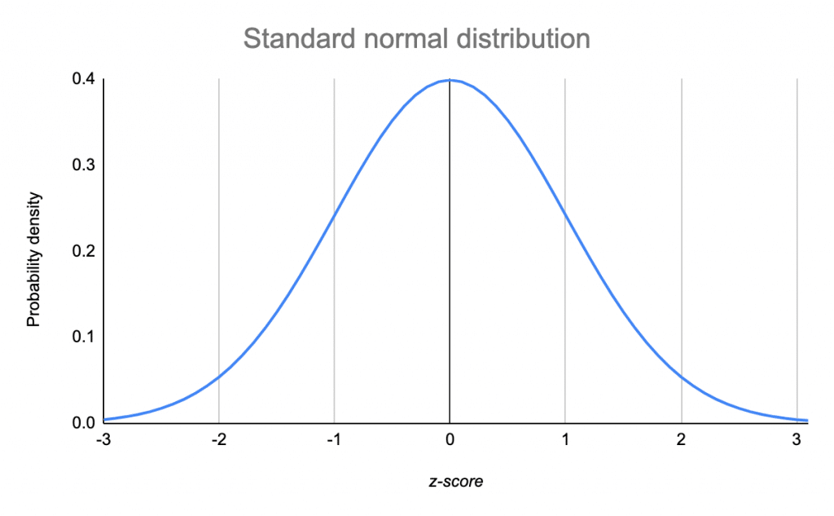
Normal Distribution
The normal distribution is centered and symmetric about 𝜇. 𝜎 describes the horizontal spread (how wide the distribution is).
The normal distribution can be used to approximate other distributions for easy calculations of probabilities
-2𝜎 -1𝜎 𝜇 1𝜎 2𝜎
Image retrieved from https://www.scribbr.com/statistics/standard-normal-distribution/

Slide 33
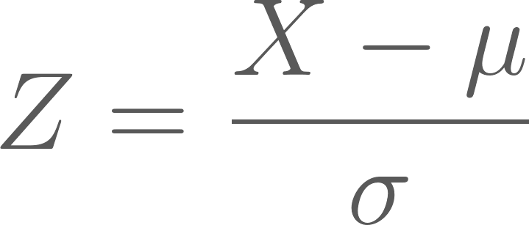
Standard Normal Distribution
The standard normal distribution is a normal distribution with mean 0 and standard deviation 1.
In general, a random variable X with a normal distribution can be standardized using the following formula,
Image retrieved from https://www.scribbr.com/statistics/standard-normal-distribution/

Slide 34
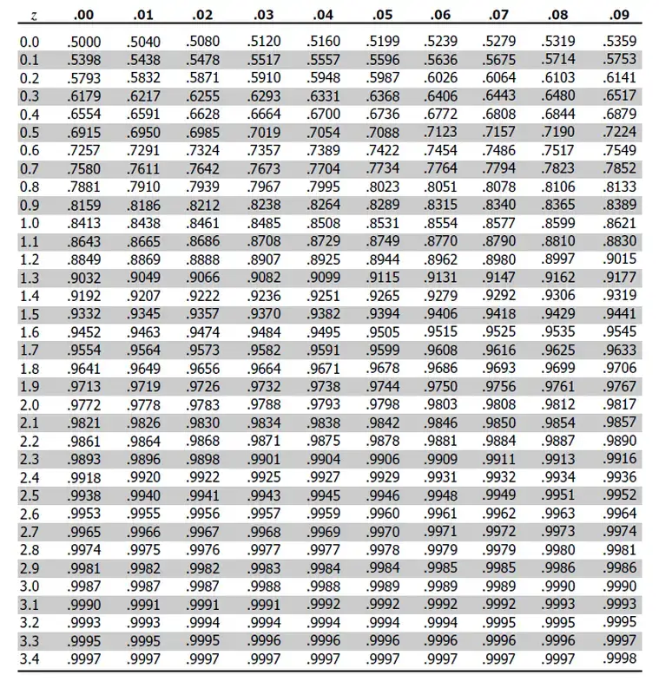
Example: Z-Scores
Z-Scores represent the probability that a value is less than or equal to the value of a given standardized random variable.

Slide 35
Law of Large Numbers

Slide 36
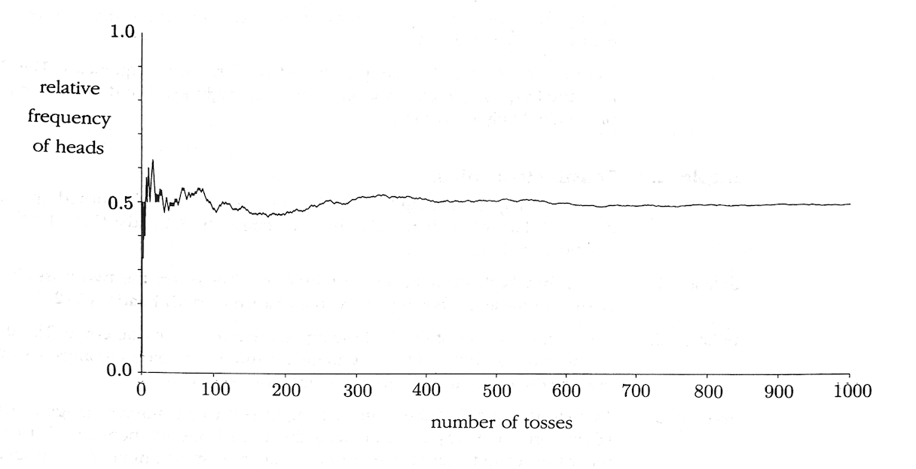
Law of Large Numbers
Pitman (1993), Figure 2

Slide 37
Law of Large Numbers
If the number of trials n is large, the proportion of successes in n independent trials will, with overwhelming probability, be very close to p, the probability of success on each trial
Intuition for sampling: As the number of units sampled increases, the proportion of units that exhibits a certain trait will grow closer and closer to the true proportion of individuals in the population with that trait

Slide 38
Python Demo Time!

Slide 39
Expected Value

Slide 40
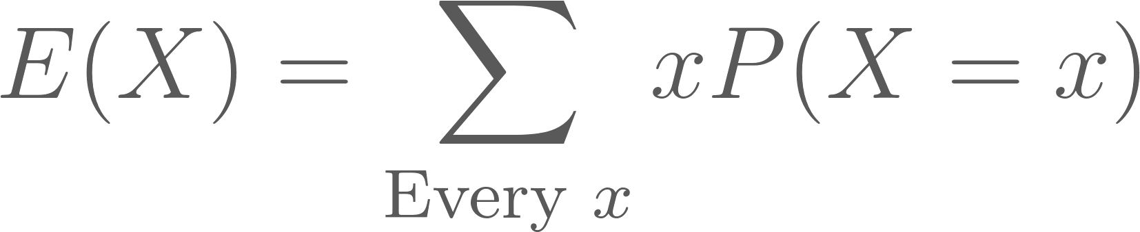

Expected Value
The expected value or expectation of a random variable X is the mean of the distribution of X, denoted E(X) or 𝜇. This is represented mathematically as,
The expected value is the average of all possible values of X weighted by their probabilities.
The expected value of indicator variable I_{A} is the probability of event A,

Slide 41
Example: Sampling a student
Suppose you are randomly sampling a student from a school. There are 200 students each of ages 16-18. Let random variable X represent the age of the student sampled.
The expected age of the student selected is,
Now suppose there are 100 students age 16, 200 students age 17, and 300 students age 18. The new expected age is,

Slide 42
Variance and Standard Deviation

Slide 43
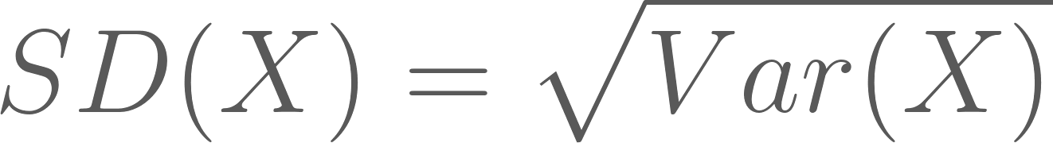
Variance and Standard Deviation
The variance of X, denoted Var(X), is the mean squared deviation of X from its expected value E(X),
The standard deviation of X, denoted SD(X), is the square root of the variance of X:
Notes:
TODO: Walk through a simple proof deriving the computational formula for variance from the usual formula

Slide 44
Variance and Standard Deviation
Variance is often denoted 𝜎², with SD denoted 𝜎
Variance and SD describe how spread out the distribution of a variable is
SD is often easier to interpret since its units are the same as the mean
In general:
For a random variable X with some distribution, you should expect the value of X to be around the expected value E(X), plus or minus a few times the standard deviation SD(X)

Slide 45
Example: Normal Distribution
On a normal distribution, ~68% of the probability density lies within one SD of the mean:
For the standard normal N(0, 1), this means X is fairly likely to be between -1 and 1, and that 2.5 would be a very unlikely value of X.
34.1%
34.1%
13.6%
13.6%
2.1%
2.1%
Image retrieved from https://www.scribbr.com/statistics/standard-normal-distribution/

Slide 46
Central Limit Theorem

Slide 47
Central Limit Theorem
Let S_{n} = X₁ + X₂ + … + X_{n} be the sum of n independent random variables each with the same distribution. For large n, the distribution of S_{n} is approximately normal, with mean E(S_{n}) = n𝜇 and variance Var(S_{n}) = 𝜎²n, where 𝜇 = E(X_{i}) and 𝜎² = Var(X_{i}).
Basically: if we have a population with mean μ and standard deviation σ and take sufficiently large random samples from the population, then the distribution of the sample will be approximately normal.
Notes:
Note: Open R file “5.1-Probability-CLT Demo.R” and work through the demo

Slide 48
Python Demo Time!

Slide 49
Who cares?
Sample size and quantity affect how well our conclusions can represent our target population (LLN, CLT)
Distributions and their assumptions affect our statistical models and the ways that we calculate various statistics

Slide 50
Next time!
Probability vs Non-probability sampling
Sampling Types and Sample Design
Observational Studies and Censuses

