Slide 1
Sampling
Simple Probability Samples, Systematic Samples, Stratified Samples
Data Sciences Institute, University of Toronto

Slide 2
Today, we will...
f

Slide 3
Simple Random Samples

Slide 4
Recall
Probability sampling is a sampling method in which every population unit has a selection probability that is known to those conducting the sampling, and units are selected at random.
Small probability samples can be used to make inferences about relatively large populations
A simple random sample (SRS) is taken when every possible combination of population units has an equal chance of being sampled

Slide 5
SRS With vs Without Replacement
Consider a population of size N
Simple random sampling with replacement:
Select one unit for measurement, with probability 1/N
Sampled unit is return to the population
Select second unit for measurement, with probability 1/N
Repeat until desired sample size is obtained
Simple random sampling without replacement:
Select one unit for measurement, with probability 1/N
Select second unit for measurement, with probability 1/(N-1)
Repeat until desired sample size is obtained. The final unit in the sample will be selected with probability 1/(N-n+1), where n is the total sample size.

Slide 6
SRS With vs. Without Replacement
Basically
When we sample with replacement, an observation can be selected more than once
When we sample without replacement, once an observation is selected, it cannot be selected again

Slide 7
Notes:
We’re going to walk through some math but the things to take away are 1. KNOW WHAT THE KEY TERMS MEAN for when you come across them, and 2. understand some relationships between these key terms and ideas

Slide 8
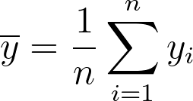
Sample Mean and Variance
Consider a sample of size n from a population of size N.
The population mean, 𝝁, can be estimated using the sample mean, ,which is the sum of all observations in the sample, divided by sample size n, calculated,
for x_{i} representing each unit in the sample.

Slide 9
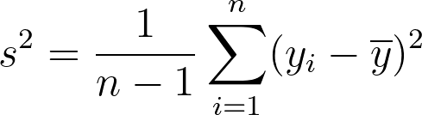
Sample Mean and Variance
We can calculate sample variance, s², with,
(Sum of the squared difference between each sample observation and the sample mean, divided by n-1.)
Sample variance tells us how ‘spread out’ our sample data are.

Slide 10
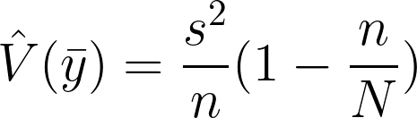
Estimator Variance
The variance of is,
This is a measure of the variability of values of computed from different samples.
Estimator Variance tells us how much our sample mean would differ across different samples n.

Slide 11
Estimator Variance
n/N is called the sampling fraction and represents the proportion of individuals from the population captured in the sample.
(1 - n/N) is called the finite population correction.
As sample size increases, the value of the sampling fraction n/N increases, which makes the value of the finite population correction decrease, which makes the estimator variance decrease!
AKA: As sample size increases, we gain more information about the population, and the variance of our estimate decreases.
(Recall from last slide)

Slide 12
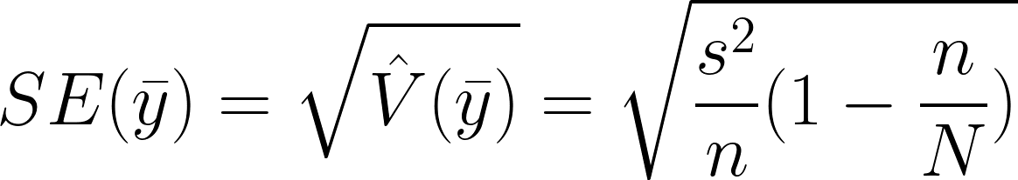
Standard Error
The standard error (SE) is the square root of the estimated variance of ,
We tend to see SE more often than estimated variance.
Standard Error tells us how much our sample mean would differ from our population mean.
AKA (again!): As sample size increases, we gain more information about the population, and the variance of our estimate decreases.

Slide 13
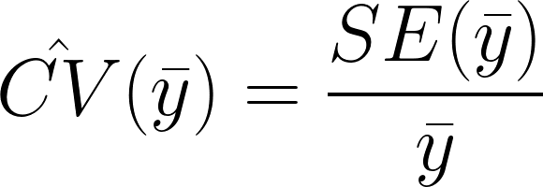
Coefficient of Variation
We can use SE to calculate the coefficient of variation (CV) for ≠ 0:
The CV is a unitless measure of relative variability. The estimated CV is the SE expressed as a percentage of the sample mean.

Slide 14
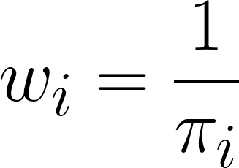
Sampling Weights
Let 𝜋i be the probability that population unit i is included in the sample.
Then the sampling weight of unit i is defined as,
The sampling weight can be interpreted as the number of population units that a given unit in the sample represents.

Slide 15


Sampling Weights for SRS
All units have the same inclusion probability (by definition)
All sampling weights are the same
Each unit in the sample represents the same number of population units; this is called a self-weighting sample

Slide 16
Systematic Sampling

Slide 17
Systematic Sampling
Obtain a randomized list of the population (size N).
Choose a sample size n.
Calculate N/n. If N/n is an integer, let k = N/n. If it is not an integer, let k be the next integer after N/n. k is the selection interval.
Select a random integer R between 1 and k. R is the starting point for the sampling procedure.
Working through the list, sample units R, R+k, R+2k, etc. until the end of the list is reached.

Slide 18
Systematic Sampling and SRS?
Systematic sampling is a type of cluster sampling, not SRS, BUT…
If the original population is truly randomized, systematic samples behave similarly to SRS and the same analysis methods can be used
If the original population is in increasing or decreasing order, or periodic in some way (e.g. alternating male and female names), the sample will not be representative and will not behave like an SRS
Usual considerations apply when defining a target population and frame
From what source are we obtaining our list?
If sampling in person, where are we sampling?

Slide 19
So when can we use a simple random sample?

Slide 20
When to use an SRS?
When you have a complete list of and access to all possible observation units
If your original list is not comprehensive, an SRS will not be representative and the usual analysis methods will not be possible
If the geographic area covered by the original list is too large, an SRS may contain units that cannot be observed and the usual analysis methods will not be possible
When there is little supplementary information about the population that can be used to design the survey/study
This eliminates the possibility of stratified or cluster sampling
When the main focus of the survey/study is multivariate relationships
Analysis can be much simpler for an SRS

Slide 21
Stratified Sampling

Slide 22
What is stratified sampling?
Divide the whole population into non-overlapping subpopulations based on shared characteristics. These subpopulations are called strata.
Take independent probability samples (often SRS) from each stratum.
Pool individual samples together to calculate overall population estimates.
Stratified sampling often requires supplemental information about a population in order to divide it into separate groups.
E.g. if you have a list of all student emails from a university and you want to stratify by gender, this list will need to be linked with a data source that includes each student’s gender

Slide 23
Why use stratified sampling?
Prevent a non-representative sample
Seek estimates with known precisions for certain subpopulations
Convenience and lower cost
Higher precision (lower variance) estimates for population means and totals

Slide 24
Sample and Population Sizes
Suppose we have a population of size N divided into H strata. Let Nh be the number of population units in stratum h. Then we must have,
N1 + N2 + … + NH = N
Suppose we then take an SRS from each stratum. Let nh represent the size of the sample selected from stratum h. The total sample size is,
n1 + n2 + … + nH = n
Sample and population sizes do not have to be equal across all strata.

Slide 25
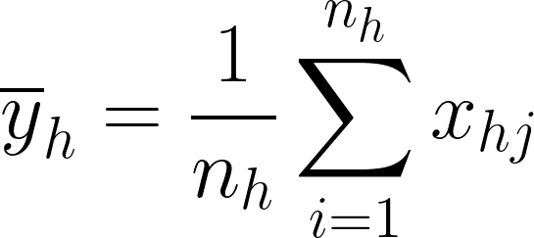
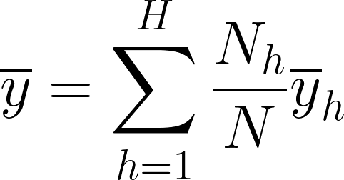
Sample Mean
The sample mean for stratum h can be calculated,
To estimate the population mean, the sample mean for the whole sample (from all strata combined) can be calculated,
This is a weighted mean of all sample strata means.

Slide 26
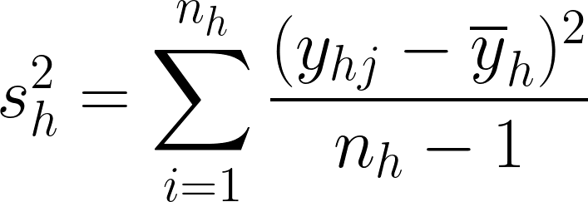
Stratum Sample Variance
The sample variance for the sample from each stratum can be computed the same way as an SRS:

Slide 27

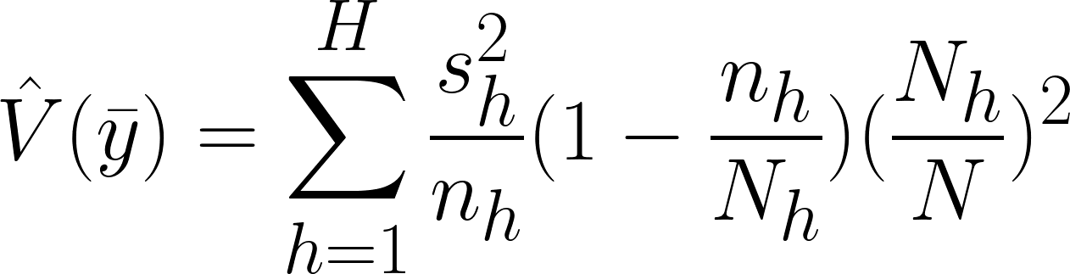
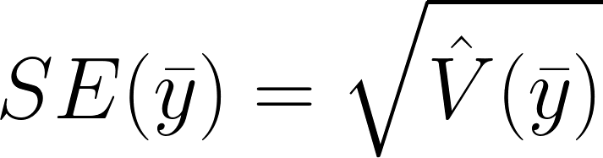
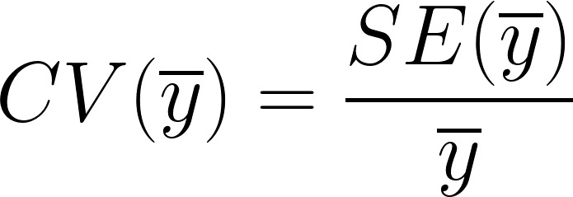
Estimator Variance and Error
The variance of the sample mean can be computed,
The standard error (SE) and coefficient of variation (CV) remain the same as for an SRS:
How much our mean will vary across samples

Slide 28


Stratified Sample Weights
Remember from SRS: a sample weight is how much a sample is ‘worth’, or how much of our original population it represents.
When using stratified sampling, weights may differ by stratum.
Inclusion probability for unit i of stratum h is,
Where nh is the size of SRS from stratum h and Nh is the total number of units in stratum h. Like before, sampling weight for unit i of stratum h is:

Slide 29
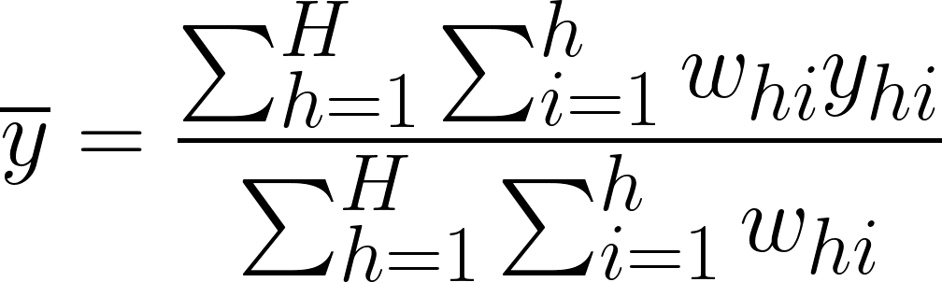
Using Sample Weights
The population mean can be estimated directly using a weighted mean of recorded observations:
In stratified sampling, we need to sum over the weights and units in each stratum, and then sum over all strata.

Slide 30
So how do we divide our population into strata?
Mean values should differ greatly between strata
Stratify by a variable that is closely related to the variable(s) you are trying to estimate
For example, if you wish to estimate average height, you might stratify by age or sex instead of geographic location
Data availability
Is there existing survey data to help you define appropriate strata? If not, are you able to collect preliminary data for this purpose?
More supplementary data often means more strata
Difficulty and cost
More strata may mean a higher cost or effort involved
Is this additional cost worthwhile for the precision you wish to achieve or the type of analysis you wish to conduct?

Slide 31
How many units to sample from each stratum?
Proportional Allocation
Sample the same proportion of units from each stratum
Sample weights (𝜋hi) are the same for each sampled unit regardless of stratum
Optimal Allocation
Variation among larger sampling units may be greater than variation among smaller sampling units, so a higher proportion of large units should be sampled
Useful for businesses, cities, and institutions like schools or hospitals
Allocation for Precision with Strata
Sample to reduce the variation in stratum-level estimates, not population-level estimates
Useful when the goal is comparing estimates between strata

Slide 33
Quota Sampling
Population is divided into subpopulations like strata
Non-probability sampling is conducted within each subpopulation (Often convenience sampling)
Specified amounts (quotas) of types of units are selected

Slide 34
Why use quota sampling?
Probability sampling may be expensive or impractical
May give better results than a pure convenience sample due to enforced quotas
Cheaper than probability samples

Slide 35
Why not use quota sampling?
Prone to selection bias
Methods of analysis for probability samples do not apply

Slide 36
template
A census is a survey or study conducted on every observational unit within a finite target population.
A

