Slide 1
Sampling
Sample size, Cluster Sampling, Respondent-Driven Sampling
Data Sciences Institute, University of Toronto

Slide 2
Calculating Sample Size

Slide 3
Recall: Choosing sample size in strata
Proportional Allocation
Sample the same proportion of units from each stratum
Sample weights (𝜋hi) are the same for each sampled unit regardless of stratum
Optimal Allocation
Variation among larger sampling units may be greater than variation among smaller sampling units, so a higher proportion of large units should be sampled
Useful for businesses, cities, and institutions like schools or hospitals
Allocation for Precision with Strata
Sample to reduce the variation in stratum-level estimates, not population-level estimates
Useful when the goal is comparing estimates between strata

Slide 4
Recall: Choosing sample size in strata
Proportional Allocation
Sample the same proportion of units from each stratum
Sample weights (𝜋hi) are the same for each sampled unit regardless of stratum
Optimal Allocation
Variation among larger sampling units may be greater than variation among smaller sampling units, so a higher proportion of large units should be sampled
Useful for businesses, cities, and institutions like schools or hospitals
Allocation for Precision with Strata
Sample to reduce the variation in stratum-level estimates, not population-level estimates
Useful when the goal is comparing estimates between strata

Slide 5
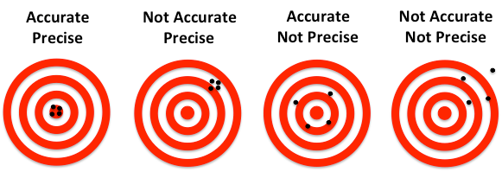
What is precision?
Precision = How close our measurements are to each other
vs.
Accuracy = How close our measurements are to the ‘true’ value

Slide 6
Calculating sample size
Determine the desired precision for the quantities that will be estimated from the sample.
What are the consequences of the study results? How much error is tolerable?
Find an equation relating the sample size n and your desired precision from step 1.
Precision should be in terms of error or variation
Estimate unknown quantities in the equation and solve for n.

Slide 7
1. Determine desired precision
A common way to express precision is in terms of the margin of error, e, and confidence level, 1 - 𝜶.
This can be interpreted as desiring a sample size n such that there is a probability of (1 - 𝜶) that the absolute difference between the population and sample means is less than the specified error.
Common values for margin of error and confidence level are e = 0.03 and 𝜶 = 0.05 (95% confidence level).

Slide 8
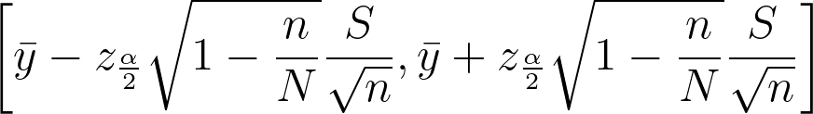
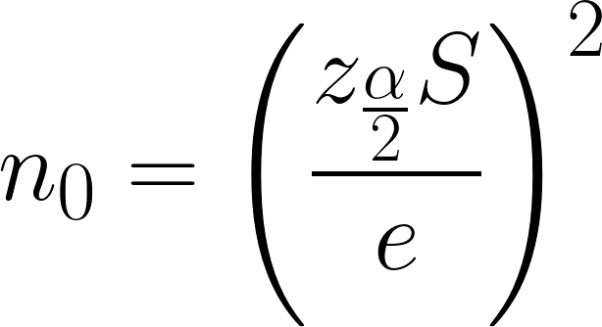
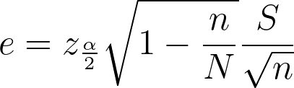
2. Find an equation to relate precision & sample size
Observe the formula for a 100(1 - 𝛼)% confidence interval:
Where the z term is the (1 - 𝛼/2)th percentile of the standard normal distribution, N is the population size, and S is the population standard deviation.
This gives us a logical formula for our specified e:
Solve for n0 then n

Slide 9
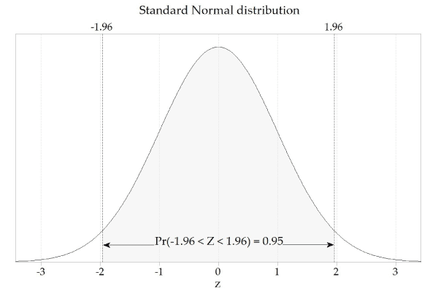
3. Estimate unknown quantities
The values in our equation for n are z𝛼/2 , S, e, and N.
𝛼 is chosen in step 1 and z𝛼/2 can be calculated directly (remember our Z scores table!). For 𝛼 = 0.05, z𝛼/2 = 1.96.
e is also chosen in step 1
N should be known
S must be estimated
2
2
2

Slide 10
3. Estimate unknown quantities
Strategies for estimating S
Run a pilot survey on a small sample and calculate standard deviation based on this survey
Use previous studies or related data that already exists
Guess based on a hypothesized distribution
Once S is estimated and the other quantities are determined, the equation can be solved to determine the appropriate n

Slide 11
The stuff you actually need to remember
We can decide how precise we need our study to be, and by stating that precision in terms of error and confidence, can calculate the needed sample size
Doing that calculation will require making some assumptions (about the distribution of our population, about the standard deviation) and justifying them

Slide 12
Sample size - Power
Other than focusing on precision (when we’re estimating), it is common to calculate sample size based on power (when we’re trying to test a hypothesis)
Power
How small of a difference or treatment effect do I need to be able to detect?
High power = High chance of my study correctly identifying a true effect (lower chance of false negatives)

Slide 13
Sample size considerations
Often the initial sample size calculated will be much larger than what is realistic
Is the study feasible given the available budget and desired precision?
Adjust estimates or precision expectations accordingly
Larger sample = smaller sampling error, but a larger sample size may increase non-sampling errors

Slide 14
Cluster Sampling

Slide 15
Cluster Sampling 101
Divide the whole population into non-overlapping subpopulations based on shared characteristics. These subpopulations are called clusters.
Randomly select a sample of clusters.
Survey every individual unit within each sampled cluster.

Slide 16
Sampling Units
Primary sampling units (PSUs)
Groupings in the first iteration of sampling – AKA clusters
Secondary sampling units (SSUs)
Individuals who are selected and/or surveyed directly
Also known as the observational units
Observational units are only included in the sample if they belong to the sampled PSU (cluster)

Slide 17
Why use cluster sampling?
It may be difficult, expensive, or impossible to create a sampling frame of individual (non-clustered) sampling units
For example, all birds in a forest or all individuals in a city at a given time
Population may occur in natural or pre-existing clusters
For example, households or schools
For geographically widespread populations, sampling by cluster reduces the chance of extensive travel to reach a single individual

Slide 18
Why not use cluster sampling?
Decreased precision
SSUs in each cluster tend to share similar characteristics
More difficult to generalize to population-level estimates

Slide 19
Cluster sampling vs. stratified sampling
Both are non-overlapping subpopulations for a given population
Clusters are often defined for convenience, while strata may be defined to benefit particular types of analysis
Sampling procedure is different
Stratified sampling: define strata → sample within each stratum → survey/observe units in the samples
Cluster sampling: define clusters → sample a subset of clusters → survey/observe all units in each sampled cluster

Slide 20
Stratified Sampling
Cluster Sampling
Based on Lohr, 2019, Figure 5.1

Slide 21
One-stage cluster sampling
A random subset of PSUs (clusters) is sampled, and all SSUs within each sampled PSU are measured
Used when the cost of measuring SSUs is small compared with the cost of sampling PSUs

Slide 22
Equal-sized clusters
Let N represent the total number of PSUs. Let n represent the number of sampled PSUs. Let ti represent the total for all elements in PSU i.
Let M represent the number of people in each cluster. In one stage cluster sampling with samples of equal size, M = Mi = mi for all i.
Interpretation: The number of people in each cluster (Mi) is the same for all clusters, and all units from each sampled cluster are measured (mi)

Slide 23
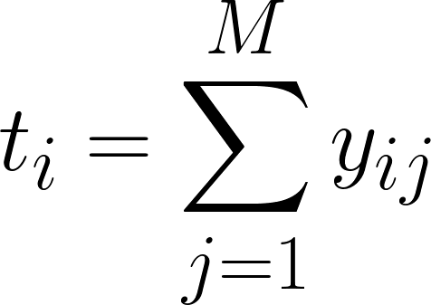
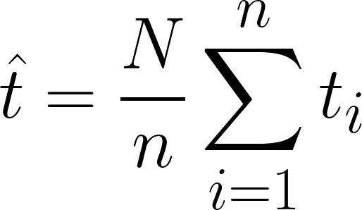
Equal-sized clusters: PSU total
Let yij represent the measurements from SSU (observational unit) j within PSU (cluster) i. The total measurement within PSU i is,
The total across all PSUs can be estimated with,
This is a weighted sum of the total measurements from each individual cluster

Slide 24
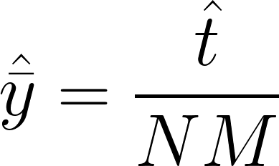


Equal-sized clusters: Sample mean
To estimate the average per SSU (observational unit), divide the estimated total by the total number of SSUs:
is an estimator for the sample mean . Since the calculation involves the estimator for the population total, this is not a direct calculation of the sample mean.

Slide 25
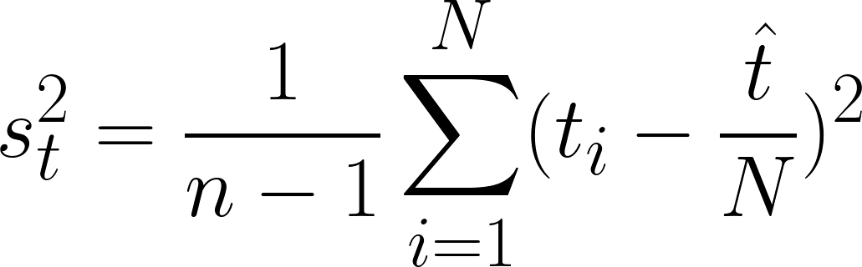
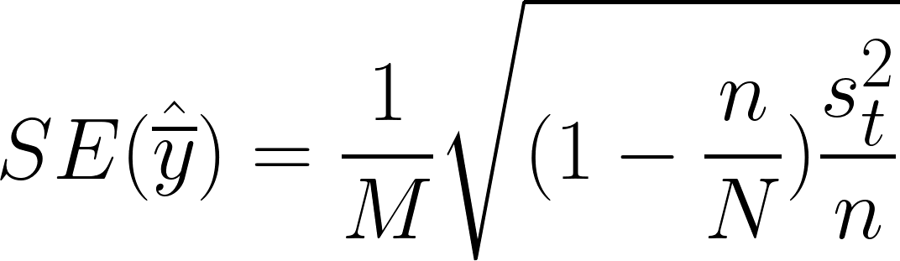
Equal-sized clusters: Sample variance
The sample variance of the PSU totals is,
st2 can then be used to compute the standard error of the estimated sample mean:

Slide 26
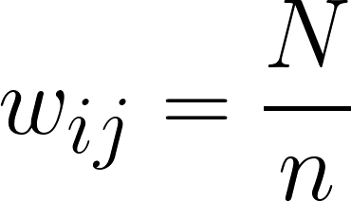
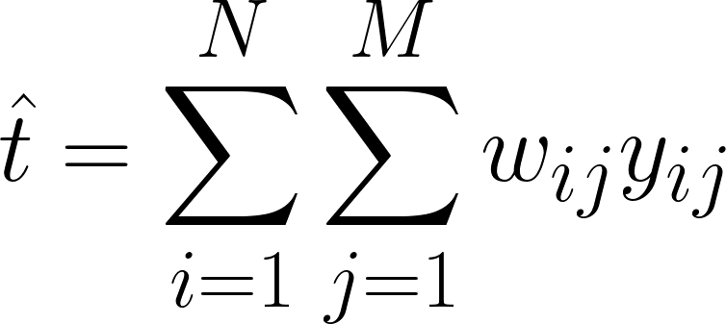
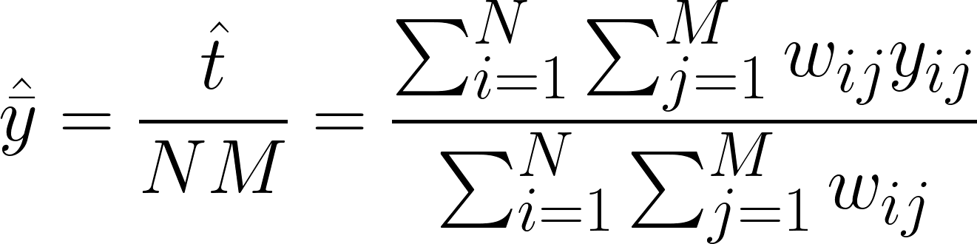
Equal-sized clusters: Weights
One-stage cluster sampling with clusters of equal sizes produces a self-weighting sample, with weights,
These weights can be used to estimate the sample total and mean directly from SSU measurements yij:

Slide 27
Unequal-sized clusters
The definitions for n, N, and ti are the same as previously.
Let Mi represent the number of individuals in PSU (cluster) i. For clusters of unequal sizes, it is now possible that Mi ≠ Mj for i ≠ j.
One-stage sampling means that mi = Mi still (all SSUs in each cluster are sampled).

Slide 28


Unequal-sized clusters: SSU total
The total number of SSUs in the population is defined as,
This can be computed directly when the size of every PSU is known. However, this is not always possible. M0 can thus be estimated:

Slide 29
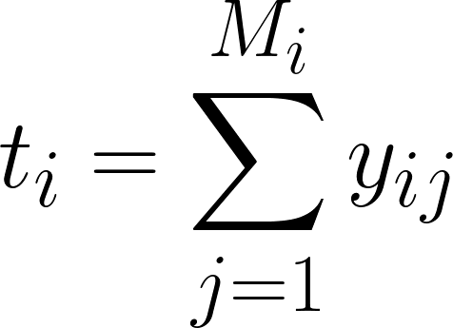
Unequal-sized clusters: PSU total
The total within each PSU can be estimated nearly the same way as for clusters of equal sizes, with the difference that Mi may be different for different clusters:
The total across all PSUs can be estimated with,
This is the same as for clusters of equal sizes.

Slide 30
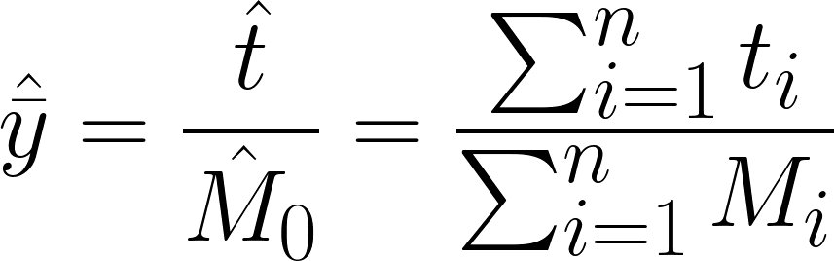
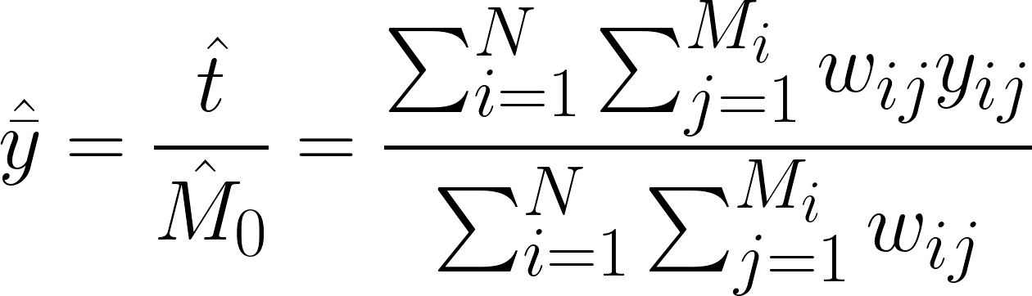
Unequal-sized clusters: Sample mean
The sample mean can be calculated using the estimates for t and M0 :
This can also be calculated using weights, with the same weights and calculation as for clusters of equal sizes:

Slide 31
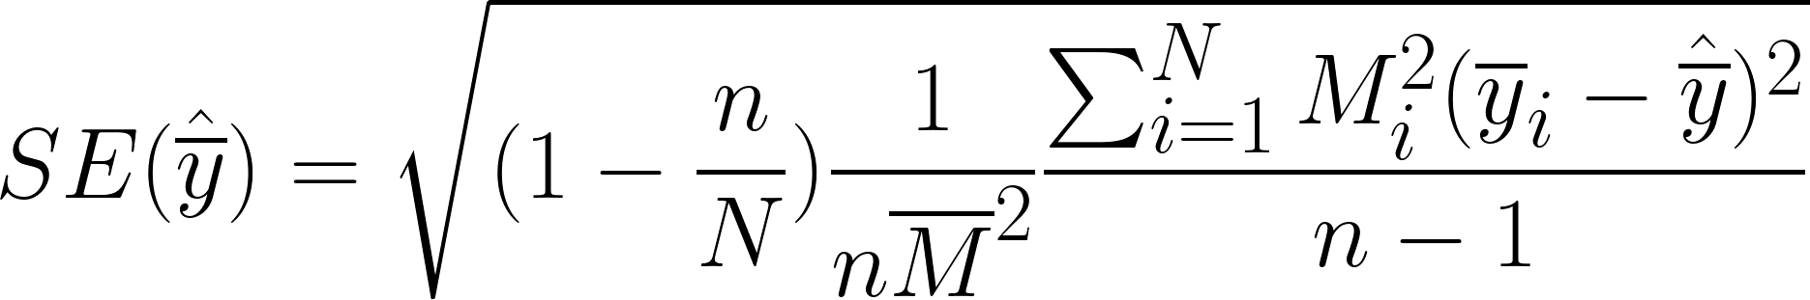


Unequal-sized clusters: Sample mean variance
The standard error for the sample mean can be estimated as follows,
where represents the sample mean within PSU i and represents the mean number of SSUs in each PSU.
TAKEAWAY: If our clusters are different sizes, the ways that we estimate sample mean, error, and variance change. It matters!

Slide 32
Two-stage cluster sampling
A random subset of PSUs (clusters) is selected, and then a random sample of the SSUs (observational units) within each PSU is selected for observation.
Two stage sampling might be used if:
The cost of sampling SSUs is relatively high compared with the cost of sampling PSUs
Elements in a cluster are very similar to each other

Slide 33
Two-stage cluster sampling
One-Stage
Randomly select n PSUs
Measure all SSUs within each sampled PSU
Two-Stage
Randomly select SSUs within each sampled PSU
Randomly select n PSUs

Slide 34

Two-stage cluster sampling: Selection probability
Since sampling is occurring at two different stages now, the selection probability of yij (the jth SSU in PSU i) is a combination of the probability of PSU i being selected, and the probability of SSU j being selected within PSU i. Assuming an SRS is taken at both stages, we have:
𝜋ij = P(jth SSU in ith PSU selected)
= P(ith PSU selected) x P(jth SSU selected | ith PSU selected)
=

Slide 35

Two-stage cluster sampling: Weights
As always, the weight of observational unit yij is the reciprocal of its selection probability.
If mi/Mi is approximately constant for all PSUs (i.e. a proportional sample from all clusters), this is considered a self-weighting sample.

Slide 36
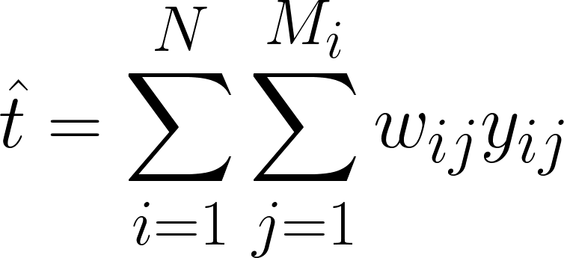
Two-stage cluster sampling: Population total
The population total can be estimated in the same way as one-stage cluster sampling.

Slide 37
Two-stage cluster sampling: Sample mean
The sample mean can be calculated using the estimates for t and M0 . This is much the same as in one-stage cluster sampling, except the totals for each PSU must now be estimated as well:
This can also be calculated using weights, with the same weights and calculation as for one-stage sampling:

Slide 38
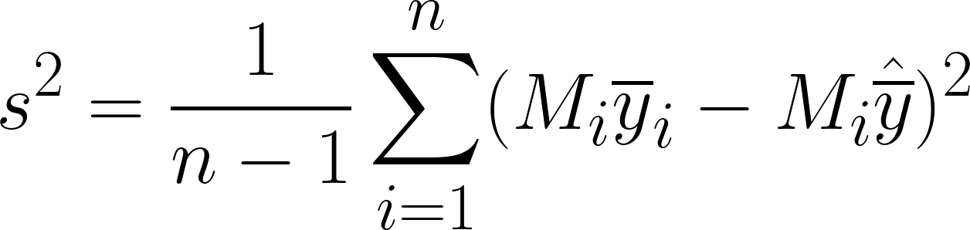
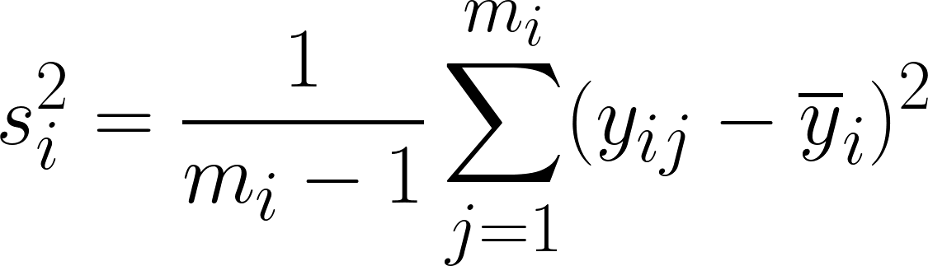
Two-stage cluster sampling: Sample variance
With two-stage sampling, there are two types of variance: between PSUs, and within PSUs. Both calculations follow a familiar structure.
The variance between PSUs can be calculated,
The variance within PSU i can be calculated,

Slide 39
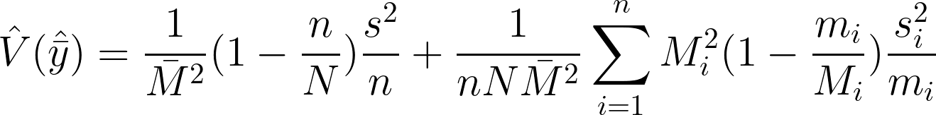
Two-stage cluster sampling: Estimator variance
The estimated variance of the sample mean is also comprised of variance within and between PSUs,
where s2 and si2 are defined as previous, and is average PSU size.
Takeaways: Two-stage sampling changes our mean calculations and changes the chances for any individual to be included in our sample

Slide 40
Choosing a PSU size (M)
Often will come about naturally or from pre-existing groupings
E.g. classrooms, farms, stores, ponds
Larger PSU size can mean larger variability within a PSU
PSUs that are too large or too small may reduce cost saving benefits of cluster sampling

Slide 41
Choosing a SSU size (m)
Cost
Is measuring more SSUs marginally expensive or inexpensive?
Accessibility
Do you have access to all SSUs in a given PSU? How difficult is it to measure more SSUs?
Homogeneity
Are all the SSUs in a given PSU relatively similar? How much more information is gained by measuring more SSUs?
In general, the same considerations as a general also SRS apply.

Slide 42
Choosing a sample size (n)
This process is similar to selecting sample sizes for SRS.
Determine precision needed.
Propose PSU and sub-sample sizes.
Choose n to achieve desired precision.
Iterate until n is realistic given available resources.

Slide 43
Respondent Driven Sampling

Slide 44
What is respondent-driven sampling?
Researchers select a small number of individuals from the target population (“seeds”)
Seeds recruit other members of the target population from their own social networks
New sample members recruit additional sample members, and so on
Same thing as snowball sampling? → No!

Slide 45
What is respondent-driven sampling?
Salganik and Heckathorn, 2004, Figure 1
Population
Population
Estimation
Social Network
Collection
Estimation
Collection
Sample
Sample
Estimation
Traditional Sampling
Respondent-Driven Sampling

Slide 46
Sampling Procedure
Wave 0
Select s initial seeds based on existing connections with target population.
Each seed is interviewed/surveyed.
Each seed receives c unique recruitment coupons to give to others in the target population.
Seeds are incentivized both for participation and recruitment.
Wave 1
Individuals who received coupons from original seeds are interviewed/surveyed.
Each individual receives c new recruitment coupons.
Wave 1 individuals are incentivized both for participation and recruitment.
Waves 3,..., n
Recruitment and survey/interview process continues until desired sample size is reached.

Slide 47
Considerations
Number of recruitment coupons (c)
Needs to be large enough that recruitment can continue even if some participants do not recruit anyone
Needs to be small enough that there will be multiple waves before sample size is reached
High number of waves is desirable – higher chance of accessing all parts of a social network, especially if seed selection is biased

Slide 48
Considerations
Duplication
Unique identification must be provided to ensure each individual only participates once
Non-traditional forms of identification may be preferable for hidden populations
Target population membership verification
Membership verification will be population/study specific

Slide 49
Data Collection
In addition to the data points collected in an interview/survey, it is also important to identify:
Recruitment connections
If the respondent is not a seed, who recruited them?
Traced through unique recruitment coupons
Self-reported respondent degree
How many additional population members is the respondent connected to?

Slide 50
Assumptions
Population network forms one connected component
There is a series of relationships that connect any one person in the population to any other
All respondents receive and use one coupon
Seeds are drawn with a probability proportional to their degree
Can be shown that then each relationship has an equal probability of selection for recruitment, and individuals in waves 1 through n have selection probability proportional to their degree as well

Slide 51
A social network
and represent two different types of people.
Dotted lines represent relationships between people of the same group.
Solid lines represent relationships between members of different groups.

Slide 52
A social network
Denote the group of all circles as group A, the group of all diamonds as group B, and the highlighted circle as circle i.
Let di represent the degree of person i, meaning number of relationships that involve person i.
Here, di = 4.

Slide 53
A social network
Let nA represent the number of individuals sampled from from group A and nB represent the number of individuals sampled from from group B.
If the orange shapes represent sampled individuals, nA = 2 and nB = 1

Slide 54
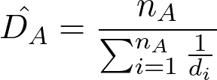
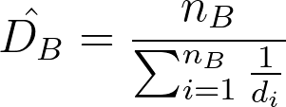
Estimating degree of groups A and B
Let Di be the average degree of members of group i.
DA and DB can be estimated as follows:

Slide 55
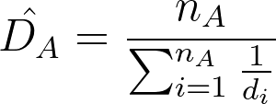
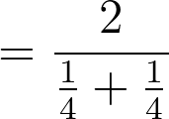

Estimating degree of groups A and B

Slide 56

Estimating degree of groups A and B

Slide 57
Let rij represent the total number of recruitments from sampled members of group i to members of group j.
For example, suppose the purple lines represent recruitments from sampled individuals.
Then,
rAB = 1 ( → )
rAA = 3 ( → )
rBA = 1 ( → )
rBB = 2 ( → )

Slide 58


Estimating inter-group relationships
Let CA,B be the probability that if we start with a random individual in group A and follow a randomly chosen relationship from this individual, we end up finding an individual in group B (CB,A is thus the opposite).
CA,B and CB,A can be estimated,

Slide 59
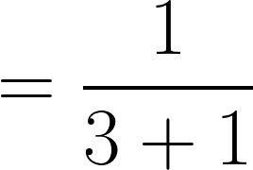
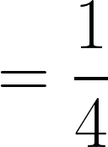

Slide 60
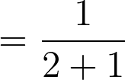


Slide 61
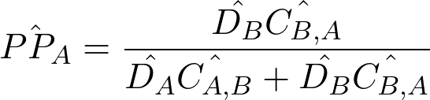

Estimating population proportion
An estimator for the population proportion of group A is,

Slide 62
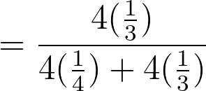




Slide 63
(True PP_{A} is 0.6)
(True PP_{B} is 0.4)

Slide 64
Why bother? → Hidden populations!
Small target population size, or difficulty distinguishing target population from general population
E.g. amateur musicians or chefs
An extremely large and expensive sample would be needed to find individuals of interest
Difficulty accessing target population members
E.g. people experiencing homelessness, drug users, illegal immigrants
Members may be difficult to access by typical survey means (mail, random digit dialing, etc.)
Members may be unwilling to self-identify
Sampling frame construction may be impossible due to lack of documentation

Slide 65
Benefits of respondent-driven sampling
Researchers do not have to seek out target population members directly
Seeds do not have to identify their peers to researchers
Subsequent waves of participants self-identify and participate voluntarily

