Slide 1
Module 5: Sampling
5.1: Probability
Annie Collins
Data Sciences Institute, University of Toronto

Slide 2
Learning Outcomes
How do we calculate and interpret probabilities? What is a statistical distribution?
…

Slide 3
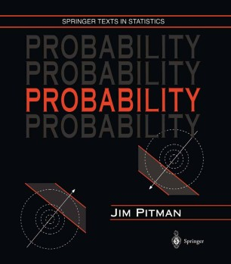
Key Texts
Pitman, 1993, Probability, Springer, Chapters 1-3
Image source: Springer

Slide 4
Introduction

Slide 5
Definitions
An outcome space is a set of all possible outcomes of some kind, often represented by 𝛀.
For example, 𝛀 = {A, B, C,..., Z} is an outcome space containing all letters of the alphabet
An event is a subset of an outcome space.
There are often many possible events for a specific outcome space
Possible events for 𝛀 above could be vowels {A, E, I, O, U} or letters before E {A, B, C, D}
A probability is a function of an event describing how likely it is to occur

Slide 6

Equally Likely Outcomes
If all outcomes in a set 𝛀 are equally likely, the probability of event A is the number of outcomes in A divided by the total number of outcomes,
P(A) can be read as “the probability of A”.

Slide 7
Example: Rolling a die
For a six-sided die, the outcome space is,
𝛀 = {1, 2, 3, 4, 5, 6}
Some possible events and their probabilities are,
Description | Event | Probability
An even number is rolled | A = {2, 4, 6} | 3/6 = ½ = 0.5
A number less than 6 is rolled | B = {1, 2, 3, 4, 5} | ⅚ = 0.833…
A 6 is rolled | C = {6} | ⅙ = 0.166…

Slide 8
Sets and Events
Pitman (1993), Table 1
Event language | Set language | Set notation | Venn diagram
Outcome space | Universal set | 𝛀
Event | Subset of 𝛀 | A, B, C, etc.
Impossible event | Empty set | ∅
Not A, or the opposite of A | Complement of A | A^{C}
Either A or B or both | Union of A and B | A ⋃ B
Both A and B | Intersection of A and B | A ∩ B
A and B are mutually exclusive | A and B are disjoint | A ∩ B = ∅
If A, then B | A is a subset of B | A ⊆ B
A
A
B
A
B
A
B
A
B

Slide 9
Partitions
An event B is partitioned into n events B₁ , B₂ ,..., B_{n} if
B = B₁ ⋃ B₂ ⋃ … ⋃ B_{n} – every outcome in B belongs to some event B_{i}, none are left out
B₁ , B₂ ,..., B_{n} are mutually exclusive – if an outcome is in event B_{i}, it is not in any other event
Adapted from Pitman (1993), Figure 1
B
B
B
B₁
B₁
B₃
B₃
B₁
B₂
B₃
B₄
B₂
B₂

Slide 10
Rules of Probability
For an event B over an outcome space 𝛀,
Non-negativity: P(B) ≥ 0
Addition: If B₁ , B₂ ,..., B_{n} is a partition of B, then
P(B) = P(B₁) + P(B₂) + … + P(B_{n})
Total one: P(𝛀) = 1

Slide 11
Example: Drawing cards
Suppose you have a regular deck of cards. Let B represent the event “drawing a heart”. Let B₁ and B₂ be a partition of B, with B₁ = “drawing non-numeric heart card (J, Q, K, A)” and B₂ = “drawing an ace or numeric heart card (2,…,10)”
B₁ and B₂ is a valid partition, since all heart cards are either numeric or non numeric, and a card cannot be both a numeric card and a non-numeric card (mutual exclusivity)
P(B) = 13/52 = 1/4 ≥ 0
P(B₁) + P(B₂) = 4/52 + 9/52 = 13/52 = 1/4 = P(B)
P(𝛀) = P(“draw any card in the deck”) = 1

Slide 12
Conditional Probability

Slide 13
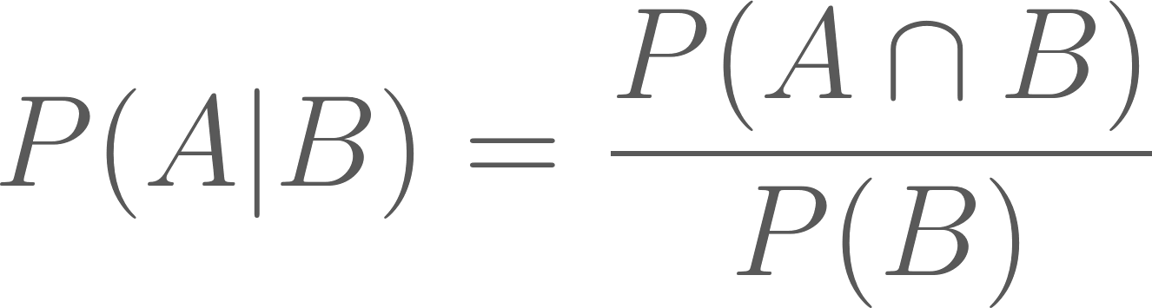
Conditional Probability
Conditional probability can be described as the probability that event A will happen given that event B has already happened
The notation for conditional probability is P(A|B), which can be read as “the probability of A given B”
The formula for conditional probability is,
As long as P(B) ≠ 0

Slide 14
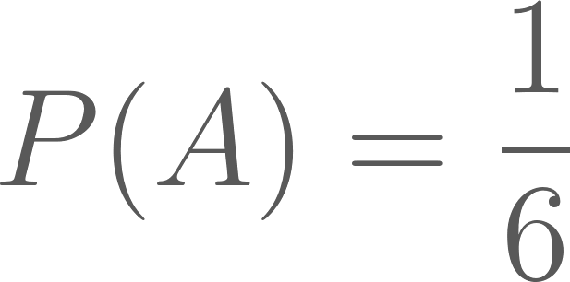
Example: Rolling a die
Suppose you roll a regular die, but haven’t yet looked at the result. Let event A be “rolling a 4”, and let event B be “rolling an even number”.
The probability that number you rolled is a 4 is,
Now suppose I look at the die and tell you that the number you rolled is even. Given this new information, the probability that the number you rolled is a 4 is,

Slide 15


Independence
If events A and B are independent, event A is not affected by the occurrence of event B.
This can be described mathematically as,
From the formula for conditional probability, we can then derive the following formula for independent events,
The same applies for any number of disjoint events.

Slide 16
Example: Selecting a high school student
Pitman (1993), Exercises 1.4, Exercise 9
Three high schools have senior classes of size 100, 400, and 500, respectively. Here are two schemes for selecting a student from among the three senior classes:
Make a list of all 1000 seniors, and choose a student at random from this list.
Pick one school at random, then pick a student at random from the senior class in that school.
Are these two strategies equivalent?

Slide 17
Random Variables

Slide 18
Random Variables
Random variables are a way to describe a set possible outcomes with a distribution of probabilities over the set of outcomes.
Usually denoted with capital letters: X, Y, Z, etc.
Random variables are similar to events
Events are a specific outcome or set of outcomes, while random variables describe possible outcomes and their various probabilities
An event “Number on the die is a five” or {5} or X = 5 is one possible outcome of the random variable X, “the number obtained by rolling a die”

Slide 19
Random Variables
The range of a random variable is all of the values it could possibly take. This can be continuous (0 ≤ X ≤ 10) or discrete (X ∈ {1, 2, 3}).
The distribution of random variable is determined by the probabilities of values within its range,
P(X = x) for x ∈ range of X

Slide 20
Example: Rolling two dice
Let X represent the sum of the faces showing on two rolled dice.
x | 2 | 3 | 4 | 5 | 6 | 7 | 8 | 9 | 10 | 11 | 12
Possible outcomes | 1+1 | 1+2, 2+1 | 1+3, 2+2, 3+1 | 1+4, 2+3, 3+2, 4+1 | 1+5, 2+4, 3+3, 4+2, 5+1 | 1+6, 2+5, 3+4, 4+3, 5+2, 6+1 | 2+6, 3+5, 4+4, 5+3, 6+2 | 3+6, 4+5, 5+4, 6+3 | 4+6, 5+5, 6+4 | 5+6, 6+5 | 6+6
P(X = x) | 1/36 | 1/18 | 1/12 | 1/9 | 5/36 | 1/6 | 5/36 | 1/9 | 1/12 | 1/18 | 1/36

Slide 21
Indicator Variables
Indicator variables, denoted I_{A} , are specific type of random variable that take the value 0 or 1 to indicate a the occurrence of a given event A.
Some examples of indicator variables may be votes in a two-party election (with event A being a vote for a particular candidate), votes for or against a bill, satisfied versus not satisfied reviews for a product, etc.

Slide 22
Distributions

Slide 23
Distributions
A probability distribution is a statistical function that describes the probabilities of all possible events in an outcome space.
Distributions can be discrete (if the outcome space is distinct events, like rolling a die) or continuous (if the outcome space is a range of values, like choosing any real number between 1 and 10).
Some features of interests for distributions may be their mean, variance, mode, skew, etc.

Slide 24
Binomial Distribution

Slide 25
Binomial Distribution
The binomial distribution concerns sequences of events with two possible outcomes: success and failure.
Success occurs with probability p, and failure occurs with probability q = 1 - p. Trials defined this way are called Bernoulli trials.
The binomial distribution helps determine the probability of getting k successes in n independent trials (with replacement)

Slide 26
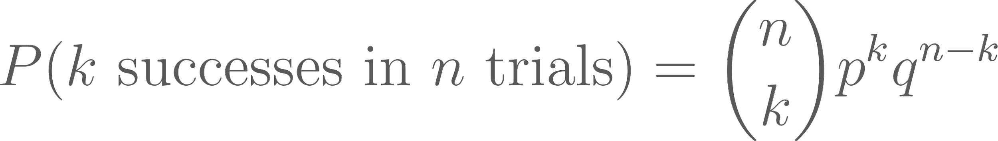

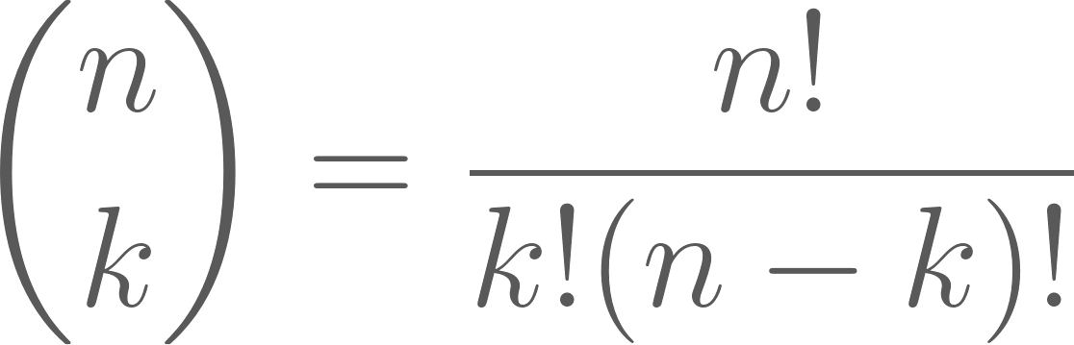
Binomial Distribution Formula
For n independent trials with probability p of success and probability q = 1 - p of failure, the probability of k success in n independent trials (with replacement) is,
is called “n choose k” and describes the number of possible combinations of k successes and n - k failures:

Slide 27
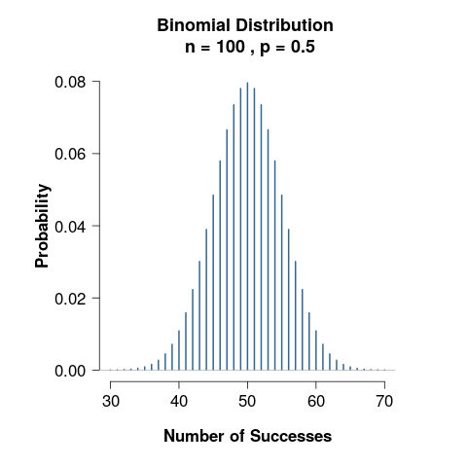
Binomial Distribution
For a large number of trials n, we expect the number of successes to be about np.
For n = 100 and p = 0.5, the distribution of number of successes is centered around 50 (the most likely) and the total number of successes gets less likely as the numbers get farther from 50.

Slide 28
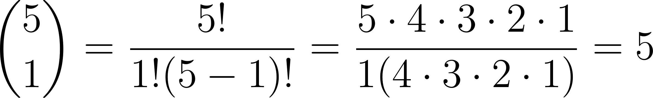
Example: Drawing cards
Suppose you draw n = 5 cards from a standard deck, and your desired outcome is drawing a club.
Then p = 13/52 = ¼ and q = 1 - p = 1 - ¼ = ¾.
For k = 1 success, the possible combinations of cards drawn are:
{♣♣♣♣♣}, {♣♣♣♣♣}, {♣♣♣♣♣}, {♣♣♣♣♣}, {♣♣♣♣♣}
Mathematically this can be represented as,
Notes:
NOTE: As an exercise, go through 5 choose 2 and the logic behind the equation.

Slide 29
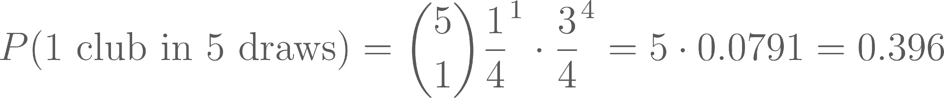
Example: Drawing cards
Since the trials are independent, the probability of getting 1 success in 5 trials is the product of the probability of getting a club on one trial and the probability of getting non-clubs on four trials.
Putting the two calculations together, we have,

Slide 30
Uniform Distribution

Slide 31
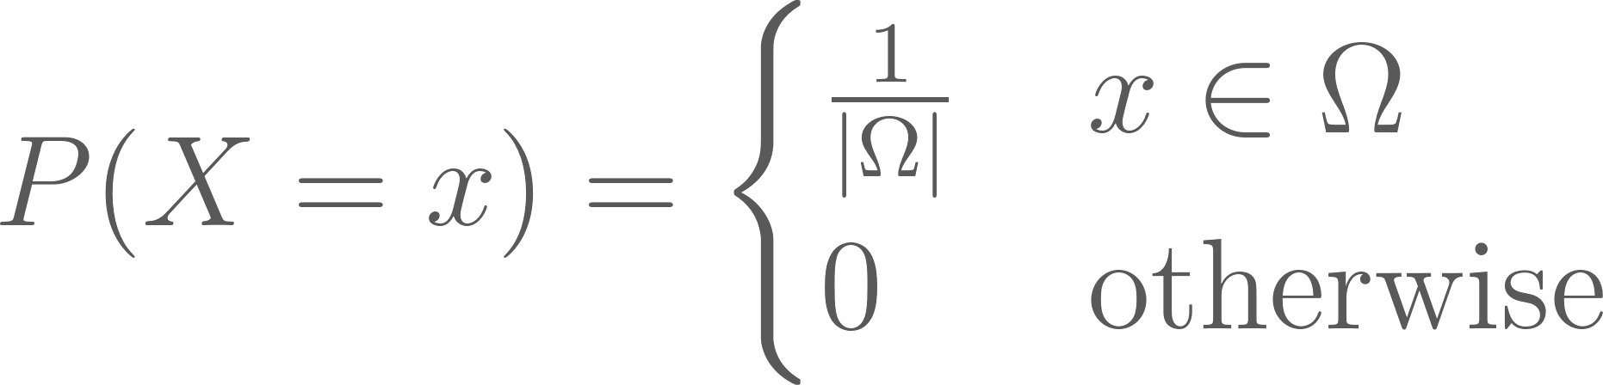
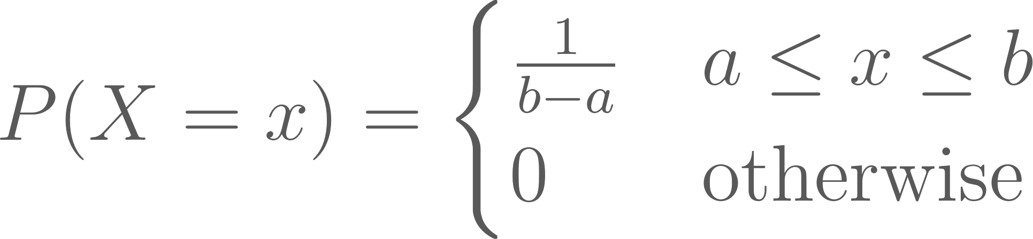
Uniform Distribution
The uniform distribution describes a situation in which every outcome on a certain set or interval is equally likely.
This can be represented mathematically as,
or

Slide 32
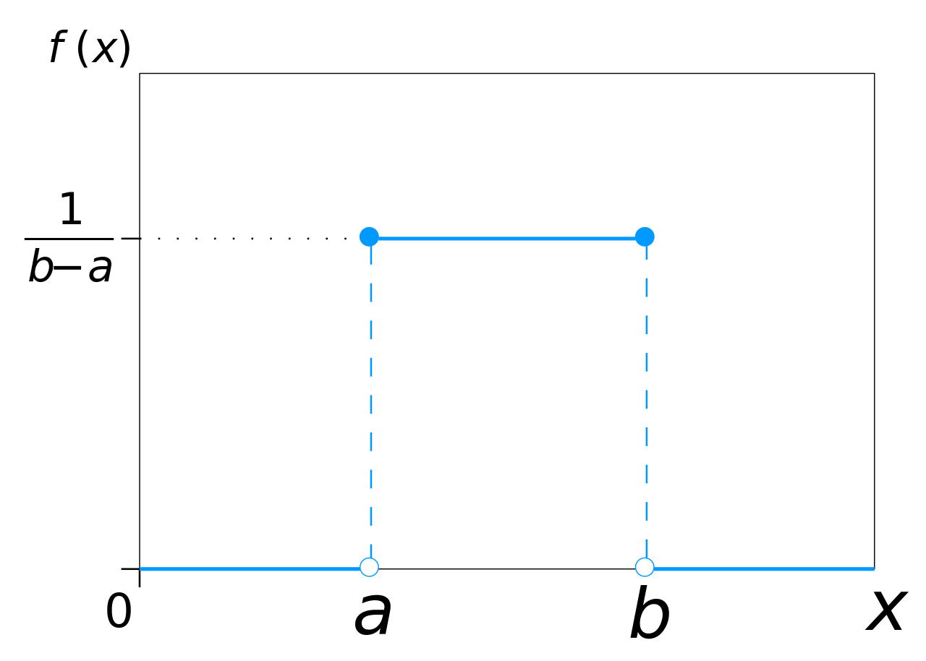
Uniform Distribution
Examples
Rolling a die
Drawing any card from a normal deck
Choosing a random number between 1 and 100
Choosing a random student in a classroom
Image retrieved from https://commons.wikimedia.org/wiki/File:Uniform_Distribution_PDF_SVG.svg

Slide 33
Poisson Distribution

Slide 34
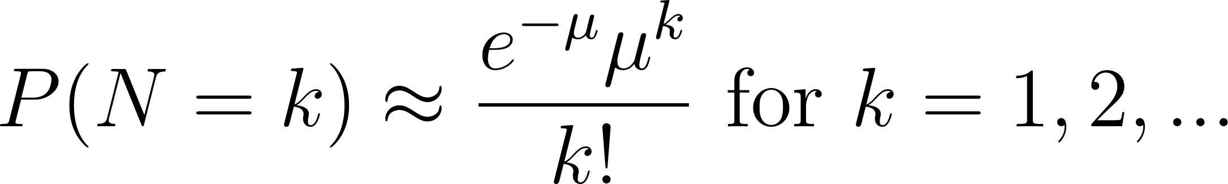
Poisson Distribution
The Poisson distribution is an approximation of the distribution of the number N of occurrences of events of some kind, when the events all have small probabilities and are independent.
The Poisson distribution is a discrete probability distribution.

Slide 35
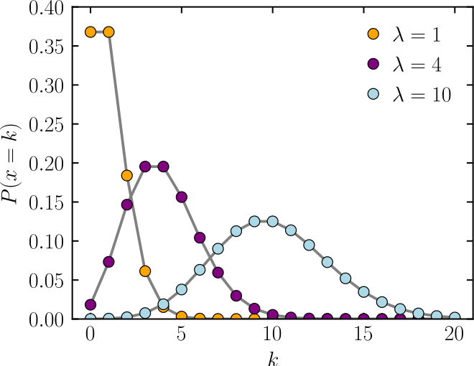
Poisson Distribution
Examples
Number of wins in n games of roulette for a gambler who bets on a single number each game
Number of rain drops that land on a particular area of a roof during a set time interval
Number of people who enter a store in a certain time interval
𝜇
𝜇
𝜇
Image retrieved from https://commons.wikimedia.org/wiki/File:Poisson_pmf.svg

Slide 36
Normal Distribution

Slide 37
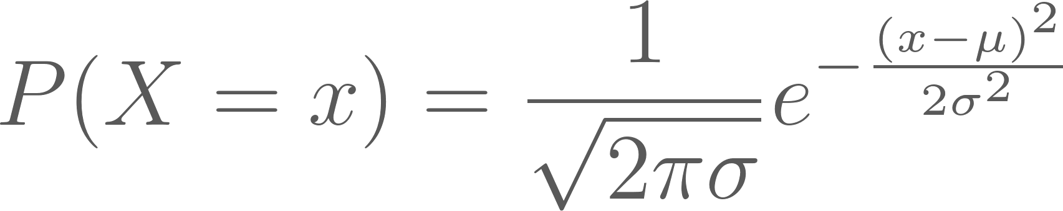
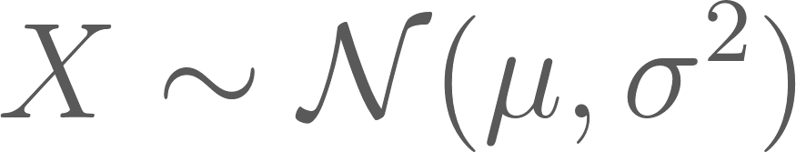
Normal Distribution
The normal distribution is one of the most common and important distributions
It is represented by the equation,
where 𝜇 is the mean of X and 𝜎 is the standard deviation.
A random variable X following a normal distribution is often denoted,

Slide 38
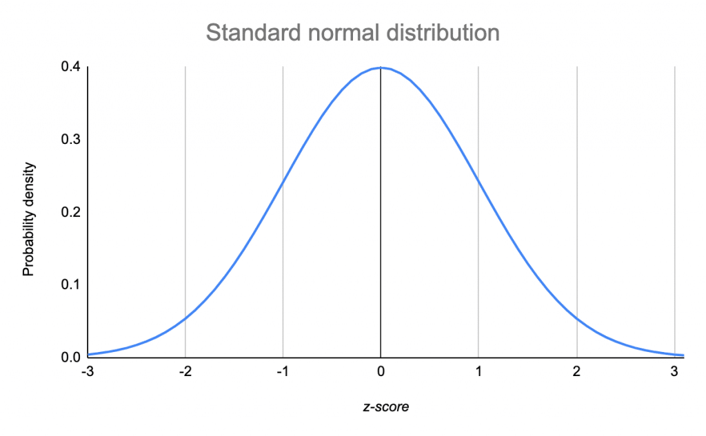
Normal Distribution
The normal distribution is centered and symmetric about 𝜇. 𝜎 describes the horizontal spread (how wide the distribution is).
The normal distribution can be used to be use to approximate other distributions for easy calculations of probabilities
-2𝜎 -1𝜎 𝜇 1𝜎 2𝜎
Image retrieved from https://www.scribbr.com/statistics/standard-normal-distribution/

Slide 39
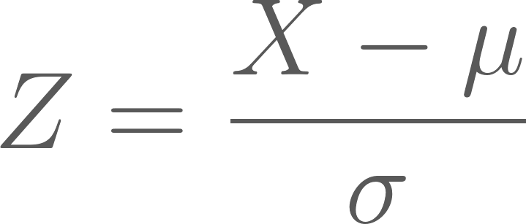
Standard Normal Distribution
The standard normal distribution is a normal distribution with mean 0 and standard deviation 1.
In general, a random variable X with a normal distribution can be standardized using the following formula,
Image retrieved from https://www.scribbr.com/statistics/standard-normal-distribution/

Slide 40
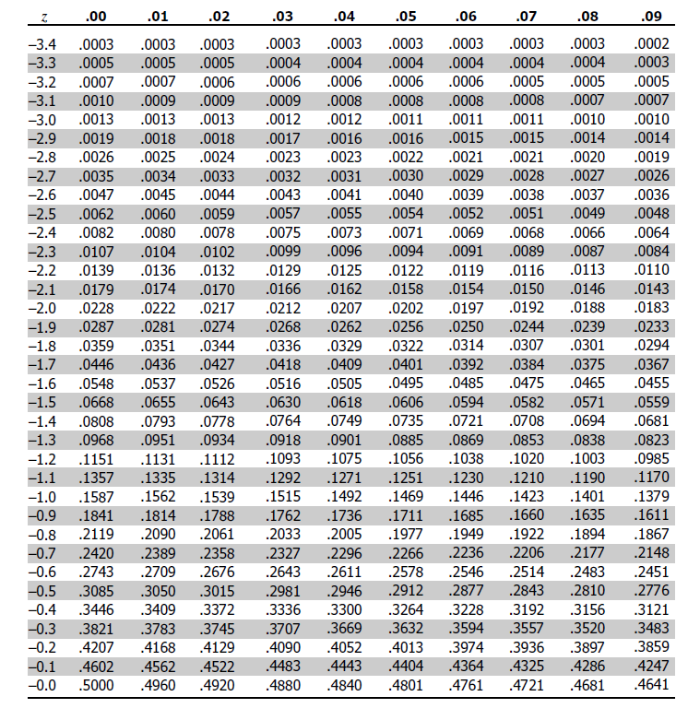
Example: Z-Scores
Z-Scores represent the probability that a value is less than or equal to the value of a given standardized random variable.
Image retrieved from http://www.z-table.com/

Slide 41
Law of Large Numbers
Notes:
Note: Open R file “5.1-Probability-LLN Demo.R” and work through the demo

Slide 42
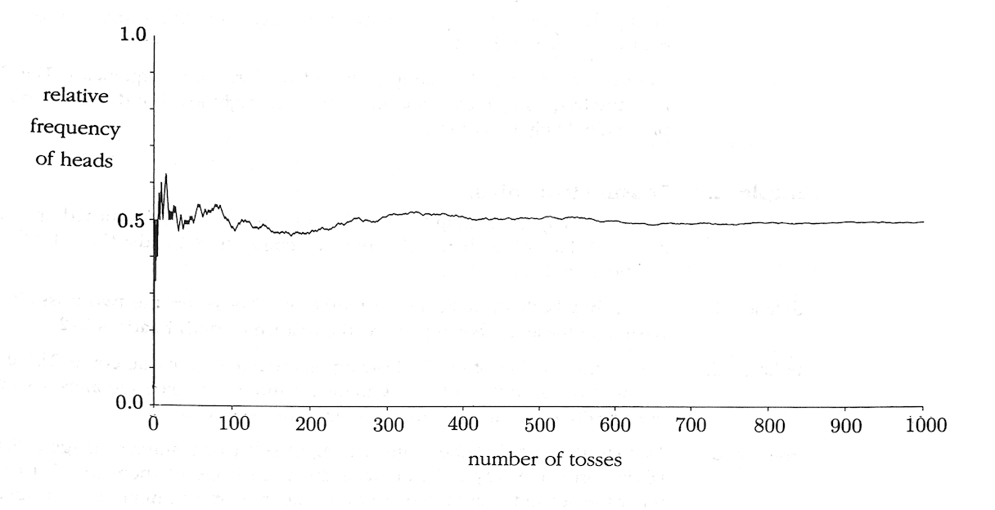
Law of Large Numbers
Pitman (1993), Figure 2

Slide 43
Law of Large Numbers
If the number of trials n is large, the proportion of successes in n independent trials will, with overwhelming probability, be very close to p, the probability of success on each trial
Intuition for sampling
As the number of units sampled increases, the proportion of units that exhibits a certain trait will grow closer and closer to the true proportion of individuals in the population with that trait

Slide 44
Expected Value

Slide 45
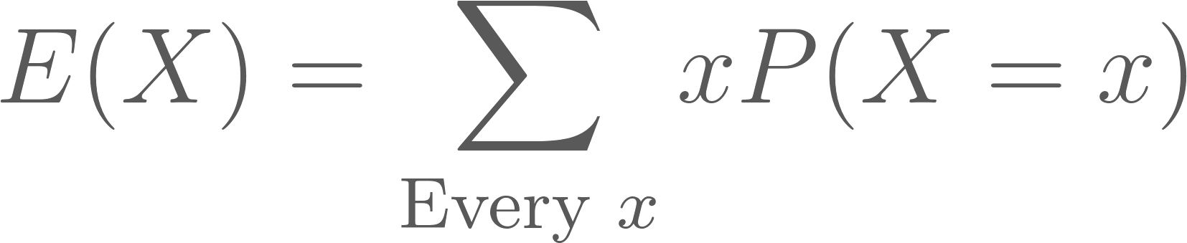

Expected Value
The expected value or expectation of a random variable X is the mean of the distribution of X, denoted E(X) or 𝜇. This is represented mathematically as,
The expected value is the average of all possible values of X weighted by their probabilities.
The expected value of indicator variable I_{A} is the probability of event A,

Slide 46
Example: Sampling a student
Suppose you are randomly sampling a student from a school. There are 200 students each of ages 16, Let random variable X represent the age of the student sampled.
The expected age of the student selected is,
Now suppose there are 100 students age 16, 200 students age 17, and 300 students age 18. The new expected age is,

Slide 47
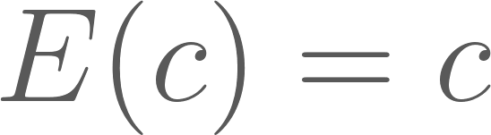

Properties of Expectation
Constants: The expectation of a constant random variable is its constant value
Scalar multiplication: For random variable X multiplied by constant c,
Addition: The expectation of a sum of random variables is the sum of the expectations

Slide 48
Variance and Standard Deviation

Slide 49
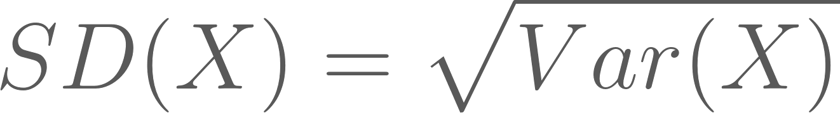
Variance and Standard Deviation
The variance of X, denoted Var(X), is the mean squared deviation of X from its expected value E(X),
The standard deviation of X, denoted SD(X), is the square root of the variance of X:
Notes:
TODO: Walk through a simple proof deriving the computational formula for variance from the usual formula

Slide 50
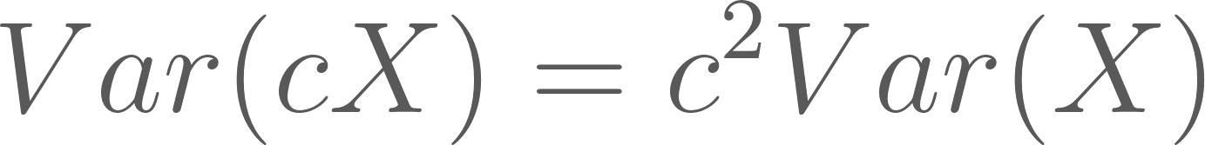
Variance Properties
Addition: for independent random variables X₁, X₂,..., X_{n}, the variance of their sum is,
Scalar multiplication: for random variable X and scalar c,
Notes:
TODO: Easy derivation from the definition for variance

Slide 51
Variance and Standard Deviation
Variance is often denoted 𝜎², with SD denoted 𝜎
Variance and SD describe how spread out the distribution of a variable is
SD is often easier to interpret since its units are the same as the mean
In general:
For a random variable X with some distribution, you should expect the value of X to be around the expected value E(X), plus or minus a few times the standard deviation SD(X)

Slide 52
Example: Normal Distribution
On a normal distribution, ~68% of the probability density lies within one SD of the mean:
For the standard normal N(0, 1), this means X is fairly likely to be between -1 and 1, and that 2.5 would be a very unlikely value of X.
34.1%
34.1%
13.6%
13.6%
2.1%
2.1%
Image retrieved from https://www.scribbr.com/statistics/standard-normal-distribution/

Slide 53
Central Limit Theorem

Slide 54
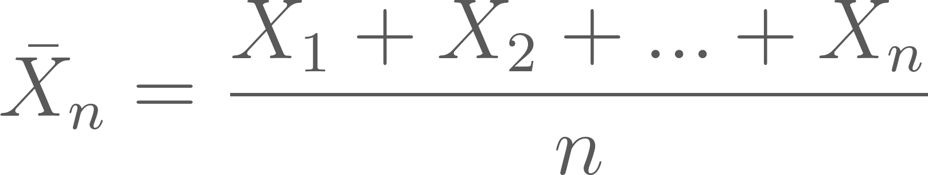
Law of Averages
Let X₁,..., X_{n} be a sequence of independent random variables with the same distribution as random variable X. Let 𝜇 = E(X) denote the expected value for all X_{i}. Let the following random variable represent the average of X₁,..., X_{n},
Then for every 𝝐 > 0, no matter how small,

Slide 55
Law of Averages
“The probability that the difference between the calculated mean and the true mean is very small approaches 1 as n approaches infinity”
As the number of random variables increases, the average of the random variables will be arbitrary close to the expected value of any one random variable

Slide 56
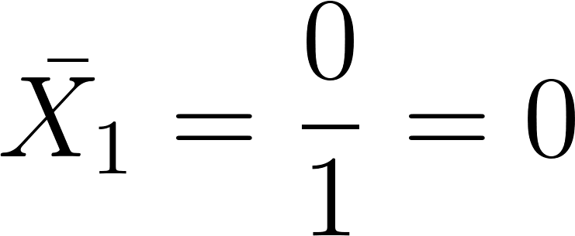
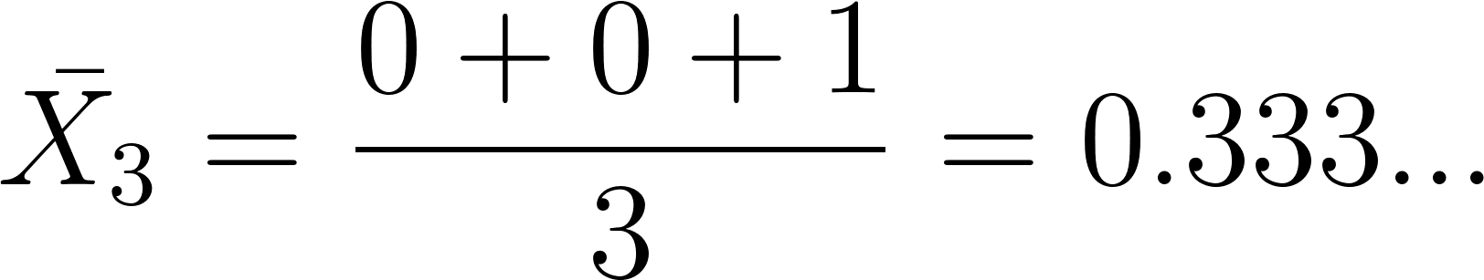
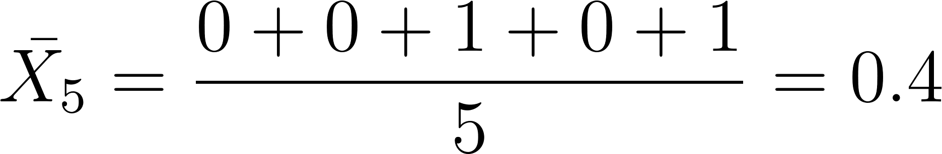
Example: Tossing a coin
Suppose we are tossing a fair coin. We assign a value of 0 for heads and 1 for tails. Let indicator variable I represent the result of a given going toss. Then,
Observe the following sequences of coin tosses:
n | Results
1 | {h}
3 | {h, h, t}
5 | {h, h, t, h, t}
10 | {h, h, t, h, t, t, t, h, t, h}

Slide 57
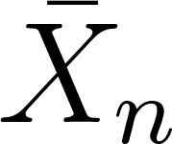

Example: Tossing a coin
Pitman (1993), Figure 2
Notes:
The Law of Averages can be thought of as a more general version of the Law of Large Numbers. LOA deals with random variables in general. LLN concerns proportions.

Slide 58
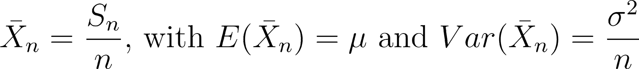
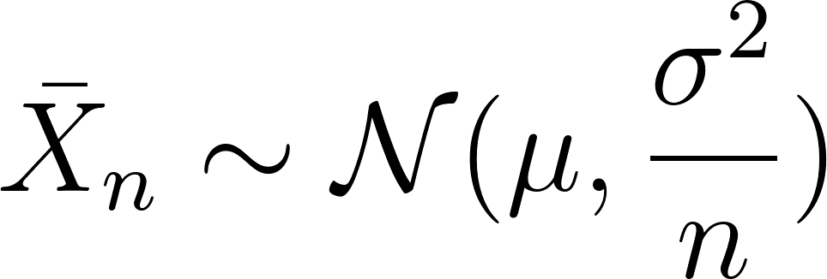
Central Limit Theorem
Let S_{n} = X₁ + X₂ + … + X_{n} be the sum of n independent random variables each with the same distribution. For large n, the distribution of S_{n} is approximately normal, with mean E(S_{n}) = n𝜇 and variance Var(S_{n}) = 𝜎²n, where 𝜇 = E(X_{i}) and 𝜎² = Var(X_{i}).
This also holds true for,
Notes:
Note: Open R file “5.1-Probability-CLT Demo.R” and work through the demo

Slide 59
Next
5.2 Populations, censuses, surveys, and observational data

