Slide 1
Module 5: Sampling
5.4: Errors
Annie Collins
Data Sciences Institute, University of Toronto

Slide 2
Learning Outcomes
How might your sampling and surveying approach cause inaccuracies in your data?
Ability to identify sources of error in sampling and survey methodology.
Ability to distinguish between different types of errors, such as variance and bias, sampling and non-sampling errors, etc.

Slide 3
Variance and Bias

Slide 4
Variance and Bias
Variance | Bias
Random error Describes variability of calculated quantities Want to minimize | Systematic error Describes difference between calculated and true quantities (i.e. between sample statistics and population parameters) Ideally, we want to eliminate bias. In practice, this is often not possible.

Slide 5
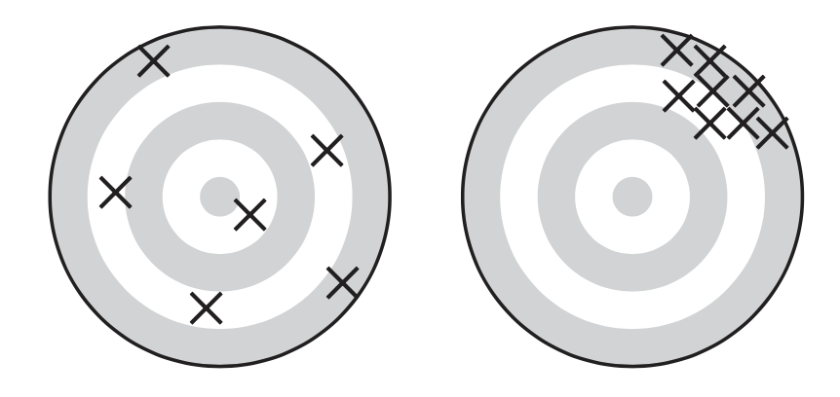
Lohr, 2019, Figure 2.3
Which of these displays high variance and which displays high bias?

Slide 6
Sampling Errors

Slide 7
Sampling Error
Sampling error is the error that results from taking a given sample instead of measuring the entire frame population
Different samples will likely produce different sample statistics, and these sample statistics will likely be different from the true population parameter
Sampling error can only be avoided if the frame population and sample population are exactly the same
Example: margin of error

Slide 8
Non-Sampling Error
Non-sampling error is error that does not occur as the result of variability between different samples
Often systemic (i.e. a result of study design or pre-existing characteristics of the population)
Examples: selection bias, measurement error

Slide 9
Selection Bias

Slide 10
Selection Bias
Selection bias occurs when some population units are unintentionally excluded from the sample population
Results in a non-representative sample
May often arise in non-probability samples which more commonly sample certain types of individuals by virtue of their design (i.e. convenience or judgement sampling)

Slide 11
Sources of Selection Bias
Lohr, 2019, Section 1.3
Using a sample selection procedure that, unknown to the investigators, depends on some characteristic associated with the properties of interest
Deliberately or purposively selecting a “representative” sample
Misspecifying the target population
Failing to include all of the target population in the sampling frame (undercoverage)
Including population units in the sampling frame that are not in the target population (overcoverage)
Having multiplicity of listings in the sampling frame, without adjusting for the multiplicity in the analysis
Substituting a convenient member of a population for a designated member who is not readily available
Failing to observe responses from all of the chosen sample (nonresponse)
Allowing the sample to consist entirely of volunteers

Slide 12
Overcoverage versus Undercoverage
Undercoverage may occur when certain individuals are not able to be reached by the survey (i.e. they do not own a phone or have a permanent address) or because individual-level data is systematically inaccessible (i.e. individuals in the prison system or long-term care facilities)
Overcoverage may occur when ineligible units in the general population are not removed from the frame population, or when those who are collecting data are not properly informed about sample eligibility and collect data from ineligible individuals

Slide 13
Non-Response Error

Slide 14
Non-Response Error
Sampled individuals who participate in a survey or study are called respondents
Non-response error occurs when members of the sample do not respond to the survey or study (i.e. when the respondents to a survey are only a subset of the sample)
Non-response bias occurs when respondents are systematically different from those who didn’t respond
Non-response will be covered in greater depth in Module 5.8

Slide 15
Representation

Slide 16
Representation
“Representation is about making inferences from your respondents to your target population” - Salganik, 2018
Coverage Error
Sampling Error
Non-
response Error
Target Population
Frame Population
Sample Population
Respondents
Inference

Slide 17
Measurement Error

Slide 18
Measurement Error
Measurement error occurs when survey responses tend to differ from the true population value
Measurement bias occurs when measurement errors tends to occur consistently in one direction

Slide 19
Sources of Measurement Error
Lohr, 2019, section 1.4
People sometimes do not tell the truth
People do not always understand the questions
People forget
People give different answers to different people
People may say what they think an interviewer wants to hear or what the think will impress the interviewer
A particular interviewer may affect the accuracy of the response, by misreading question, recording responses inaccurately or antagonizing the respondent
Certain words mean certain things to different people
Question wording and question order have a large effect on the responses obtained

Slide 20
Total Survey Error Framework

Slide 21
Total Survey Error = Representation Errors + Measurement Errors
The total survey error framework states that there are two types of error – bias and variance – and there are two sources of these errors – representation and measurement.
Representation errors
Coverage error
Sampling error
Selection bias
Non-response error
Non-response bias
Measurement errors
Measurement error
Measurement bias

Slide 22
Next
5.5 Simple Probability Samples

