Slide 1
Module 5: Sampling
5.14: Reproducibility
Author: Annie Collins, Edited by: Daniel Razavi
Data Sciences Institute, University of Toronto

Slide 2
Sampling in Python & R

Slide 3
Sampling in Python & R
Some reasons you might need to sample in Python/R:
Simulating data
Bootstrap sampling
Hypothesis testing
Common sampling functions in Python:
numpy.random.choice() – sample items from an array
numpy.random.uniform() – sample from a uniform distribution (input low and high)
numpy.random.normal()– sample from a normal distribution (input mean and standard deviation)
Common sampling functions in R:
sample() – sample items from a vector
runif() – sample from a uniform distribution (input min and max)
rnorm() – sample from a normal distribution (input mean and standard deviation)

Slide 4
Sampling in Python & R
These functions are all forms of probability sampling, therefore there is always some randomness involved.
The “randomness” in Python and R results from pseudorandom number generators.
Pseudorandom number generators output numbers based on a set algorithm and an initial seed.
The same initial seed will produce the same outputted number(s) or item(s) every time

Slide 5
Seeds
(Partial review from Module 3)
set.seed()in R and numpy.random.seed()in python allow you to set the initial seed for Python/R functions that use pseudorandom number
A sampling function called after a specific seed is set will produce the same output each time
Setting a seed makes sampling procedures reproducible

Slide 6
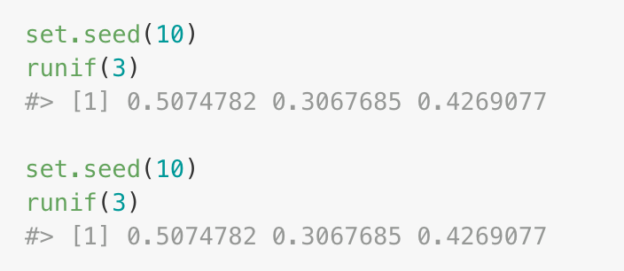
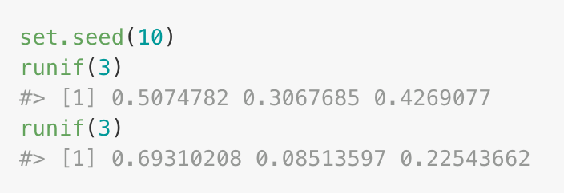
Seeds: Scope (R)
set.seed() sets the initial state of the random number generator which is stored under the name .Random.seed in the global environment.
.Random.seed changes deterministically after executing functions that depend on a the seed.
Setting the seed at the beginning of a script file will produce the consistent results when the file is run in its entirety, but not for individual calls to the same function.
vs.
Notes:
NOTE: For the example on the left, the two calls to runif() will produce the same two outputs every time as long as set.seed(10) is run before the first call. This is an example of .Random.seed changing deterministically, and is a good representation of the behaviour of set.seed() if it is called at the beginning of an R Script or R Markdown file.

Slide 7
Seeds: Scope (Python)
numpy.random.seed() sets the initial state of the random number generator within NumPy's environment.
The state of the random number generator changes deterministically after executing functions that depend on the seed.
Setting the seed at the beginning of a script will produce consistent results when the script is run in its entirety, but not necessarily for individual calls to the same function in.
Notes:
NOTE: For the example on the left, the two calls to runif() will produce the same two outputs every time as long as set.seed(10) is run before the first call. This is an example of .Random.seed changing deterministically, and is a good representation of the behaviour of set.seed() if it is called at the beginning of an R Script or R Markdown file.

Slide 8
When to set seed:
Writing reproducible sampling scripts or simulation-based studies
Creating reproducible examples
Code testing and debugging
When NOT to set seeds :
Inside a function or loop that you want to produce different results every time
Notes:
May want to refer to the assignment that was completed in the lab as an example of where to use set.seed() appropriately. It doesn’t make sense to place set.seed() anywhere within the function called in pbsapply() otherwise each loop will produce the same results. Setting a seed before pbsapply() (i.e. at the top of the file) will allow the whole simulation to be reproducible.

Slide 9
Data Documentation

Slide 10
Data Documentation
Open data is one of the hallmarks of open science and reproducibility
Having access to the data behind a study is useless if you know nothing about how that data was collected or manipulated prior to analysis
Data documentation refers to the process of recording all of the steps taken to obtain and process your data
Similar to commenting code, documenting data communicates important features of your data set that may impact its analysis and allows other researchers to more easily reproduce your results

Slide 11
What should be documented?
All aspects of survey design should be documented. This includes (but is not limited to):
Populations
Target, frame
Sampling methodology
Type of sampling used, eligibility criteria, sample size, any supplemental data used
Mode
Timeline
Release and closing date, frequency (for repeat surveys or longitudinal studies)
Response rate
Cleaning procedure
Any editing to address missing values, repeated values, outliers
Weights
Weighting procedure and supplemental data used
Accuracy
Known sources of error, bias, limitations

Slide 12
How should data be documented?
In addition to raw data files, consider:
Recording and summarising all steps taken during the survey design and sampling process
Including all original questionnaire or survey materials
Including code that was used for processing
Be sure code is reproducible by using comments, seeds, R projects, etc.
Website like GitHub and The Open Science Framework (OSF) can help store relevant files in self-contained repositories for later reference.

Slide 13
Next
5.14 Differential privacy

