Slide 1
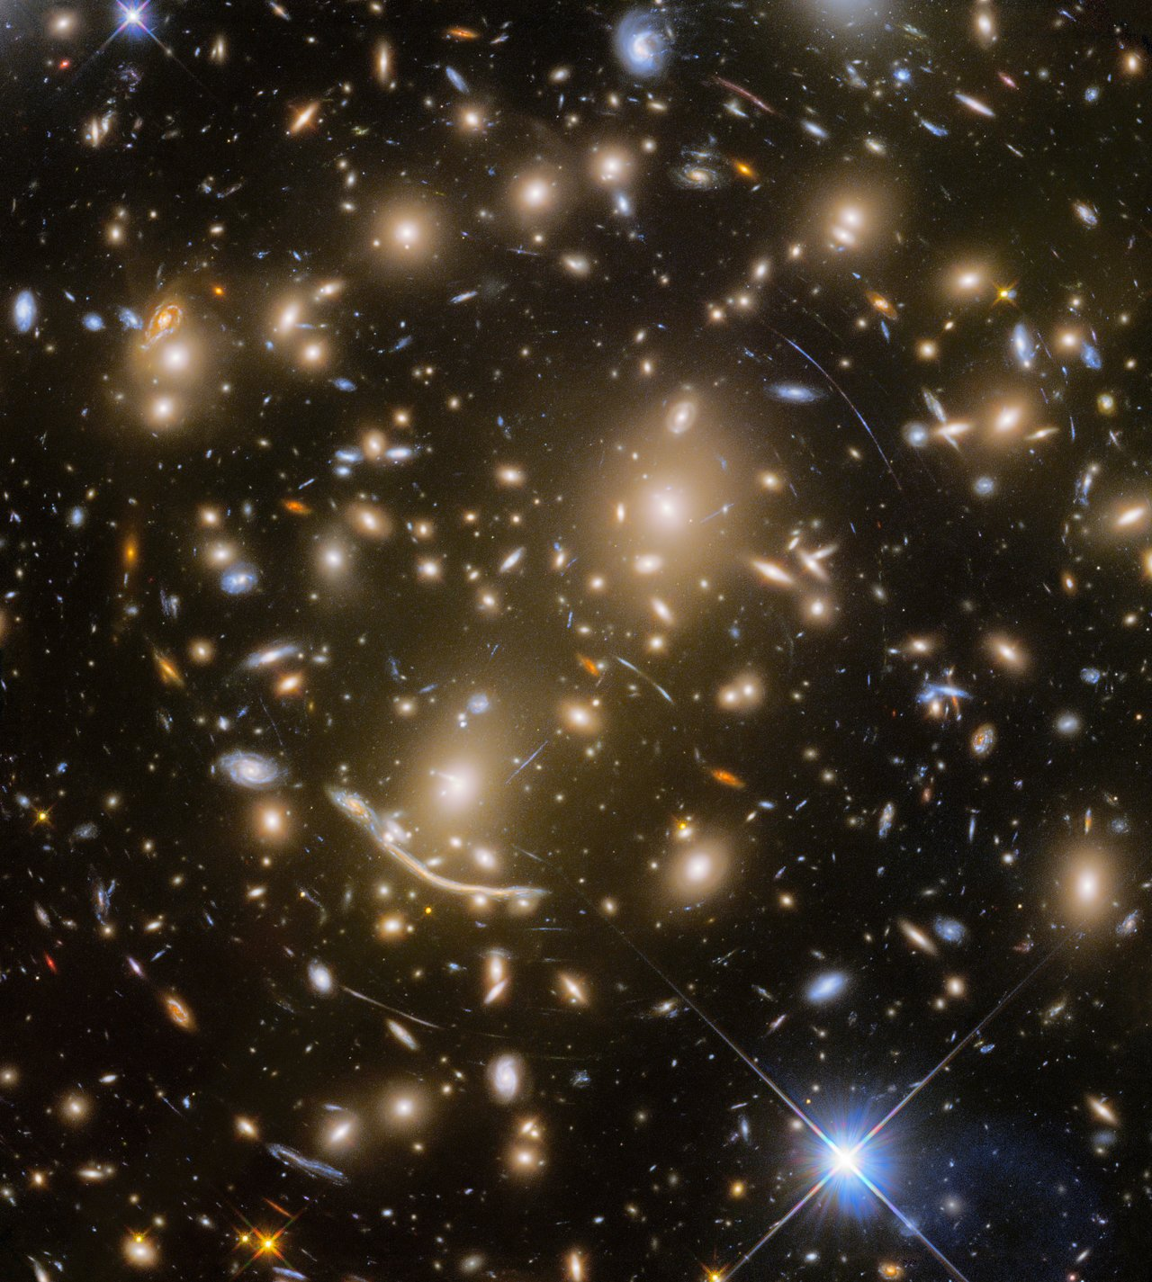
SIMULATION-BASED INFERENCE • BAYESFLOW • LENSTRONOMY
Inferring Strong Gravitational Lens Parameters from Images
Recovering the physics of an SIE lens — Einstein radius, ellipticity, shear, source — from a single noisy telescope image, with full posteriors in milliseconds.
Sayed Atique Newaz · Noureen Alam Meem · Mashuk Khan
University project — July 2026
Background: galaxy cluster Abell 370 — NASA, ESA/Hubble Frontier Fields
Notes:
Title. Abell 370: every stretched arc in this Hubble image is a background galaxy distorted by the cluster's gravity — the phenomenon this project inverts.

Slide 2
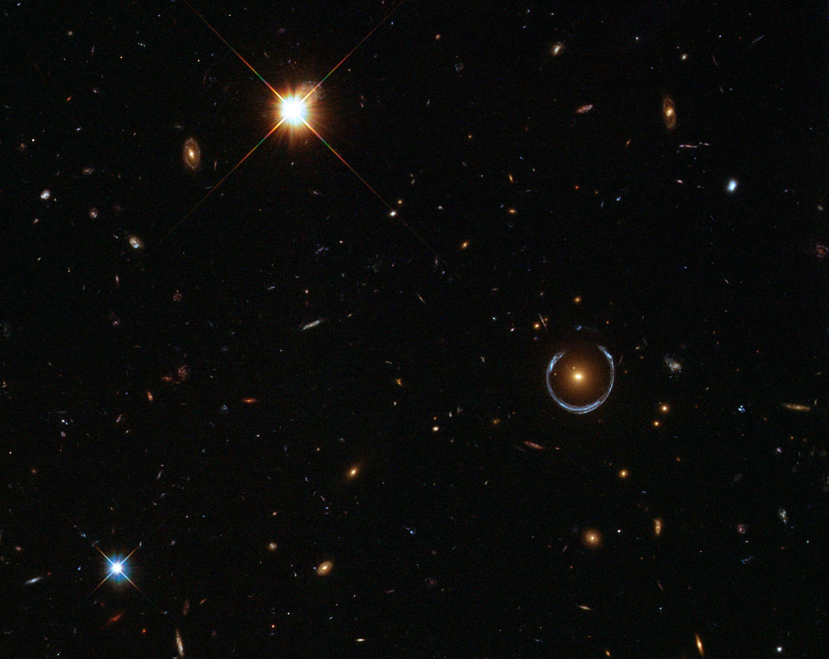
THE PHYSICS
Gravity's magnifying glass
A massive foreground galaxy warps spacetime; light from a distant background galaxy bends around it (general relativity).
Alignment decides the picture: a small offset gives multiple images and arcs; near-perfect alignment gives a complete Einstein ring.
The distortion encodes the lens: ring radius ↔ enclosed mass, arc shapes ↔ ellipticity and tidal shear.
Our task is the inverse problem: given one noisy image, recover the physical parameters that produced it.
The Cosmic Horseshoe (LRG 3-757): a blue background galaxy smeared into a near-complete Einstein ring — ESA/Hubble & NASA
2 / 12
Notes:
Set up the physics: lensing is a direct, model-able consequence of GR. The image is a fingerprint of the lens mass distribution.

Slide 3
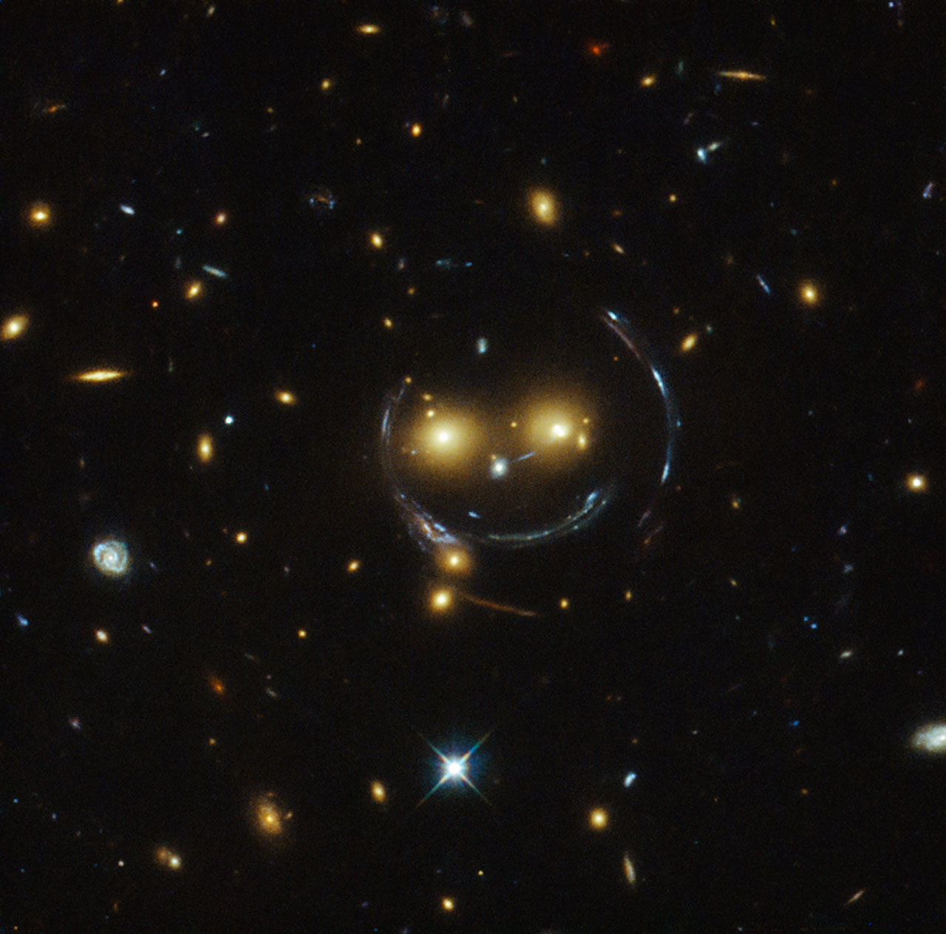
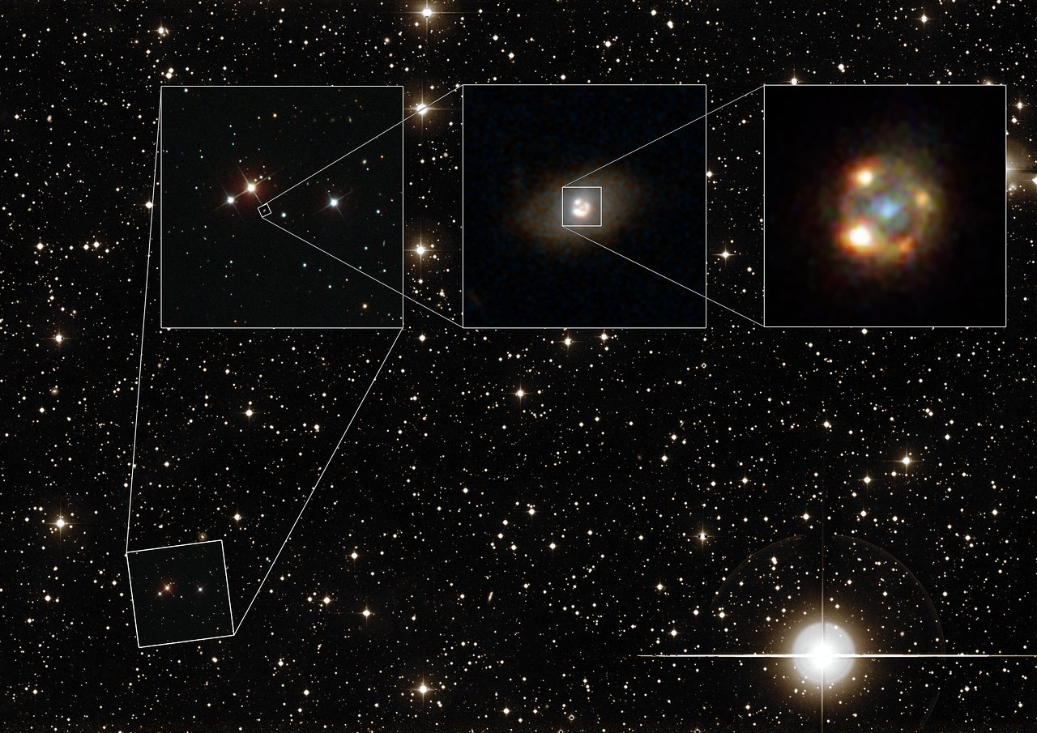
SEEN BY HUBBLE
The Universe runs this experiment for us
Cosmic Horseshoe
Near-complete Einstein ring around a luminous red galaxy.
SDSS J1038+4849
A galaxy-group lens: ring arcs make the famous “smiley face”.
Supernova iPTF16geu
One supernova, four images — quadruply lensed by a foreground galaxy.
Image credits: NASA, ESA/Hubble
3 / 12
Notes:
Three real morphologies our simulator has to cover: full rings, partial arcs, and multiple point-like images.

Slide 4
THE PROBLEM
An intractable likelihood — and how SBI sidesteps it
The forward direction is easy: lenstronomy simulates the image for any parameter vector θ.
The reverse is not: PSF blur, pixel noise and parameter degeneracies make the likelihood p(image | θ) intractable.
Classical MCMC fits one system at a time — hours per lens, and it needs that likelihood.
BayesFlow (neural posterior estimation): train a network on simulated (θ, image) pairs once, then get the full posterior for any new image in milliseconds — amortized inference.
Parameter | Meaning | Prior
θE | Einstein radius | U(0.7, 1.6)″
e1, e2 | Lens ellipticity | q ∈ (0.6, 1.0), φ ∈ (0, π)
γ1, γ2 | External shear | γ ∈ (0, 0.08), φ ∈ (0, π)
xs, ys | Source position | U(−0.3, 0.3)″
Rs | Source half-light radius | U(0.05, 0.25)″
κ | External convergence | U(0, 0.2) — optional 9th
θ: the 8 (or 9, with κ) numbers the network must infer from one image
4 / 12
Notes:
Key idea of SBI: replace likelihood evaluation with simulation. The priors define the training distribution.

Slide 5
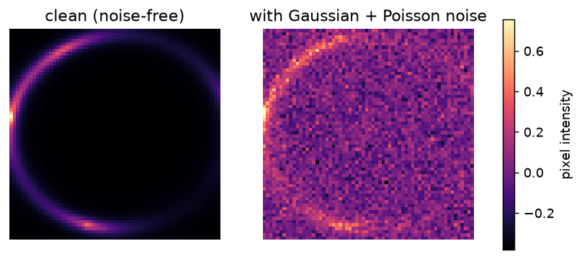
METHOD — STEP 1
Simulating realistic lenses with lenstronomy
Lens model: singular isothermal ellipsoid (SIE) + external shear + optional convergence sheet κ.
Source: elliptical Sérsic profile, ray-traced through the lens equation.
Instrument: 64×64 px at 0.05″/px (3.2″ field), Gaussian PSF, FWHM 0.1″.
Noise: Gaussian background (rms 0.1) + Poisson shot noise (100 s exposure).
Source amplitude tuned in a sweep → peak SNR median ≈ 16 (assignment target 10–30 ✓).
One simulated system: noise-free lensed arcs (left) and the observed image the network actually sees (right)
5 / 12
Notes:
Everything configurable lives in src/config.py. Dataset generation is parallelized across CPU cores; only training needs the GPU.

Slide 6
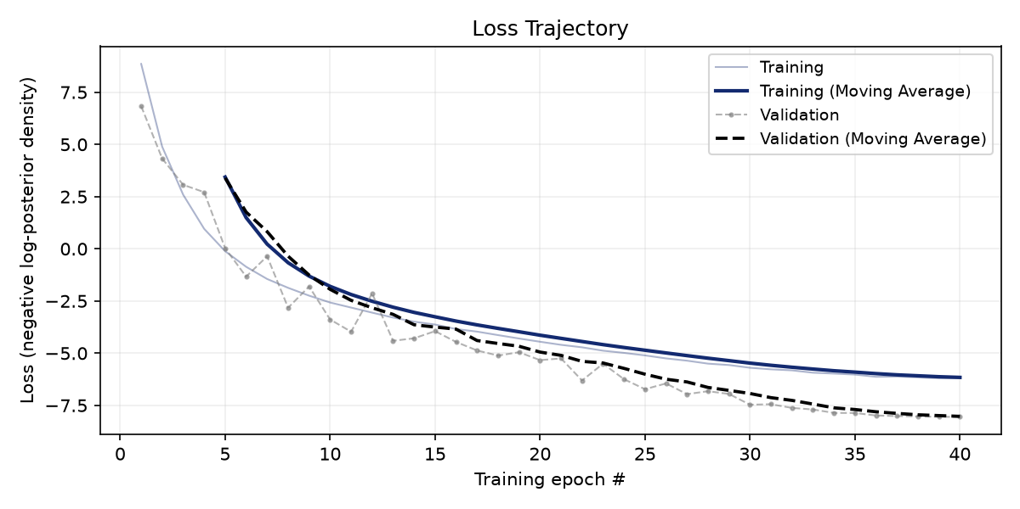
METHOD — STEP 2
Training BayesFlow on 50,000 simulated lenses
Dataset: 50,000 train / 2,000 val / 300 test image–parameter pairs, precomputed offline.
Summary network: small CNN compresses each image to a 48-dim learned summary.
Inference network: conditional coupling flow (depth 4) maps summaries to the joint posterior over θ.
40 epochs, batch 32, Adam 10⁻³, early stopping. RTX 3060 GPU: ~2 h at 118 ms/step — vs ~500 ms/step on CPU.
Validation loss stays below training loss for all 40 epochs → no overfitting (early stopping armed but never needed).
Negative log-posterior loss: best val −8.05 at the final epoch (20k run: −5.87)
6 / 12
Notes:
Run 4 config. Early runs (8k images, low SNR) overfit after epoch ~20; scaling the dataset removed it entirely.

Slide 7
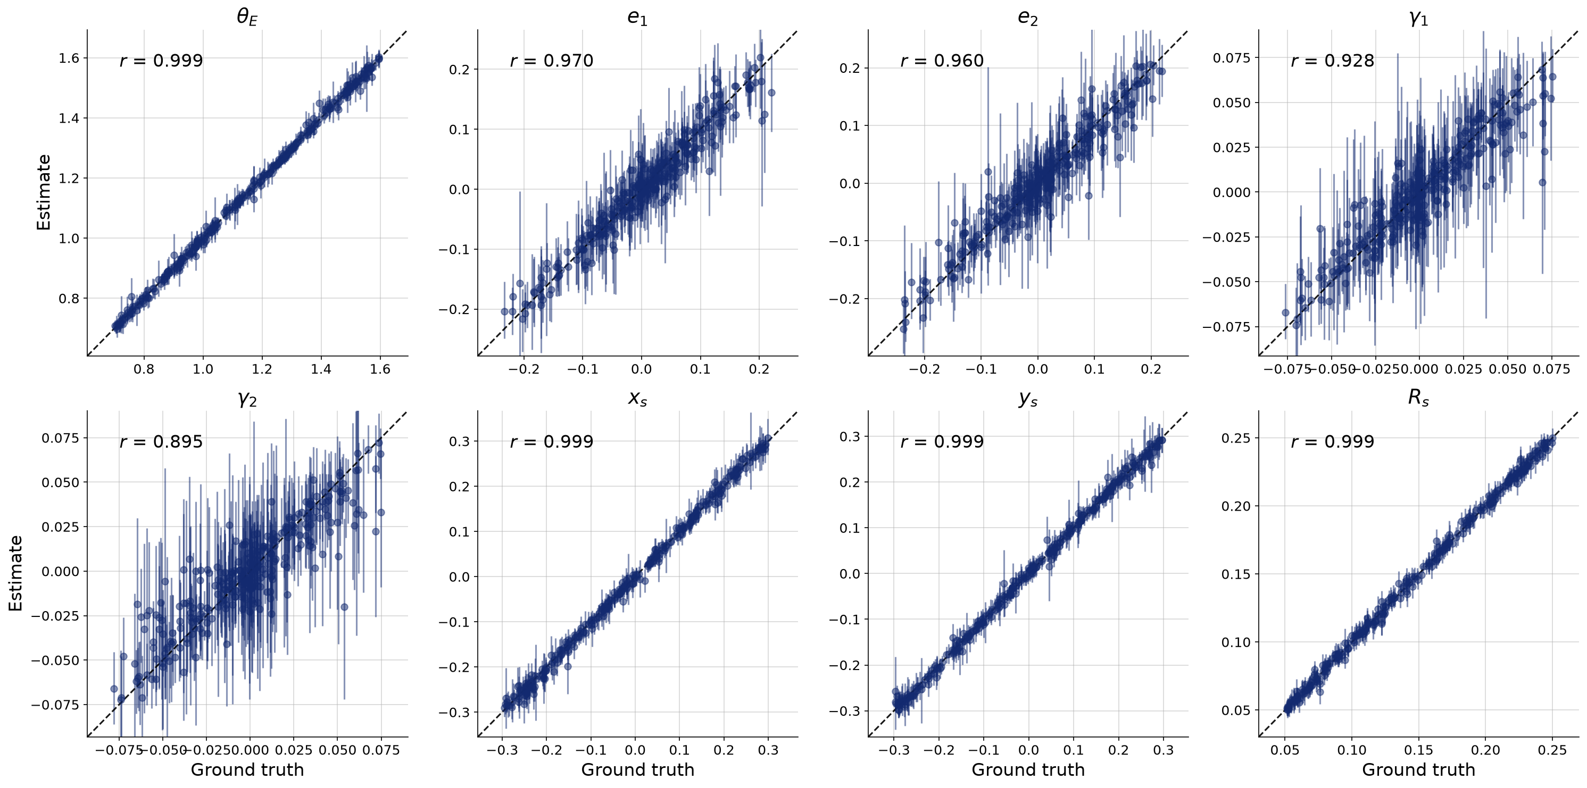
RESULTS
Near-perfect parameter recovery at realistic SNR
R² — posterior mean vs truth, 300 unseen test systems:
θE, Rs = 1.00 xs, ys = 1.00
e1 = 0.94, e2 = 0.92
γ1 = 0.86, γ2 = 0.80 (shear is intrinsically subtle)
Image quality is everything: at the uncorrected low SNR (median 3.7), the same pipeline managed only γ1 = 0.21 and γ2 = 0.06 — fixing the SNR to spec unlocked every parameter.
Error bars shrink where the data are informative and stay wide where they are not — exactly what a posterior should do.
7 / 12
Notes:
Run 4, 8-parameter model. Each dot is one test lens; dashed line = perfect recovery.

Slide 8
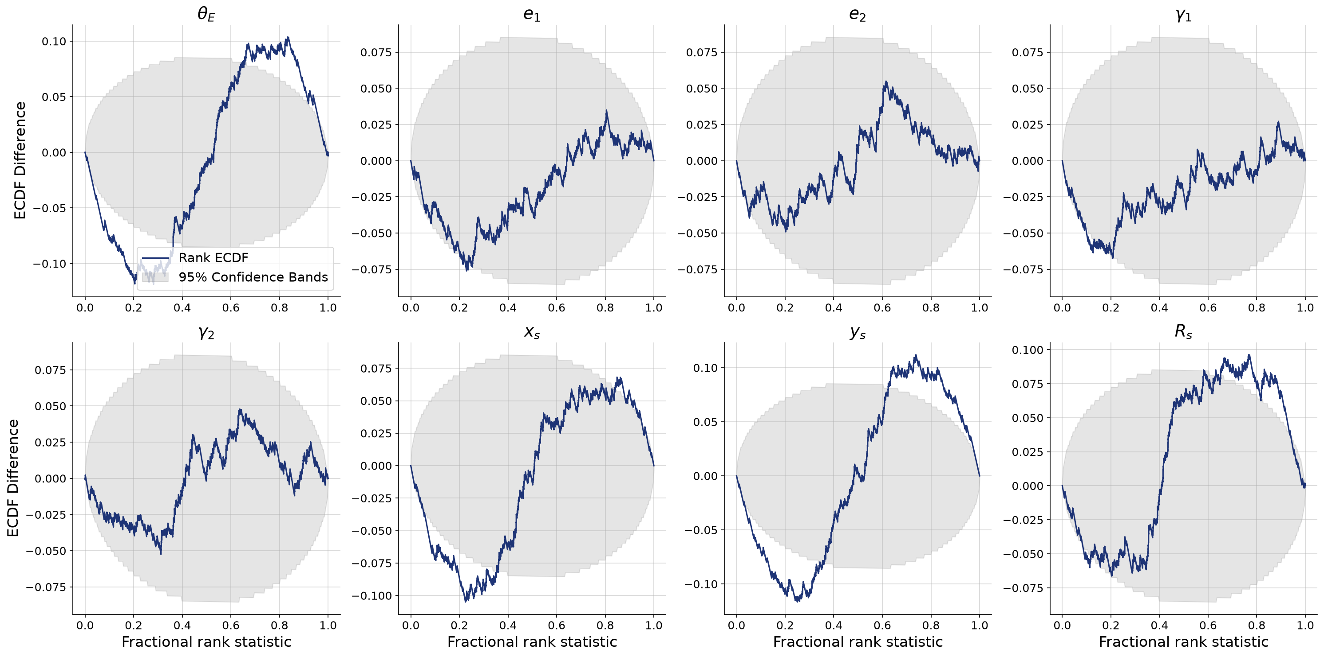
RESULTS — UNCERTAINTY
Are the error bars honest? Simulation-based calibration
SBC test: rank the true θ within its own posterior samples — over many systems the ranks must be uniform.
e1, e2, γ1, γ2: rank ECDF inside the 95% band → well calibrated.
θE, xs, ys, Rs: central S-shape → mildly underconfident — error bars a touch wide, the safe direction to err.
Identical at 20k and 50k samples → a network-capacity effect, not a data-volume one.
8 / 12
Notes:
Grey band = 99% expectation under uniformity. Flat within band = trustworthy uncertainties.

Slide 9
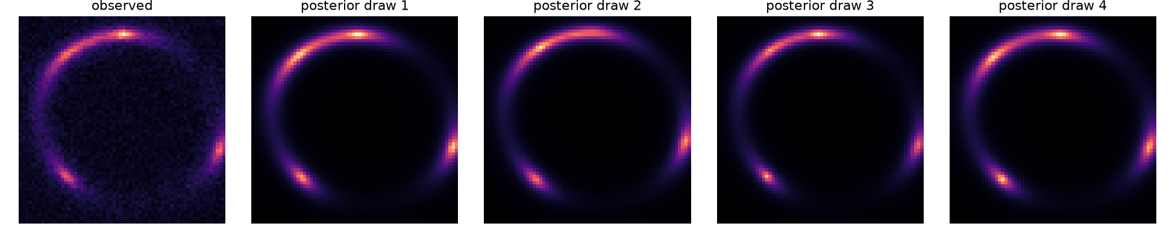
RESULTS — CLOSING THE LOOP
Posterior predictive: re-simulate what the network believes
Draw θ from the posterior of one observed image, push each draw back through the simulator, and compare.
Ring radius, all three bright knots and the azimuthal light profile are reproduced; draws differ mainly in knot brightness — the part the noise genuinely hides.
9 / 12
Notes:
Left panel: the noisy observation. Right: four independent posterior draws re-simulated.

Slide 10
THE PHYSICS TEST
The mass-sheet degeneracy, rediscovered by the network
Theory: adding a uniform convergence sheet κ (with rescaling) leaves the image almost unchanged — κ cannot be measured from one image.
The trained network agrees: κ posterior ≈ prior (contraction +0.16, R² = 0.21).
corr(κ, θE) = −0.96 — the posterior collapses onto exactly the degeneracy ridge the lens equations predict.
Only θE pays: R² 1.00 → 0.94. Every other parameter is untouched.
A calibrated method must refuse to know the unknowable — and it does.
 | with κ | without κ
θE | 0.94 | 1.00
κ | 0.21 (≈ prior) | —
e1 / e2 | 0.92 / 0.90 | 0.94 / 0.92
γ1 / γ2 | 0.85 / 0.80 | 0.86 / 0.80
xs / ys / Rs | 0.99 / 0.99 / 0.98 | 1.00 / 1.00 / 1.00
Recovery R² per parameter — 9-parameter (κ) run vs 8-parameter run
10 / 12
Notes:
This is the assignment's key comparison: the degeneracy is specific to the (κ, θE) pair, exactly as the lensing equations predict.

Slide 11
WRAP-UP
Conclusions
End-to-end SBI pipeline: simulate → train → amortized posteriors in milliseconds per lens.
At realistic SNR (median ≈ 16): R² ≥ 0.99 for Einstein radius, source position and size; 0.80–0.94 for ellipticity and shear.
Uncertainties are honest (calibrated, or mildly conservative for the best-constrained parameters), and the mass-sheet degeneracy emerges exactly where theory demands it.
GPU acceleration makes iteration feasible: a full 50,000-sample retrain takes ~2 hours on a single RTX 3060.
Next steps: a larger network (the remaining conservatism is capacity-limited, not data-limited), more complex sources, and real survey cutouts (Euclid, Rubin-LSST) — where amortized inference is the only way to keep up with the expected ~100,000 new lenses.
11 / 12
Notes:
Close with the scale argument: upcoming surveys make per-lens MCMC impossible; amortized SBI is built for exactly this.

Slide 12
THANK YOU
Questions?
Sayed Atique Newaz · Noureen Alam Meem · Mashuk Khan
Software: lenstronomy · BayesFlow · PyTorch · NumPy · Matplotlib Hubble imagery: NASA, ESA/Hubble (CC BY 4.0) Full write-up: report/report.pdf · results log: RESULTS.md
SDSS J1038+4849 — even the Universe approves. (NASA & ESA/Hubble)
12 / 12
Notes:
Credits and pointers to the repo, report and results log.

