Slide 1


SEPT 2026
INJEQT: Improved Magic-State Injection Protocol for Fault-Tolerant Quantum Extractor Architectures
Sayam Sethi, Sahil Khan, Aditi Awasthi, Abhinav Anand, Jonathan Mark Baker

Slide 2
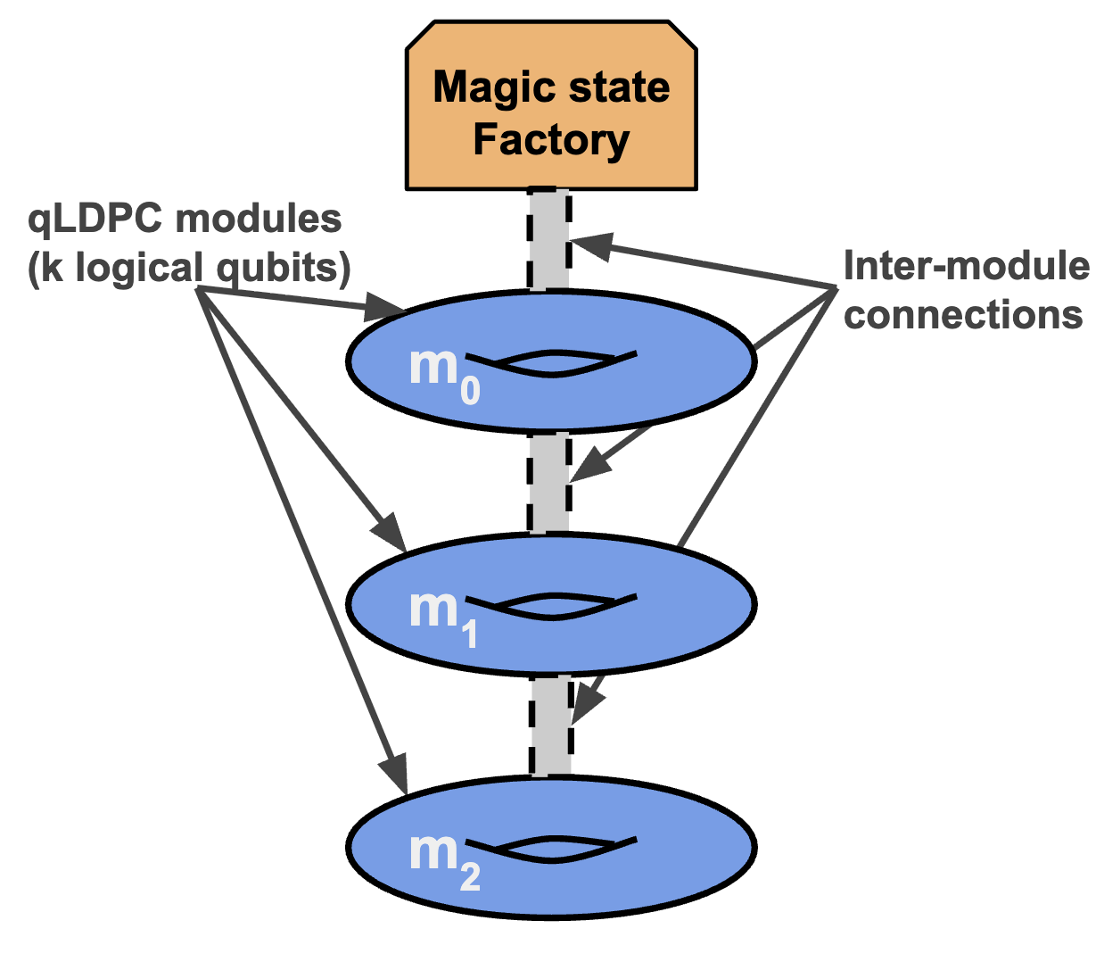
Extractor-Based Architectures
Recent works^{[27,9,31]} have proposed architectural designs and a PBC (Pauli-Based Computation) compilation pipeline
These techniques enable universal quantum computation on any high-rate code
Still need to address
  mechanism and cost of resource state generation + injection
  construction of adapters for inter-module operations
[27] https://arxiv.org/abs/2410.03628
[9] https://arxiv.org/abs/2503.10390
[31] https://arxiv.org/abs/2506.03094

Slide 3
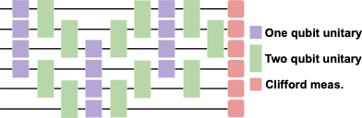
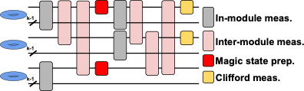
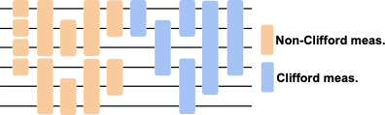
Compiling to Extractor Architecture
Start with a Clifford + Rz/T circuit
Commute all Cliffords to the end to obtain Pauli Product Rotations/Measurements (PPRs/PPMs)
Compile the PPRs and PPMs into extractor instructions

Slide 4
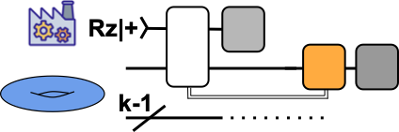
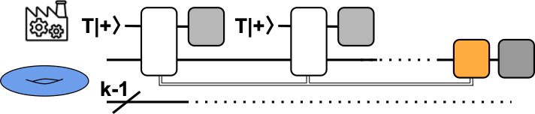
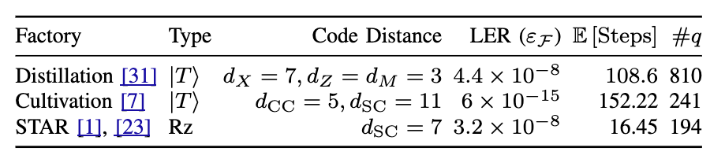
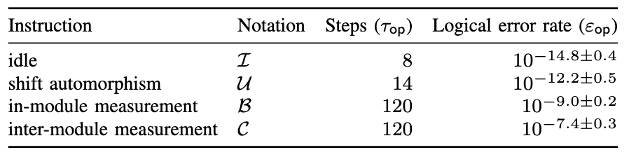
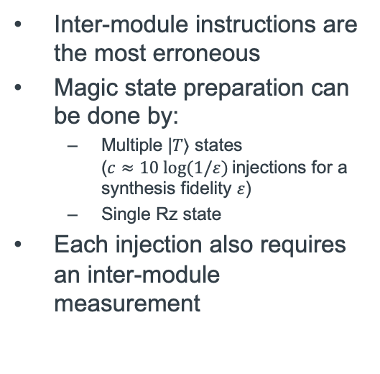
Extractor ISA on the Gross Code (Tour de Gross)
requires a correction Rz with 50% probability
Inter-module instructions are the most erroneous
Magic state preparation can be done by:
  Multiple |𝑇⟩ states
  ($c≈10 log⁡(1/ε)$ injections for a synthesis fidelity $ε$)
  Single Rz state
Each injection also requires an inter-module measurement
[31] https://arxiv.org/abs/2506.03094
[7] http://arxiv.org/abs/2409.17595
[1] https://arxiv.org/abs/2303.13181v1
[23] http://arxiv.org/abs/2408.14708

Slide 5
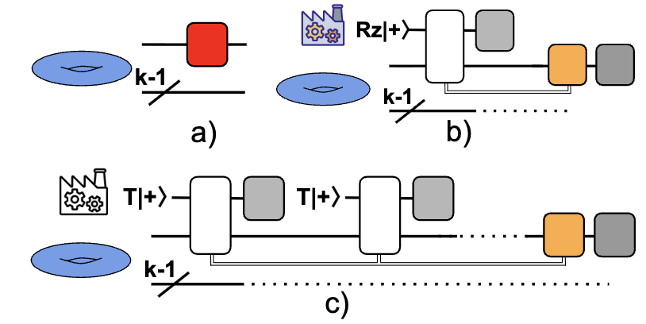
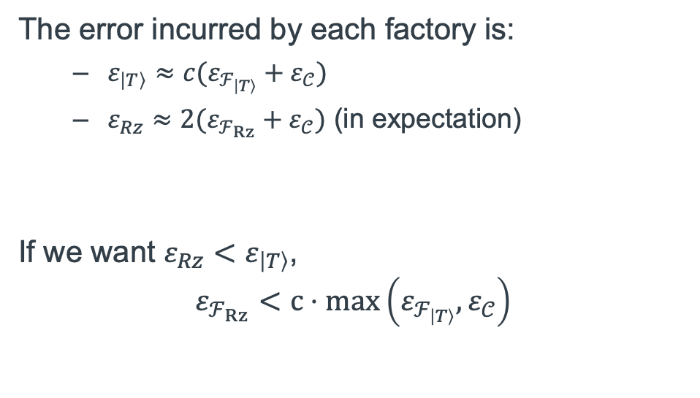
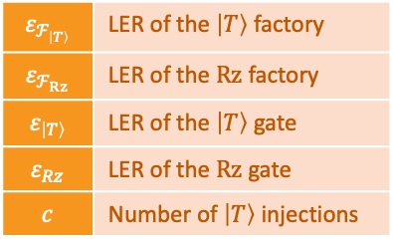
Error Analysis – Deciding between $\left|T\right\rangle$ and $Rz$
$$ε_{ℱ_{\left|T\right\rangle }}$$ | LER of the $\left|T\right\rangle$ factory
$$ε_{ℱ_{Rz}}$$ | LER of the $Rz$ factory
$$ε_{\left|T\right\rangle }$$ | LER of the $\left|T\right\rangle$ gate
$$ε_{Rz}$$ | LER of the $Rz$ gate
$$c$$ | Number of $\left|T\right\rangle$ injections
The error incurred by each factory is:
  $ε_{\left|T\right\rangle }≈c(ε_{ℱ_{\left|T\right\rangle }}+ε_{𝒞})$
  $ε_{Rz}≈2(ε_{ℱ_{Rz}}+ε_{𝒞})$ (in expectation)
If we want $ε_{Rz}<ε_{\left|T\right\rangle }$,
$$ε_{ℱ_{Rz}}<c⋅\max\left(ε_{ℱ_{\left|T\right\rangle }},ε_{𝒞}\right)$$
Notes:
Rz injections fail with 50% probability

Slide 6
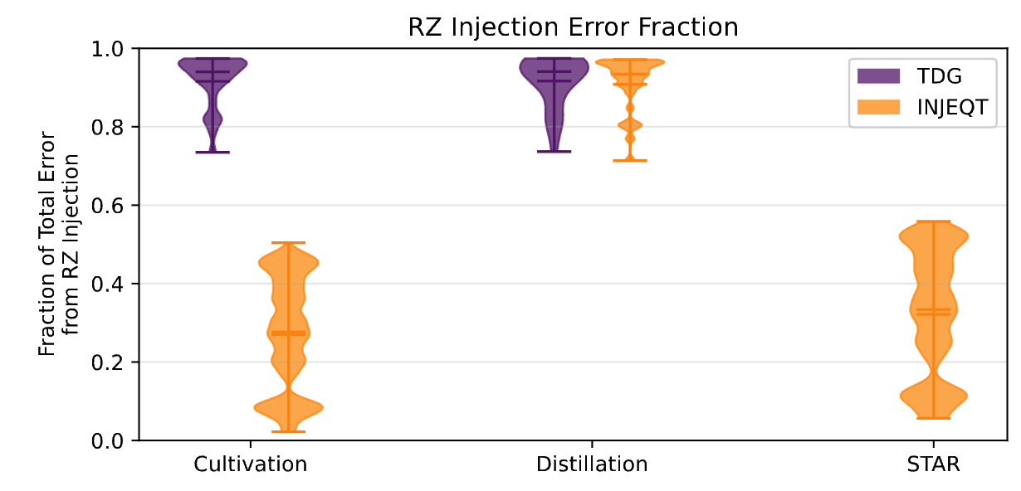
Error Analysis – $Rz$ wins over $\left|T\right\rangle$ at current LER estimates
Notes:
We can achieve better Rz error rates than T via INJEQT at current error estimates

Slide 7
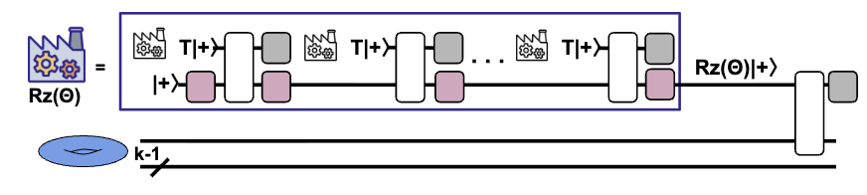
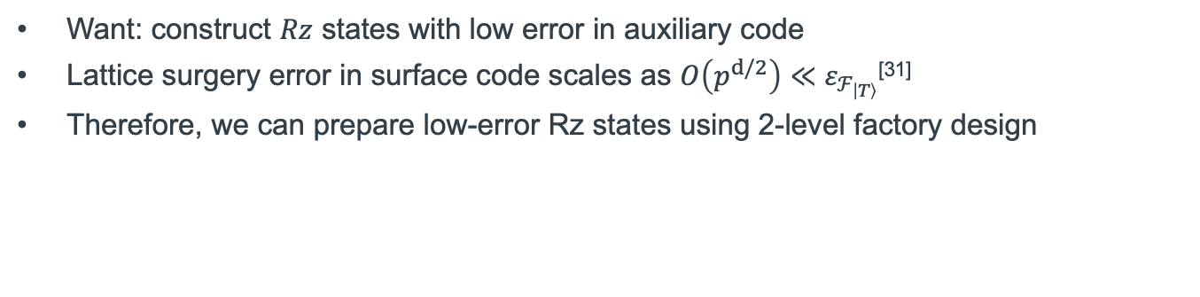
INJEQT: 2-Level Factory Design
Want: construct $Rz$ states with low error in auxiliary code
Lattice surgery error in surface code scales as $O\left(p^{d/2}\right)≪ε_{ℱ_{\left|T\right\rangle }}$^{[31]}
Therefore, we can prepare low-error Rz states using 2-level factory design
[31] https://arxiv.org/abs/2506.03094
Note: [17] http://arxiv.org/abs/2604.20013 is a same-time work with a similar construction

Slide 8
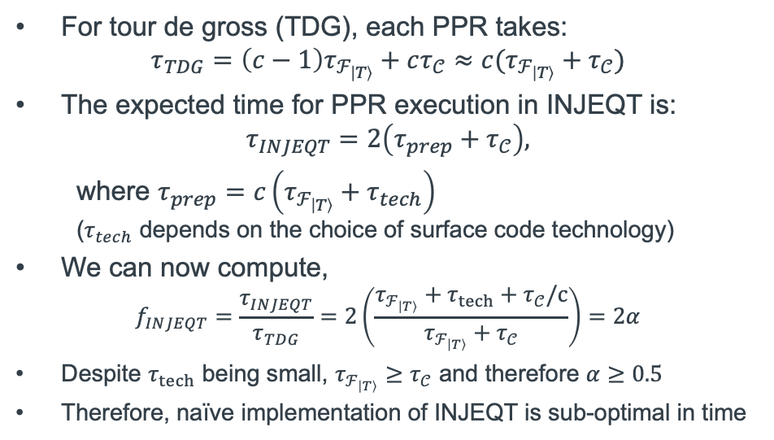
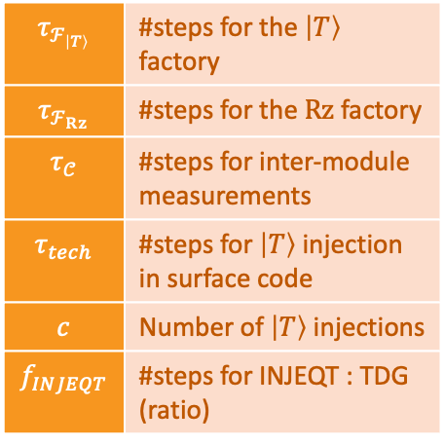
INJEQT: Timing Analysis
For tour de gross (TDG), each PPR takes:
$$τ_{TDG}=\left(c−1\right)τ_{ℱ_{\left|T\right\rangle }}+cτ_{𝒞}≈c(τ_{ℱ_{\left|T\right\rangle }}+τ_{𝒞})$$
The expected time for PPR execution in INJEQT is:
$$τ_{INJEQT}=2\left(τ_{prep}+τ_{𝒞}\right),$$
where $τ_{prep}=c\left(τ_{ℱ_{\left|T\right\rangle }}+τ_{tech}\right)$
($τ_{tech}$ depends on the choice of surface code technology)
We can now compute,
$$f_{INJEQT}=\frac{τ_{INJEQT}}{τ_{TDG}}=2\left(\frac{τ_{ℱ_{\left|T\right\rangle }}+τ_{tech}+τ_{𝒞}/c}{τ_{ℱ_{\left|T\right\rangle }}+τ_{𝒞}}\right)=2α$$
Despite $τ_{tech}$ being small, $τ_{ℱ_{\left|T\right\rangle }}≥τ_{𝒞}$ and therefore $α≥0.5$
Therefore, naïve implementation of INJEQT is sub-optimal in time
$$τ_{ℱ_{\left|T\right\rangle }}$$ | #steps for the $\left|T\right\rangle$ factory
$$τ_{ℱ_{Rz}}$$ | #steps for the $Rz$ factory
$$τ_{𝒞}$$ | #steps for inter-module measurements
$$τ_{tech}$$ | #steps for $\left|T\right\rangle$ injection in surface code
$$c$$ | Number of $\left|T\right\rangle$ injections
$$f_{INJEQT}$$ | #steps for INJEQT : TDG (ratio)
Notes:
Okay so we addressed error rates, what about time?

Slide 9
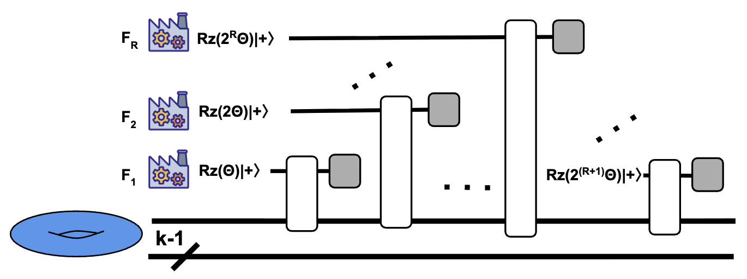
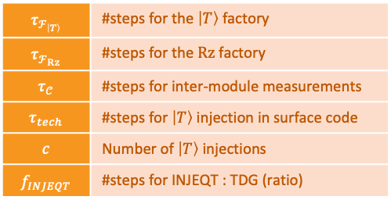
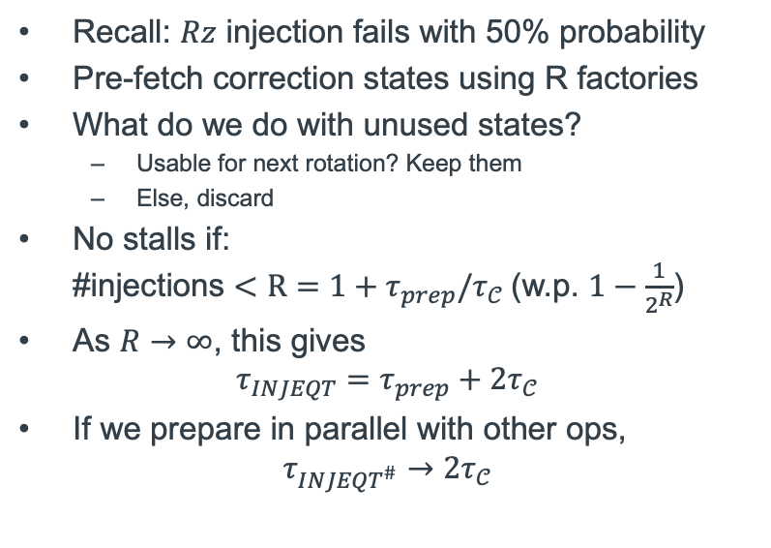
INJEQT: Improve Performance by Pre-Fetching
Recall: $Rz$ injection fails with 50% probability
Pre-fetch correction states using R factories
What do we do with unused states?
  Usable for next rotation? Keep them
  Else, discard
No stalls if:
#injections $<R=1+τ_{prep}/τ_{𝒞}$(w.p. $1−\frac{1}{2^{R}}$)
As $R→∞$, this gives
$$τ_{INJEQT}=τ_{prep}+2τ_{𝒞}$$
If we prepare in parallel with other ops,
$$τ_{INJEQT^{\#}}→2τ_{𝒞}$$
$$τ_{ℱ_{\left|T\right\rangle }}$$ | #steps for the $\left|T\right\rangle$ factory
$$τ_{ℱ_{Rz}}$$ | #steps for the $Rz$ factory
$$τ_{𝒞}$$ | #steps for inter-module measurements
$$τ_{tech}$$ | #steps for $\left|T\right\rangle$ injection in surface code
$$c$$ | Number of $\left|T\right\rangle$ injections
$$f_{INJEQT}$$ | #steps for INJEQT : TDG (ratio)
Notes:
Well, that’s bad, so how do we fix this?

Slide 10
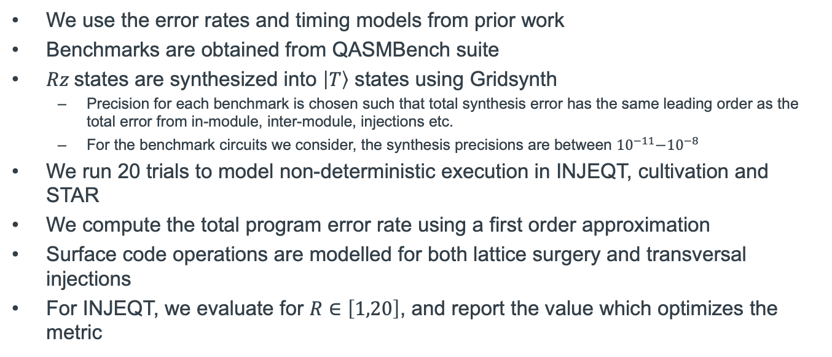
Evaluation Methodology
We use the error rates and timing models from prior work
Benchmarks are obtained from QASMBench suite
$Rz$states are synthesized into $\left|T\right\rangle$ states using Gridsynth
  Precision for each benchmark is chosen such that total synthesis error has the same leading order as the total error from in-module, inter-module, injections etc.
  For the benchmark circuits we consider, the synthesis precisions are between ${10}^{−11}\text{−}{10}^{−8}$
We run 20 trials to model non-deterministic execution in INJEQT, cultivation and STAR
We compute the total program error rate using a first order approximation
Surface code operations are modelled for both lattice surgery and transversal injections
For INJEQT, we evaluate for $R∈\left[1,20\right]$, and report the value which optimizes the metric
Notes:
Well, that’s bad, so how do we fix this?

Slide 11
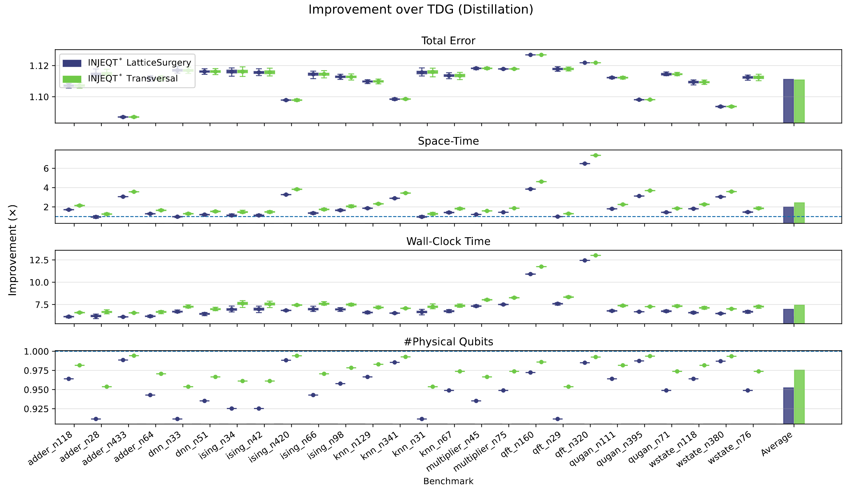
Evaluation – Distillation Factory
Up to 12.5% improvement in total error
Up to 7x improvement in space-time
Up to 13x improvement in wall-clock time
With at most an 8% increase in #physical qubits

Slide 12
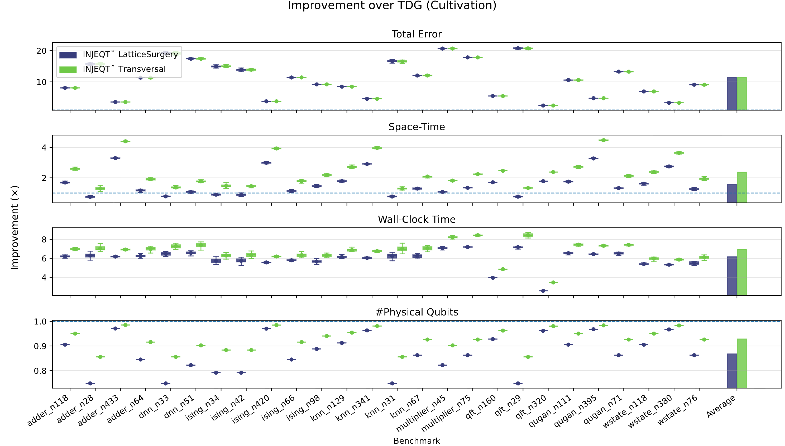
Evaluation – Cultivation Factory
Up to 22x improvement in total error
Up to 5x improvement in space-time
Up to 8.8x improvement in wall-clock time
With at most a 25% increase in #physical qubits

Slide 13
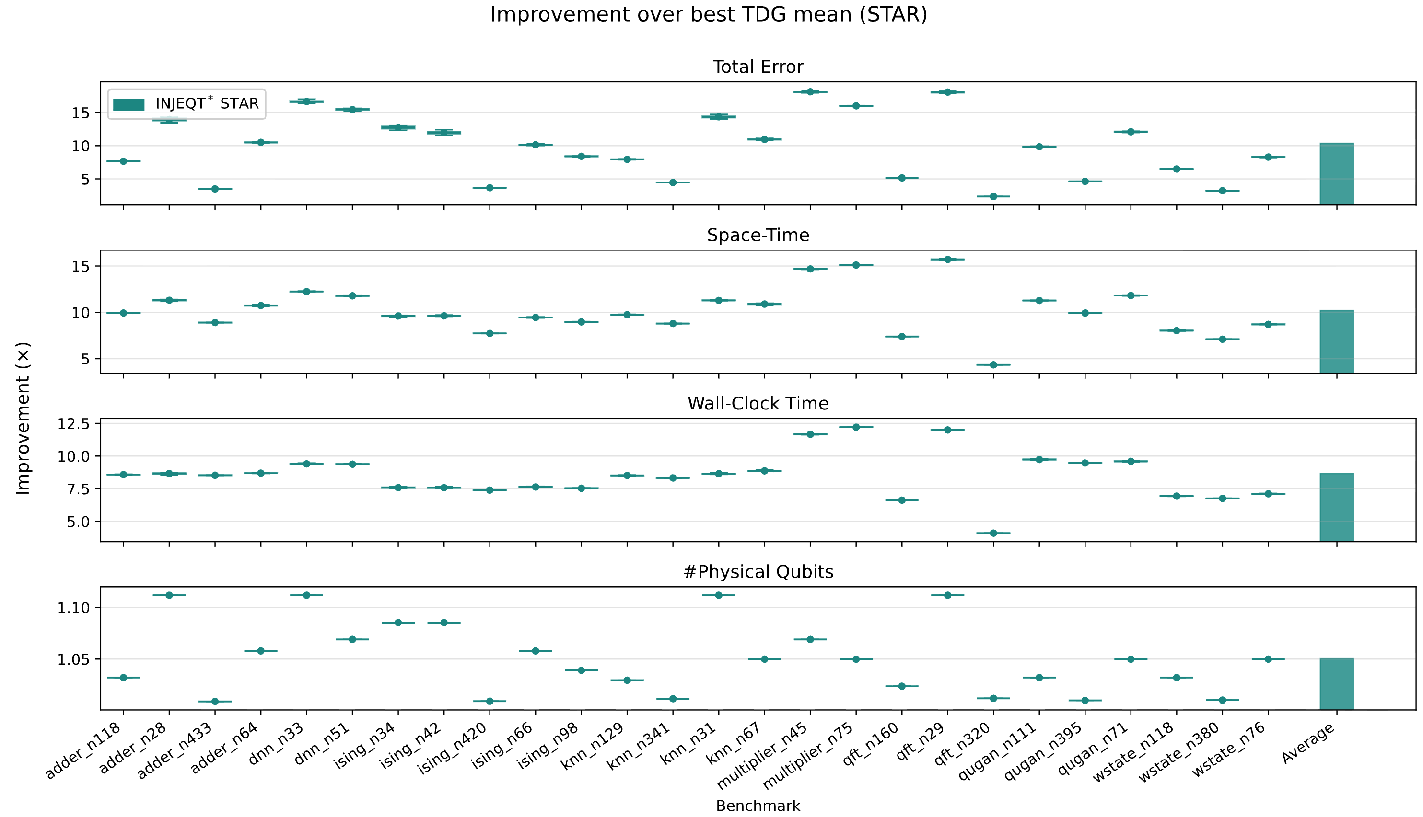
Evaluation – STAR Factory
Up to 18x improvement in total error
Up to 16x improvement in space-time
Up to 12x improvement in wall-clock time
Up to 11% improvement in #physical qubits

Slide 14
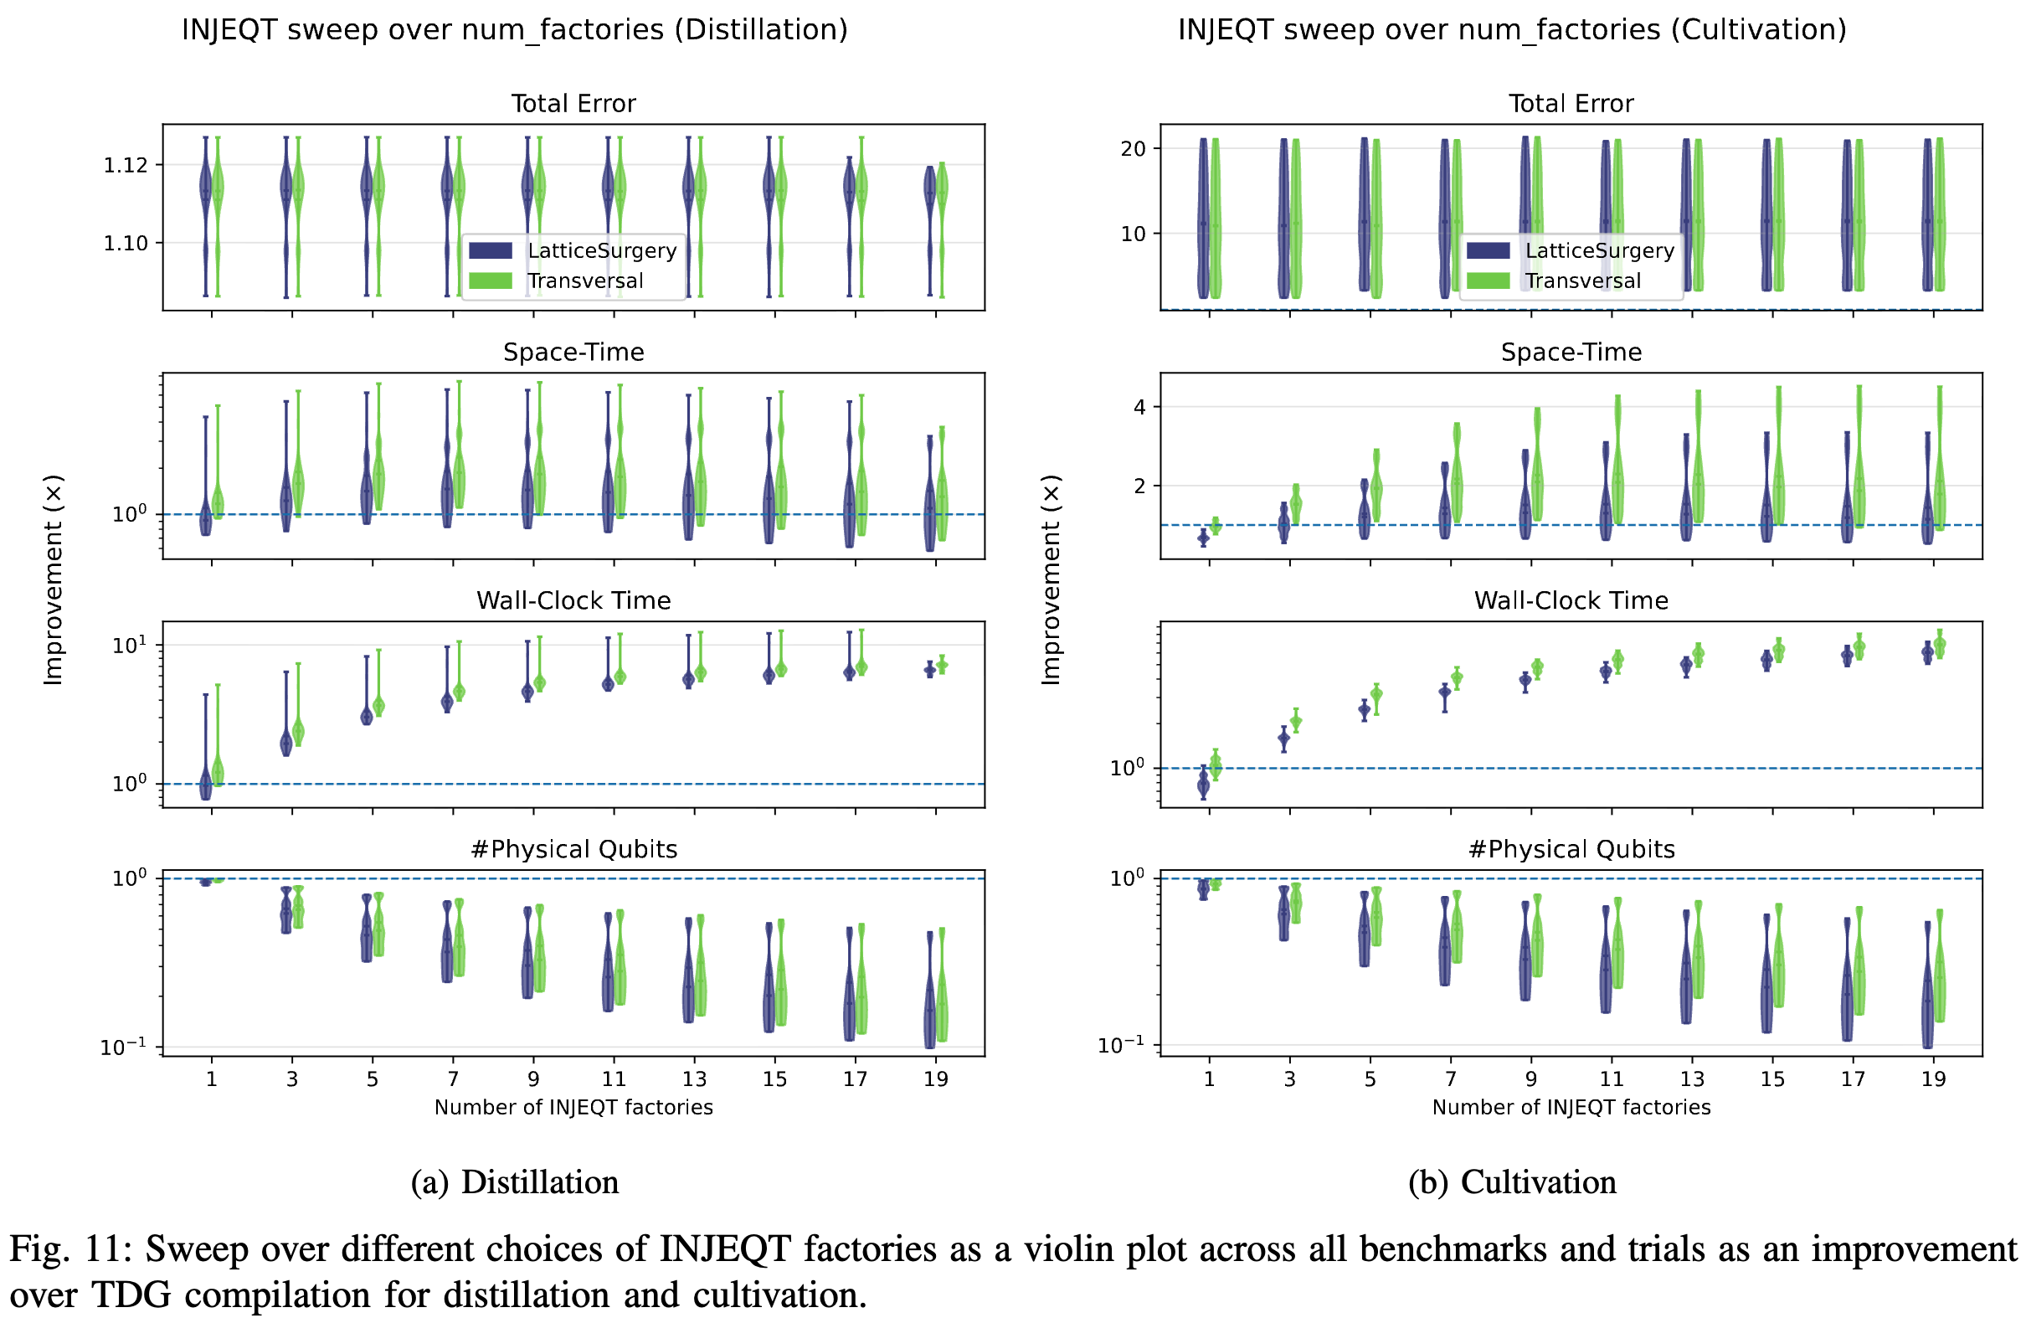
Evaluation – Sensitivity to #Factories (R)
No change
Different benchmarks have different operating points
Improvements saturate with increasing factories
Monotonic increase in #qubits

Slide 15
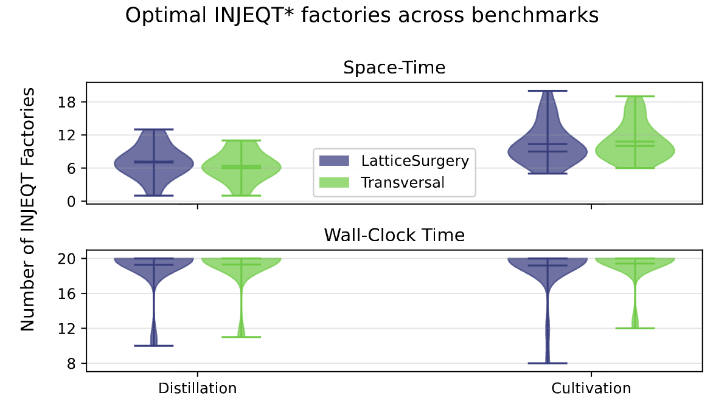
Evaluation – Sensitivity to #Factories (R)
Optimal R for most benchmarks is ~7-10
Some benchmarks achieve maximal speedup with fewer factories

Slide 16
Conclusion
Extractor-based architectures are bottlenecked by:
  sequential execution and high error rates of inter-module measurements
  Resource state injection contributes over 90% of the total program error
We propose INJEQT, a 2-level factory design:
  first prepare Rz states in an auxiliary code,
  then inject the Rz state onto the extractor module
INJEQT improves program error rates by up to 12.5% for distillation, up to 22x for cultivation, and up to 18x for STAR factories
To improve latency of the 2-level factory, we introduce a pre-fetching technique
  prepare the Rz state and potential corrections in parallel with other extractor operations
This approach improves the wall-clock times by up to 13x for distillation, 8.8x for cultivation and 12x for STAR

Slide 17

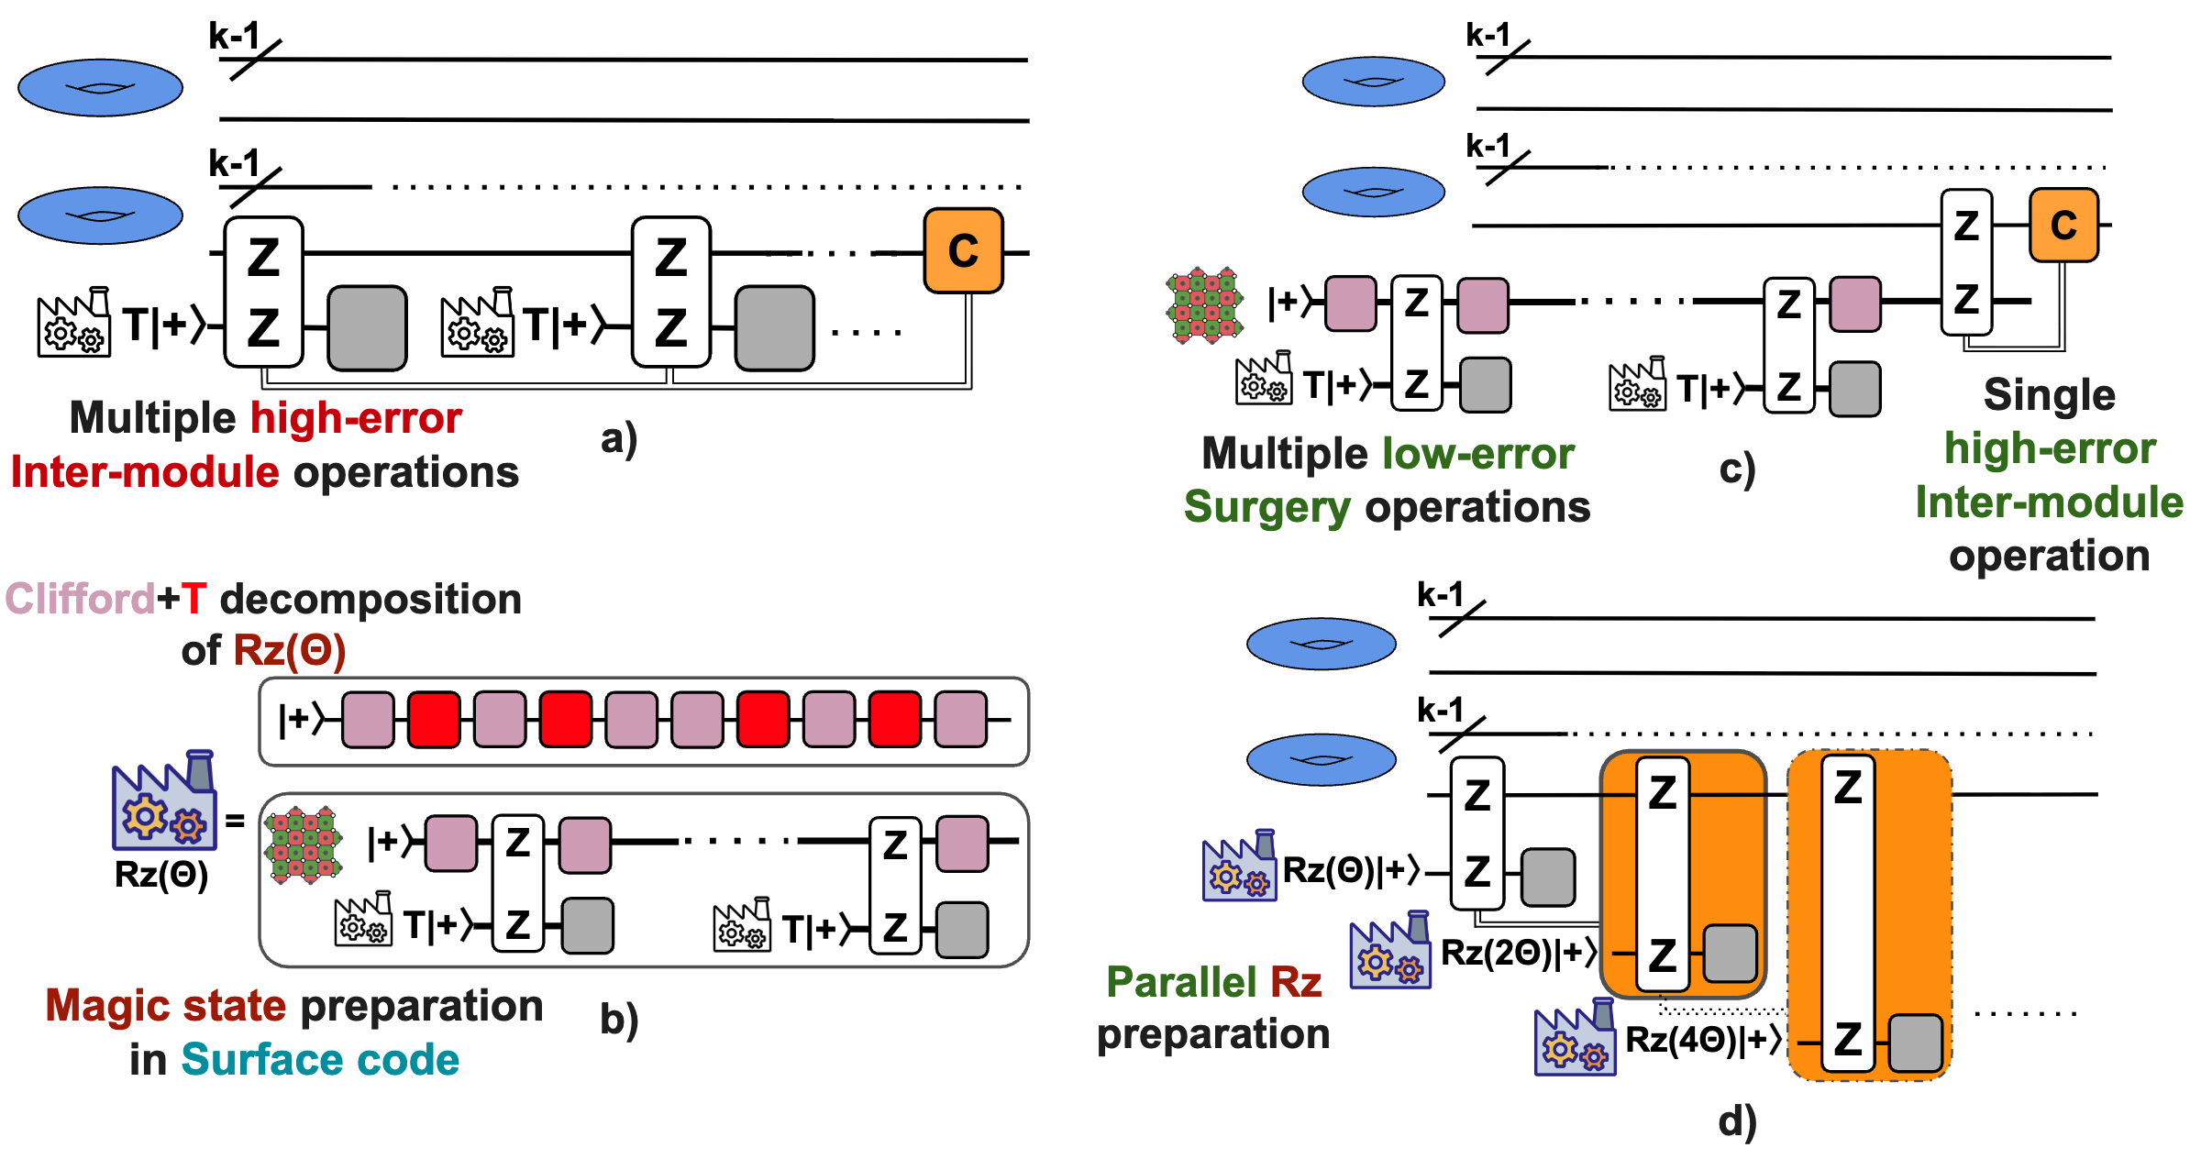
Thanks!
Code available

