Slide 1

ECE 382V: QUANTUM COMPUTING SYSTEMS:
A SOFTWARE/ ARCHITECTURE PERSPECTIVE
Gate error mitigATION
POULAMI DAS
ECE, The University of Texas at Austin

Slide 2
NISQ Objective: Maximize Program Success Rate
Use minimum gates
Use commutative properties, re-order operations
Program
Optimal native gate decomposition
Efficient mapping to reduce SWAPs
Unroll loops/ Decompose multi-qubit operations
Cancel
Gates
Map
Qubits
Schedule + Route
Cancel
Gates
Nativize
Gates
Correct Readout Errors
Reduce SWAPs, select better-than-worst SWAPs
Another round of cancellations+ reordering
Generate Pulse Schedule
Run
Post-process
Optimize at pulse-level to reduce program length
Characterization Circuits OR Functionally identical copies
Cut and Stitch
Software compiler optimizations are crucial to improve the success-rate of NISQ applications

Slide 3
Multi-Qubit Gate Decomposition Using Minimum Gates
Most quantum computers allow a limited number of single-qubit and two-qubit gates as their basis gates [Example: IBM Basis Gate Set: ID, SX, RZ, CX, X]
Multi-qubit gates must be decomposed using minimal gates [Example: Toffoli gates decomposition using CNOT gates]
Controlled Gates: Bit-Flip versus Phase-Flip
Quantum compilers transform high-level programs into low-level sequence of control pulses

Slide 4
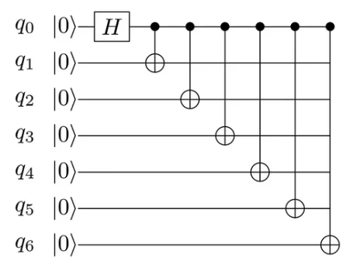
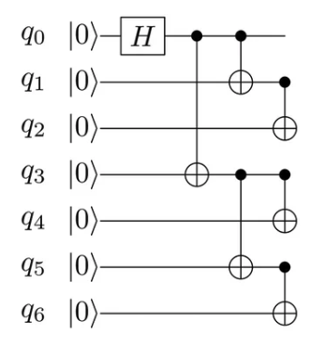
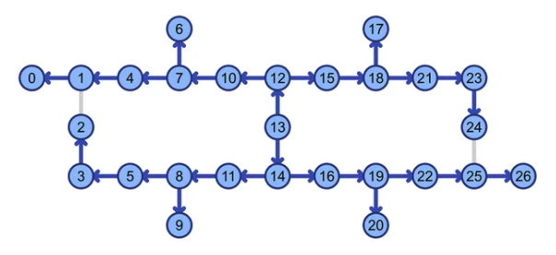
Instruction Reordering
GHZ-6 (serial)
GHZ-6 (parallel)
CNOT Depth: 6
CNOT Depth: 3
SWAPs: 3
SWAPs: 0
SWAP q0,q1
SWAP q1,q2
SWAP q2,q4
5
0
1
2
4
6
4
3
5
6
IBM
Toronto
3
0
1
2
https://research.ibm.com/blog/whole-device-entanglement
Re-ordering instructions enable us to reduce depth and SWAP overheads

Slide 5
Other Examples Of Instruction Blocks That Commute
U
U
R_{z}
R_{z}
V
V
+
+
Gates acting on different qubits
Controls with Z-axis rotations
U1 0
0 U2
V1 0
0 V2
V1 0
0 V2
U1 0
0 U2
+
+
+
+
CNOTs with different controls but same target
Gates with diagonal matrices
Compilers use commutative rules to re-order instructions

Slide 6
Gate Cancellations
A sequence of gates which is effectively identity operation can be removed
Reduce the number of gates by combining them (Example: CNOT followed by a SWAP)
q0
H
A
B
q1
+
q0
q1
+
q0
H
H
H
H
+
H
+
+
q1
Gate cancellation is typically performed twice (before and after scheduling and routing)

Slide 7
Some Key Takeaways So Far
One optimization (typically) affects another
The demarcation between optimizations can be blurry (for example, a good initial mapping leads to reduced SWAP overheads)
Minimizing operations may not always lead to higher probability of successful execution
Each compiler optimization attempts to trade-off across several dimensions [circuit duration or depth, total gate count, compilation latency]
Some optimizations may be counter-intuitive
Time-Optimal Qubit Mapping [trade-off SWAPs at the cost of circuit depth]
Do not always remove sequences of gates that are effectively Identity [we add them!!!]
Controlled Gates: Bit-Flip versus Phase-Flip
What do you think is the net effect of all optimizations combined?

Slide 8
GATE NATIVIZATION
Why quantum computing? What topics will be covered? What are the requirements and expected outcomes?

Slide 9








What Is Gate Nativization?
Quantum program/circuit operations are high-level operations
Devices support only low-level native gates
Each high-level operation must be mapped into a sequence of native gates
Some systems support multiple native gates to translate the same high-level operation
Example: Rigetti systems allow XY, CZ, and CPHASE natives gates to translate CNOTs
H
High-level
Gate Nativization
RZ ($\frac{Π}{2}$)
RX ($\frac{Π}{2}$)
RZ ($\frac{Π}{2}$)
Low-level
q0
R_{X}($Π$)
M
q1
+
M
Nativized using XY
Nativized using CZ
Nativized using CPHASE
Controlled Gates: Bit-Flip versus Phase-Flip
Nativization produces a sequence of operations compatible with the target device

Slide 10
Key Requirements For Gate Nativization
Functional equivalence
Translation using a sequence with fewest gates
Selecting the optimal native gate for a high-level operation when there are multiple native gates available [Example: Should we choose XY or CPHASE or CZ to translate a CNOT on Rigetti machines?]
Second problem is analogous to the ISA providing many ADD operations to choose from while translating the instruction a+b
How do we determine the optimal native gate to translate our program?

Slide 11

Trivial Solution: Global Native Gate Selection
One global native gate for all CNOTs in the program
Native gates exhibit variability in error-rates
XY error-rates
1
1%
2%
1%
4%
1
2
3
4
q0
H
XY
M
q3
q0
q1
q2
q3
q4
2
q0
q1
q2
q4
+
q1
+
XY
3
M
CP error-rate
1%
q2
+
XY
4
M
Nativize using XY
Nativize
using CZ
Nativize using CP
q3
+
XY
M
Device error unaware
q4
+
M
Select a global native gate
Use it to translate every CNOT
Nativization must account for device error characteristics

Slide 12


Solution: Device Error Profile-Based Local Selection?
Select the native gate with the lowest error-rate using device error profile
1
q0
H
CP
2
M
+
+
q1
+
XY
3
M
Nativize using XY
Nativize using CZ
Nativize using CP
Nativized using XY
Nativized using CZ
Nativized using CP
q2
+
XY
4
M
q3
+
CP
M
Error Profile
XY: 3 %
CZ: 2 %
CP: 1 %
Device link
q4
+
M
Device error profile-
based selection
CP
XY
XY
CP
q0
q1
q2
q3
q4
1
2
3
4
How does such device error profile driven local selection perform?

Slide 13
Challenge: Device Error Based Selection Is Inefficient
Prepare 81 native gate decompositions (sequences)
There are 4 CNOTs, each CNOT can be decomposed into XY, CZ, or CP
Global Select
Device profile-based
Runtime best
XY, XY, XY, XY
CP, XY, XY, CP
CP, CP, CZ, CP
q0
H
M
1.2X
Poor device
error profile
q1
+
M
1.3X
q2
+
M
Application-
Unaware
q3
+
M
q4
+
M
Nativization must account for program characteristics

Slide 14

Application-Specific Native Gate Selection
Hard Non-Clifford
Poor
??
Poor
Unknown output
Classical Hard/ Quantum Easy
Program
Good
Poor
Easy Clifford
Poor
Poor
Different known output
Classical Easy/ Quantum Easy
Proxy
Good
Poor
Poulami Das et al. “The Imitation Game”, HPCA 2022
Leverage proxy circuits to mimic application behavior and learn the optimal native sequence

Slide 15

Insight-1: Imitate The Program Using Clifford Circuits
Create CopyCats- proxy circuits that approximately mimic the program, but has a known output
Program
Unknown
Output
CopyCat
Known Output
A
Hard Non-Cliffords-> Easy Cliffords
A
q0
U3
U2
M
q0
U3
S
M
B
C
B
C
q1
+
M
q1
+
M
q2
+
U1
+
M
q2
+
Z
+
M
CopyCat is used to learn the optimal native gate sequence

Slide 16
Insight-2: Narrow Down The Search Space
Challenge: Even if we known the output, search scales exponentially
Start the search with the sequence based on the device error profile,
update it if an alternative sequence with higher success-rate is found
Reference
A
q0
A
q0
U3
S
M
q0
U3
S
M
0
XY
B
C
A
B
C
q1
+
M
CP
XY
q1
+
M
CZ
CZ
CZ
q2
+
Z
+
M
2
1
M
B
C
q2
+
Z
+
q2
q1
The reference represents the best-known sequence at any given time

Slide 17

Navigate Towards The Optimal Native Gate Sequence
Attempt to find a better native gate candidate for each link, continuously update
A
A
q0
U3
S
M
q0
U3
XY
S
M
CZ
XY
CZ
B
C
B
C
Higher Success-Rate
q1
+
M
q1
+
M
CZ
CZ
CZ
CZ
q2
+
Z
+
M
q2
+
Z
+
M
Update
Reference
Reference
Replacement-1
q0
A
0
q0
U3
S
M
XY
A
CP
CP
XY
B
C
q1
+
M
CZ
CZ
CZ
2
1
B
C
q2
+
Z
+
M
q2
q1
Replacement-2

Slide 18
Insight-3: Learn Simultaneously For Multiple CNOTs
A
A
q0
U3
S
M
q0
U3
XY
S
M
CZ
CZ
XY
B
C
B
C
Lower Success-Rate
q1
+
M
q1
+
M
CZ
CZ
XY
CZ
CZ
XY
q2
+
Z
+
M
q2
+
Z
+
M
Reference
Replacement-3
q0
A
0
q0
U3
CZ
S
M
A
XY
B
C
Lower Success-Rate
CP
XY
+
M
q1
CP
CZ
CZ
CZ
CP
2
1
B
C
q2
+
Z
+
M
q2
q1
Replacement-4

Slide 19


ANGEL: Overview
Initial:
Device Error Profile-Based
Optimal For CopyCat
Optimal For Program
A
A
A
S
M
S
M
q0
U3
q0
U3
S
M
q0
U3
CZ
U2
XY
CZ
XY
XY
B
C
B
C
B
C
q1
+
M
q1
+
M
q1
+
M
CZ
CZ
CZ
CZ
CZ
CZ
M
M
q2
U1
M
q2
+
Z
+
q2
+
Z
+
+
Z
+
CopyCat
CopyCat
Compiled Program
ANGEL uses the optimal sequence of the CopyCat to nativize the input program

Slide 20
Design Implementation Of ANGEL
ANGEL has two key features: (1) copyCats and (2) a scalable search algorithm

Slide 21
Performance Overview Of ANGEL
Average: 1.4x
Best-Case: 2x
Scalability vs. Performance Trade-off
Exhaustive | 4 | 81 | 19.7K | 27 | 27 | 729 | 243 | 81
ANGEL | 4 | 5 | 5 | 7 | 7 | 7 | 7 | 9
ANGEL enables efficient gate nativization

Slide 22
Limitations Of ANGEL
CopyCats cannot imitate programs 100%, local search has limited capabilities
Device drifts may hurt ANGEL’s learning step
Device drifts limit the performance of software optimizations in general

Slide 23
NISQ Objective: Maximize Program Success Rate
Use minimum gates
Use commutative properties, re-order operations
Program
Optimal native gate decomposition
Efficient mapping to reduce SWAPs
Unroll loops/ Decompose multi-qubit operations
Cancel
Gates
Map
Qubits
Schedule + Route
Cancel
Gates
Nativize
Gates
Correct Readout Errors
Reduce SWAPs, select better-than-worst SWAPs
Another round of cancellations+ reordering
Generate Pulse Schedule
Run
Post-process
Optimize at pulse-level to reduce program length
Characterization Circuits OR Functionally identical copies
Characterization Circuits OR Functionally identical copies
Cut and Stitch
Software compiler optimizations are crucial to improve the success-rate of NISQ applications

Slide 24
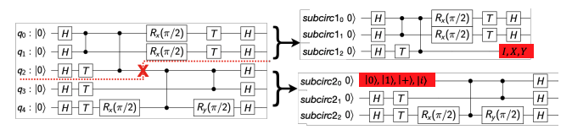
Circuit Cutting/ Circuit Knitting
Given circuit has many operations and therefore, higher probability of encountering errors
Cut it into sub-circuits where each sub-circuit has fewer operations
Run the sub-circuits on NISQ machine
Knit the sub-circuit results using tensor product using classical computers
Circuit cutting reduces the number of gate operations, depth, and measurements

Slide 25




More On Circuit Cutting/ Circuit Knitting
Program
Subcircuits
NISQ
Classical
Output
N cuts
2^{N}
subcircuits
Quantum Overheads
Exponential Overheads
Tianyi Peng et al. “Simulating Large Quantum Circuits on a Small Quantum Computer”, https://arxiv.org/abs/1904.00102
Wei Tang et al. “CutQC: Using Small Quantum Computers for Large Quantum Circuit Evaluations”, ASPLOS 2021
What are the overheads of circuit cutting? How to reduce these overheads?

Slide 26
Open Research Trends In Circuit Cutting
Program
Subcircuits
NISQ
Classical
Output
Where to cut? Application-specific?
Balanced subcircuits?
Parallel execution
Distributed knitting, Approximate knitting, Application-specific
N cuts
2^{N}
subcircuits
Quantum Overheads
Exponential Overheads
How can we use circuit knitting to show computational advantage for a 1000-qubit problem?

Slide 27
Summary
Gate errors can be reduced by minimizing the total number of gates in a circuit and via efficient gate nativization.
The gate count of a circuit can be reduced by decomposition using fewest gates, instruction re-ordering, gate cancellations, intelligent qubit mapping and routing.
Accounting for the device characteristics further reduces impact of gate errors (noise-aware).
Accounting for the application-specific properties enable us to further reduce gate errors.
Circuit-cutting is an emerging technique that is orthogonal to compiler optimizations. It cuts a circuit (with more operations) into multiple sub-circuits (with fewer operations). However, it incurs classical post-processing overheads.

