Slide 1

A brief overview of quantum LDPC codes
Nicolas Delfosse
Microsoft $→$ IonQ
November 28th 2023
UT Austin

Slide 2
What is a quantum computer?
First attempt:
A machine capable of performing quantum computations.
More accurate definition:
A machine capable of performing Quantum Error Correction and a little bit of computation.
QEC = Quantum Error Correction

Slide 3
Example - Shor’s algorithm
How many qubits are used to compute?
How many qubits with QEC?
Cost of a single entangling gate?
Cost of a single entangling gate with QEC?
$$14,238$$
$$22,325,184$$
$2$ qubits and $≈100ns$
$2,925$ qubits and $≈27,000ns$
$39,339$ qubit initialization
$39,339$ measurements
$153,090$ CNOTs
Assumptions: Time of a logical joint measurements with surface code with $d=27$ and time per meas. round = $1μs$

Slide 4
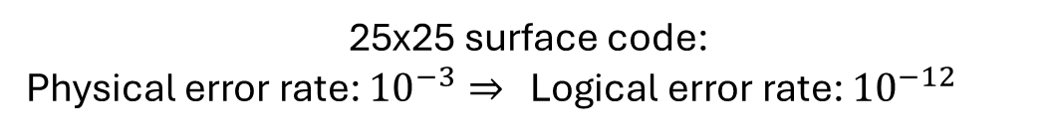
Surface codes
25x25 surface code:
Physical error rate: ${10}^{−3}⇒$ Logical error rate: ${10}^{−12}$
Advantages:
High noise threshold (about 1%).
Implemented with 2D local gates.
Main issue:
Thousands of physical qubits per logical qubit.
Here: 1250 physical qubits
Dennis, Kitaev, Landhal, Preskill – Topological quantum memory. arxiv:0110143
Raussendorf, Harrington – Fault-Tolerant quantum computation with high threshold in two dimensions. arxiv:0610082
Fowler, Mariantoni, Martinis, Cleland – Surface code: Toward practical large-scale quantum computation. arxiv:1208.0928

Slide 5
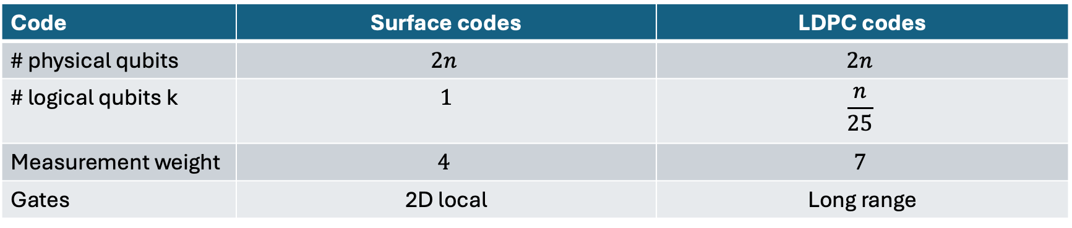
Surface codes vs LDPC codes
Code | Surface codes | LDPC codes
# physical qubits | $$2n$$ | $$2n$$
# logical qubits k | $$1$$ | $$\frac{n}{25}$$
Measurement weight | $$4$$ | $$7$$
Gates | 2D local | Long range

Slide 6
Goal of this lecture
Describe the three components of a quantum LDPC memory:
The code
The circuit
The decoder (briefly)
More lectures:
https://www.nicolas-delfosse.com/ipam2023

Slide 7
The code

Slide 8
Error correction with repetition codes
encoding
errors
decoding
001
(00000)(00000)(11111)
(01100)(00001)(01100)
000

Slide 9

Tanner graphs of repetition codes
0
0
0
0
0
0
0
1
0
0
1
1
0
0
Bits nodes
Check nodes
1
0
1
0
1
0
$bit 1+bit 2$ mod 2
Issue: The repetition code encodes only 1 logical bit.
Solution: Use more general graphs.

Slide 10

Hamming code
0
0
1
0
1
1
0
0
0
0
$$x_{1}+x_{3}+x_{5}+x_{7}$$
Number of bits?
7
Number of logical bits?
4
Notation: [7, 4]
Issue: Decoding is hard
Solution: Use sparse graphs

Slide 11

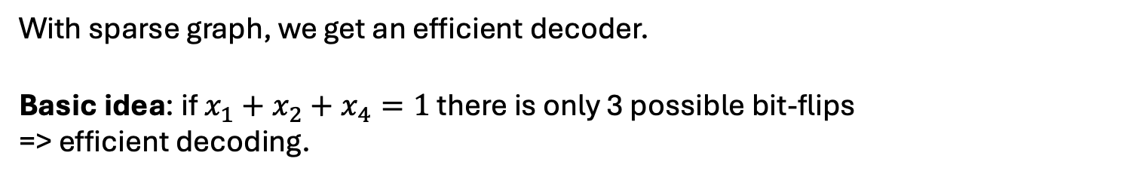


Low Density Parity-Check (LDPC) codes
LDPC codes = codes defined by low degree checks
$x∈{\left\{0,1\right\}}^{n}= x_{1}{ x}_{2}{ x}_{3}$ ${ x}_{4}$ ${ x}_{n}$
$…$
$…$
$$x_{1}+x_{2}+x_{4}=0$$
With sparse graph, we get an efficient decoder.
Basic idea: if $x_{1}+x_{2}+x_{4}=1$ there is only 3 possible bit-flips
=> efficient decoding.
Gallager – Low-Density Parity-Check codes (1963)

Slide 12
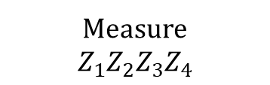

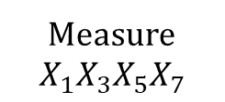
Quantum Hamming codes (Steane code)
Quantum codes detect X errors and Z errors:
Classical code detect bit flips:
0
1
1
Measure
$$X_{1}X_{3}X_{5}X_{7}$$
Flip
X
Z
1
0
0
Measure
$$Z_{1}Z_{2}Z_{3}Z_{4}$$
$$x_{1}+x_{2}+x_{3}+x_{4}$$
1
0
1
Calderbank, Shor – Good Quantum Error-Correcting codes exist arxiv:9512032
Steane – Multiple Particle Inference and Quantum Error Correction. arxiv:9601029

Slide 13
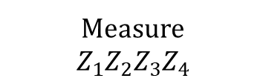





How to define quantum checks?
$$?$$
$$?$$
Requirement:
The checks must commute
Commutation ⬄ even X/Z overlap
$$0$$
$$0$$
$$0$$
Measure
$$Z_{1}Z_{2}Z_{3}Z_{4}$$
Is this a good choice?

Slide 14
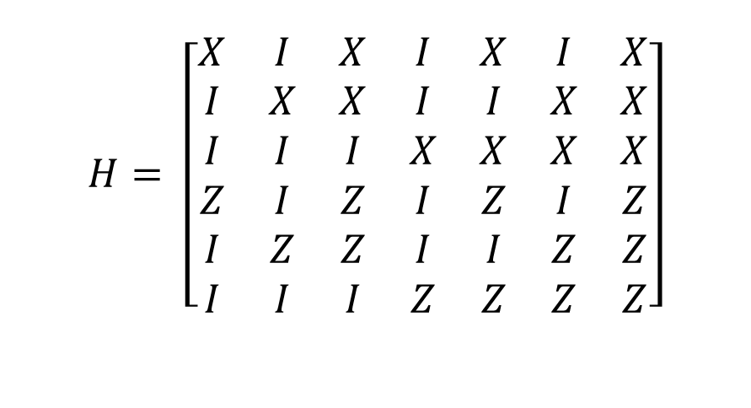
Stabilizer matrix
$$H= \left[\begin{matrix}X & I & X & I & X & I & X \\ I & X & X & I & I & X & X \\ I & I & I & X & X & X & X \\ Z & I & Z & I & Z & I & Z \\ I & Z & Z & I & I & Z & Z \\ I & I & I & Z & Z & Z & Z\end{matrix}\right]$$

Slide 15

Counting logical qubits
$$H= \left[\begin{matrix}X & I & X & I & X & I & X \\ I & X & X & I & I & X & X \\ I & I & I & X & X & X & X \\ Z & I & Z & I & Z & I & Z \\ I & Z & Z & I & I & Z & Z \\ I & I & I & Z & Z & Z & Z\end{matrix}\right]$$
$$=> [[7, 1]]$$

Slide 16

Counting logical qubits
$$H=\left[\begin{matrix}X & X & I & I & I \\ I & X & X & I & I \\ I & I & X & X & I \\ I & I & I & X & X \\ X & I & I & I & X\end{matrix}\right]$$
$$=> [[5, 1]]$$

Slide 17

Counting logical qubits
$$=> [[4, 2]]$$

Slide 18




Counting logical qubits
$$\frac{\left|00\right\rangle +\left|11\right\rangle }{\sqrt{2}}$$
$$\left|0\right\rangle$$
$$=> [[4, 1]]$$
$$=> [[2, 0]]$$

Slide 19
Hypergraph product (HPG) code
Take the cartesian product of two Tanner graphs:
Place a qubit on each circle-circle.
Place a qubit on each square-square.
Define a X checks for each square-circle.
Define a Z checks for each circle-square.
What is n?
n=11
What is the first X check?
III XII XII XI
X
Z
Z
Z
X
X
Z
Tillich, Zémor – Quantum LDPC codes with positive rate and minimum distance proportional to $n^{1/2}$. arxiv:0903.0566

Slide 20

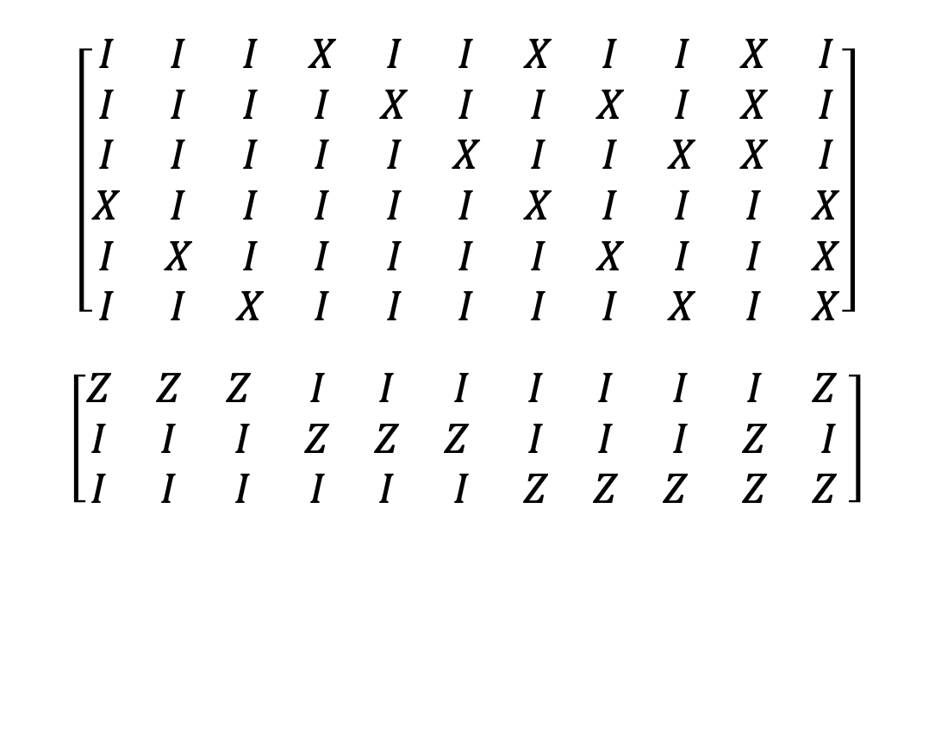
Example - X checks of a HGP code
$$\left[\begin{matrix}I & I & I & X & I & I & X & I & I & X & I \\ I & I & I & I & X & I & I & X & I & X & I \\ I & I & I & I & I & X & I & I & X & X & I \\ X & I & I & I & I & I & X & I & I & I & X \\ I & X & I & I & I & I & I & X & I & I & X \\ I & I & X & I & I & I & I & I & X & I & X\end{matrix}\right]$$
$$\left[\begin{matrix}Z & Z & Z & I & I & I & I & I & I & I & Z \\ I & I & I & Z & Z & Z & I & I & I & Z & I \\ I & I & I & I & I & I & Z & Z & Z & Z & Z \end{matrix}\right]$$
X
X
X
$$=> [[11, 2]]$$

Slide 21

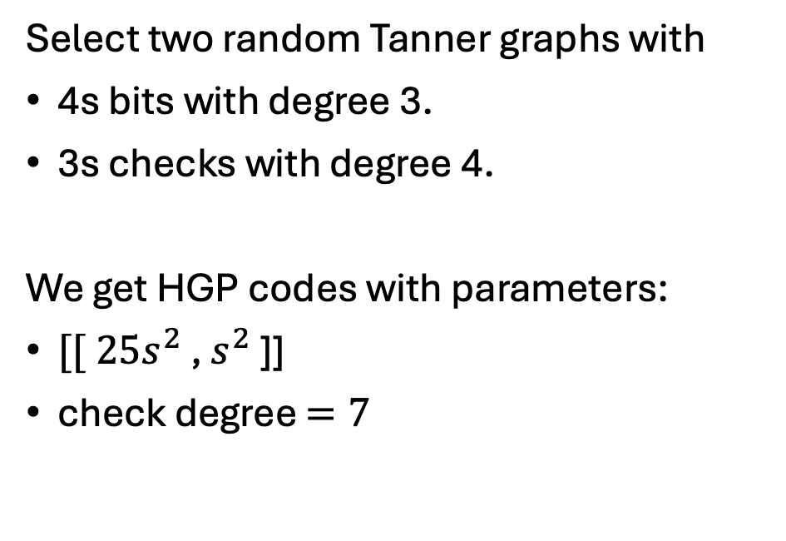



A family of LDPC codes with constant rate
$$4s$$
$$3s$$
Select two random Tanner graphs with
4s bits with degree 3.
3s checks with degree 4.
We get HGP codes with parameters:
$[[ 25s^{2}$ , $s^{2}$ ]]
check degree $=7$
$$4s$$
$$3s$$
Grospellier, Krishna – Numerical study of hypergraph-product codes. arxiv:1810.03681

Slide 22
The circuit

Slide 23
Syndrome extraction circuit
$$|+>$$
$$|+>$$
$$|+>$$
$$|+>$$
Z
Z
flip
$$|+>$$
$$|+>$$
$$|+>$$
$$|+>$$
X plaquette circuit
$$|+>$$

Slide 24
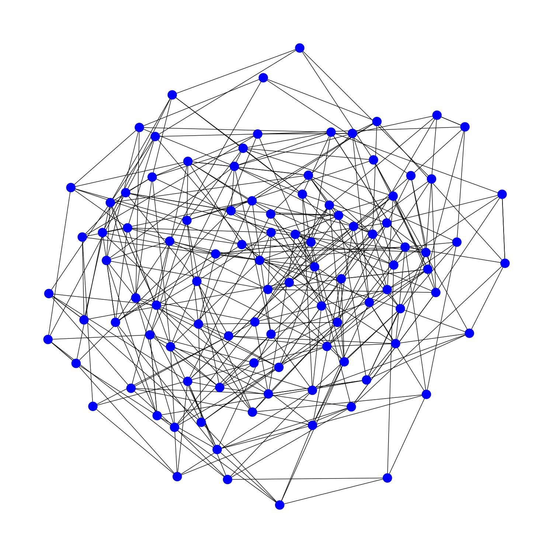
Can we implement quantum LDPC codes?
Typical LDPC code
Typical quantum computer

Slide 25
2D local gates vs long-range gates
With 2D local gates¹:
Need large depth circuits or many ancilla qubits.
Numerically: poor performance.
With long-range connections^{2, 3}:
Layout based on only a few planar layers.
Numerically outperform surface codes.
1. Delfosse, Beverland, Tremblay – Bounds on stabilizer measurement circuits and obstruction to local implementations of quantum LDPC codes. arxiv2109.14599
2. Tremblay, Delfosse, Beverland – Constant overhead quantum error correction with thin plan connectivity. arxiv:2109.14609
3. Bravyi, Cross, Gambetta, Maslov, Rall, Yoder – High threshold and low overhead fault-tolerant quantum memory. arxiv:2308.07915

Slide 26

Bounds on 2D syndrome extraction circuits
For surface codes: depth = 6.
Theorem¹. (informal) For quantum LDPC codes² implemented with 2D local gates:
depth $≥constant×\frac{n}{\sqrt{q}}$
where q = total number of qubit used.
 | Constant depth | Constant qubit overhead
Bound | # ancilla $≥constant× n^{2}$ | Depth $≥constant ×\sqrt{n}$
Delfosse, Beverland, Tremblay – Bounds on stabilizer measurement circuits and obstruction to local implementations of quantum LDPC codes. arxiv2109.14599
Proved for constant rate QLDPC codes with some form of local expansion.

Slide 27

Measurement of a X check
$$|+>$$

Slide 28




Simultaneous measurement of all the X checks
Construct an edge coloration
Prepare a readout qubits in $|+⟩$ for each check.
For each color c do:
Apply a CNOT on each edge with color c
Measure readout qubits in the X basis.
$$|+>$$
$$|+>$$
$$|+>$$

Slide 29
Switch-based circuit
3
4
5
1
6
2
7
3 4 1 5 2 6 7
3 1 4 2 5 6 7
1 3 2 4 5 6 7
1 2 3 4 5 6 7
1 2 3 4 5 6 7
Bell
1 2 3 4 5 6 7
Bell
1
2
3

Slide 30
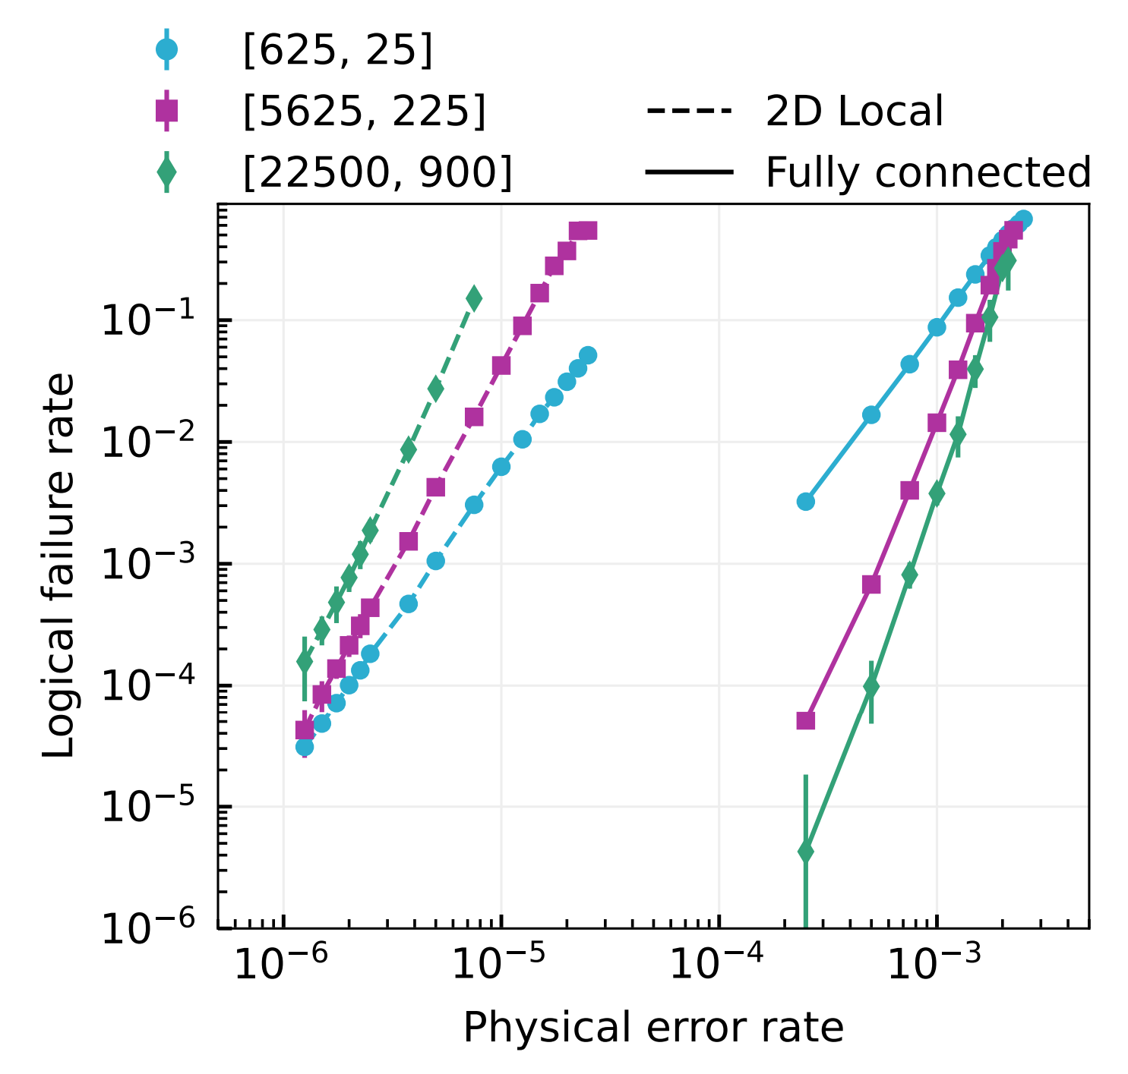
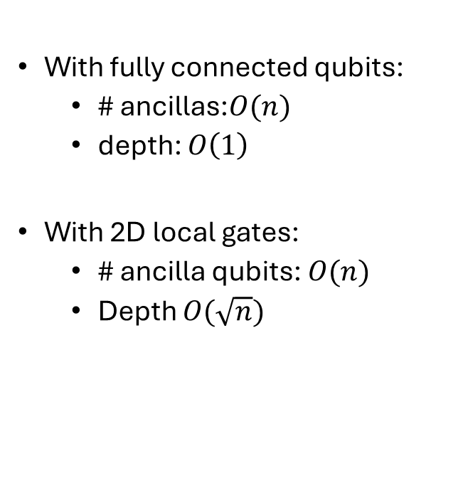
2D local vs fully connected implementation
With fully connected qubits:
# ancillas:$O(n)$
depth: $O\left(1\right)$
With 2D local gates:
# ancilla qubits: $O(n)$
Depth $O(\sqrt{n})$
Cost of locality

Slide 31
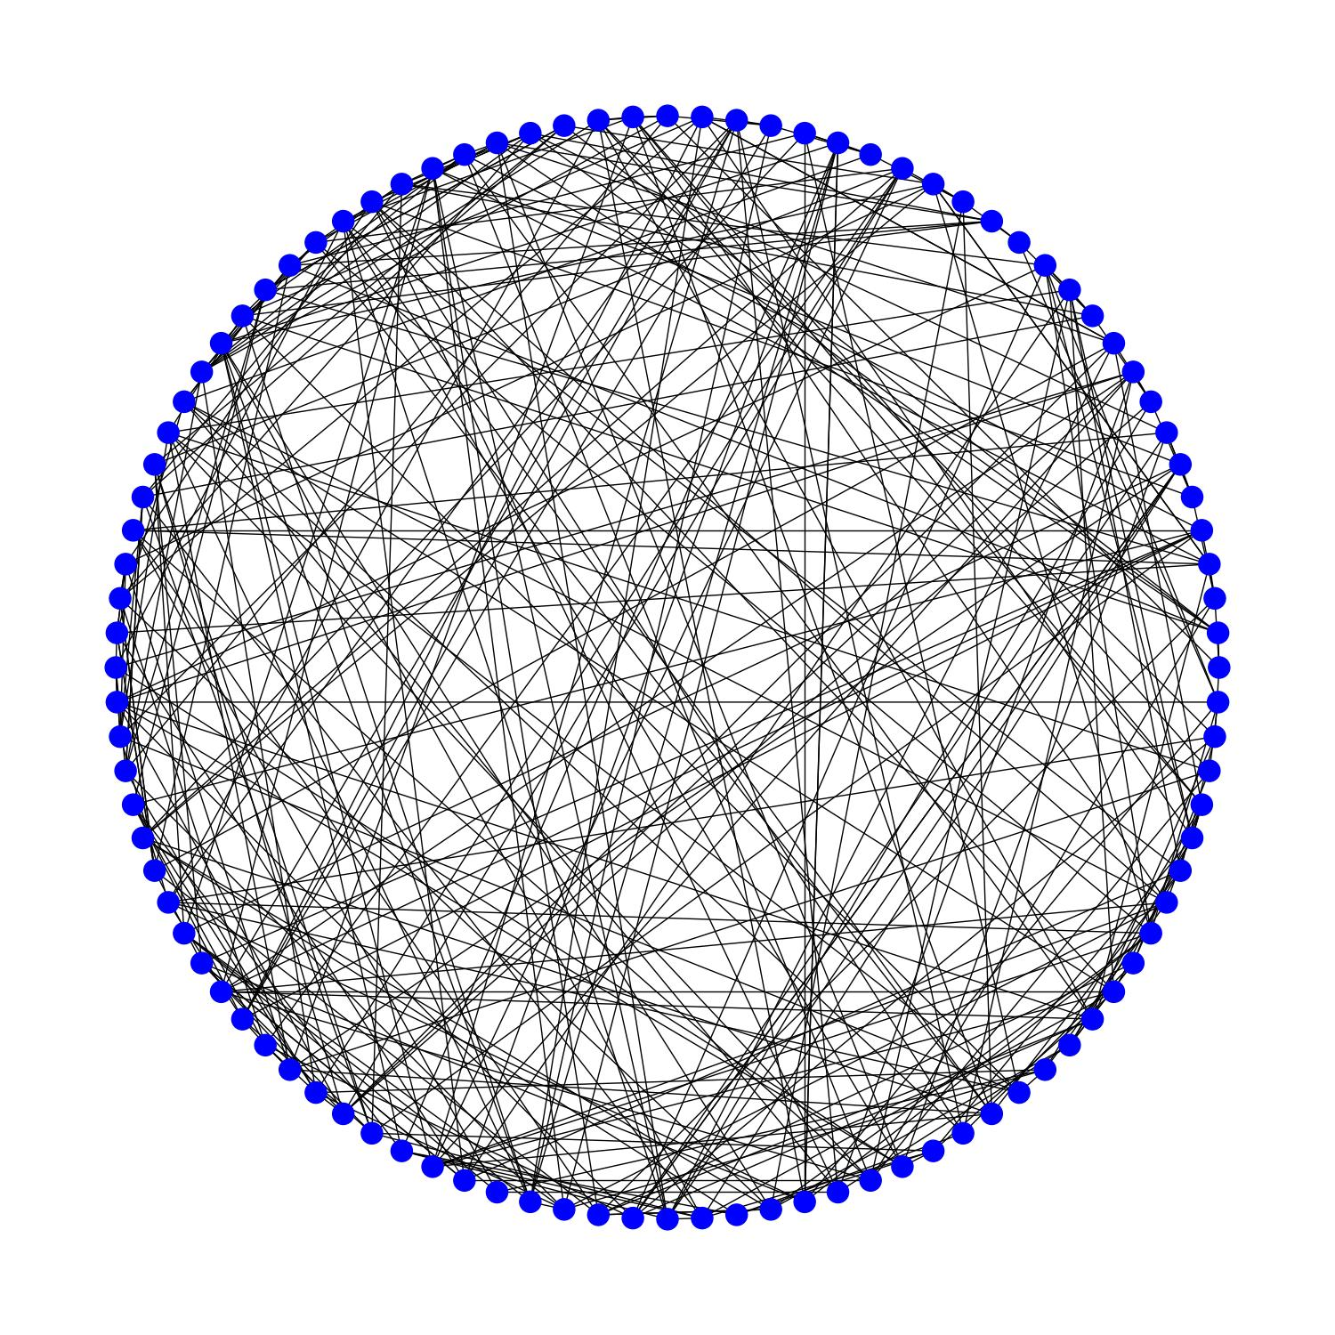

Naïve layout with long-range connectivity
Issue:
Crossing gates may induce correlated errors.
Goal:
A small number of crossing gates.
Short depth.
Graph with 100 vertices with degree 8

Slide 32
Planar decomposition of the Tanner graph
Degree = 4
# planar layers = 2

Slide 33
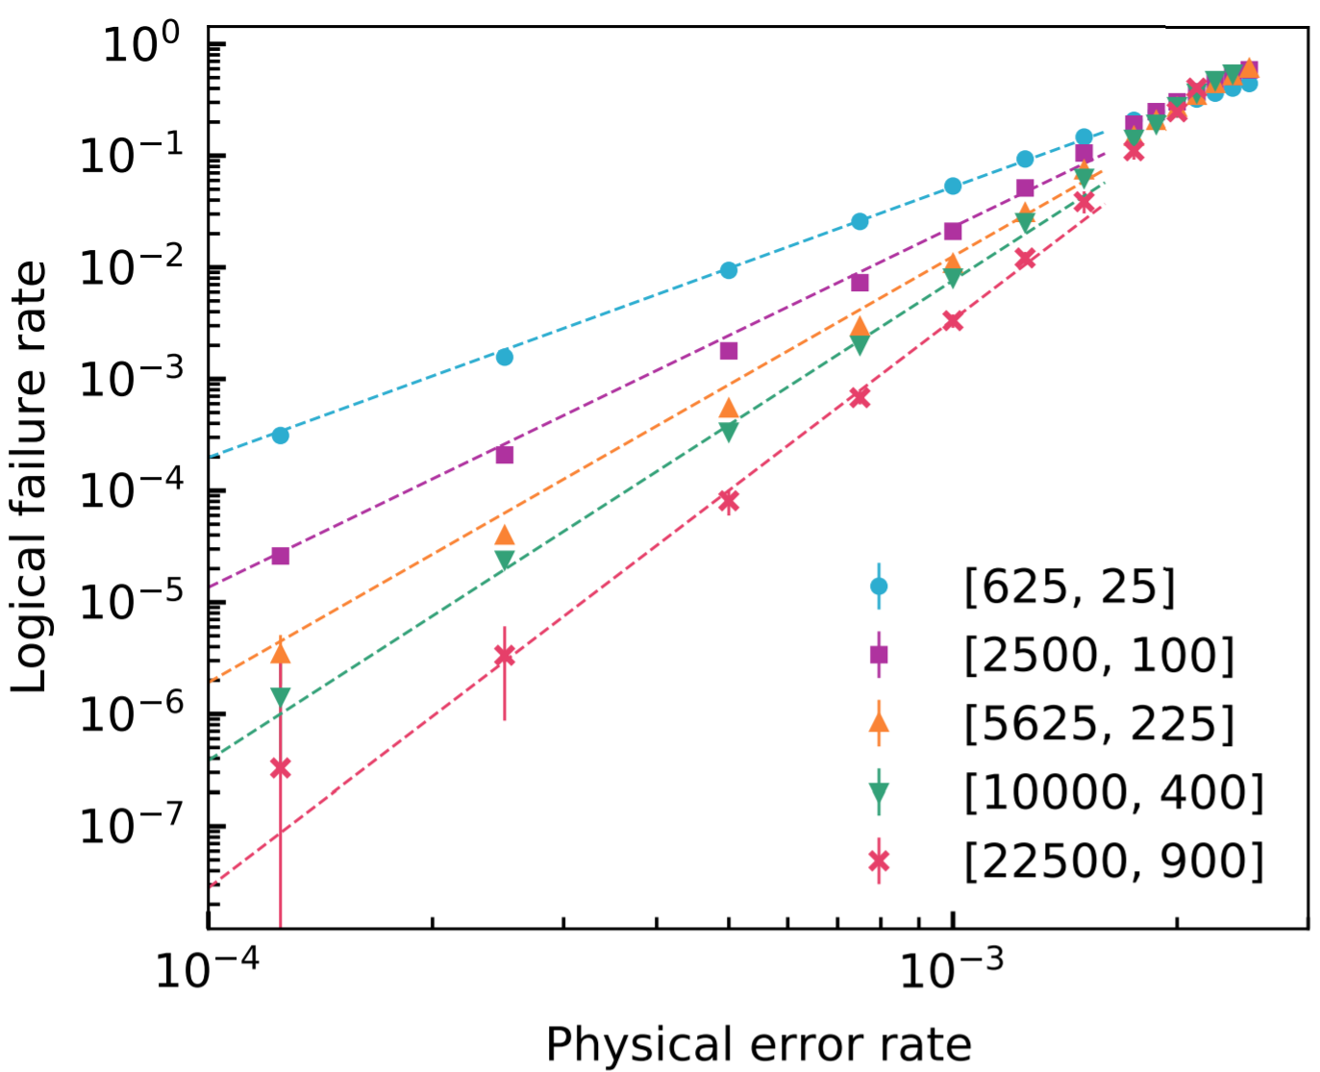
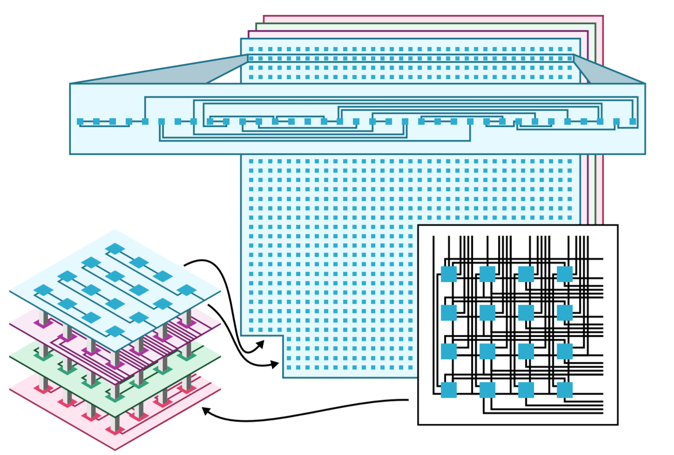
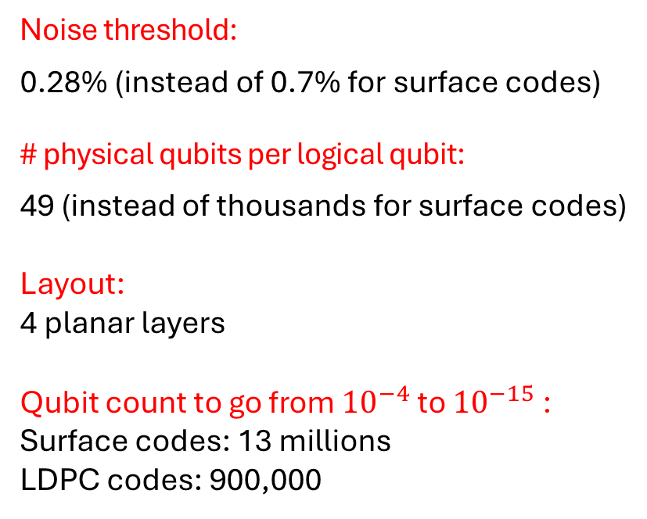
Numerical results
Noise threshold:
0.28% (instead of 0.7% for surface codes)
# physical qubits per logical qubit:
49 (instead of thousands for surface codes)
Layout:
4 planar layers
Qubit count to go from ${10}^{−4}$ to ${10}^{−15}$ :
Surface codes: 13 millions
LDPC codes: 900,000
Tremblay, Delfosse, Beverland – Constant overhead quantum error correction with thin plan connectivity. arxiv:2109.14609

Slide 34
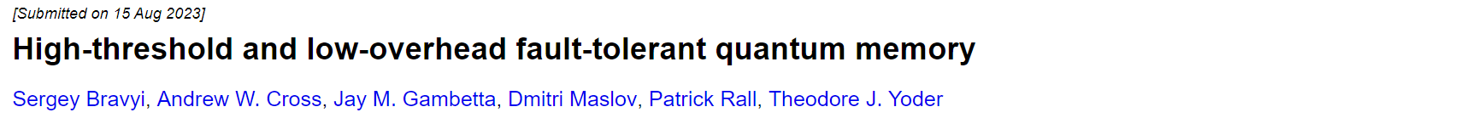
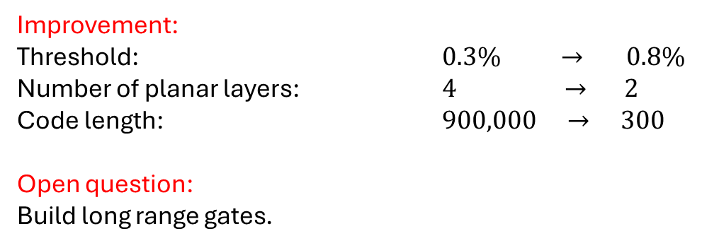
Small quantum LDPC codes
Improvement:
Threshold: $0.3\% → 0.8\%$
Number of planar layers: $4 → 2$
Code length: $900,000 → 300$
Open question:
Build long range gates.
Using codes from: Kovalev, Pryadko – Quantum hyperbicycle low-density parity check codes with finite rate. arxiv:1212.6703

Slide 35
The decoder

Slide 36
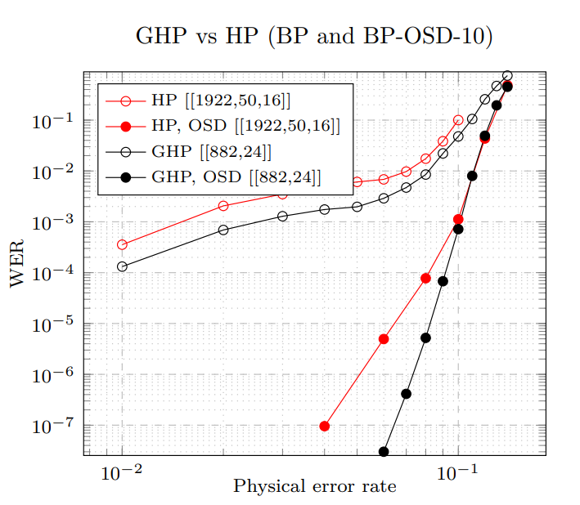
Some decoders for QLDPC codes
PB: Does not work well with quantum LDPC because of short cycles
BP-OSD¹: Heuristic but seems to behave well in simulation.
UF for QLDPC²: Corrects a poly number of errors but may reduce the distance
1. Panteleev, Kalachev - arXiv:1904.02703.
2. Delfosse, Londe, Beverland – arXiv:2103:08049

Slide 37


Overview of the whole scheme
code
Syndrome extraction circuit
X syndrome of E
0
1
1
Pauli error E
Correction of E
Decoder
$$\left|ψ\right\rangle ∈code$$
$$E\left|ψ\right\rangle$$
Syndrome extraction circuit
1
0
1
Z syndrome of E
circuit
layout

Slide 38
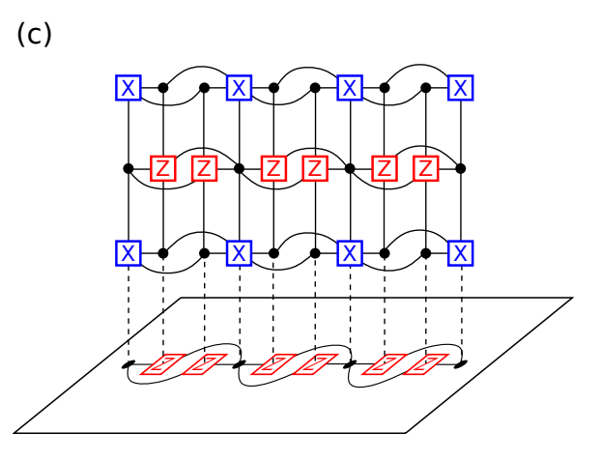
What about computation?
2013: Gottesman - Fault-Tolerant Quantum Computation with constant overhead.
Other proposals for fault-tolerant logical gates in QLDPC codes^{1,2, 3, 4}.
1. Jochym-O’Connor, arxiv:1807.09783
2. Krishna, Poulin, arxiv:1909.07424
3. Cohen, Kim, Bartlett, Brown, arxiv: 2110.10794
4. Breuckmann, Burton, arxiv:2202.06647
Figure from ref 3.

Slide 39
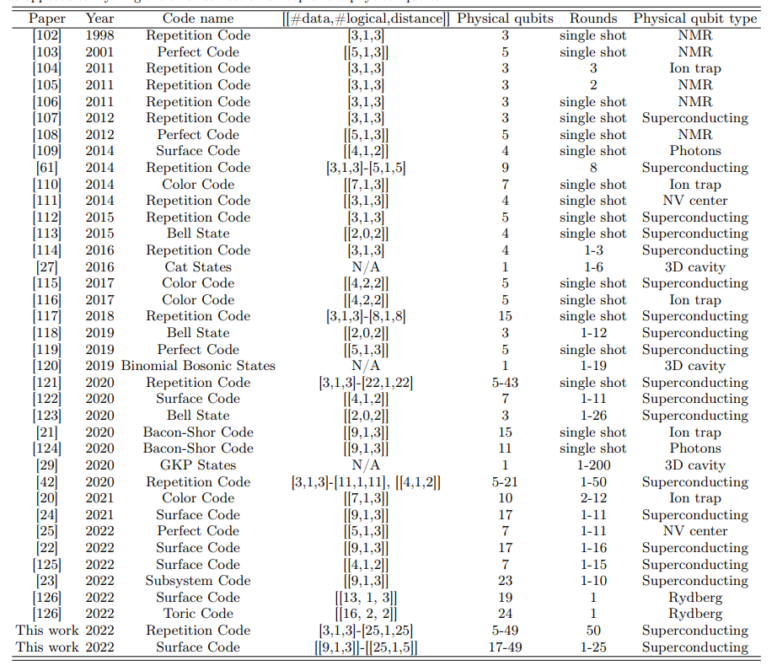
QEC experiments
Table from the Google surface code paper:
page 38 of arxiv:2207.06431

Slide 40









Some hardware players with long-range gates
Photonic
Trapped ions
Neutral atoms

Slide 41
Conclusion
Thank you!
Quantum LDPC codes beat surface codes^{1,2} in theory
We need more work on
The code, the circuit, the decoder
Logical operations
Hardware implementation
https://www.nicolas-delfosse.com/why-i-am-joining-ionq
2. Tremblay, Delfosse, Beverland - arxiv:2109.14609
3. Bravyi, Cross, Gambetta, Maslov, Rall, Yoder – arxiv:2308.07915

