Slide 1

ECE 382V: QUANTUM COMPUTING SYSTEMS:
A SOFTWARE/ ARCHITECTURE PERSPECTIVE
BANDWIDTH Problem
IN QEC
POULAMI DAS
ECE, The University of Texas at Austin

Slide 2
Cryogenic Control Processors For Large Scale Quantum
Intel Horse-Ridge
Google Cyro-CMOS
Superconducting
Control Processor
300K
(27ºC)
Control Processor
4K
(-269º C)
Metal Wires
→ Thermal Leakage
Superconducting wires
→ Low Leakage
Qubits
20mK
20mK
Qubits
https://www.intel.com/content/www/us/en/newsroom/news/2nd-gen-horse-ridge-cryogenic-quantum-control-chip.html
https://blog.research.google/2019/02/on-path-to-cryogenic-control-of-quantum.html
Cryogenic control processors operate at 4K inside dilution refrigerator (closer to the qubits)

Slide 3
Cryo-CMOS vs. Superconducting Devices at 4 Kelvin
Cryo-CMOS
Superconducting
Transistor as a switch
Faster switching at cryo temp. than room
Large device densities
Dense memory solutions
Relatively easy to fabricate after several years of development in EDA toolchains
Large power dissipation
Josephson junction as a switch
2 picosecond switching time (even faster)
Low device densities
Lack of dense memories
Unique challenges that limit usage of current EDA tools, harder to fabricate
Ultra-low power dissipation
Large cooling overheads (1000x), limited power budgets (1W or below)
Currently, research efforts in both directions

Slide 4
CONTROL BANDWIDTH
Manage QEC in hardware, share QEC instructions to improve scalable architectures

Slide 5
Control Processor Supplies QEC Instructions
Uncorrectable Errors !!
Control Processor
Qubits
Instruction supply must be deterministic and timely

Slide 6
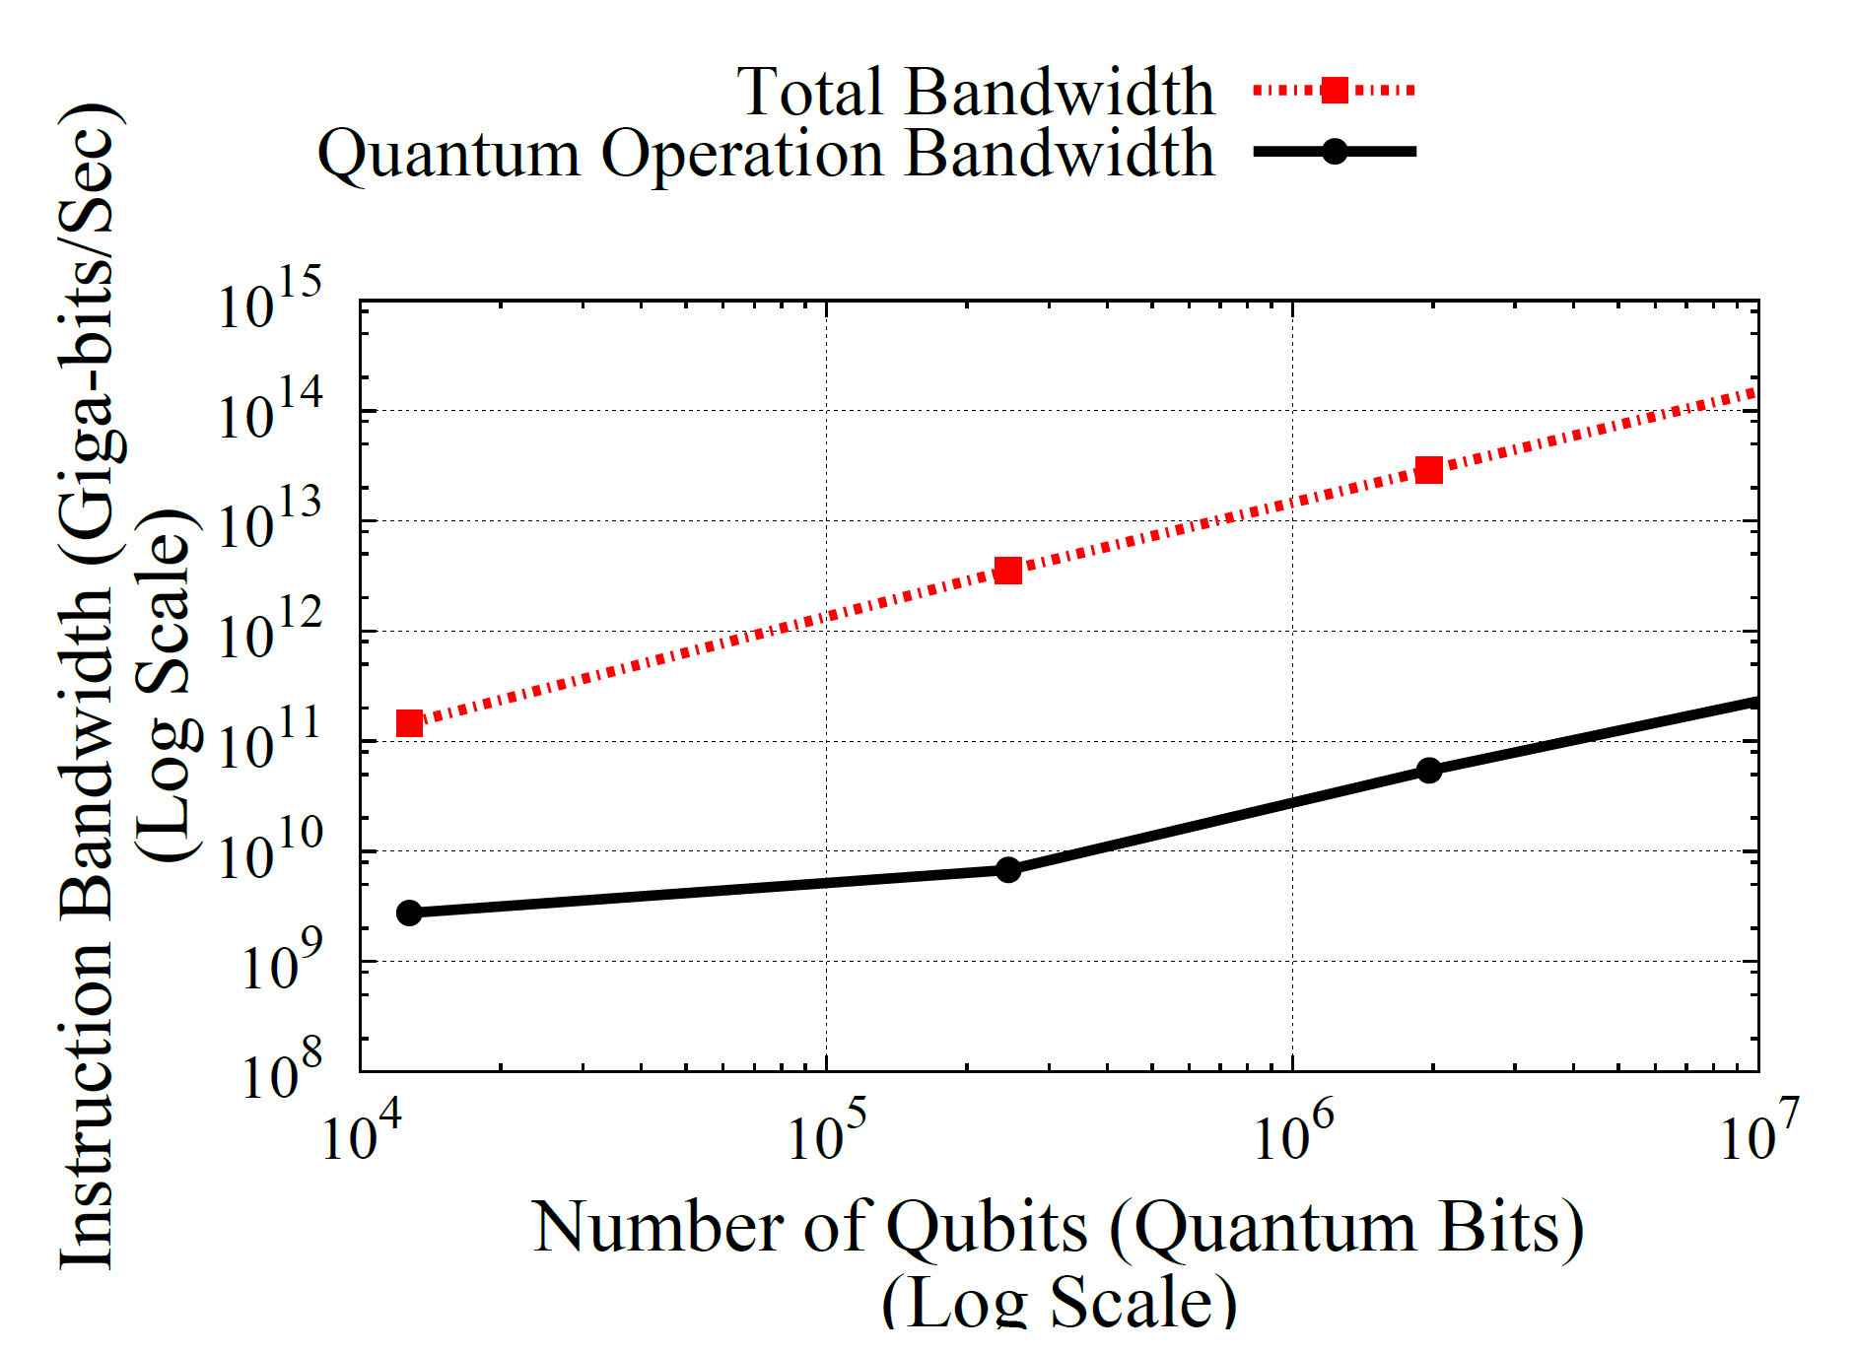

Instruction Bandwidth Bottleneck
Shor’s Algorithm
Delay in delivery of QECC instructions causes errors to accumulate [cannot use software managed QEC and caches]
Required instruction bandwidth scales linear in number of qubits
Total Bandwidth
Non-QECC Bandwidth
1024 bit
QECC Bandwidth Bloat – 10,000X
Instruction Bandwidth (B/s)
Can’t use
i-cache
256 bit
128 bit
Number of Qubits
Instruction bandwidth bottleneck is a problem, 99.99% of instructions are for QEC

Slide 7
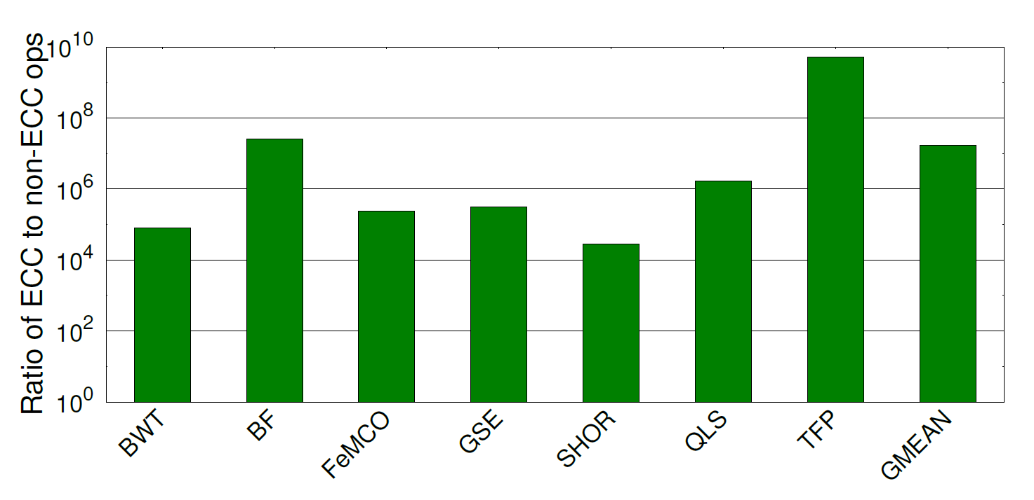
QEC Instruction Overheads
QEC instruction bloat is dominant in all large scale quantum workloads

Slide 8
Manage QEC Using Micro-Code
Micro-Code Engine (MCE) continuously issues QECC µops from local µcode
Master controller issues regular instructions. MCE decodes it to µops
Master Controller
Control Processor
µ-Code
Engine
µ-Code
Engine
µ-Code
Engine
µ-Code
Engine
Qubits
Swamit Tannu et al. “Taming the Instruction Bandwidth of Quantum Computers via Hardware Managed Error Correction”, MICRO 2018
Issue micro-ops locally, managed fully in hardware

Slide 9
Micro-Code Engine Based Architecture
Leverage multiple thermal domains for improved efficiency

Slide 10
Managing Logical Operations And QEC Operations
QECC Microcode → supplies QECC µops to all qubits
Logical Microcode → supplies logical µops
Mask Bits → selects between QECC µop and Logical µops
Quantum Execution Unit
Dedicated QEC microcode is continuously run to manage QEC, logical microcode is interspersed

Slide 11
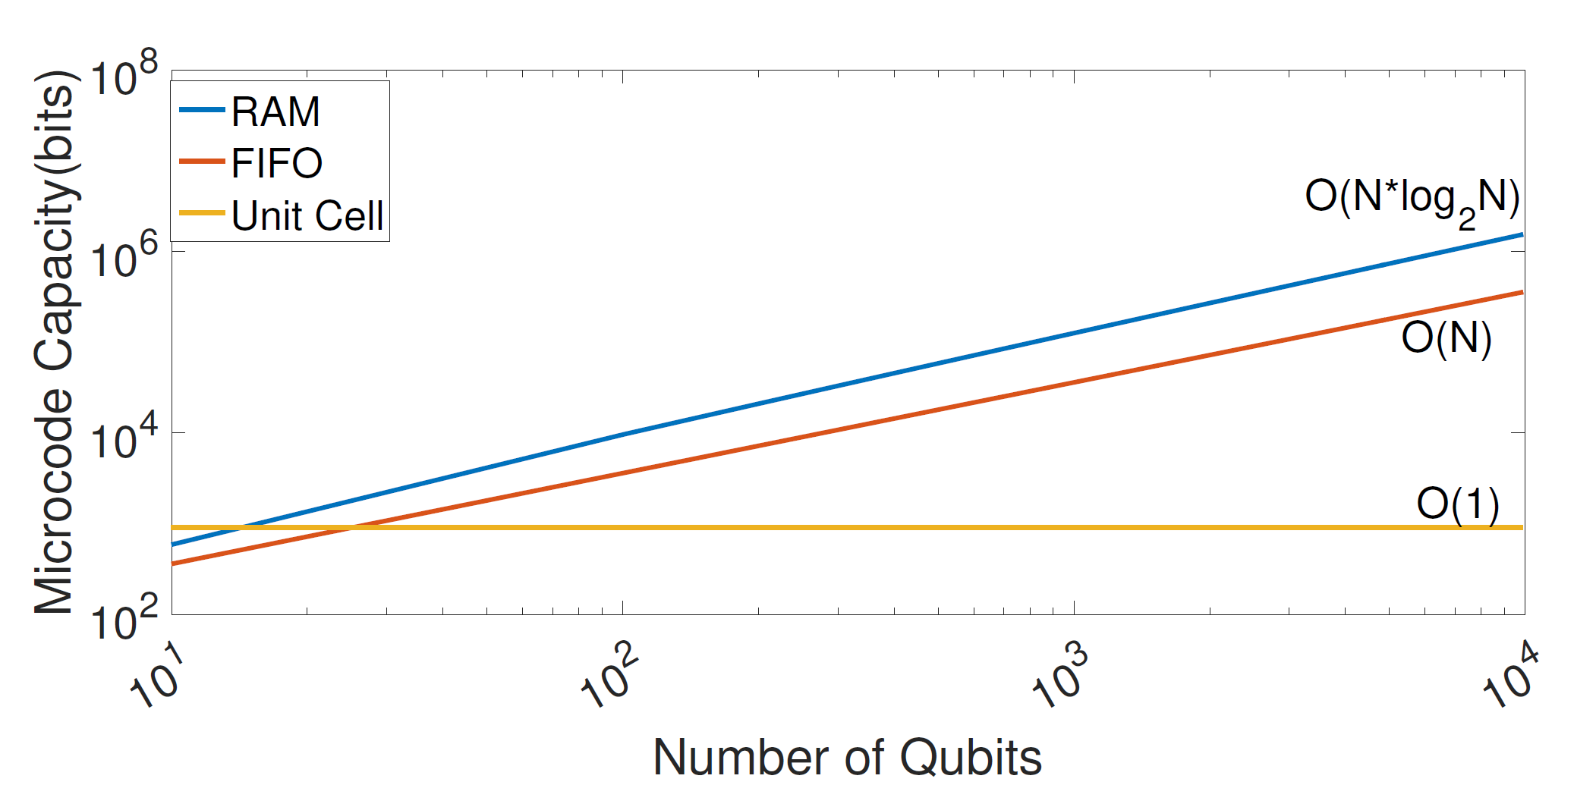
Micro-Code Memory Scaling
µ-Code
Log(N) bits
C bits
QECC µops
Qubits
Microcode memory capacity requirement increase linearly in the number of qubits

Slide 12
Superconducting Memory Capacity Limits #Qubits
Capacity of state of the art JJ based Memory
4Kb µcode memory can only support about 35 qubits

Slide 13
QEC Instructions Have Spatial Locality
Unit Cell
Unit Cell
A
B
C
D
QECC
µops
A
B
C
D
A
B
C
D
A
B
C
D
Qubit1
Qubit12
QECC have spatially repeating instruction blocks -- Unit Cell
Unit-Cell µops can generate QECC µops for all the qubits
QECC instruction patterns are leveraged to minimize µcode capacity

Slide 14
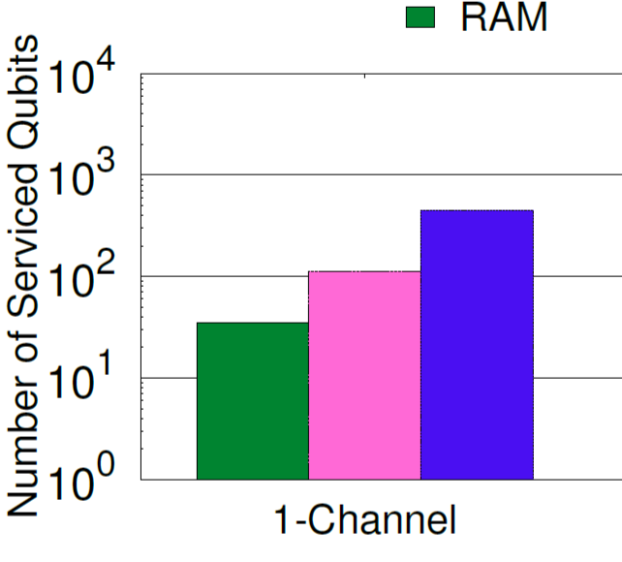
Microcode Sharing Via Unit Cell Improves Scalability
90x
Capacity of state of the art JJ based Memory
UNIT
CELL
UNIT
CELL
O(1)
FIFO
RAM
For 4Kb Memory Budget
Microcode can service up to 2000 qubits with 4Kb of microcode

Slide 15
Syndrome BanDWIDTH
Transmit compressed syndromes, enable multi-level decoding

Slide 16
Syndrome Transmission Bandwidth Requirement
Syndrome transmission requires 100-1000s of Gigabits per sec bandwidth

Slide 17
Syndrome Compression
Each error flips two parity qubits
Long error-chains have fewer parity flips
3d³ fault locations
6d³p possible non-zero syndrome bits
d = 11, p = 10⁻³
8 non-zero bits in 1000-bit syndrome
Insight: Syndrome data is sparse, can be compressed
Compressing syndromes enable us to send more data per unit time

Slide 18
Dynamic Zero Compression
0
0
0
0
0
0
0
0
0
0
0
0
Zero Indicator Bit Vector
0
0
0
Transmit
0
0
0
0
0
0
0
0
0
0
0
0
1
0
0
Zero Indicator Bit Vector
0
0
1
Transmit
0
0
1
0
1
0
0
Dynamic Zero Compression for Cache Energy Reduction, Luis Villa, Michael Zhang, and Krste Asanovic, MICRO 2000
Data compression is well-studied in conventional systems, work well for syndrome compression

Slide 19
Sparse Representation
0
0
0
0
0
0
0
0
0
0
0
0
Sparse Representation Bit
1
Transmit
1
0
0
0
0
0
0
0
0
0
1
0
0
Sparse Representation Bit
0
Transmit
0
1
0
0
1
Sending the indices of non-zero syndrome bits
Fast compression/de-compression using low logic density
Compression ratio depends on error rates with average reduction of 30x. Typically sparse representation outperforms for larger distances and low physical error-rates

Slide 20
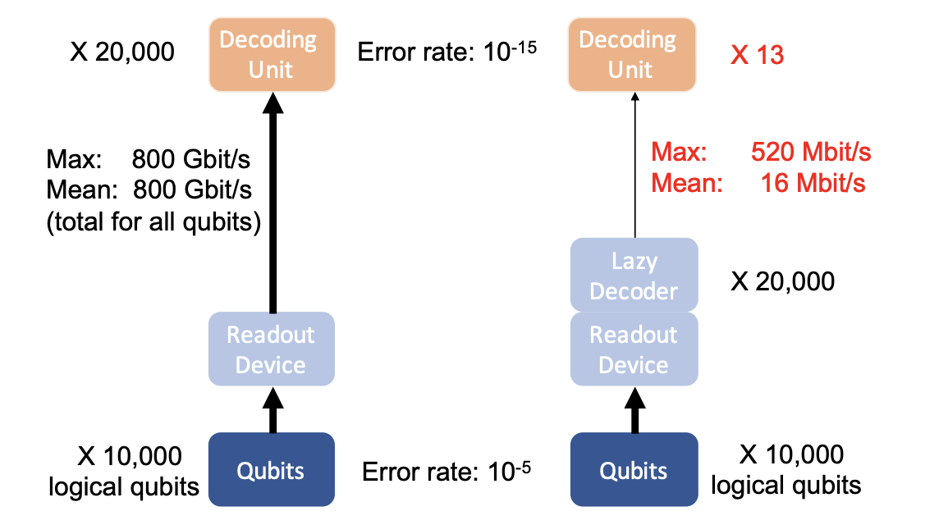
Hierarchical Decoding
Nicolas Delfosse, Hierarchical decoding to reduce hardware requirements for quantum computing
Key Idea: Only send complex error events to a complex decoder, decode others locally

Slide 21
System-Level View: Decoding Outside Refrigerator
Low latency needed for functional correctness!!
1 microsecond
1000 L * 1000 P = O(1,000,000) qubits
COMPLEX
COMPLEX
COMPLEX
COMPLEX
COMPLEX
300 K
E
E
E
E
E
300 K
E
E
E
E
E
E
E
E
E
E
Metal Interconnects
L
B
4 K
E
E
E
E
E
4 K
E
E
E
E
E
E
E
E
E
E
Superconducting Wires
H B
20 mK
20 mK
1
2
3
4
5
E: Error Signatures
Bandwidth bottleneck: could require up to Tbps for certain applications

Slide 22
System-Level View: Decoding Inside Refrigerator
1000 L * 1000 P = O(1,000,000) qubits
300 K
300 K
L
B
Metal Interconnects
COMPLEX
COMPLEX
COMPLEX
COMPLEX
COMPLEX
P = 1W
P = ~1W
E
E
E
E
E
4 K
4 K
E
E
E
E
E
E
E
E
E
E
Superconducting Wires
H B
20 mK
20 mK
1
2
3
4
5
E: Error Signatures
Cryo-power bottleneck: Limited cryogenic power budget (~1W)

Slide 23
Not All Error Events Are Equally Hard To Decode
E
E
E
E
E
E
E
E
E
E
Easy to separate!
Most errors are trivial!
T
T
T
T
T
T
T
T
C
C
T: Trivial-to-decode
C: Complex-to-decode
Separately decode trivial (inside refrigerator) and complex (outside refrigerator) error events

Slide 24
Isolated Error Events Vs. Error Chains
Isolated errors: Trivial to decode and very common!!
Error chains: Hard to decode and relatively rarer!!
T
(90 - 99+ %)
C
(<1 - 10 %)
1
1
T: Trivial-to-decode
C: Complex-to-decode
Most error events are isolated and trivial to decode, send them to small decoder (Clique)

Slide 25
System-Level Overview In Presence Of Clique Decoder
COMPLEX
COMPLEX
COMPLEX
COMPLEX
COMPLEX
BW
reduction
C
C
300 K
300 K
C
C
L
Metal Interconnects
B
CLIQUE
CLIQUE
CLIQUE
CLIQUE
CLIQUE
HW
reduction
T
T
T
T
T
4 K
4 K
T
T
T
T
T
T
T
T
T
T
Superconducting Wires
H
B 20 mK
20 mK
1
2
3
4
5
Gokul Ravi et al., “Clique: Better Than Worst-Case Decoding for Quantum Error Correction”, ASPLOS 2023
Reduces bandwidth requirement by decoding trivial syndromes locally. Reduces hardware requirement by decoding complex syndromes off-chip outside refrigerator.

Slide 26
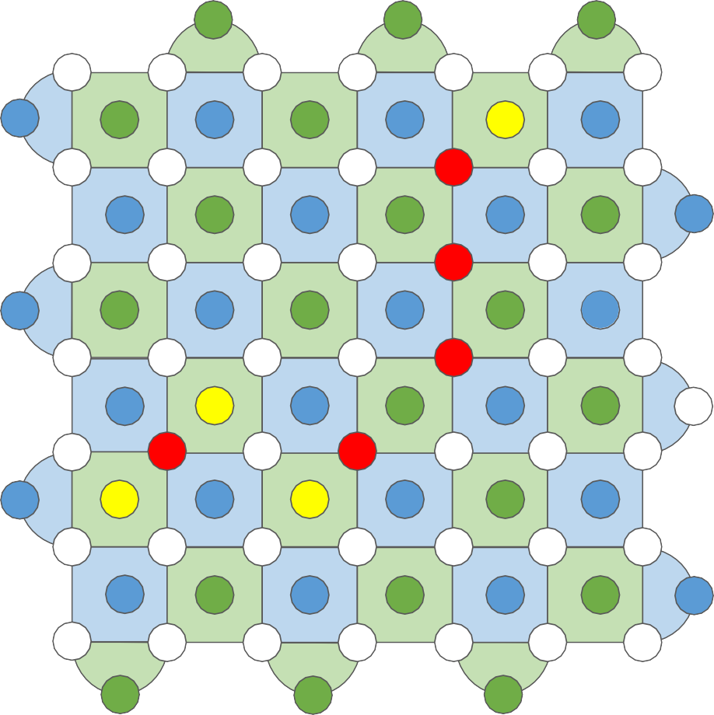
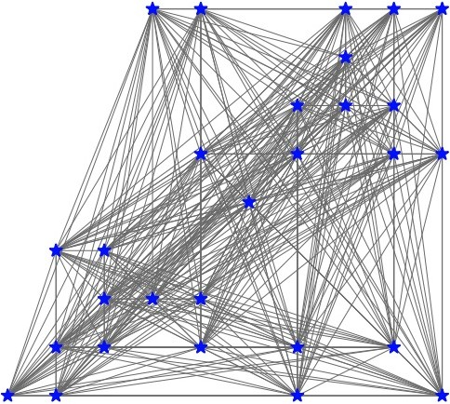







When Are Error Events Hard To Decode?
COMPLEX DECODER
2
d
2
d
c b
a
1
2 } :
X 9
X 4
{ 1
c
b
a
1
Minimum Weight Perfect Matching
Chained errors trigger non-local syndromes that are more challenging to pair and decode

Slide 27
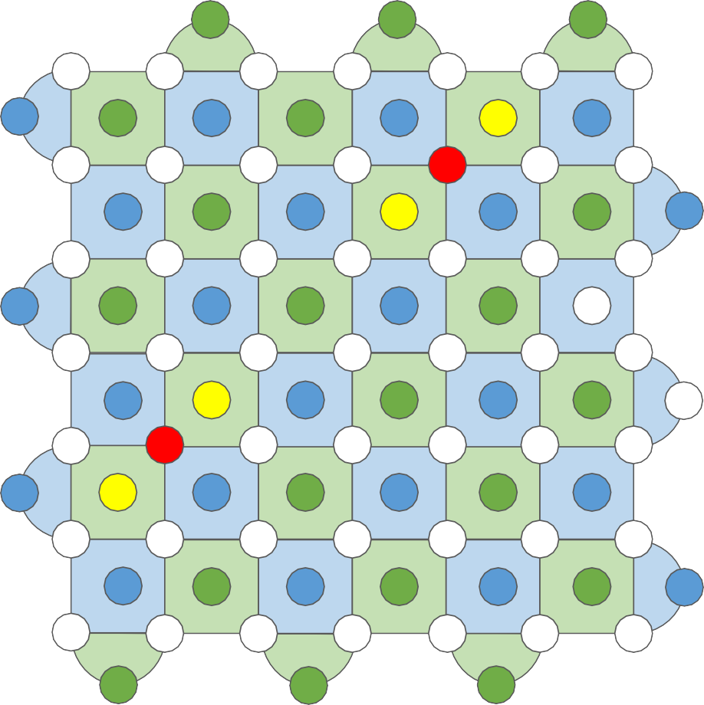
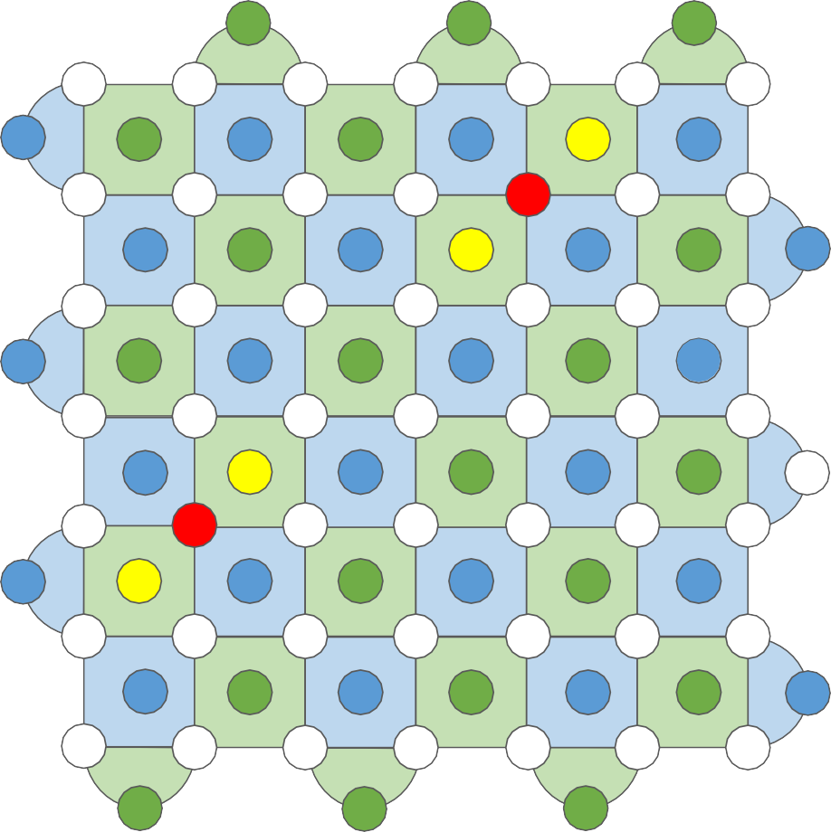
When Are Error Events Trivial To Decode?
4
b
3
4
b
3
CLIQUE DECODER
CU: ~10 combinational gates. Clique decoder: d² CUs.
Linear Clique scaling wrt. physical qubits.
CU
CU
CU
2
a
1
2
a
1
d
CU
CU
CU
CU
CU
CU
CU
Unit of the Clique decoder
Code distance (d)
Isolated errors only trigger locally paired syndromes which are easy to decode

Slide 28








Understanding Benefits Of Clique
Clique supports 2.5M physical qubits at 1W power → 1000s of logical qubits.
90 - 100% of decodes handled trivially by Clique, largely eliminating outside-fridge decoding.
Clique Coverage (d=15)
100%
>90 % error events handled by Clique decoder leading to significant bandwidth savings
2.5M physical qubits!
Logical qubits (1W)
Errors decoded by Clique (%)
10000
Number of logical qubits
95%
1000
90%
100
85%
10
80%
5.00E-03 5.00E-04 5.00E-05
Qubit physical error rate
1
5E-3/1E-5 5E-4/1E-10
Physical ER / Logical ER
5E-5/1E-15
The Clique decoder leads to significant reduction in bandwidth and cryogenic compute resources

Slide 29
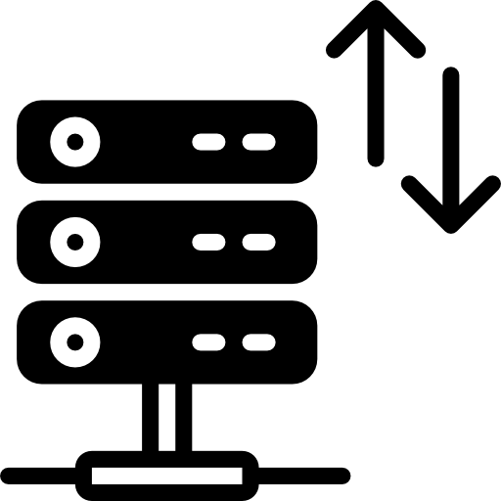


Summary
Micro-code And Resource Sharing
QEC requires large bandwidth
Instruction BW reduced using ucode and resource sharing
Syndrome BW reduced by sending compressed syndromes
Syndrome BW reduced by using hierarchical decoding (+ resource savings)

