Slide 1

ECE 382V: QUANTUM COMPUTING SYSTEMS:
A SOFTWARE/ ARCHITECTURE PERSPECTIVE
Quantum cloud Services
POULAMI DAS
ECE, The University of Texas at Austin

Slide 2
Recap: Quantum Computer Organization
Host
Interface for access
Compilation
Output processing
Programs
Software
Control
Processor
Precise control to perform operations
Resource management
Qubit
Devices
Seamless access
Output
(Distribution)
Flexibility to device providers
Quantum computers accessible via cloud services (such as IBM Cloud, Azure, AWS)

Slide 3
Quantum Cloud Services: Key Metrics Of Success
No to maximum control
Maximize profit
Minimum cost
Lower resource management overheads (e.g. reduced downtimes for calibrations)
Quality of solutions
Maximize resource utilization
Reduced wait times
Improve QoS
Manage diverse systems
Own vs. Third-party machines
Good classical support for apps
Quantum cloud services must optimize across multiple vectors

Slide 4




Submitting Jobs To Quantum Cloud
Access to the quantum cloud modeled as per IBM’s methods.
Users create a batch of circuits to execute as a job – all circuits in a batch are run back to back.
User selects a machine to run on and compiles all circuits in the job for the target machine.
Job sent to the queue and user waits for execution and return (priorities exist).
Quantum #1
Machine
Batch of circuits
A
Per-machine queues
Quantum Machine
#2
A
B
Quantum Jobs
Quantum Machine
#3
B
What are the challenges?

Slide 5
Quantum Resource Management: Challenges
Which machine?
What’s the right batch size?
Who compiles?
How to combine software error mitigation circuits execution with actual program?
What’s my priority?
Which machine(s)?
Which cloud provider?
Queue management?
Access(dedicated,pay-as-you-go)?
Third-party device queues
Classical <-> Quantum
Managing calibrations?
Understanding quantum machines and jobs are critical for efficient quantum cloud services

Slide 6
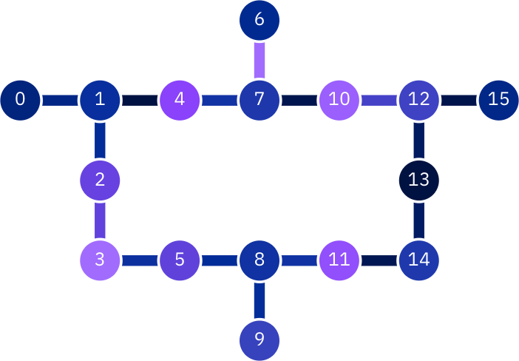
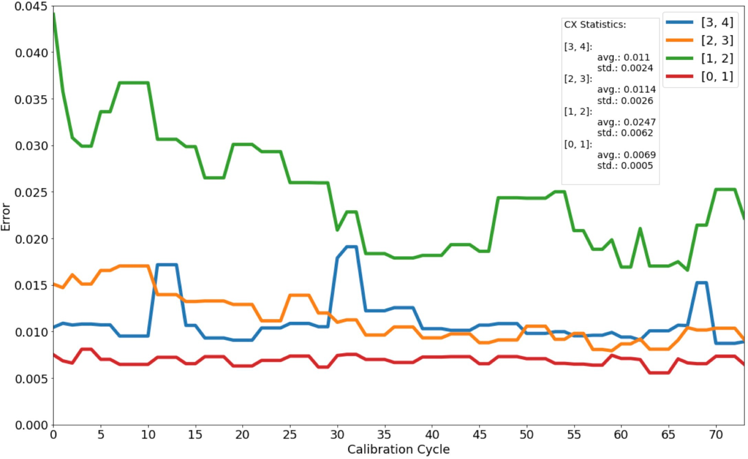
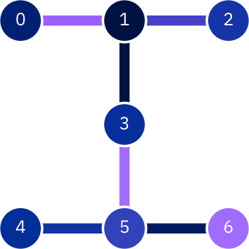
Machine <-> Application Mapping Challenges
Device size, topology
Variation in error-rates
Affects routing overheads
Latency of program (superconducting vs. trapped-ions)
Largest program that can be mapped
Impacts compilation & quality of solution
Little correlation between machine size and average error-rates
Drift (invisible) hurts even best compilers
Machine characteristics are hard to comprehend and influence the best machine for a program

Slide 7
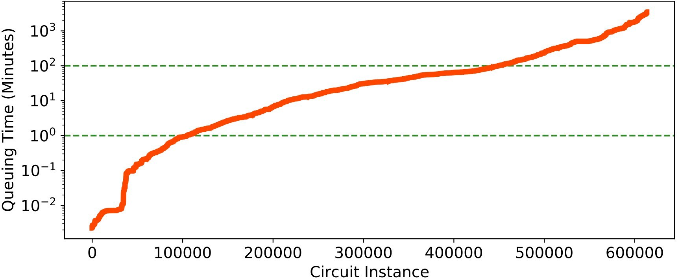
What About Queuing Delays?
Queuing time for EPIQC jobs (2-year data)
Median: 1 hour
> 25% of the circuits queued for > 2 hours
~5% queued for > 1 day
2 hr
1 minute
Queueing delays have only gotten worse over time
EPiQC: NSF Expedition In Quantum Computing
Why are queuing delays particularly bad in quantum cloud?

Slide 8
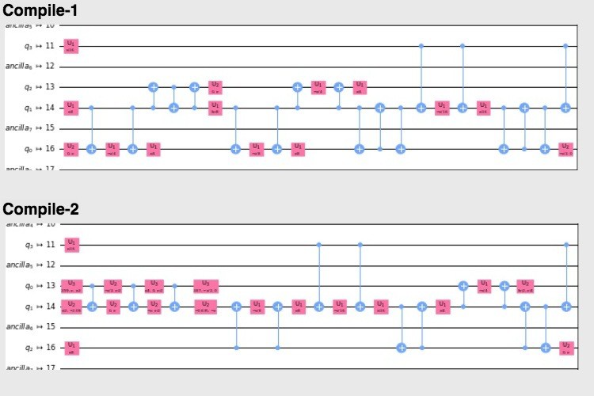
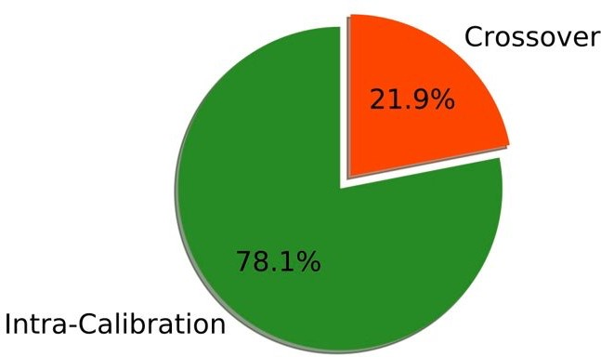
Long Wait Times Is A Source Of Errors
Jobs compiled for one calibration cycle but executing in another
Noise-aware mapping over calibrations
What about the overheads of the characterization circuits used for software error mitigation?
Long queuing latencies may hurt the correctness of quantum programs

Slide 9
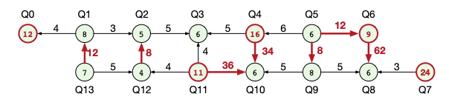
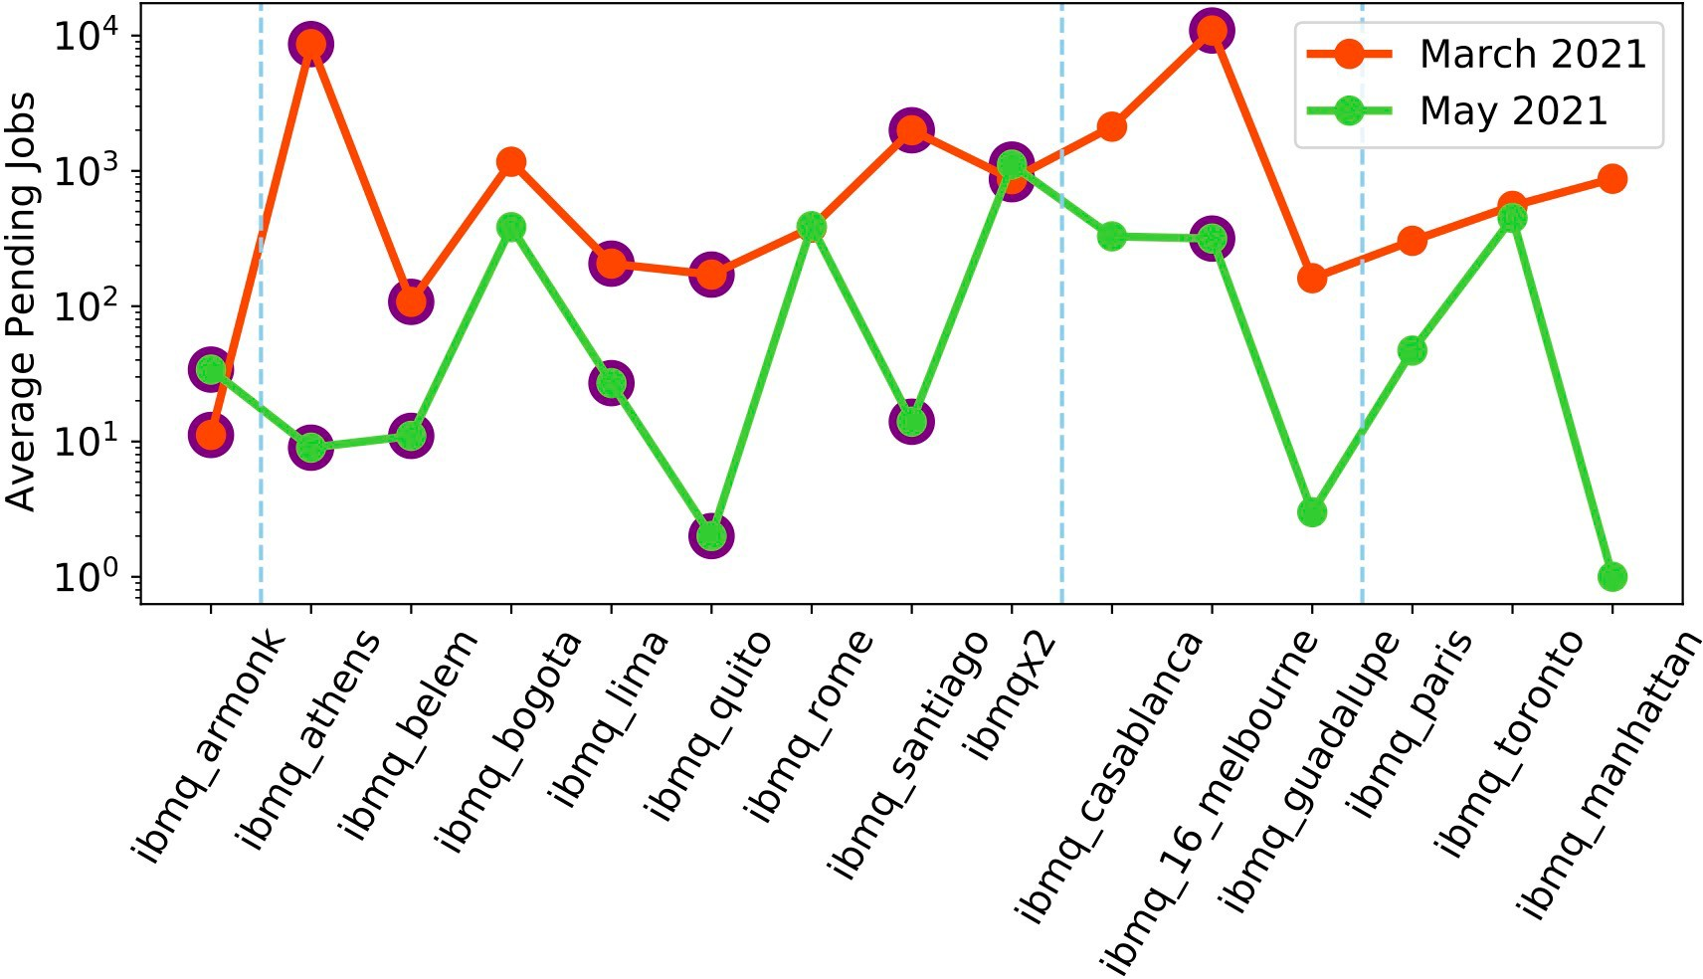
Another Problem: Quantum Computers Are Underutilized
Not all qubits of a machine are used
Not all machines are equally used
Quantum Machine | Number of Qubits | Quantum Volume
Guadalupe | 16 | 32 [5x5]
Kolkata | 27 | 128 [7x7]
Sherbrooke | 127 | 32 [5x5]
Gokul Ravi et al. “Quantum Computing in the Cloud: Analyzing job and machine characteristics”, IISWC 2021
Gokul Ravi et al. “Adaptive job and resource management for the growing quantum cloud”, QCE 2021
Poulami Das et al. “A Case for Multiprogramming Quantum Computers”, MICRO 2019
How do we improve machine utilization and increase system throughput?

Slide 10
MULTI-Programming
Why quantum computing? What topics will be covered? What are the requirements and expected outcomes?

Slide 11
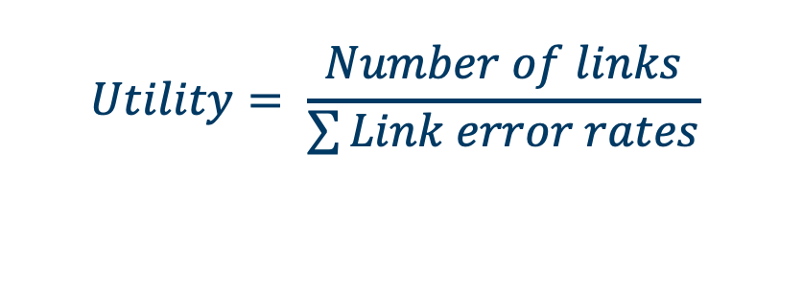
Multi-programming: Resource Allocation Challenges
Non-uniformity in error-rates cause challenges in resource allocation
P1
P2
High
Medium
Low
2
3
2
2
3
2
10
Bad
Link
3
3
3
$$Utility= \frac{Number of links}{\sum{Link error rates}}$$
4 qubit program
3 qubit program
Fair And Reliable Resource Partitioning
The FRP algorithm ensures each co-running application gets fair share of reliable qubits

Slide 12
Multi-programming: Instruction Scheduling Challenges
Programmers’ View
Proposed approach
Interference
P1
M
Delay
P2
M
P1
M
Existing approach
P2
M
Decoherence
Barriers
P1
M
P2
M
Delayed Instruction Scheduling reduces both interference from measurements and decoherence

Slide 13
Adaptive Multiprogramming (Real-Time Monitoring)
I Independent Trials
Independent Queue
Disable Multi-Programming
Queue Manager
Schedule
Process
Output
Incoming Job Queue
Shared Queue
Analyses Reliability
S Shared Trials
S >> I
Poulami Das et al. “A Case for Multiprogramming Quantum Computers”, MICRO 2019
Adaptive multiprogramming enables robust mitigation of impact on program fidelity

Slide 14
Performance Of Multi-Programming
Average: 7.7%
Worst: 12%
S=6K, I=2K, 1.6x throughput
What are the limitations of this approach?

Slide 15
Limitations Of Multi-Programming [2019 Proposal]
Only CNOT-Measurement crosstalk handled, CNOT-CNOT crosstalk?
Machine too noisy [IBM-Melbourne]
Other Works:
Better allocation
Enhanced scheduling
Understanding security implications
IBM’s new devices [multiple qubit planes with classical links]
Ohkura et al.
Xtalk aware multi-programming
IEEE TQC
Das et al.
Multiprogramming
MICRO
Murali et al.
S/W xtalk mitigation
ASPLOS
2019
2020
2021
Understanding the right way to multi-program quantum systems remains a research problem

Slide 16
IMPROVING MULTI-SYSTEM THROUHPUT
Why quantum computing? What topics will be covered? What are the requirements and expected outcomes?

Slide 17
Machine Utilization Remains Low
Natural tendency to opt for higher fidelity device

Slide 18
Managing Jobs/ Resources In Quantum Clouds
Estimate fidelity trends across machines
1
Automated Job Scheduling & Resource Allocation
Optimize for QoS, machine recalibrations
Quantum Cloud Resource Manager
Estimate runtimes and thereby, wait times
4
2
Prioritize fidelity (low load), wait time (high load)
3
The quantum cloud resource manager is a fully automated software framework

Slide 19


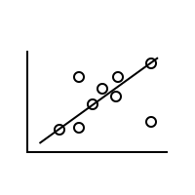
Quantum Cloud Resource Manager: Overview
What is the expected fidelity given a set of circuit features?
Gate count, depth
Machine info
Compiler
Circuit
Features
Fidelity
Correlator
Program
Fidelity if low load
One from batch
Wait time if high load
Queue
Data
Queueing Estimator
Machine
Selection
Send to
machine
Batch size, #shots, program latency
Calibration schedule?
Other constraints?
What are the drawbacks of this methodology?

Slide 20
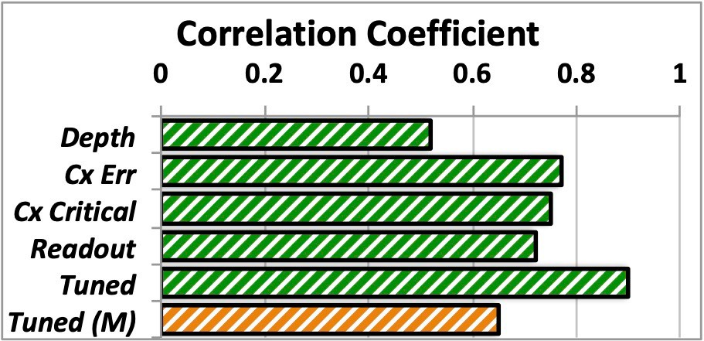
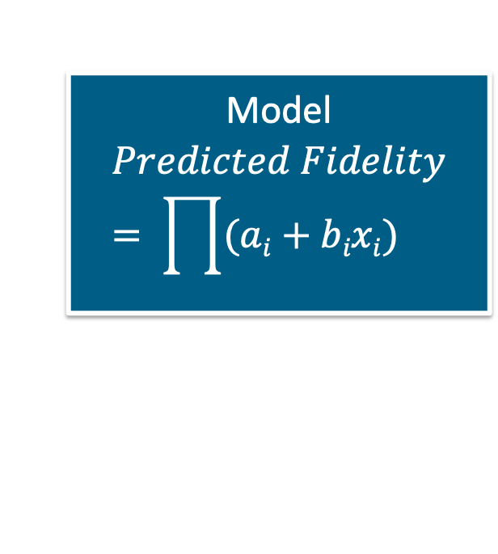
Fidelity Correlator Design
Circuit Depth
Pre-trained using a dataset
Avg. CX error over the circuit
Model
$$Predicted Fidelity= \prod{(ai+bixi)}$$
Avg. CX error along critical path
a_{i}, b_{i} are parameters
Strong correlation
Avg. readout error of circuit
x_{i} is feature
Even a simple model provides good fidelity prediction

Slide 21
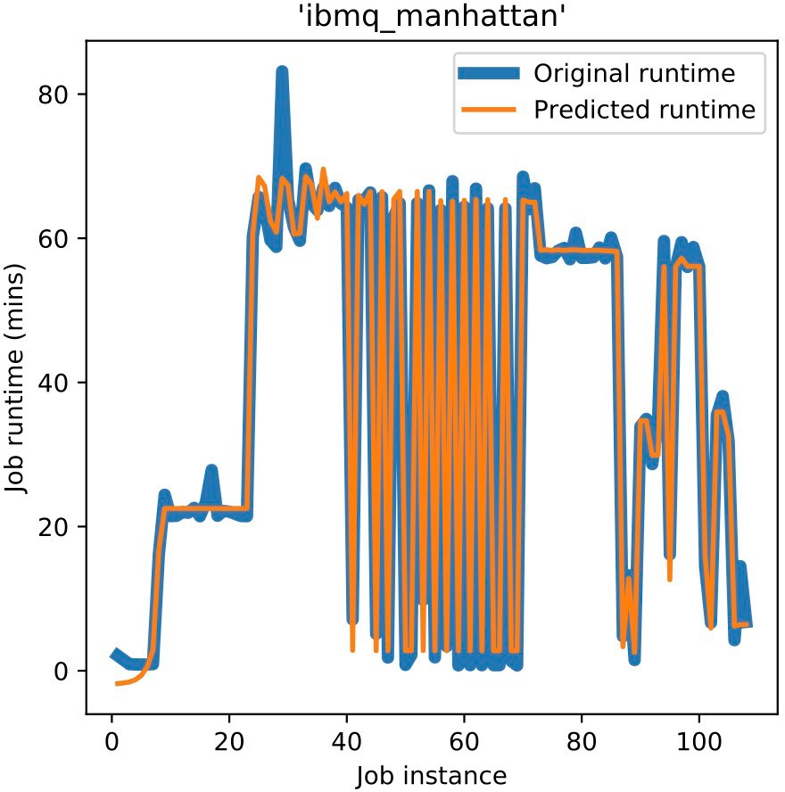
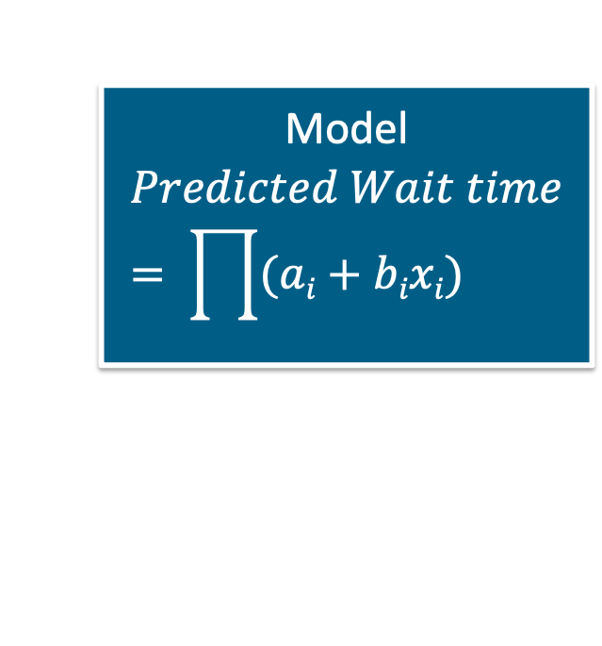
Wait Time Estimator
Batch Size
Pre-trained using a dataset
Number of shots
Model
$$Predicted Wait time= \prod{(ai+bixi)}$$
Circuit: depth, width, gates
a_{i}, b_{i} are parameters
Machine: Qubits, Memory slots
x_{i} is feature
Predicted vs. Actual Runtimes
How does the queuing delay estimator perform based on the features?

Slide 22
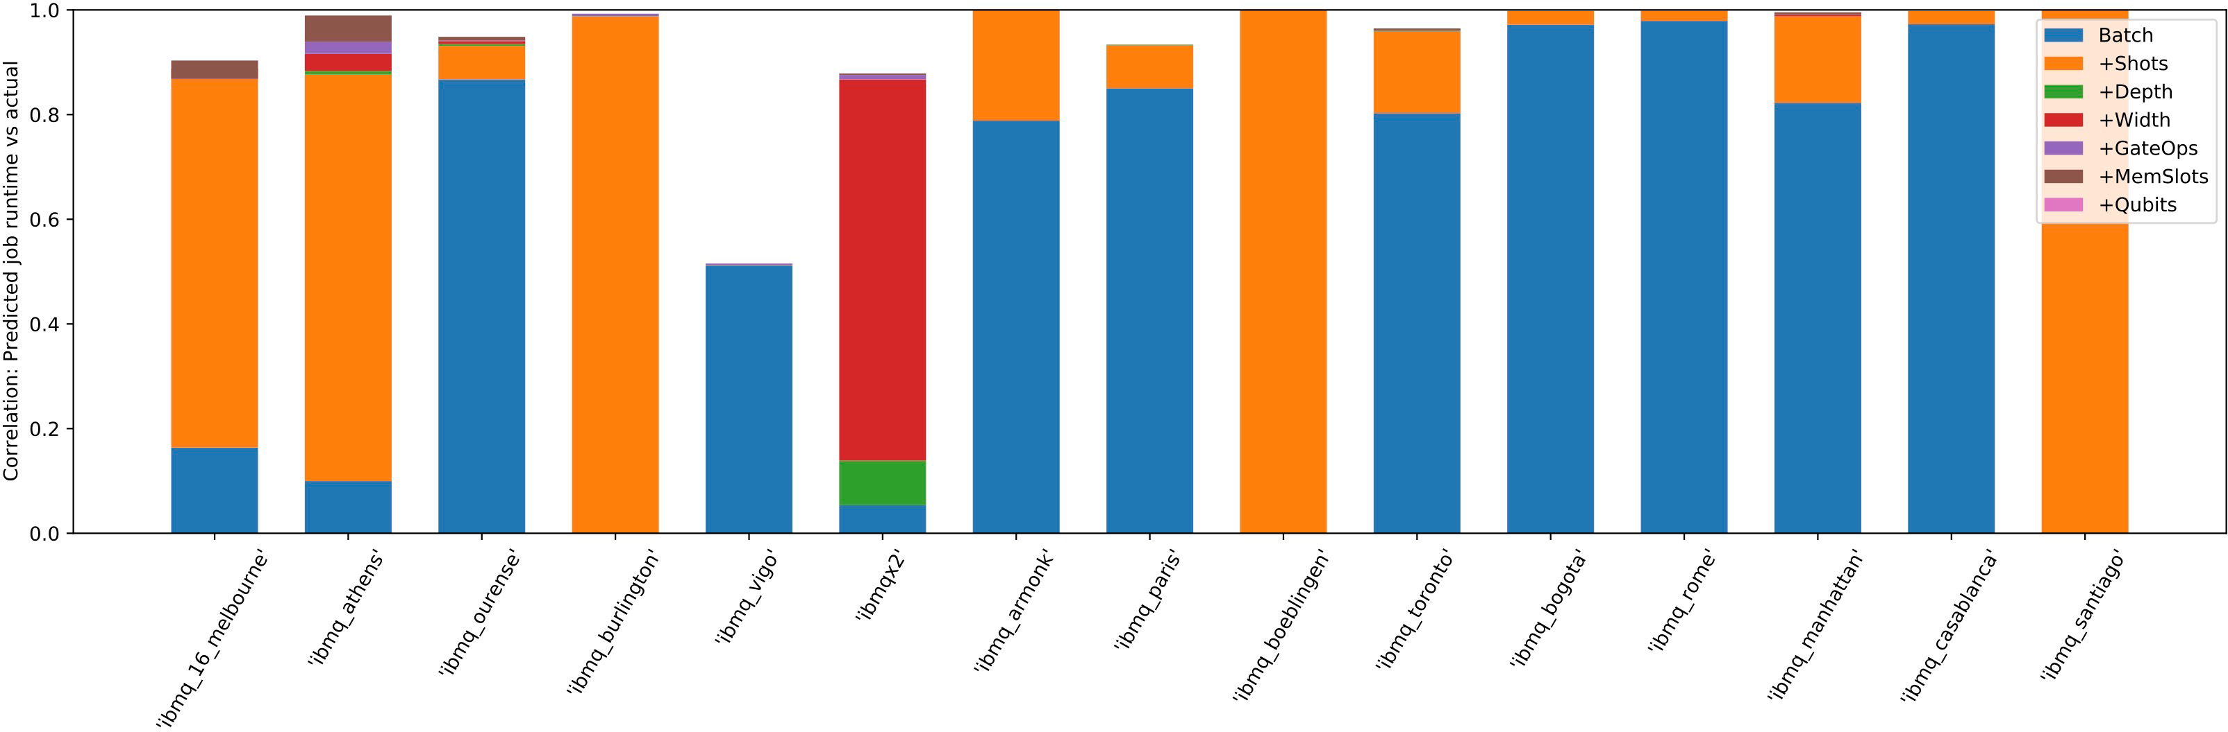
Performance Of Queueing Delay Estimator
Batch size most crucial, followed by number of shots (for low batch sizes)
Again, a simple model works quite well

Slide 23
Job Scheduling Challenges
Predicting wait times is non-trivial
Variational Quantum Algorithms?
Dynamic circuits? New access models?
User priorities? Reservations?
Third-party machines?
Convergence?
Circuit latency?
Avoid starvation for low priority users
Less control on device access/calibration times
Quantum idle time during classical optimization
Pay-As-You-Go: User requests more shots
User reserves machine but jobs are scheduled
Same machine on multiple clouds
Efficient scheduling of jobs on quantum computers is an open problem

Slide 24
IBM’s PAY-As-you-Go
Example of a cloud service where the cloud provider owns the quantum computers and the software stack

Slide 25
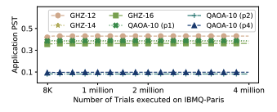
Pay Only For Resources Used
Number of iterations for variational quantum algorithms unknown
Number of trials does not necessarily improve application fidelity
Models such as Pay-As-You-Go enables cloud providers to provide competitive pricing

Slide 26
Amazon BraKET
COST MODEL
Why quantum computing? What topics will be covered? What are the requirements and expected outcomes?
Example of a cloud service where the cloud provider owns the software stack and manages third-party quantum computers

Slide 27
Pricing Of Quantum Computers
Depends on number of qubits, qubit technology, device error-rates
Pricing grows quickly for using quantum systems
Quantum Machine | Per Task Price | Per Shot Price
IonQ-Harmony | 0.30 | 0.01
IonQ-Aria | 0.30 | 0.01
OQC-Lucy | 0.30 | 0.00035
QuEra-Aquila | 0.30 | 0.01
Rigetti-Aspen-M | 0.30 | 0.00035
How to reduce the total cost of execution?

Slide 28
Open Problems
Are simple models for predicting fidelity and wait times good enough?
Choosing between multiple qubit technologies? Choosing between different cloud providers?
Estimating wait times for jobs on a machine handled by third-party [For example, Rigetti machine is hosted on both AWS and Azure, job queues managed by Rigetti, how can we predict jobs launched from AWS/Azure?
Idle times even when machines are reserved [Example: classical optimizer is running for a variational algorithm and the quantum processor waits for the updated circuit].
Managing software error mitigation overheads on shared access systems [Example: compiler needs to access machine to run characterization circuits to perform optimizations].
Classical resources relatively cheaper, but not free. Balance quantum <-> classical costs?

Slide 29
Summary
Developing efficient quantum cloud services is crucial for better management of quantum systems as well as seamless use access.
Each cloud provider works differently, presenting unique challenges.
Quantum computers often remain underutilized.
Multi-programming enables us to share resources on the same quantum computer between different circuits (from the same/different users)
Automated resource management by estimating circuit fidelity and queuing delays enable us to maximize the throughput of systems across the cloud.
Preliminary solutions only, more advanced machine recommendations and scheduling policies required in the future

