Slide 1

ECE 382V: QUANTUM COMPUTING SYSTEMS:
A SOFTWARE/ ARCHITECTURE PERSPECTIVE
Quantum AlgorITHMS
Why quantum computing? What topics will be covered? What are the requirements and expected outcomes?
POULAMI DAS
ECE, The University of Texas at Austin

Slide 2
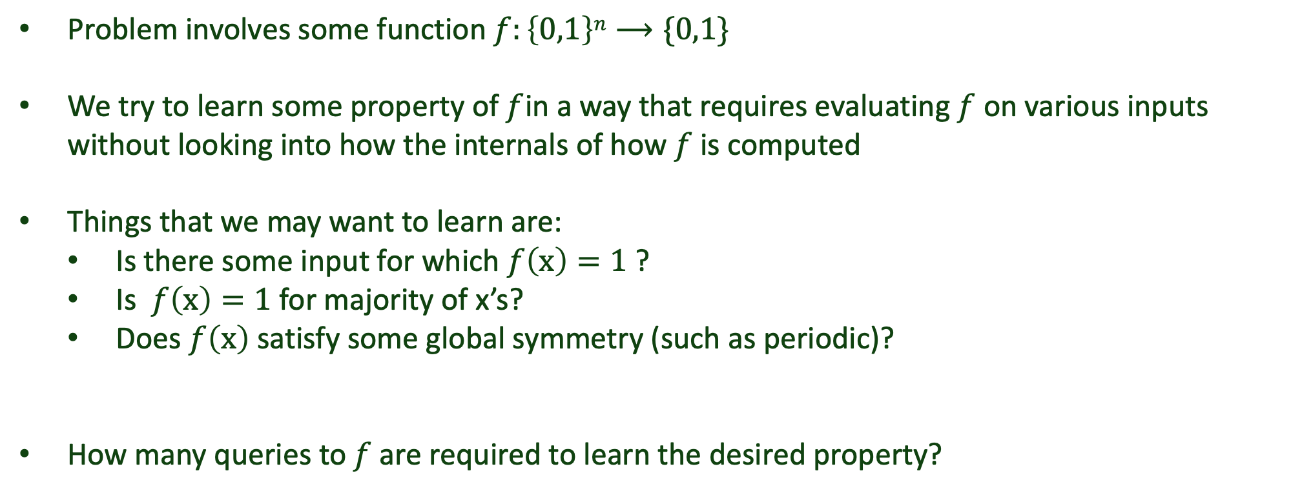
Objective: Learning Properties Of Functions
Problem involves some function $f:\left\{0,1\right\}n⟶\{0,1\}$
We try to learn some property of $f$in a way that requires evaluating $f$ on various inputs without looking into how the internals of how $f$ is computed
Things that we may want to learn are:
Is there some input for which $f\left(x\right)=1$ ?
Is $f\left(x\right)=1$ for majority of x’s?
Does $f\left(x\right)$ satisfy some global symmetry (such as periodic)?
How many queries to $f$are required to learn the desired property?
Computational advantage: fewer queries on quantum computer compared to classical computer

Slide 3




CNOT Using Modulo-2 Arithmetic Notation
Initial | Final
|00⟩ | |00⟩
|01⟩ | |01⟩
|10⟩ | |11⟩
|11⟩ | |10⟩
$$\left|ψ1\right\rangle$$
$$\left|ψ2\right\rangle$$
+
$$\left|ψ1, ψ2\right\rangle$$
$$\left|ψ1,ψ1⨁ψ2\right\rangle$$
We can generalize the usage of this notation

Slide 4




















Deutsch’s Algorithm
$$\left|0\right\rangle$$
U_{f}
$$\left|0\right\rangle$$
1
Inputs
Outputs
$$\left|0\right\rangle$$
$\left|0⨁f(0)\right\rangle =\left|f(0)\right\rangle$
$$\left|x\right\rangle$$
f(x)
$$\left|x\right\rangle$$
U_{f}
$$\left|0\right\rangle$$
U_{f}
$$\left|0\right\rangle$$
$$\left|y\right\rangle$$
$$\left|y⨁f(x)\right\rangle$$
2
$$\left|1\right\rangle$$
$$\left|1⨁f(0)\right\rangle$$
Oracle
$$\left|1\right\rangle$$
U_{f}
$$\left|1\right\rangle$$
3
$$\left|0\right\rangle$$
$$\left|0⨁f(1)\right\rangle =\left|f(1)\right\rangle$$
$$\left|1\right\rangle$$
U_{f}
$$\left|1\right\rangle$$
4
$$\left|1\right\rangle$$
$$\left|1⨁f(1)\right\rangle$$
Objective: Is f(x) constant [$f\left(0\right)=f(1)$] or balanced [$f\left(0\right)≠f(1)$] function?

Slide 5



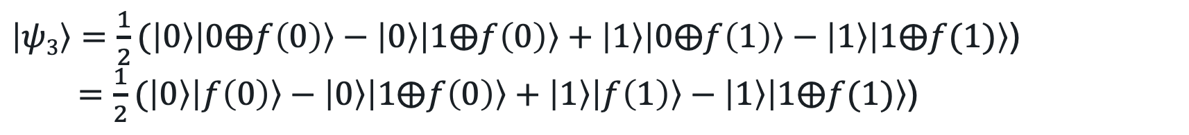





Understanding Deutsch’s Algorithm
$$\left|0\right\rangle$$
H
U_{f}
$$\left|x\right\rangle$$
f(x)
$$\left|x\right\rangle$$
$$\left|1\right\rangle$$
H
U_{f}
$$\left|y\right\rangle$$
$$\left|y⨁f(x)\right\rangle$$
$$\left|ψ1\right\rangle =\left|0\right\rangle \left|1\right\rangle$$
$\left|ψ2\right\rangle =\left|+\right\rangle \left|−\right\rangle = \frac{1}{\sqrt{2}}(\left|0\right\rangle +\left|1\right\rangle$) $\frac{1}{\sqrt{2}}(\left|0\right\rangle −\left|1\right\rangle$) = $\frac{1}{2}(\left|00\right\rangle −\left|01\right\rangle +\left|10\right\rangle −\left|11\right\rangle$)
$\left|ψ3\right\rangle =\frac{1}{2}(\left|0\right\rangle \left|0⨁f\left(0\right)\right\rangle −\left|0\right\rangle \left|1⨁f\left(0\right)\right\rangle +\left|1\right\rangle \left|0⨁f\left(1\right)\right\rangle −\left|1\right\rangle \left|1⨁f(1)\right\rangle$)
$=\frac{1}{2}(\left|0\right\rangle \left|f\left(0\right)\right\rangle −\left|0\right\rangle \left|1⨁f\left(0\right)\right\rangle +\left|1\right\rangle \left|f\left(1\right)\right\rangle −\left|1\right\rangle \left|1⨁f(1)\right\rangle$)

Slide 6

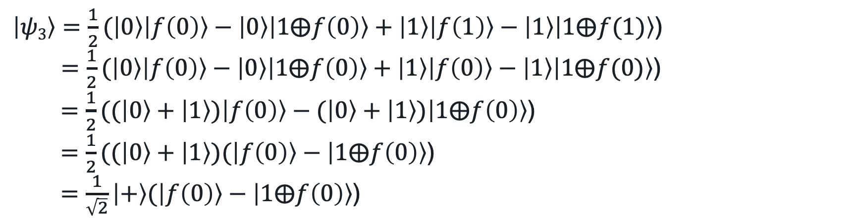

Understanding Deutsch’s Algorithm
$$\left|0\right\rangle$$
H
U_{f}
$$\left|1\right\rangle$$
H
$\left|ψ3\right\rangle =\frac{1}{2}(\left|0\right\rangle \left|f\left(0\right)\right\rangle −\left|0\right\rangle \left|1⨁f\left(0\right)\right\rangle +\left|1\right\rangle \left|f\left(1\right)\right\rangle −\left|1\right\rangle \left|1⨁f(1)\right\rangle$)
Case-1: When𝑓(x) is constant and 𝑓(0) = 𝑓(1)
$\left|ψ3\right\rangle =\frac{1}{2}(\left|0\right\rangle \left|f\left(0\right)\right\rangle −\left|0\right\rangle \left|1⨁f\left(0\right)\right\rangle +\left|1\right\rangle \left|f\left(1\right)\right\rangle −\left|1\right\rangle \left|1⨁f(1)\right\rangle$)
$=\frac{1}{2}(\left|0\right\rangle \left|f\left(0\right)\right\rangle −\left|0\right\rangle \left|1⨁f\left(0\right)\right\rangle +\left|1\right\rangle \left|f\left(0\right)\right\rangle −\left|1\right\rangle \left|1⨁f(0)\right\rangle$)
$=\frac{1}{2}((\left|0\right\rangle +\left|1\right\rangle )\left|f\left(0\right)\right\rangle −(\left|0\right\rangle +\left|1\right\rangle )\left|1⨁f\left(0\right)\right\rangle$)
$=\frac{1}{2}((\left|0\right\rangle +\left|1\right\rangle )(\left|f\left(0\right)\right\rangle −\left|1⨁f\left(0\right)\right\rangle \text{)}$
$=\frac{1}{\sqrt{2}}\left|+\right\rangle (\left|f\left(0\right)\right\rangle −\left|1⨁f\left(0\right)\right\rangle \text{)}$

Slide 7

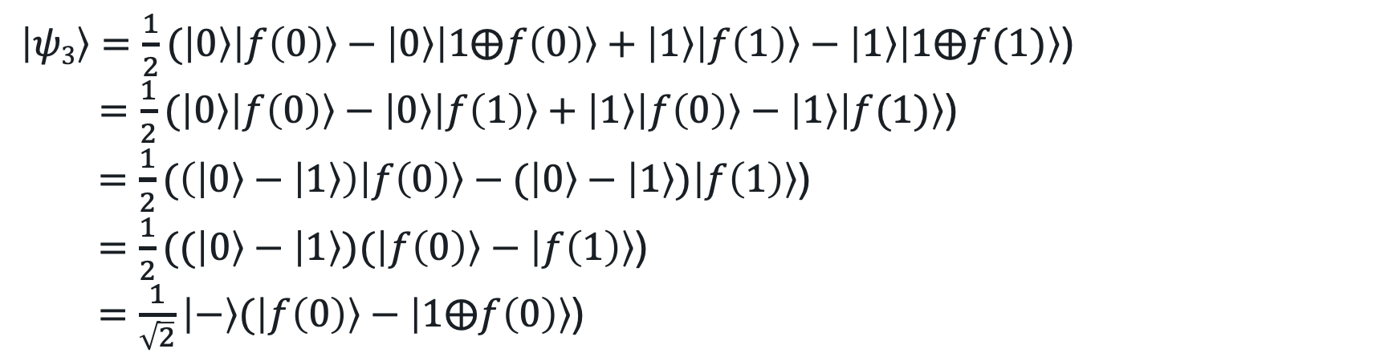

Understanding Deutsch’s Algorithm
$$\left|0\right\rangle$$
$$f\left(0\right)=1⨁f(1)$$
H
U_{f}
$$f\left(1\right)=1⨁f(0)$$
$$\left|1\right\rangle$$
H
$\left|ψ3\right\rangle =\frac{1}{2}(\left|0\right\rangle \left|f\left(0\right)\right\rangle −\left|0\right\rangle \left|1⨁f\left(0\right)\right\rangle +\left|1\right\rangle \left|f\left(1\right)\right\rangle −\left|1\right\rangle \left|1⨁f(1)\right\rangle$)
Case-2: When𝑓(x) is balanced and 𝑓(0) $≠$ 𝑓(1)
$\left|ψ3\right\rangle =\frac{1}{2}(\left|0\right\rangle \left|f\left(0\right)\right\rangle −\left|0\right\rangle \left|1⨁f\left(0\right)\right\rangle +\left|1\right\rangle \left|f\left(1\right)\right\rangle −\left|1\right\rangle \left|1⨁f(1)\right\rangle$)
$=\frac{1}{2}(\left|0\right\rangle \left|f\left(0\right)\right\rangle −\left|0\right\rangle \left|f\left(1\right)\right\rangle +\left|1\right\rangle \left|f\left(0\right)\right\rangle −\left|1\right\rangle \left|f(1)\right\rangle$)
$=\frac{1}{2}(\left(\left|0\right\rangle −\left|1\right\rangle \right)\left|f\left(0\right)\right\rangle −(\left|0\right\rangle −\left|1\right\rangle )\left|f\left(1\right)\right\rangle$)
$=\frac{1}{2}((\left|0\right\rangle −\left|1\right\rangle )(\left|f\left(0\right)\right\rangle −\left|f\left(1\right)\right\rangle \text{)}$
$=\frac{1}{\sqrt{2}}\left|−\right\rangle (\left|f\left(0\right)\right\rangle −\left|1⨁f\left(0\right)\right\rangle \text{)}$

Slide 8


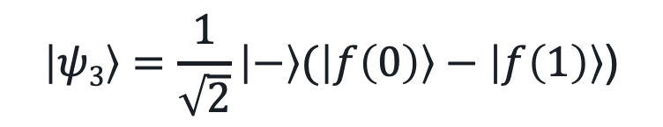
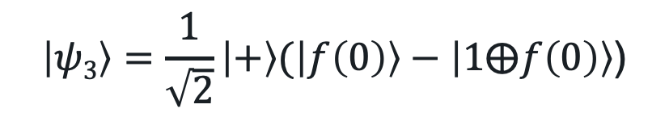
Understanding Deutsch’s Algorithm
$$\left|0\right\rangle$$
H
U_{f}
H
M
$$\left|1\right\rangle$$
H
Ignore
Case-1: When𝑓(x) is constant
Case-2: When𝑓(x) is balanced
$$\left|ψ3\right\rangle =\frac{1}{\sqrt{2}}\left|+\right\rangle (\left|f\left(0\right)\right\rangle −\left|1⨁f\left(0\right)\right\rangle \text{)}$$
$$\left|ψ3\right\rangle =\frac{1}{\sqrt{2}}\left|−\right\rangle (\left|f\left(0\right)\right\rangle −\left|f\left(1\right)\right\rangle \text{)}$$
$$\left|0\right\rangle$$
$$\left|1\right\rangle$$
How many queries to the oracle?

Slide 9
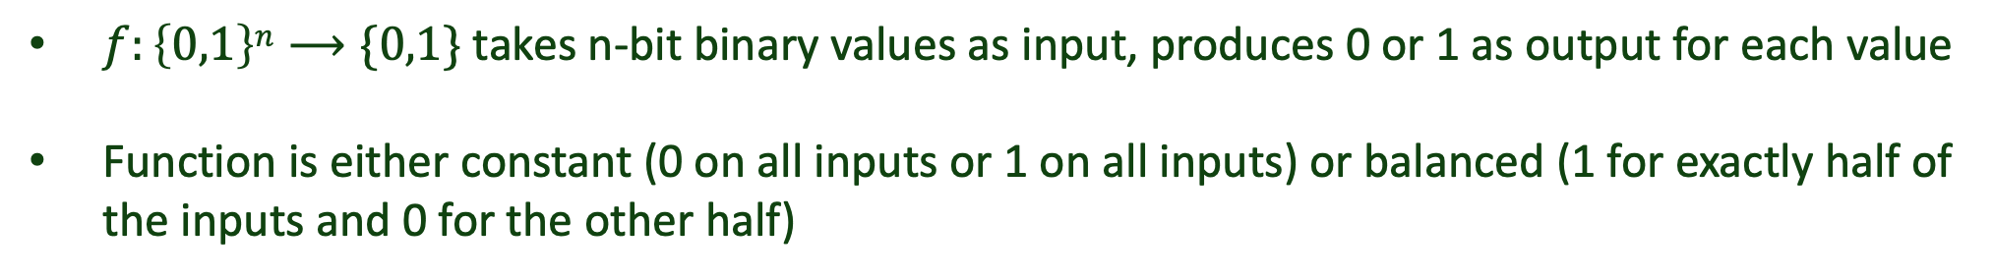





Generalization to Deutsch-Josza Algorithm
$f:\left\{0,1\right\}n⟶\{0,1\}$ takes n-bit binary values as input, produces 0 or 1 as output for each value
Function is either constant (0 on all inputs or 1 on all inputs) or balanced (1 for exactly half of the inputs and 0 for the other half)
$$\left|0..0\right\rangle$$
$$\left|0\right\rangle$$
H$⨂n$
H$⨂n$
U_{f}
H
M
H
$$\left|1\right\rangle$$
H
Ignore
Case-1: When𝑓(x) is constant
Case-1: When𝑓(x) is balanced
‘0000….0000’
Non-zero
How many queries to the oracle?

Slide 10

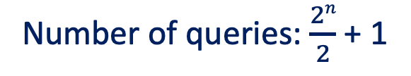
Query Complexity Of Deutsch-Josza Algorithm
Classical
Quantum
State space: $2n$
State space: $2n$
Number of queries: $\frac{2n}{2}$ + 1
Number of queries: 1
Speedup?
Theoretically, exponential speedup
Classical solution only requires 20—30 queries for small error bounds
The Deutsch-Josza algorithm (1992) served as the foundation for many quantum algorithms

Slide 11

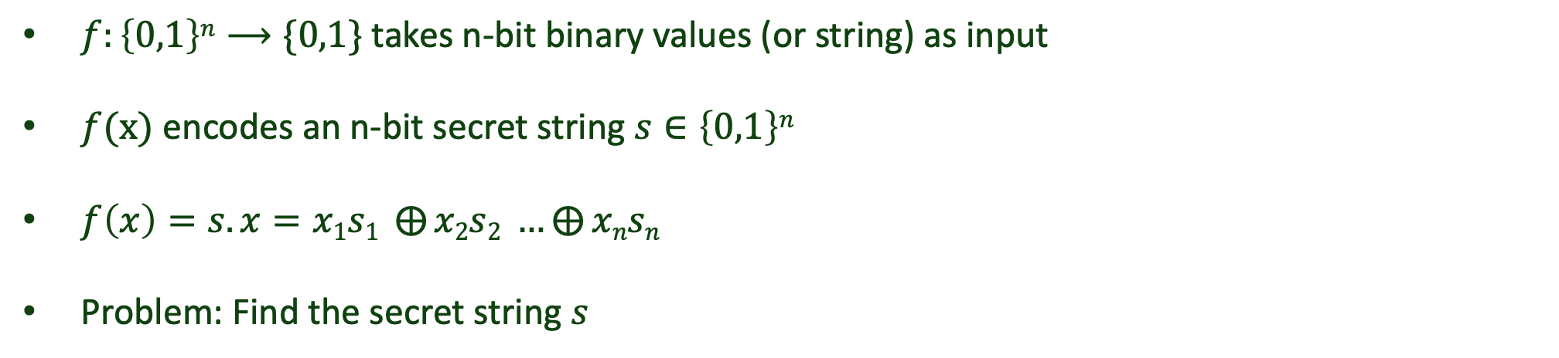




The Parity Problem
$f:\left\{0,1\right\}n⟶\{0,1\}$ takes n-bit binary values (or string) as input
$f(x)$ encodes an n-bit secret string $s∈\left\{0,1\right\}n$
$f\left(x\right)=s.x=x1s1 ⨁{x2s2 }…⨁{xnsn }$
Problem: Find the secret string $s$
$f\left(1000\right)=1.s1 ⨁0.s2$ $⨁0.s3$ $⨁0.s4=s1$
$f\left(0100\right)=0.s1 ⨁1.s2$ $⨁0.s3$ $⨁0.s4=s2$
Classical
Number of queries: $n$
$f\left(0010\right)=0.s1 ⨁0.s2$ $⨁1.s3$ $⨁0.s4=s3$
$f\left(0001\right)=0.s1 ⨁0.s2$ $⨁0.s3$ $⨁1.s4=s4$
Can we do this faster on a quantum computer?

Slide 12
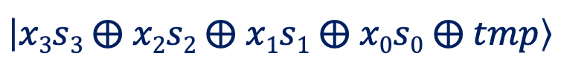





Circuit/Oracle For The Parity Problem
Secret (s₃s₂s₁s₀) = 0101
$$\left|x0\right\rangle$$
U_{f}
$$\left|x1\right\rangle$$
Inputs
$$\left|x2\right\rangle$$
$$\left|x3\right\rangle$$
$$\left|tmp\right\rangle$$
+
+
$$\left|x3s3 ⨁ x2s2 ⨁ x1s\text{1} ⨁ x0s\text{0} ⨁ tmp\right\rangle$$
Effective Goal: Identify which qubits are acting as control for CNOTs?

Slide 13
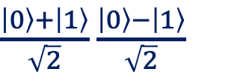





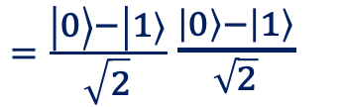

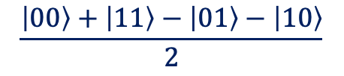

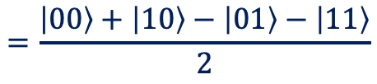
Phase Kickback
$$\left|q0\right\rangle$$
H
H
M
$$\left|q1\right\rangle$$
X
H
+
H
M
$$\left|00\right\rangle$$
$$\left|01\right\rangle$$
$$\left|+−\right\rangle$$
$\frac{\left|0\right\rangle +\left|1\right\rangle }{\sqrt{2}}$ $\frac{\left|0\right\rangle −\left|1\right\rangle }{\sqrt{2}}$
$$=\frac{\left|00\right\rangle +\left|10\right\rangle −\left|01\right\rangle −\left|11\right\rangle }{2}$$
$$\frac{\left|00\right\rangle +\left|11\right\rangle −\left|01\right\rangle −\left|10\right\rangle }{2}$$
$=\frac{\left|0\right\rangle −\left|1\right\rangle }{\sqrt{2}}$ $\frac{\left|0\right\rangle −\left|1\right\rangle }{\sqrt{2}}$
$$=\left|−−\right\rangle$$
$$\left|11\right\rangle$$
Measuring q0 tells us if the black-box (green) contains a CNOT [measure 0 for no CNOT, 1 if there is a CNOT]
Phase kickback allows us to detect if q₀ controls q₁ or not

Slide 14
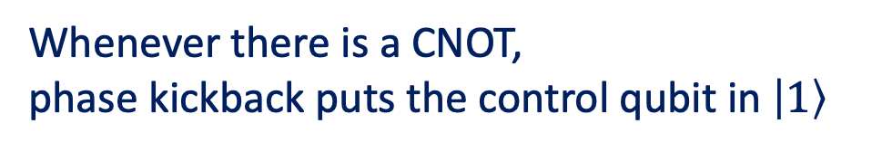

Bernstein-Vazirani Algorithm
U_{f}
$$\left|x0\right\rangle$$
H
U_{f}
H
M
Whenever there is a CNOT,
phase kickback puts the control qubit in $\left|1\right\rangle$
$$\left|x1\right\rangle$$
H
H
M
Inputs
$$\left|x2\right\rangle$$
H
H
M
The output bitstring corresponds to the secret
$$\left|x3\right\rangle$$
H
H
M
$$\left|tmp\right\rangle$$
X
H
+
+
H
Number of queries: 1
The BV algorithm is often regarded as the “Hello World” in quantum computing

Slide 15
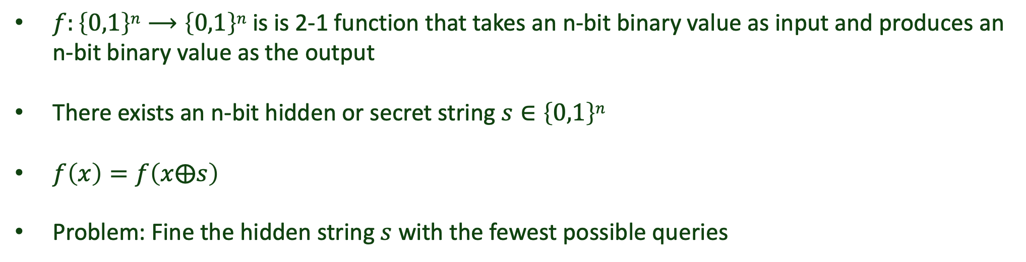
Simon’s Algorithm
$f:\left\{0,1\right\}n⟶\left\{0,1\right\}n$ is is 2-1 function that takes an n-bit binary value as input and produces an n-bit binary value as the output
There exists an n-bit hidden or secret string $s∈\left\{0,1\right\}n$
$f\left(x\right)=f\left(x⨁s\right)$
Problem: Fine the hidden string $s$ with the fewest possible queries
How many queries to the oracle?

Slide 16
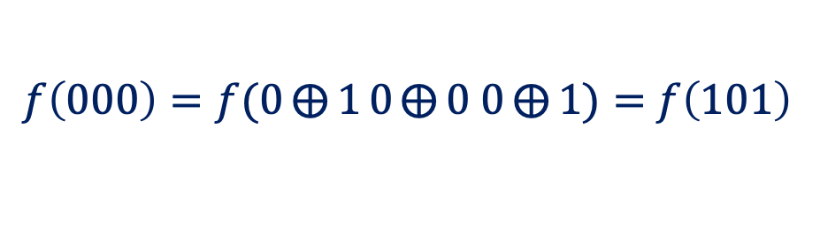

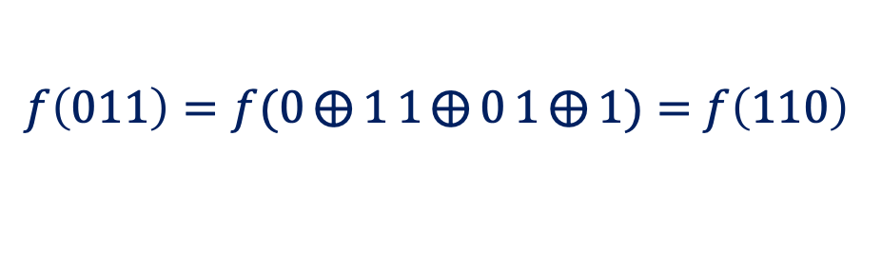
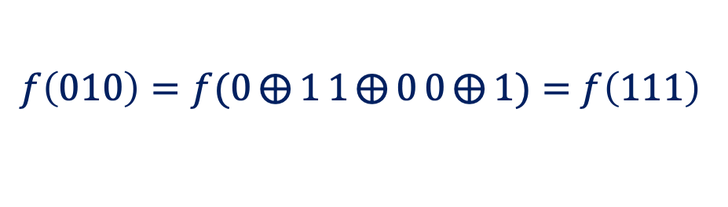
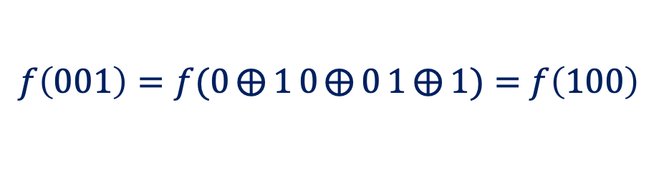
Understanding Simon’s Algorithm
n= 3
s= 101
x | f(x)
000 | 000
001 | 010
010 | 001
011 | 100
100 | 010
101 | 000
110 | 100
111 | 001
$f\left(000\right)=f(0⨁{1}0⨁{0}$ $0⨁{1})=$ $f\left(101\right)$
$f\left(001\right)=f(0⨁{1}0⨁{0}1⨁{1})=$ $f\left(100\right)$
$f\left(010\right)=f(0⨁{1}1⨁{0}0⨁{1})=$ $f\left(111\right)$
$f\left(011\right)=f(0⨁{1}1⨁{0}1⨁{1})=$ $f\left(110\right)$
Classical
Birthday paradox: In a set of N randomly chosen people, what is the probability that at least two of them will share their birthdays?
$$\sqrt{N}$$
Classical complexity scales √𝑁 where N denotes the size of the state space

Slide 17
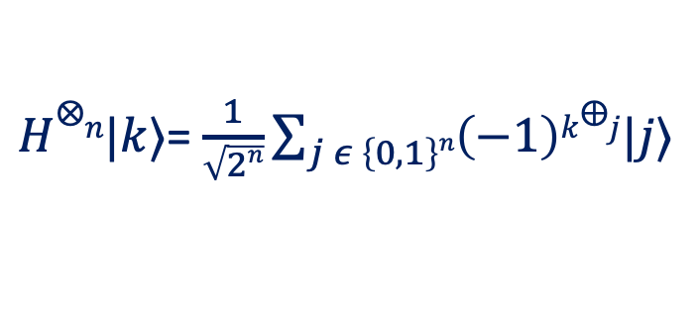
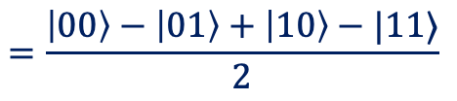
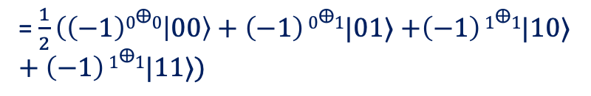
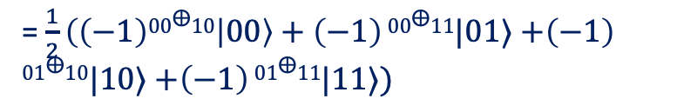
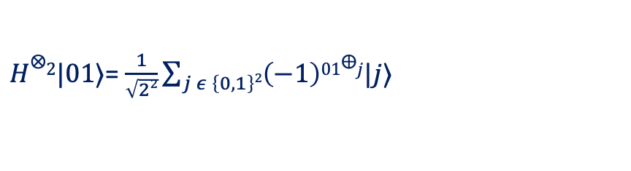
Understanding Simon’s Algorithm
Measurement of 𝑓(x) collapses|𝑥⟩
Generalized Hadamard Transform
x | f(x)
000 | 000
001 | 010
010 | 001
011 | 100
100 | 010
101 | 000
110 | 100
111 | 001
f(x) | x
000 | ?0?
010 | ?0?
001 | ?1?
100 | ?1?
$H⨂n|k⟩$= $\frac{1}{\sqrt{2n}}\sum_{j ε \left\{0,1\right\}n}{\left(−1\right)k⨁j|j⟩}$
Example:
$H⨂2|01⟩$= $\frac{1}{\sqrt{22}}\sum_{j ε \left\{0,1\right\}2}{\left(−1\right)01⨁j|j⟩}$
= $\frac{1}{2}\left(\left(−1\right)00⨁10 | 00\right\rangle +\left(−1\right)$ $00⨁11|01⟩$ $+\left(−1\right)$ $01⨁10|10⟩$ $+\left(−1\right)$ $01⨁11|11⟩)$
= $\frac{1}{2}\left(\left(−1\right)0⨁0 | 00\right\rangle +\left(−1\right)$ $0⨁1|01⟩$ $+\left(−1\right)$ $1⨁1|10⟩$ $+\left(−1\right)$ $1⨁1|11⟩)$
$$=\frac{\left|00\right\rangle −\left|01\right\rangle +\left|10\right\rangle −|11⟩}{2}$$
These are two important concepts for understanding Simon’s algorithm

