Slide 1

ECE 382V: QUANTUM COMPUTING SYSTEMS:
A SOFTWARE/ ARCHITECTURE PERSPECTIVE
From Algorithms to Qubits
Thanks to Prof. Moinuddin Qureshi & Prof. Swamit Tannu!
POULAMI DAS
ECE, The University of Texas at Austin

Slide 2

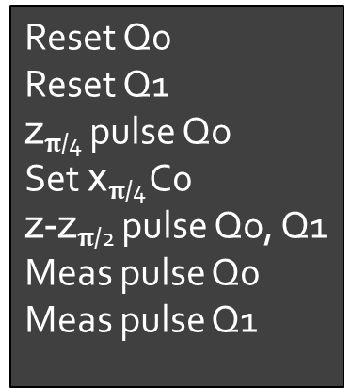
Key Role Of A Quantum Compiler
High Level Program
FPGA
Quantum_Func(2);
Quantum
Compiler
S
Higher Quantum Assembly
Lower Assembly
Q₀
Q₁
creg c[2] ;
qreg q[2]; //qubit variable
H q[0]; //equal superposition
CNOT q[0], q[1]; //entangle
MEAS (q,c); //measure
Reset Q0
Reset Q1
z$π$_{/4} pulse Qo
Set x$π$_{/4} C0
z-z$π$_{/2} pulse Qo, Q1
Meas pulse Q0
Meas pulse Q1
Q₀
//
Q₁
//
1
1
S
//
Controlled Gates: Bit-Flip versus Phase-Flip
//
Time
Quantum compilers transform high-level programs into low-level sequence of control pulses

Slide 3
NISQ Compilation Overview
Quantum
Program
Quantum
Circuit
Mapped
Circuit
Nativized
Circuit
Executable
Circuit
Generator
Qubit
Mapper
Assembler/Nativizer
Pulse
Scheduler
Quantum Compiler
Quantum compilers transform high-level programs into low-level sequence of control pulses

Slide 4
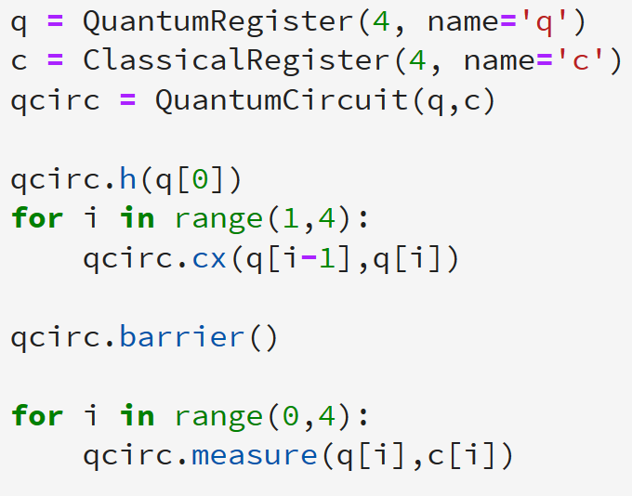
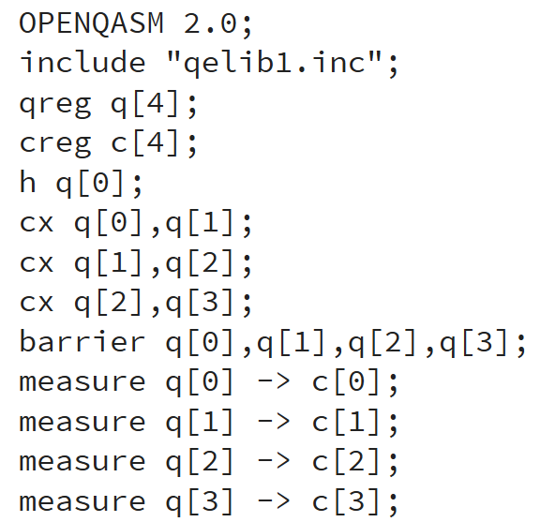
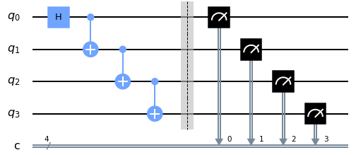
From Quantum Program To Quantum Circuit
Quantum Program
Quantum Circuit
Circuit
Generator
Classical and Quantum operations are used
Unrolled sequence of quantum operations
Controlled Gates: Bit-Flip versus Phase-Flip
The quantum circuit is often represented as a DAG to capture the data dependencies

Slide 5

From Quantum Circuit To Mapped Circuit
Qubit Allocation: Allocate each program qubit to a unique physical qubit
Qubit Routing: Introduce SWAPs to overcome limited device connectivity
Program
NISQ Device
Scheduled/Routed Program
SWAP
q0
q3
q2
q1
The scheduled and routed program is compatible with the topology of a device

Slide 6









From Mapped Circuit To Nativized Circuit
Gate Nativization: Translate each operation of the scheduled and routed program into a series of native gates that are specific to the device
Basis Gates/ Native Gates: The set of native gates supported by a device
Scheduled/Routed Program
q0
CNOT
H
q1
+
Gate Nativization
Gate Nativization
q0
R_{X}($\frac{Π}{2}$)
XY
R_{X}($\frac{Π}{2}$)
XY
RZ ($\frac{Π}{2}$)
RX ($\frac{Π}{2}$)
RZ ($\frac{Π}{2}$)
q1
R_{Z}($Π$)
R_{Z}($\frac{−Π}{2}$)
R_{X}($\frac{−Π}{2}$)
R_{X}($\frac{−Π}{2}$)
The nativized circuit is compatible with the basis gate set of a specific device

Slide 7
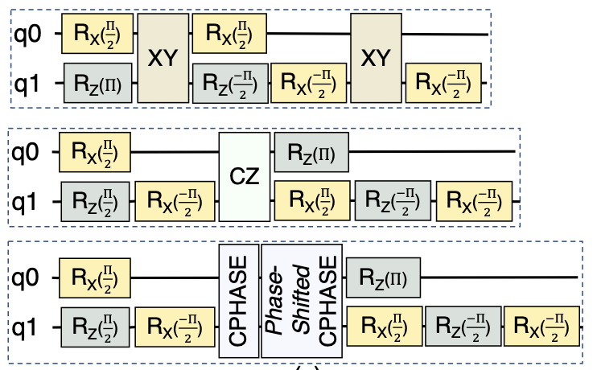
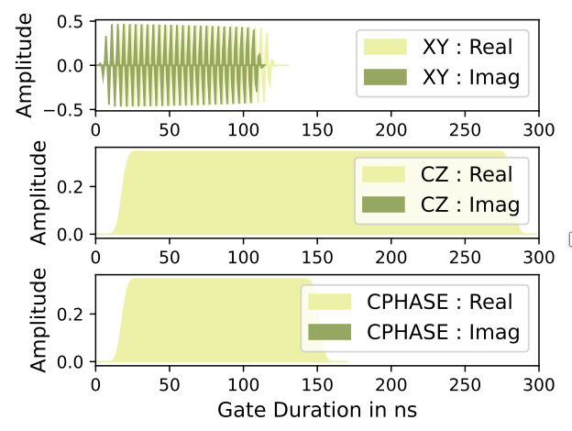
From Nativized Circuit To Pulse Schedule
Pulse Scheduling: Translate each native operation into its equivalent pulse schedule
The pulse schedule is loaded onto FPGAs and used to generate the required waveforms

Slide 8
NISQ COMPUTING
Why quantum computing? What topics will be covered? What are the requirements and expected outcomes?

Slide 9


40%
20%
20%
20%
20%
20%
20%
20%
A
B
C
D
A
B
C
D
Bevo is the live mascot at which of the following universities?
A. UT Austin
A. UT Austin
B. Georgia Tech
C. Texas A&M
D. None

Slide 10
NISQ Objective: Maximize Program Success Rate
Use minimum gates
Use commutative properties, re-order operations
Program
Optimal native gate decomposition
Efficient mapping to reduce SWAPs
Unroll loops/ Decompose multi-qubit operations
Cancel
Gates
Map
Qubits
Schedule + Route
Cancel
Gates
Nativize
Gates
Correct Readout Errors
Reduce SWAPs, select better-than-worst SWAPs
Another round of cancellations+ reordering
Generate Pulse Schedule
Run
Post-process
Optimize at pulse-level to reduce program length
Characterization Circuits OR Functionally identical copies
Cut and Stitch
Software compiler optimizations are crucial to improve the success-rate of NISQ applications

Slide 11
Qubit MaPPING AND ROUTING
Why quantum computing? What topics will be covered? What are the requirements and expected outcomes?

Slide 12
Why Is Device Connectivity Limited?
Connectivity: Requires ‘connecting’ two qubits using resonators
Impractical
Real devices have limited connectivity
IBMQ-Tokyo
Google Sycamore
IBMQ-Toronto
Rigetti Aspen
Device connectivity depends on the qubit topology

Slide 13
Qubit Routing
Key Objective: Minimize #SWAPs required to relocate a qubit from one point to another
SWAP Overheads: Increase in total number of two-qubit operations and circuit depth
Google Sycamore
3x
2x
Max-Cut beyond 17 qubits
SWAPs increase the overall gate count and depth of programs thereby, reducing fidelity

Slide 14
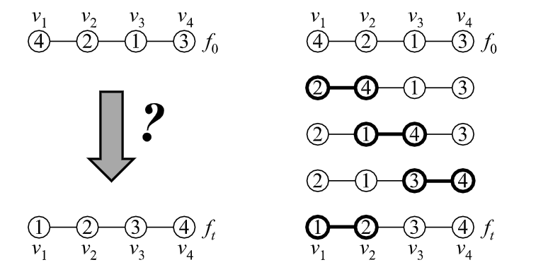
Minimizing SWAPs As A Token Swapping Problem
Given a graph G with nodes V_{i} and edges E_{ij}
Each node has a token that can only be exchanged via SWAP with the neighbor
Token configuration f₀ denotes the initial condition or arrangement of tokens
Find the minimum number of SWAPs to transform one token configuration f₀ into another f_{t} after swapping in t steps
Token swapping may be used to formulate the transformation of one qubit mapping to another

Slide 15
Implementation Example
Split program into independent layers
Transform (if required) the qubit mapping of i^{th} layer into (i+1)^{th} layer using SWAPs
Initial Qubit Allocation
L1
L2
L3
L1
cnot A,B
cnot C,D
cnot A,C
cnot A,D
A
S12
S23
B
D
B
L2
C
A
C
C
L3
A
D
SWAP minimization is NP-hard

Slide 16
Multiple SWAP Candidates
L1
cnot A,B
cnot C,D
cnot A,C
cnot A,D
B
D
B
D
C
B
D
A
B
D
D
B
L2
A
C
C
A
A
A
B
C
A
D
C
C
L3
SWAP A,C
SWAP A,B
SWAP C,D
SWAP B,D
A* search to locate candidates
Search complexity scales rapidly
Large memory footprint to store the A* search tree
A* search is not scalable

Slide 17
Lookahead Scheme
L1
cnot A,B
cnot C,D
cnot A,C
cnot A,D
cnot A,B
B
D
B
D
C
B
D
A
B
D
D
B
L2
A
C
C
A
A
A
B
C
A
D
C
C
L3
L4
SWAP A,C
SWAP A,B
SWAP C,D
SWAP B,D
SWAP insertion updates qubit mapping that impacts future operation scheduling
Choose the third SWAP candidate over the first one (CNOTs in layer L4 does not require any additional SWAPs in that case)
How far should you lookahead? What are the trade-offs?

Slide 18


Implementation Example
Drawbacks
Does it require SWAP(s)?
1
Always greedy
Lookahead
2
Early convergence on SWAPs
Directly enable future gates?
Current SWAPs affect future SWAP insertion

Slide 19
SABRE: Heuristic Algorithm
Heuristic function decides which SWAP to choose
Cost function is designed such that it enables as many gates as possible from the current layer (higher priority) and as many gates as possible from future layers (lower priority)
Initial mapping affects SWAP insertion (at the beginning of a program)
Choose SWAP candidates locally (introduce SWAPs one at a time, choose only neighbors)
Avoids the space and time complexity of A* search
Explores a vast design space to trade-off between circuit gate count, depth, and parallelism
Gushu Li et al. “Tackling the Qubit Mapping Problem for NISQ-Era Quantum Devices”, ASPLOS 2019
Widely regarded as the state-of-the-art heuristic SWAP insertion algorithm

Slide 20
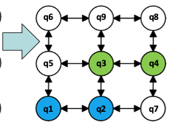
Trade-Off Between Gate Count, Depth, Parallelism
q6 q9 q8
SWAP: 4
Depth: 3
CNOT q1, q2 CNOT q3, q4
q1
q2
q4
Code:
Original Mapping:
q6 q2 q4
q5
q7
q3
SWAP: 3
Depth: 6
q5
q9
q8
q6
q9
q4
q1
q3
q7
q5
q2
q8
q1
q3
q7
The heuristic chooses a set of non-overlapping SWAPs

Slide 21









Impact Of Device Characteristics
SWAPs have different probabilities of success
Quantum devices exhibit spatial and temporal variation in error-rates
2%
L1
cnot A,B
cnot C,D
cnot A,C
cnot A,D
1%
B
D
B
D
C
B
D
A
B
D
D
B
1%
2%
2%
2%
3%
L2
3%
A
C
C
A
A
A
B
C
A
D
C
C
L3
SWAP A,C
SWAP A,B
SWAP C,D
SWAP B,D
Day-1
$$P=0.973=0.92$$
$$P=0.94$$
$$P=0.94$$
$$P=0.97$$
Day-2
$$P=0.92$$
$$P=0.97$$
$$P=0.94$$
$$P=0.94$$
Is minimizing only the number of SWAPs enough?

Slide 22
Noise-Adaptive Qubit Routing
Adjust the heuristic cost function for SWAP selection to account for device error-rates
Device error-rates available from system calibration reports
Input
DAG
Noise Adaptive Qubit Mapping and Routing
Device
Topology
Scheduled + Routed DAG
Calibration
Data
Swamit Tannu et al. “Not All Qubits Are Created Equal”, ASPLOS 2019
Prakash Murali et al. “Noise-adaptive Compiler Mappings”, ASPLOS 2019
Noise-adaptive compiler mapping maximizes the expected probability of successful SWAP

Slide 23
Understanding Qubit Mapping & Routing Research Space
Heuristics vs. exact solutions
Heuristics trade-off accuracy for lower compilation complexity (both space and time)
Solver-based approaches produce optimal solutions but require hours-days of compilation time and are not scalable beyond few tens of qubits
Ideal
Solver
Solution quality
(closeness to optimal)
ForeSight
SABRE
Space/Time complexity
Many solutions exist for both types and the space has quite saturated now (for superconducting)

Slide 24
ForeSight Insight #1: Consider Longer SWAP Routes
2
3
4
Distance Matrix (D)
0
1
2
3
1
 | 0 | 1 | 2 | 3 | 4 | 5 | 6 | 7
0
1
2
3
4
5
6
7
4
5
6
7
D[0][5]
1
0 -> 4 -> 5
Shortest Paths (P_{min})
2
0 -> 1 -> 5
3
0 -> 1 -> 2 -> 6 -> 5
2 SWAPs longer
4
0 -> 1 -> 2 -> 3 -> 7 -> 6 -> 5
4 SWAPs longer
Constraint Relaxation Factor (𝞭)
Constraint Relaxation Factor (𝞭=2)
ForeSight explores a few longer SWAP routes that can potentially reduce SWAPs in future

Slide 25
ForeSight Insight #1: Delay SWAP Selection
Existing Methods
ForeSight
ForeSight delays SWAP decisions to assess impact of a current SWAP on future SWAP selections

Slide 26
ForeSight: Managing Search Complexity
CNOT Cost
Random Selection
Program
DAG
Max. Solutions Allowed (S_{max})
Solution Tree
Continuous Pruning
Continuous pruning keeps the search complexity of ForeSight tractable

