Slide 1

ECE 382V: QUANTUM COMPUTING SYSTEMS:
A SOFTWARE/ ARCHITECTURE PERSPECTIVE
CROSSTALK & IDLE error mitigATION
POULAMI DAS
ECE, The University of Texas at Austin

Slide 2
What Is Crosstalk In Quantum Systems?
The effective measurement error-rate of a qubit increases in the presence of other measurements due to readout crosstalk.
The effective error-rate of a two-qubit CNOT gate increases in the presence of other CNOTs due to operational crosstalk.
Isolated
Multiple
Isolated
Multiple
Operation on one device impacts the error-rate of an operation on another due to crosstalk

Slide 3
CNOT-CNOT Crosstalk
Decoherence
q0
H
q0
H
q1
+
Crosstalk
q1
+
q2
+
q2
+
q3
+
q3
+
Parallel CNOTs
for depth reduction
Serial CNOTs
for crosstalk reduction
Trade-off between serial CNOT scheduling and increased probability of decohering

Slide 4
Reduce Both CNOT-CNOT Crosstalk And Decoherence
Ideally, we want to reduce both crosstalk (via serial CNOT scheduling) and the probability of decoherence (by maximizing parallel CNOT scheduling)
Low
High
Too High
Not all pairs of CNOTs are impacted by crosstalk errors equally
Not all CNOT pairs are equally susceptible to crosstalk, schedule low crosstalk pairs in parallel

Slide 5
CNOT-CNOT Crosstalk Reduction Via Scheduling
q0
H
q0
H
Parallel CNOTs reduce
decoherence
q1
+
q1
+
q2
+
q2
+
q3
+
q3
+
High crosstalk
+
+
Serial CNOTs reduce
crosstalk
q4
q4
q5
+
q5
+
q6
+
+
q6
+
+
High crosstalk CNOT pair scheduled serially
How do we determine which pairs of CNOTs are high crosstalk pairs?

Slide 6

Identifying High-Crosstalk CNOT Pairs
Characterize
Determine CNOT error-rates in isolation
Compare
Determine the CNOT error-rates for simultaneous CNOTs
The information from the device characterization is used by the compiler during scheduling

Slide 7
Compilation Workflow To Reduce CNOT-CNOT Crosstalk
Characterize
Database
n-bit
Program
Compiler
(Schedule Pass)
Executable
If two CNOTs can be scheduled in parallel because they do not have any dependencies and the CNOT pair is not a part of the high crosstalk database, then they are scheduled concurrently
What are the drawbacks of this approach?

Slide 8
Characterization Complexity Scales Exponentially
The number of CNOT pairs that must be characterized grows exponentially with the system size
Crosstalk tends to be local, characterize spatial neighbors
Prakash Murali et al. “Software Mitigation of Crosstalk”
Localized characterization incurs reduced overheads

Slide 9
IDLE Error Mitigation
Why quantum computing? What topics will be covered? What are the requirements and expected outcomes?

Slide 10
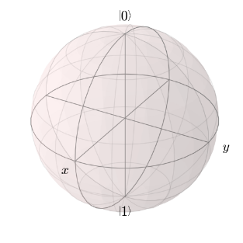
Qubit Encounter Errors Even When Idle
Qubits encounter errors while performing operations: Active Errors
Qubits are vulnerable to errors even while they are not performing operations: Idling Errors
1
Error!
1
Error!
0
0
Time = 0
Time = t (100 µS)
Decoherence
Crosstalk increases idling errors by 10x
Crosstalk from on-going operations significantly increase idle errors

Slide 11
Idle Errors At Program-Level
Long-latency of two-qubit operations
Data-dependencies
35ns
2400 ns
idle
SWAP
operations
Idle qubits are common in quantum programs

Slide 12
How Do We Reduce Idle Times On Qubits?
By default, operations are scheduled as late as possible (ALAP) to minimize decoherence
Schedule available (single) gates at the middle of idle time windows
ALAP policy schedules X when 40 ns are left for the CNOT to complete
Idle:
180
X-gate: 40 ns
Idle:
360
Idle:
180
X
q0
X
q1
+
+
CNOT gate: 400 ns
q2
+
t=0
t=40
t=440
t=620
t=800
t=840
t=1240
Kaitlin Smith et al. “TimeStitch: Exploiting Slack to Mitigate Decoherence in Quantum Circuits”
What are the drawbacks of this scheme?

Slide 13
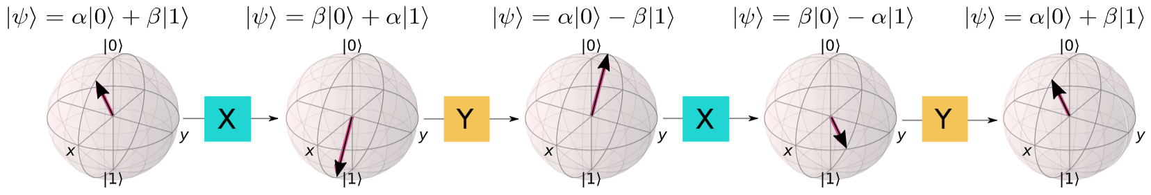
Dynamical Decoupling
Dynamical Decoupling (DD): Keep idle qubits busy
Specific gate sequence: X-X or X-Y-X-Y
Effectively Identity gate: Qubit state remains unchanged
Dynamical decoupling keeps idle qubits busy without altering their state

Slide 14


Is Dynamical Decoupling Always Helpful?
DD
Best Sequence: 010100
DD
DD
DD
DD
DD
No-DD
DD-for-All
How do we identify which qubits to apply DD pulses to for maximum success-rate improvement?

Slide 15
Knowing Which Qubits Will Benefit From DD Is Hard
DD
0
2
4
DD
1
Don’t know
which is better
3
5
Challenge-1: Which qubits will benefit from DD? Hard to characterize all possibilities
Challenge-2: Do not know correct output.
Thus, can't test fidelity with DD sequences
How do we identify the subset of qubits that will likely benefit the most from DD?

Slide 16
Use Decoy Circuits To Learn
Crosstalk from CNOTs is the dominant source of idling errors
Clifford circuits an be simulated
efficiently to find noiseless output
Poulami Das et al. “ADAPT: Adaptive Dynamical Decoupling”, MICRO 2021
Drawback: the search scales exponentially

Slide 17
Use Local Search
DD
DD
...
DD
16 Decoy Circuits
DD
Best: 0101
DD
2¹⁰ = 1024
Decoy Circuits
DD
DD
...
16 Decoy Circuits
DD
DD
Best: 1101
...
DD
DD
4 Decoy Circuits
DD
DD
Best: 01
Not Scalable
Total Decoy Circuits: 36
Optimal Sequence: 0101110101
The local search makes this approach scalable

Slide 18
ADAPT: Performance Overview
3.3
2.7
2.3
ADAPT is effective: 1.6x on average (including other machines)
Optimal DD sequence from ADAPT outperforms DD-on-All Qubits
ADAPT is effective in reducing idling errors

Slide 19
Summary
Idle errors are common in quantum circuits.
Idle errors worsen in the presence of crosstalk from on-going CNOT operations.
Idle errors can be reduced by keeping qubits busy (dynamical decoupling).
Crosstalk and idle errors depend on the basis gate set and device characteristics (IBM vs. Google devices have different crosstalk behavior).
Translating device-level approaches to program-level is non-trivial, we must rethink.
Studying crosstalk and idle errors in the context of QEC is an important open problem

