Slide 1
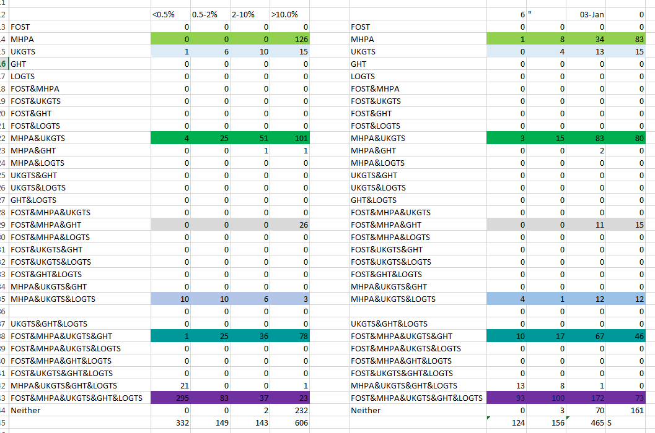

Slide 2

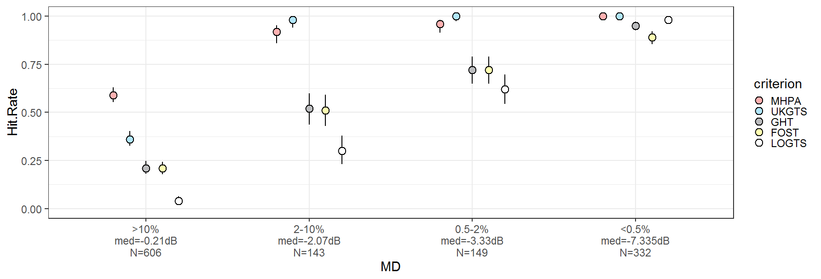
15
10
3
232
23
79
101
6
10
2
295
21
4
37
36
51
10
83
25
25
6
26
126
Legend
>10.%
N=606
2-10%
N=143
0.5-2%
N=149
<0.5%
N=338
MHPA
UKGTS
GHT
Foster
LOGTS

Slide 3
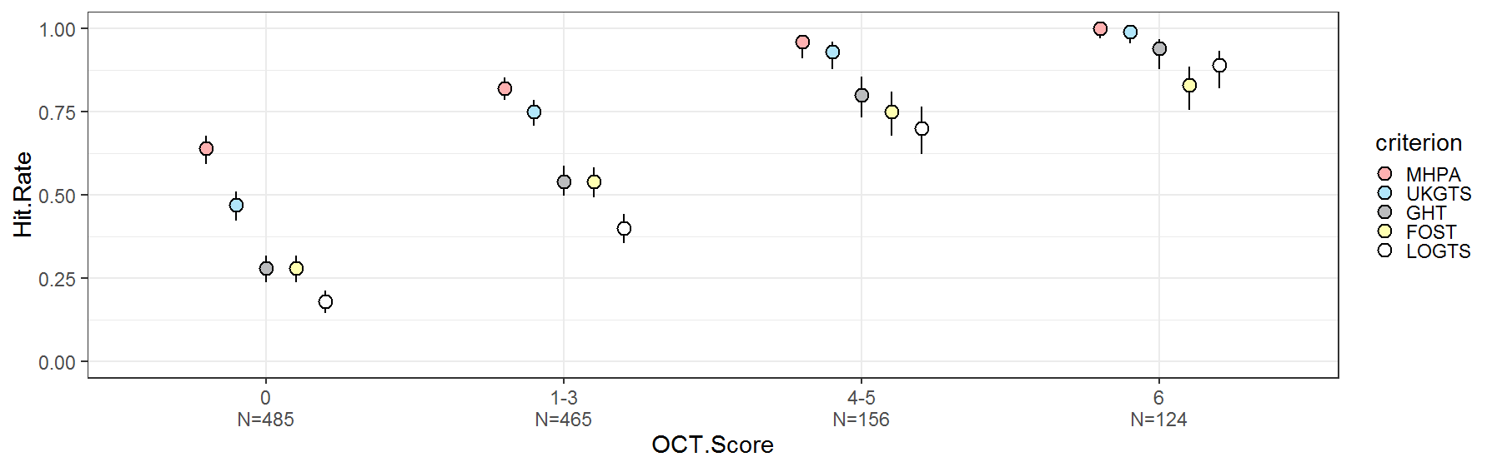
12
15
12
13
8
4
13
161
73
46
80
172
67
83
70
100
15
3
93
3
15
Legend
83
11
34
17
8
10
0
N=485
1—3
N=465
6
N=124
MHPA
UKGTS
GHT
Foster
LOGTS
4—5
N=156

Slide 4
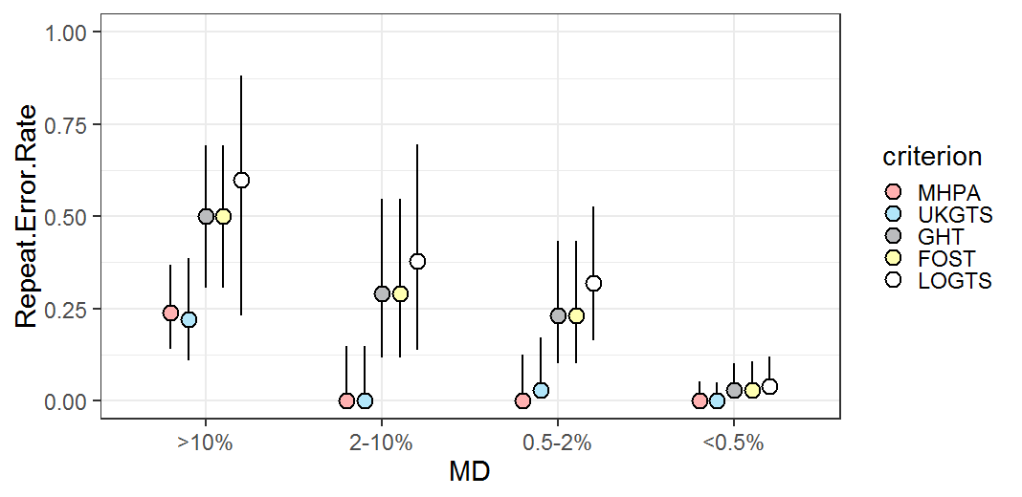
Legend
GHT
Foster
MHPA
UKGTS

Slide 5
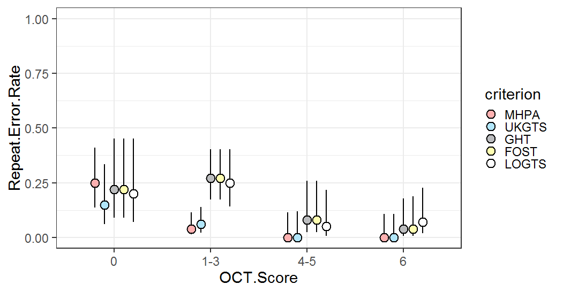
Legend
GHT
Foster
MHPA
UKGTS

