Slide 1
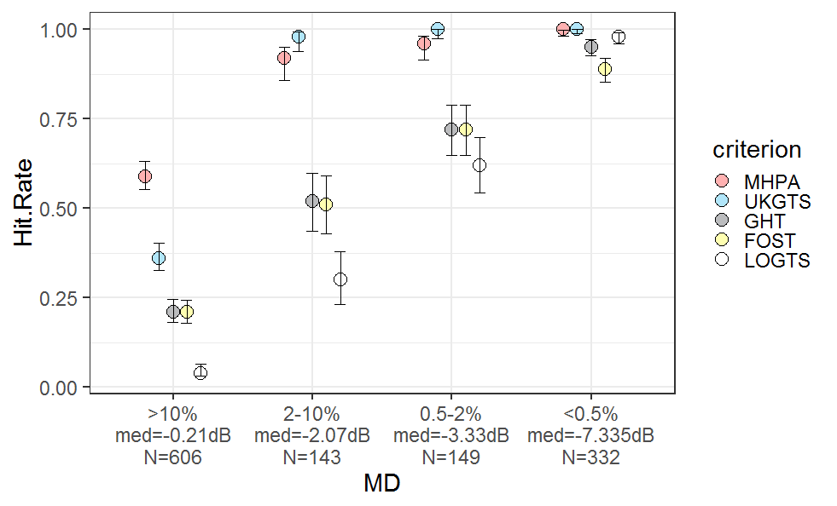
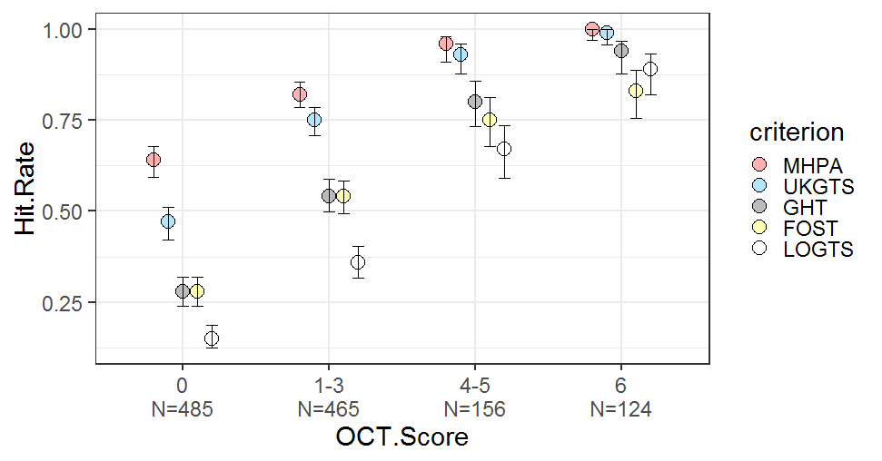

Slide 2
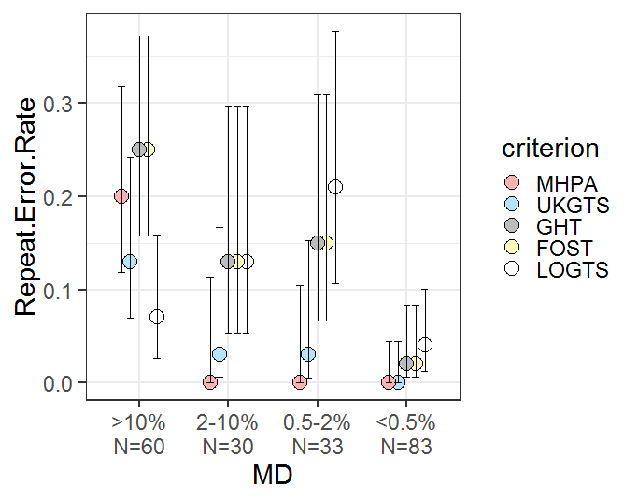
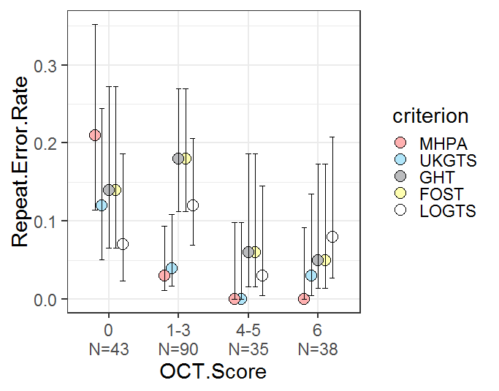

Slide 3

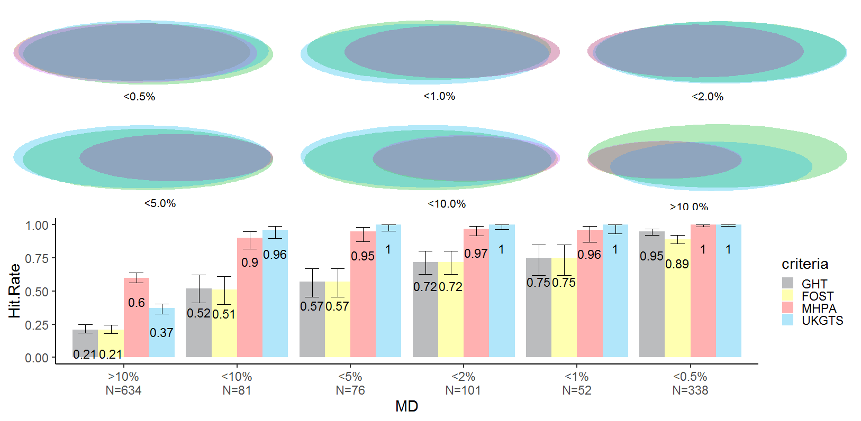
15
109
238
2
73
3
41
31
6
43
29
4
25
39
11
302
19
16
107
2
27
136
<10.%
N=81
<5.0%
N=76
<2.0%
N=101
<1.0%
N=52
>10.%
N=634
<0.5%
N=338
OLD DATA
Legend
GHT
Foster
MHPA
UKGTS

Slide 4
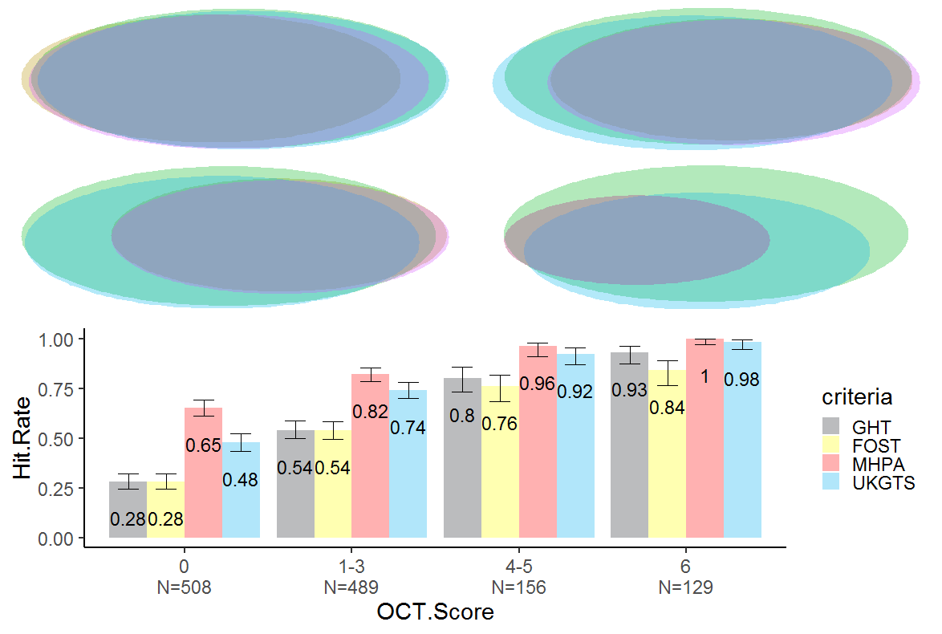
12
15
4
129
99
161
252
2
98
76
117
7
16
3
107
12
8
14
90
11
37
8
0
N=508
1—3
N=489
4—5
N=156
6
N=129
OLD DATA
Legend
GHT
Foster
MHPA
UKGTS

