Slide 1
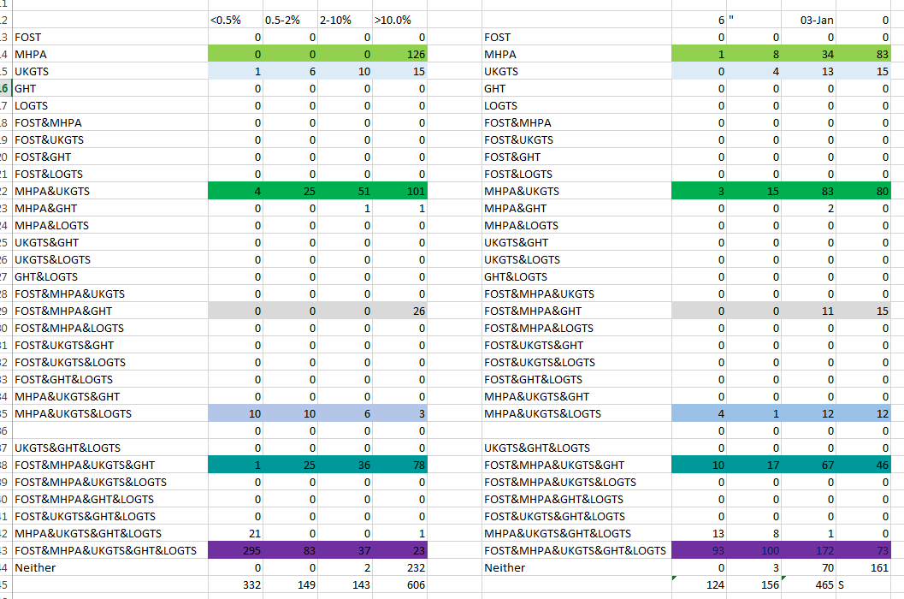

Slide 2

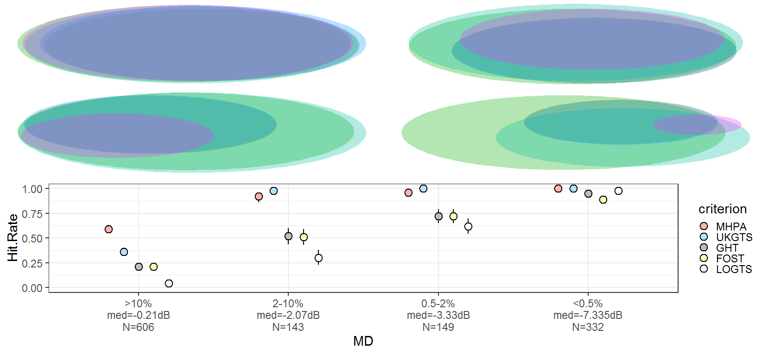
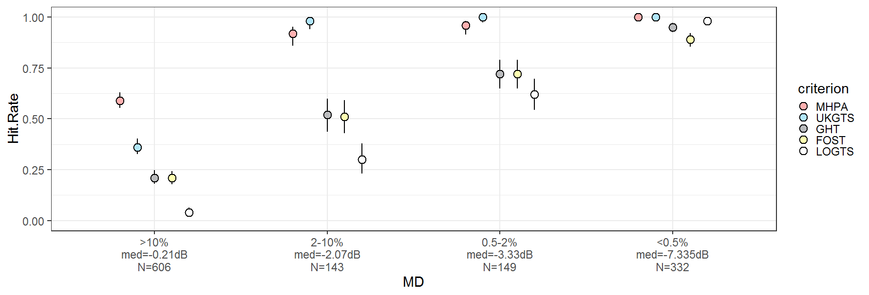
15
109
238
2
73
3
41
31
6
43
29
4
25
39
11
302
19
16
107
2
27
136
<10.%
N=81
<5.0%
N=76
<2.0%
N=101
<1.0%
N=52
>10.%
N=634
<0.5%
N=338
Legend
GHT
Foster
MHPA
UKGTS

Slide 3
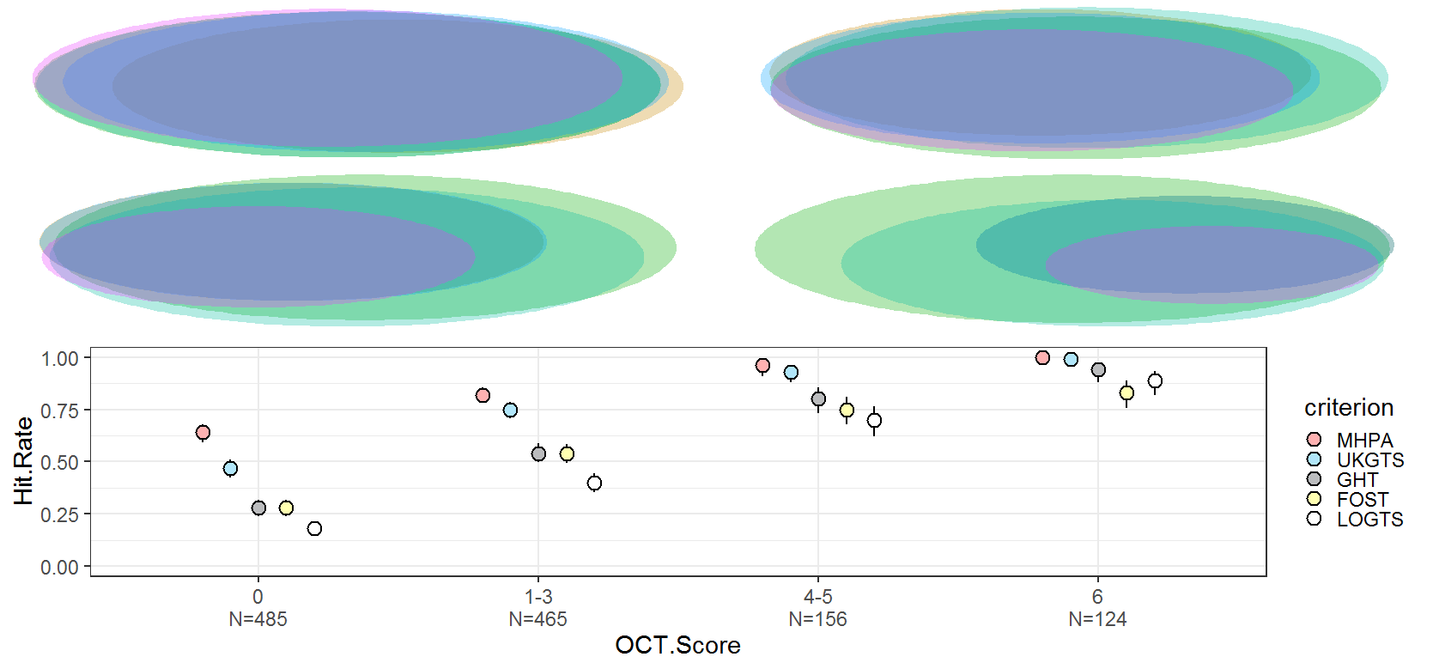
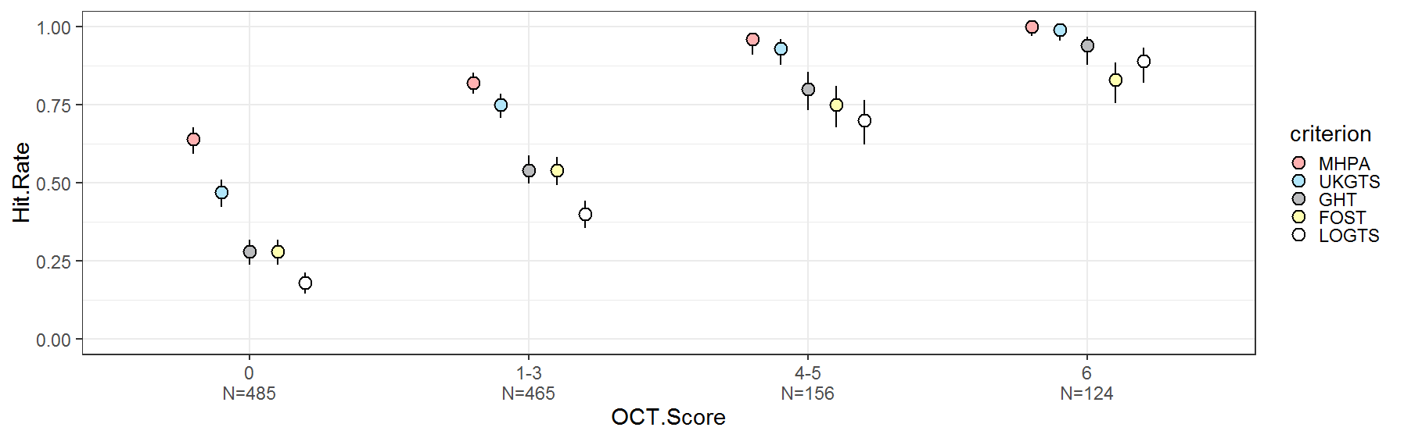
12
15
12
13
4
73
46
80
161
172
67
83
70
100
7
16
3
93
12
8
15
83
11
34
8
0
N=485
1—3
N=465
4—5
N=156
6
N=124

Slide 4
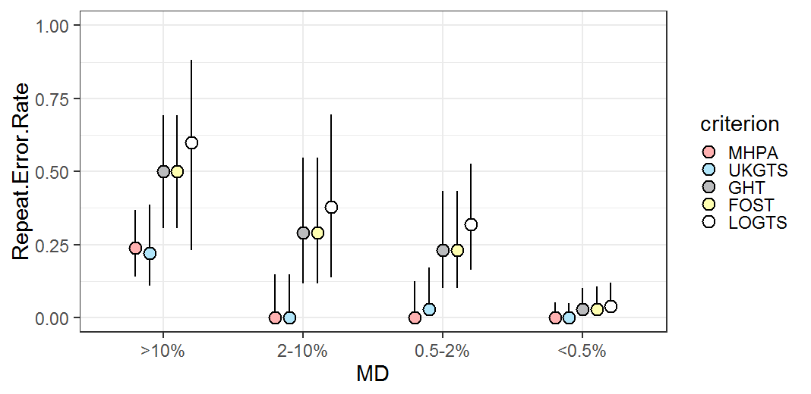
Legend
GHT
Foster
MHPA
UKGTS

Slide 5
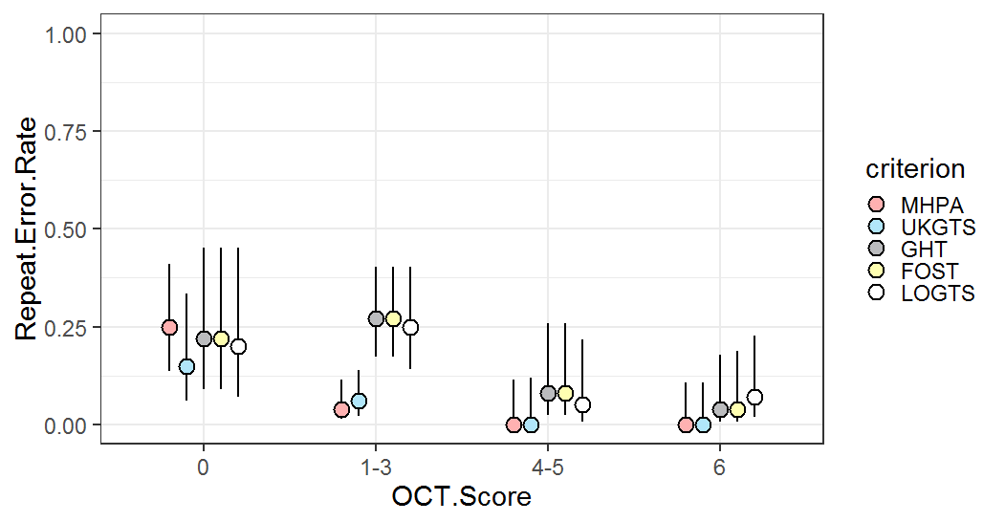
Legend
GHT
Foster
MHPA
UKGTS

