Slide 1

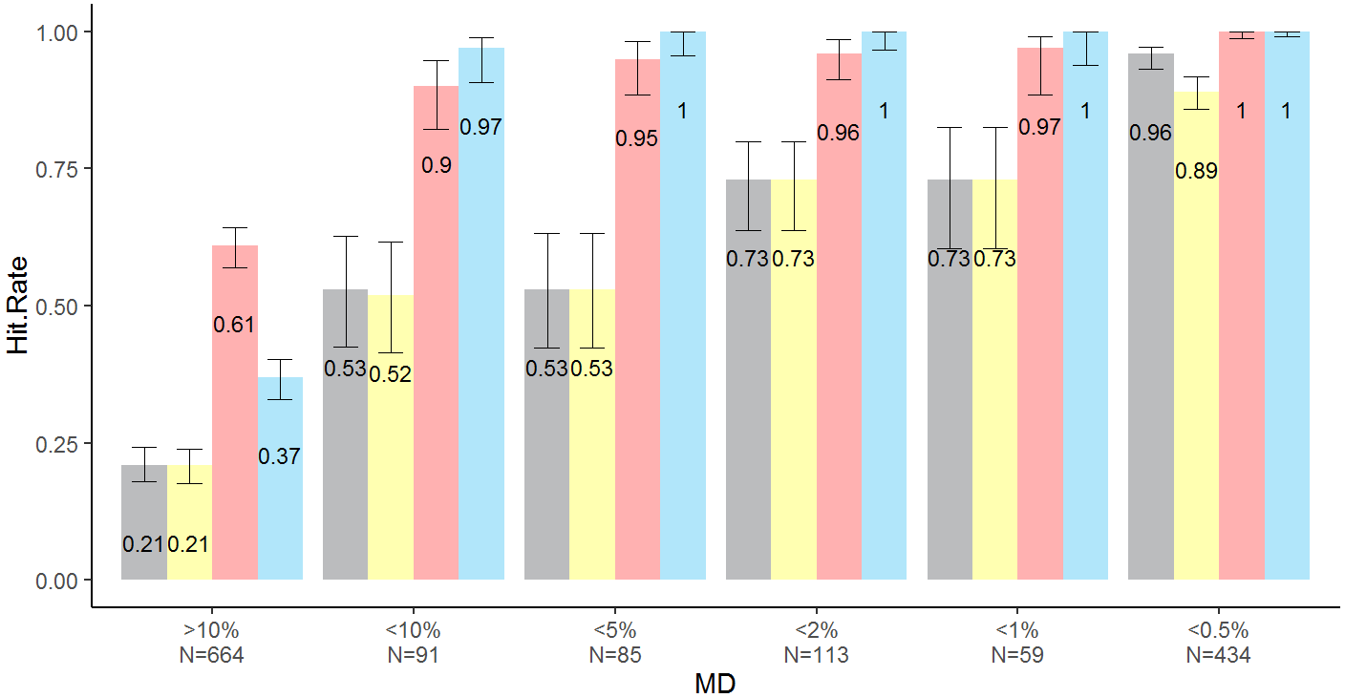
15
117
246
2
82
4
47
34
7
45
36
4
27
43
14
387
28
18
110
2
27
147
<10.%
N=91
<5.0%
N=85
<2.0%
N=113
<1.0%
N=59
>10.%
N=664
<0.5%
N=434
Legend
GHT
Foster
MHPA
UKGTS
Notes:
The next higher damage group was MD<10%. All hit rates rose. UKGTS jumped up above MHPA. In the Euler plot, the hit rates began overlapping much better.
These trends continued through the rest of the subgroups. The hit rates became better with more functional damage.
UKGTS seems to be the superior criteria because it had the highest hit rate in the high damage groups and low hit rate in the least damage group.

Slide 2
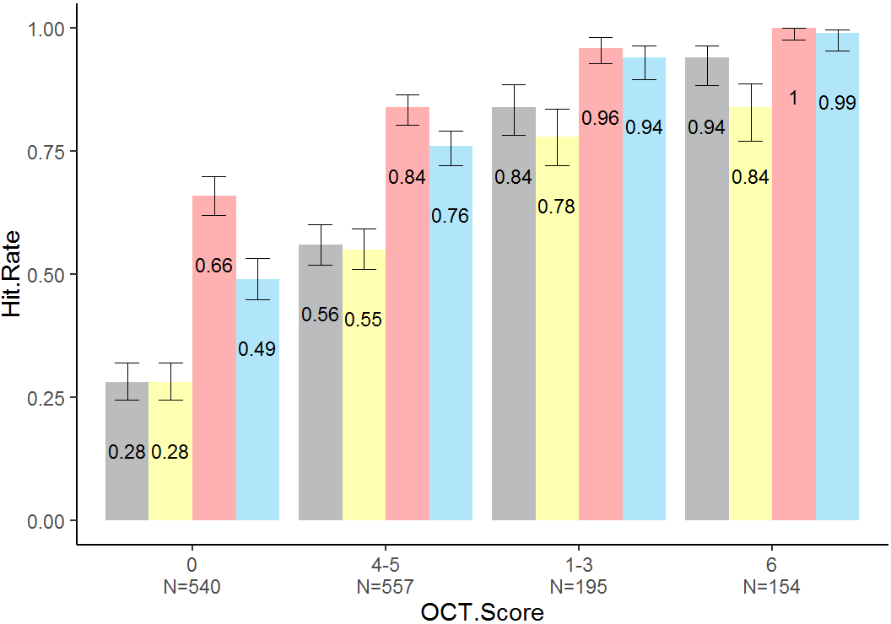
12
17
4
138
110
246
296
3
111
79
152
11
16
3
128
15
9
14
95
11
43
8
0
N=540
1—3
N=557
4—5
N=195
6
N=154
Legend
GHT
Foster
MHPA
UKGTS
Notes:
Here is the comparison of criteria hit rates stratified according to structural damage levels. There were 4 levels.
In the group with least damage, score of 0, GHT and Foster had the low hit rates while MHPA and UKGTS had high hit rates.
With more structural damage, all hit rates rose. The criteria were also able to pick up many more patients based on the Euler diagrams.
In the next groups, hit rates rose even more. The hit rates began overlapping much more.
MHPA and UKGTS had the highest hit rates in the most severe disease group. This demonstrates higher relative sensitivity.
GHT and Foster have the lowest hit rates in the low damage groups, which implies higher relative specificities.

