Slide 1

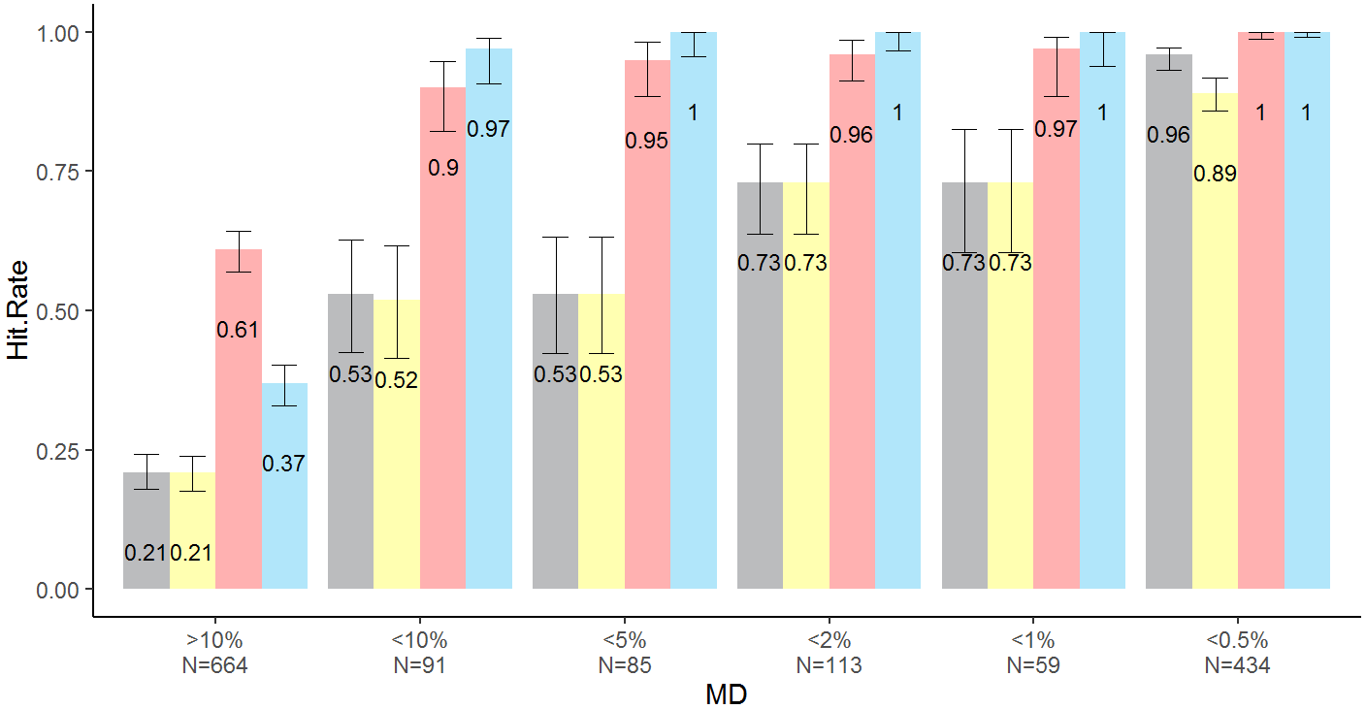
15
117
246
2
82
4
47
34
7
45
36
4
27
43
14
387
28
18
110
2
27
147
<10.%
N=91
<5.0%
N=85
<2.0%
N=113
<1.0%
N=59
>10.%
N=664
<0.5%
N=434
Legend
GHT
Foster
MHPA
UKGTS

Slide 2
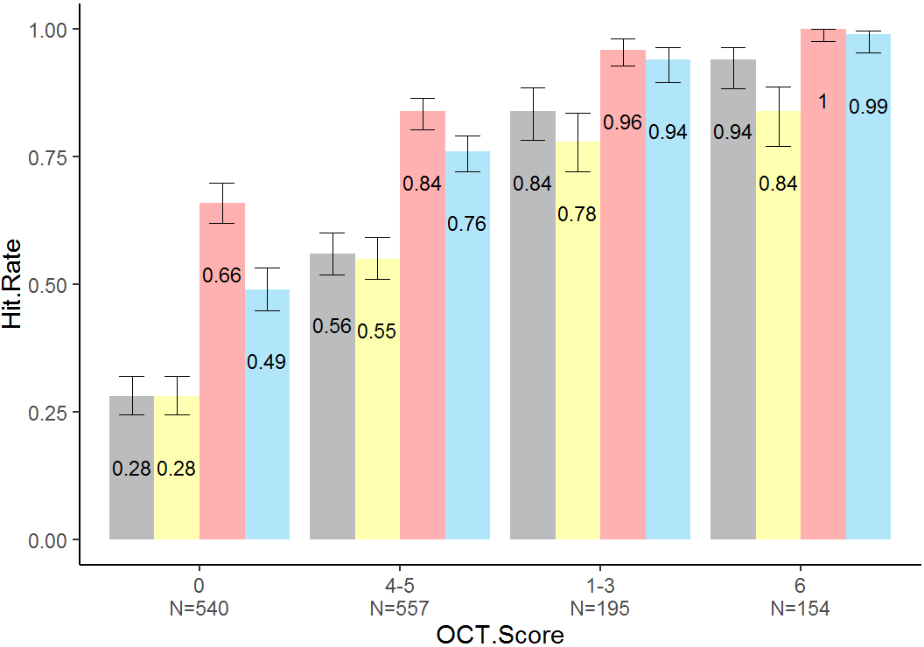
12
17
4
138
110
246
296
3
111
79
152
11
16
3
128
15
9
14
95
11
43
8
0
N=540
1—3
N=557
4—5
N=195
6
N=154
Legend
GHT
Foster
MHPA
UKGTS

