Slide 1
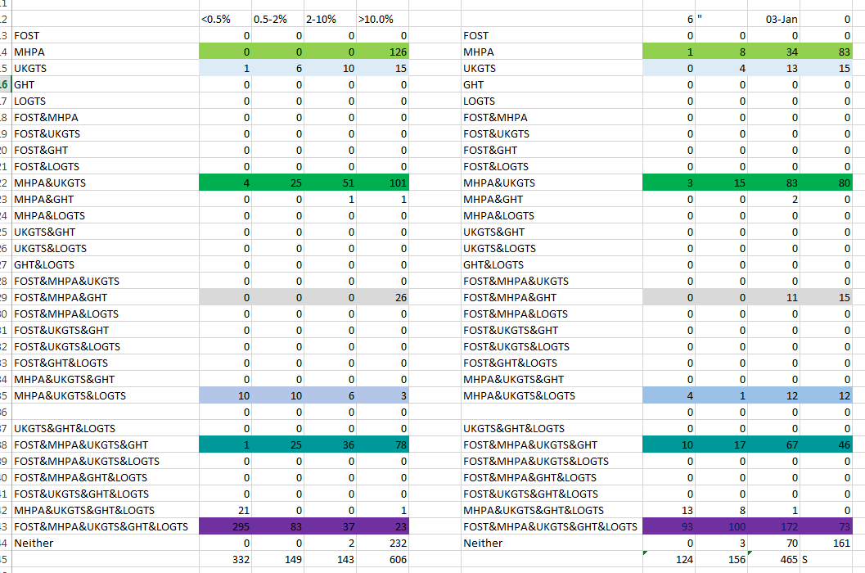

Slide 2

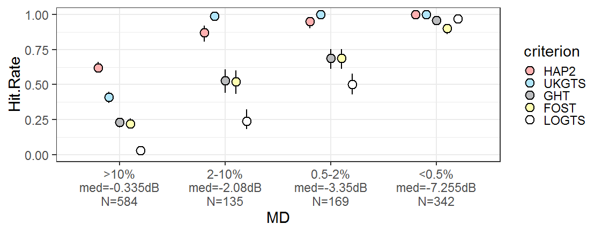
19
7
4
1
200
19
87
112
1
9
46
17
35
9
23
301
6
32
38
76
40
24
120
Legend
>10.%
N=584
2-10%
N=135
0.5-2%
N=169
<0.5%
N=342
MHPA
UKGTS
GHT
Foster
LOGTS

Slide 3
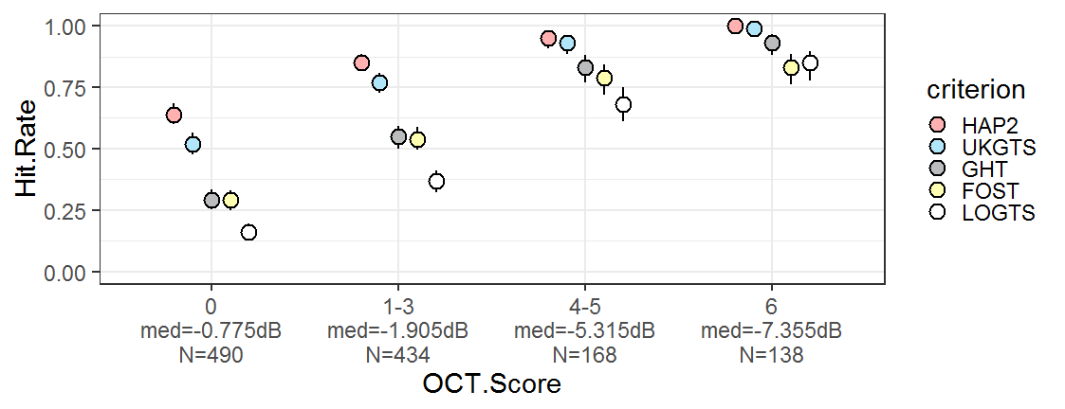
9
29
7
14
8
3
14
146
68
60
88
152
73
88
49
107
15
5
101
6
13
Legend
75
10
39
24
5
14
0
N=490
1—3
N=434
6
N=138
MHPA
UKGTS
GHT
Foster
LOGTS
4—5
N=168

Slide 4
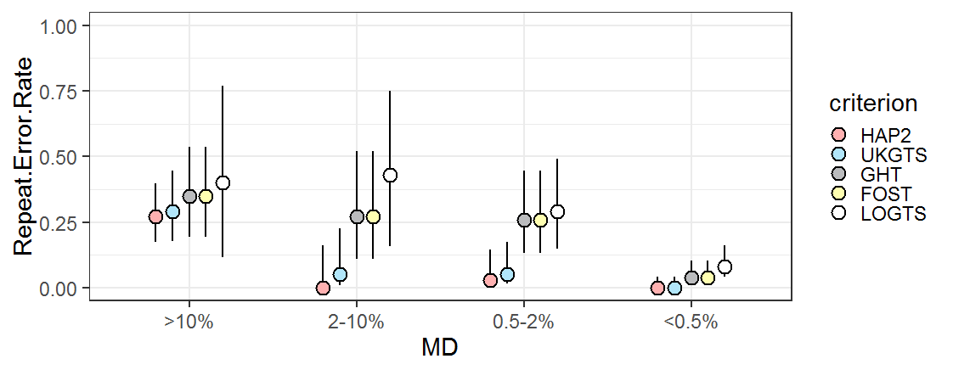
Legend
GHT
Foster
MHPA
UKGTS

Slide 5
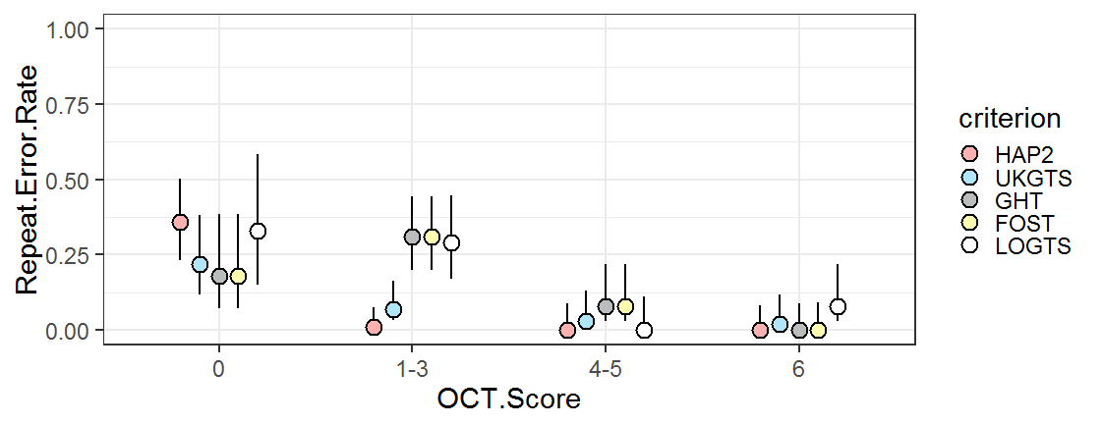
Legend
GHT
Foster
MHPA
UKGTS

