Slide 1
MD | MHPA | UKGTS | GHT | FOST | LOGTS | EAGLE | AGIS | Total
>10% | 359 | 221 | 129 | 127 | 27 | 0 | 0 | 606
2-10% | 131 | 140 | 74 | 73 | 43 | 0 | 0 | 143
0.5-2% | 143 | 149 | 108 | 108 | 93 | 0 | 0 | 149
<0.5% | 331 | 332 | 317 | 296 | 326 | 0 | 0 | 332
OCT.Score | MHPA | UKGTS | GHT | FOST | LOGTS | EAGLE | AGIS | Total
0 | 309 | 226 | 134 | 134 | 85 | 0 | 0 | 485
03-Jan | 382 | 348 | 253 | 250 | 185 | 0 | 0 | 465
05-Apr | 149 | 145 | 125 | 117 | 109 | 0 | 0 | 156
6 | 124 | 123 | 116 | 103 | 110 | 0 | 0 | 124

Slide 2
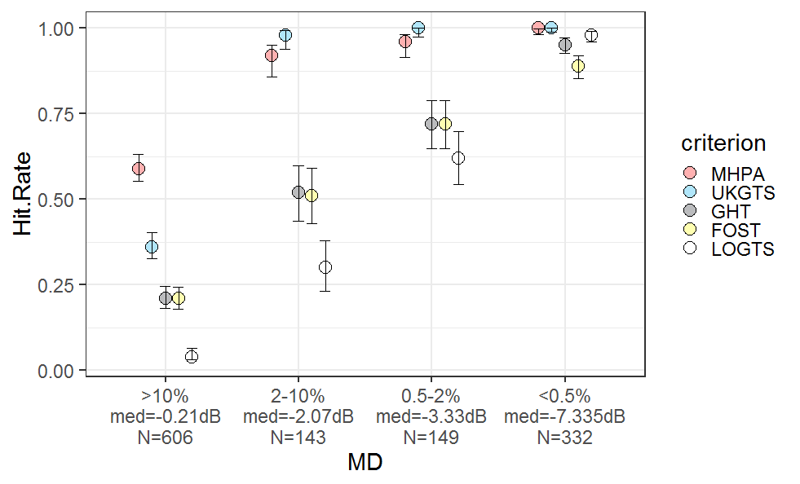
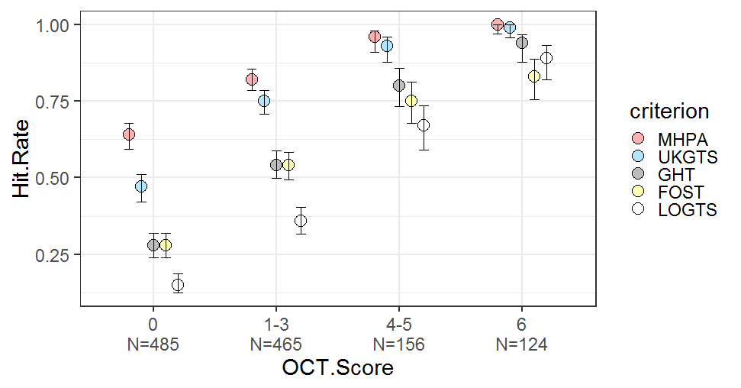

Slide 3
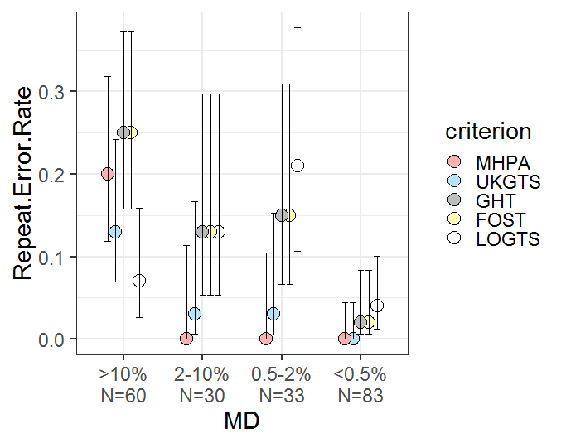
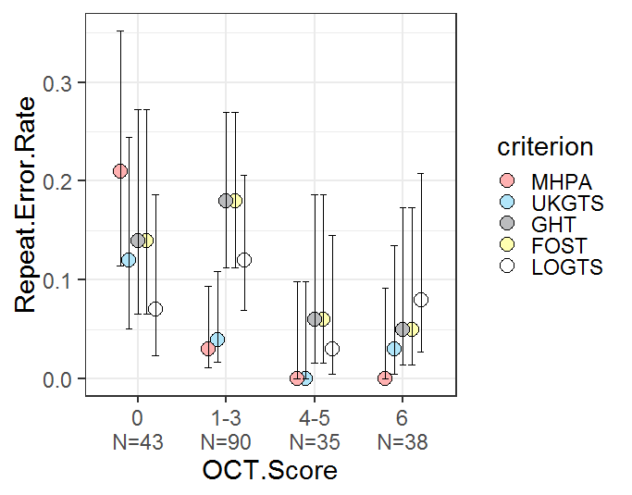

Slide 4
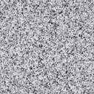
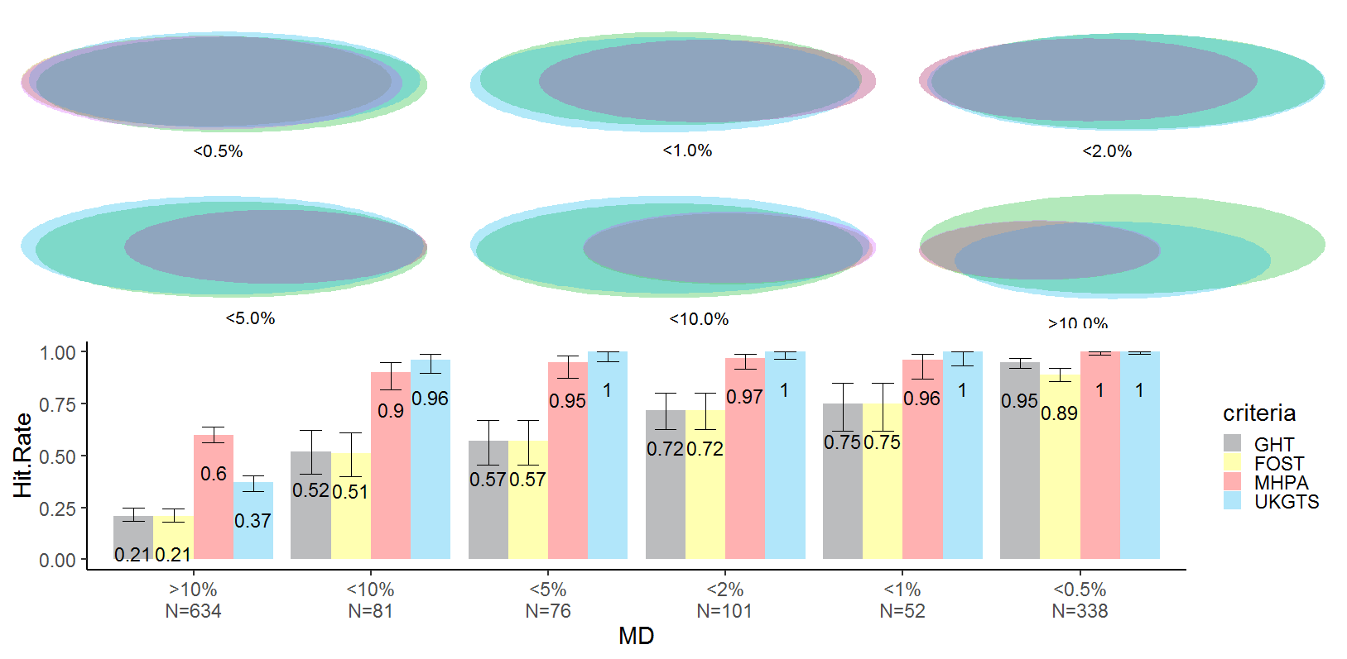
15
109
238
2
73
3
41
31
6
43
29
4
25
39
11
302
19
16
107
2
27
136
<10.%
N=81
<5.0%
N=76
<2.0%
N=101
<1.0%
N=52
>10.%
N=634
<0.5%
N=338
OLD DATA
Legend
GHT
Foster
MHPA
UKGTS

Slide 5
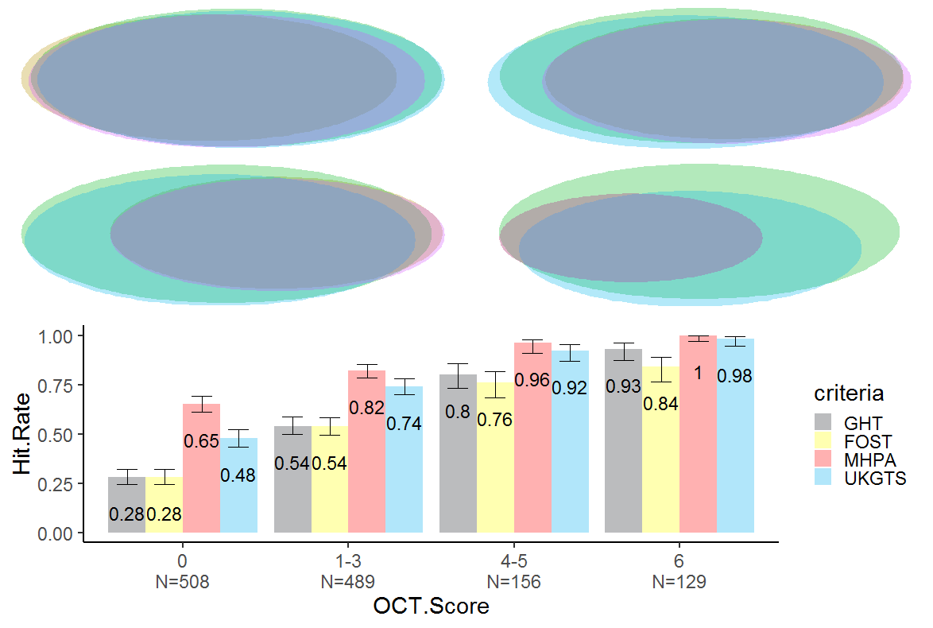
12
15
4
129
99
161
252
2
98
76
117
7
16
3
107
12
8
14
90
11
37
8
0
N=508
1—3
N=489
4—5
N=156
6
N=129
OLD DATA
Legend
GHT
Foster
MHPA
UKGTS

