Slide 1
Domestic Violence

Slide 2
What is domestic violence?
Not physical violence alone.
Purpose is to gain power and control over spouse, partner, girl/boyfriend, or intimate family member.

Slide 3
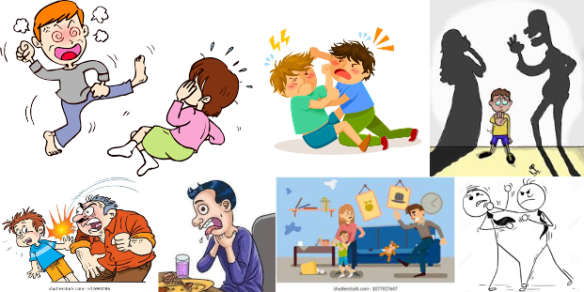
Categories of Domestic violence
Physical abuse:

Slide 4

Domestic violence
Emotional Abuse

Slide 5

Domestic violence
Social Abuse:

Slide 6
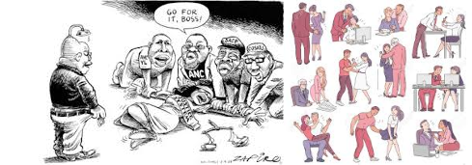
Domestic Violence
Sexual abuse:

Slide 7
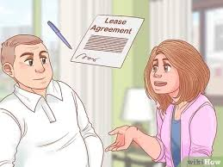
Domestic Violence
Force to live without money

Slide 8
Solution
Support Group
The Way
Family
Tell Everyone
Plan

