Slide 1
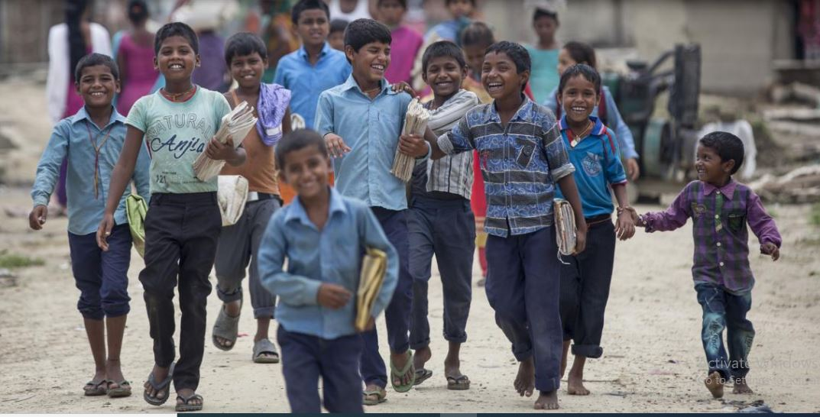
Status of Child Education
More than 770,000 children aged 5-12 years are still out of school. Drop rate is 4.8%
Social Exclusion
Social Norms
Gender bias
Disability
Child Labor
Geographical remoteness
Lack of awareness
Poverty

Slide 2

Status of Unemployment due to Pandemic Covid-19
(80-90%) in informal sector
22.5% in business sector
40% in business sector
30.5% small and medium enterprises
Salary deduction

Slide 3
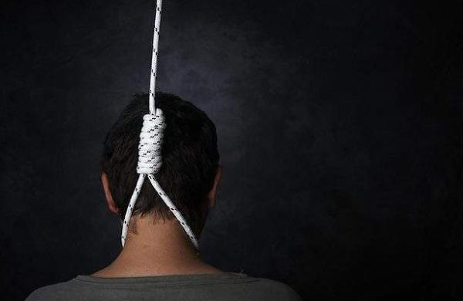
Suicide number increased during Pandemic Covid-19
In the last 10 months 5,673 people have committed suicide. This number is greater than death of people with pandemic COVID-19 up to last April.
Loss of employment
Economic problem
Social Pressure
Family burden
Mental Health
Chronic diseases

Slide 4

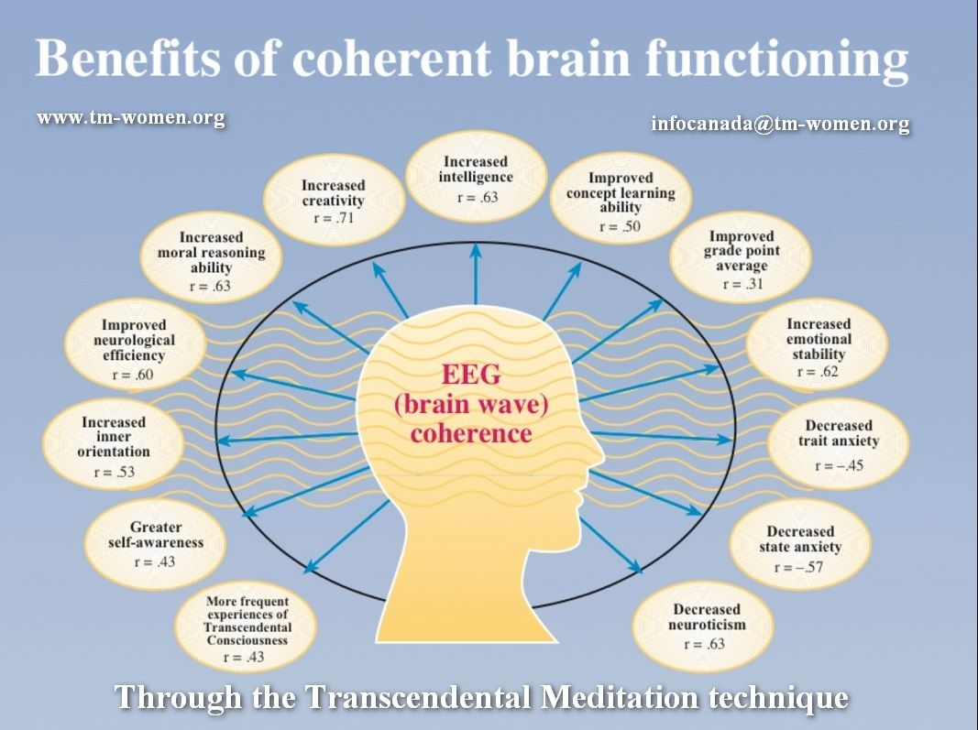

Solutions for all problem ?
Increase Literacy
Increase civilization
Increase Social awareness
Poverty alleviation
Government Stimulus package
Transcendental Consciousness
TM practice Program

