Slide 1
TM as a Tool for Human Life Transformation
Presenters :
Meghraj Kurmi
Narayan Pd. Padhya
Kashinath Parajuli
Ganesh B. Khatri

Slide 2
Problems in Society
Health Issues
Domestic Violence
Education and Unemployment

Slide 3
Health Issues
content

Slide 4

Solution ?
All in one solution ?
TM

Slide 5
Consciousness / Awareness? Mind and body are deeply connected

Slide 6

Sleep and Rest

Slide 7

Nutrition / Food

Slide 8

Exercise / Activities / Yoga Asanas

Slide 9

Transcendence
Changes perception of a person about things
Increases awarness

Slide 10
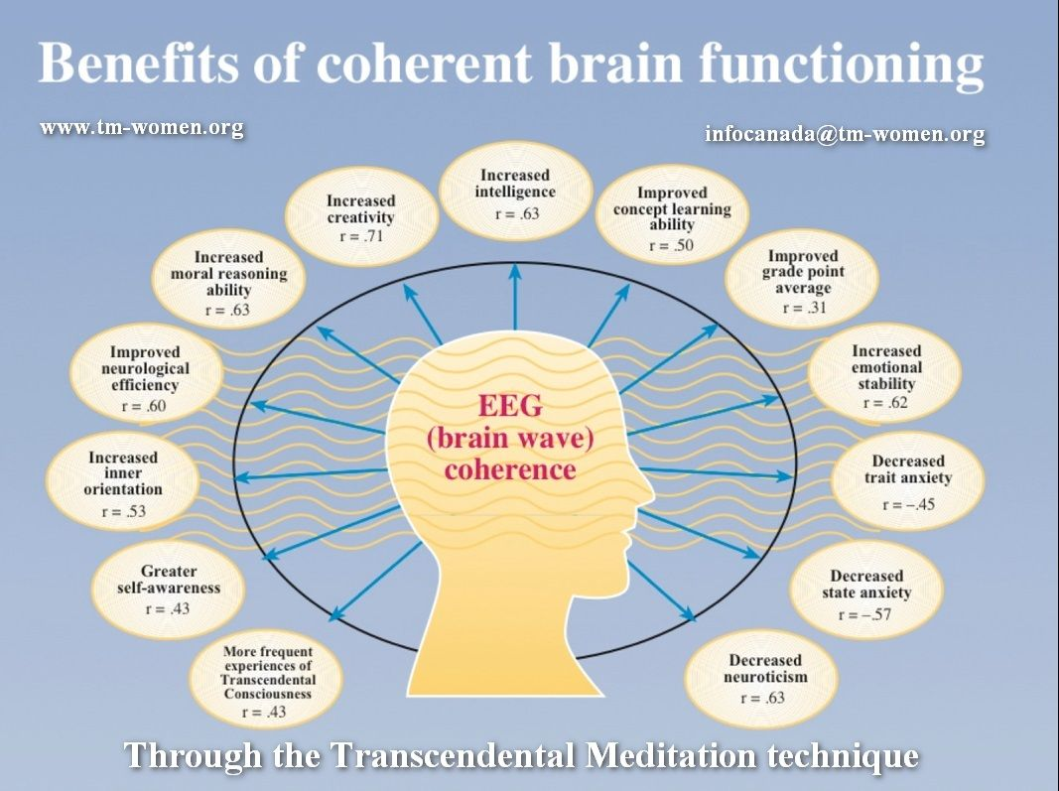

Slide 11
1960, Maharishi predicted that when even 1% of the world population learned the TM technique, whole population become peaceful.
Israel and Lebanon – reduced warfare and improved quality of life(1983) – after two months of TM by many no of meditators, war deaths dropped 76%
Reduced International Terrorism
Washington, DC – reduced violent crime, 1993 – crime rate decreased by 23.3% in two months

Slide 12
Questions ?

