Slide 1
Galois Theory
Why quintic equations have no solution formula
Measuring the solvability of equations in the language of symmetry
Date: June 7, 2026
5garashi.com Design Office

Slide 2
Goals of This Deck
1
What is a Galois group
Capturing as a group the symmetry that preserves relations (sums, products) among roots
2
Group shrinks, field grows
Base Q, intermediate L, splitting K correspond to groups
3
Solvability condition
chain reaching {e} = solvable by radicals
4
The degree-5 wall
The special nature of A₅ rules out a formula
The main part is fairly abstract — reading the appendix (worked examples) first makes it easier to follow. The common early stumbling points are collected in Appendix 3.
5garashi.com Design Office
2

Slide 3
STEP 1
Galois group = permutations preserving relations (sums, products) among roots
For any rational expression r whose value built from the roots is rational, a permutation σ of the roots keeps the value rational — collecting all such permutations gives a group: the Galois group G.
∀r, ∀σ∈G : r(α₁,…,αₙ)∈Q ⇒ σ( r(α₁,…,αₙ) )∈Q
Note: imposing this for every r yields the same group as requiring the value itself be preserved: σ( r(α₁,…,αₙ) ) = r(α₁,…,αₙ).
Simple examples — rationals stay fixed, roots swap
x³ − 1 = 0
x⁴ − 4x² + 1 = 0
Roots: 1, ω, ω² (ω: cube root of 1).
• The rational 1 cannot move (fixed)
• Swapping ω ↔ ω² preserves values → OK
Galois group = cyclic group C₂ (order 2)
α₁=(√6+√2)/2, α₂=(√6−√2)/2, α₃=−α₁, α₄=−α₂
Relations: α₁·α₂ = 1, α₁+α₃ = 0 (both rational)
Swapping only α₁↔α₂ …
• α₁·α₂ = 1 is preserved (just reordering)
• but α₁+α₃ = 0 becomes −√2, broken → NG
Swap α₃↔α₄ together with α₁↔α₂ → both preserved, OK
5garashi.com Design Office
3

Slide 4
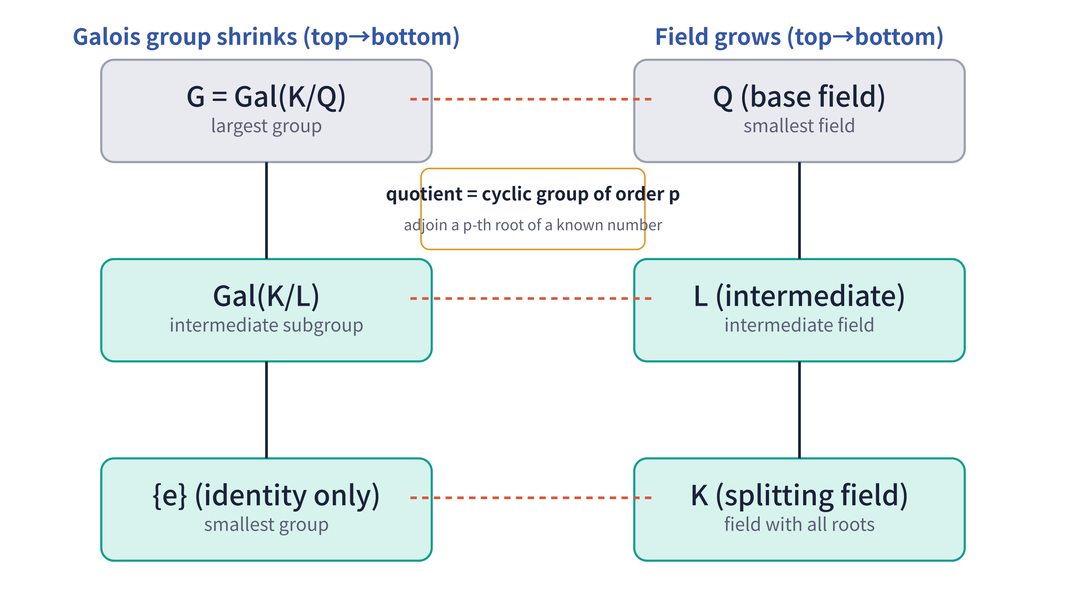
STEP 2
As the Galois group shrinks, the field grows
Base Q ⊂ intermediate L ⊂ splitting field K. Each intermediate L corresponds to the subgroup Gal(K/L) fixing L:
L ↦ Gal(K/L) = Aut(K/L) = { σ∈G : σ(x)=x (∀x∈L) }
As the group shrinks the field grows; the elements adjoined to the field are fixed over L inside K.
At each step the quotient is a cyclic group of order p (p prime), and the adjoined element is a p-th root of a previously known number.
Premise: K contains all conjugates of the adjoined elements (Galois extension). At each step, order of the quotient group = degree of that one field extension, so group shrinking and field growth match exactly.
5garashi.com Design Office
4

Slide 5
STEP 3
When an equation is solvable
An equation being solvable by radicals (the four operations and n-th roots) is the same as the Galois group shrinking in the following way:
the quotient at each step is cyclic — a chain from G down to {e}
shrinking chain
cyclic quotient
reaching {e}
shrink the group step by step
each step divides cleanly
down to the identity only
Note
• "Each quotient is cyclic" means the same as "each step is a normal subgroup with abelian quotient (which can be refined so each quotient is cyclic)."
• Definition of a solvable group: one that shrinks to {e} via such a chain (with abelian quotients).
5garashi.com Design Office
5

Slide 6
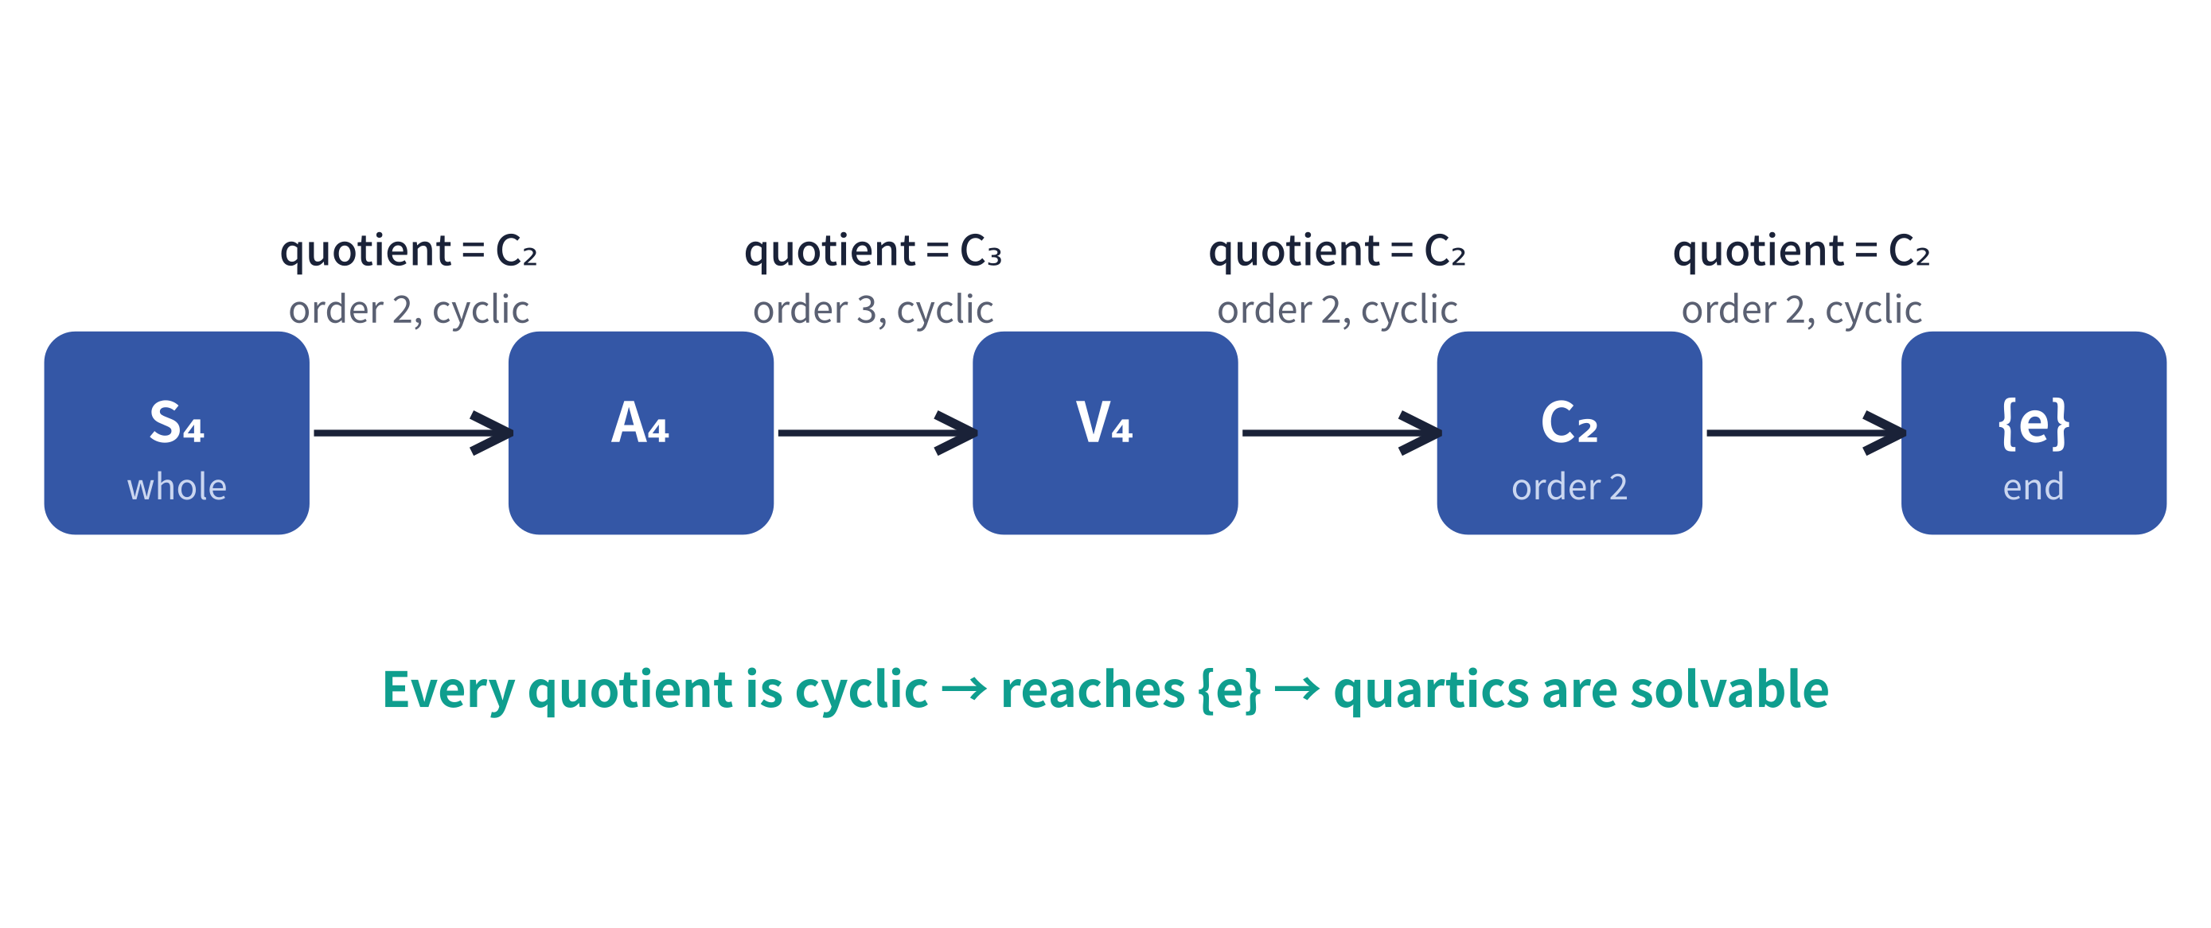
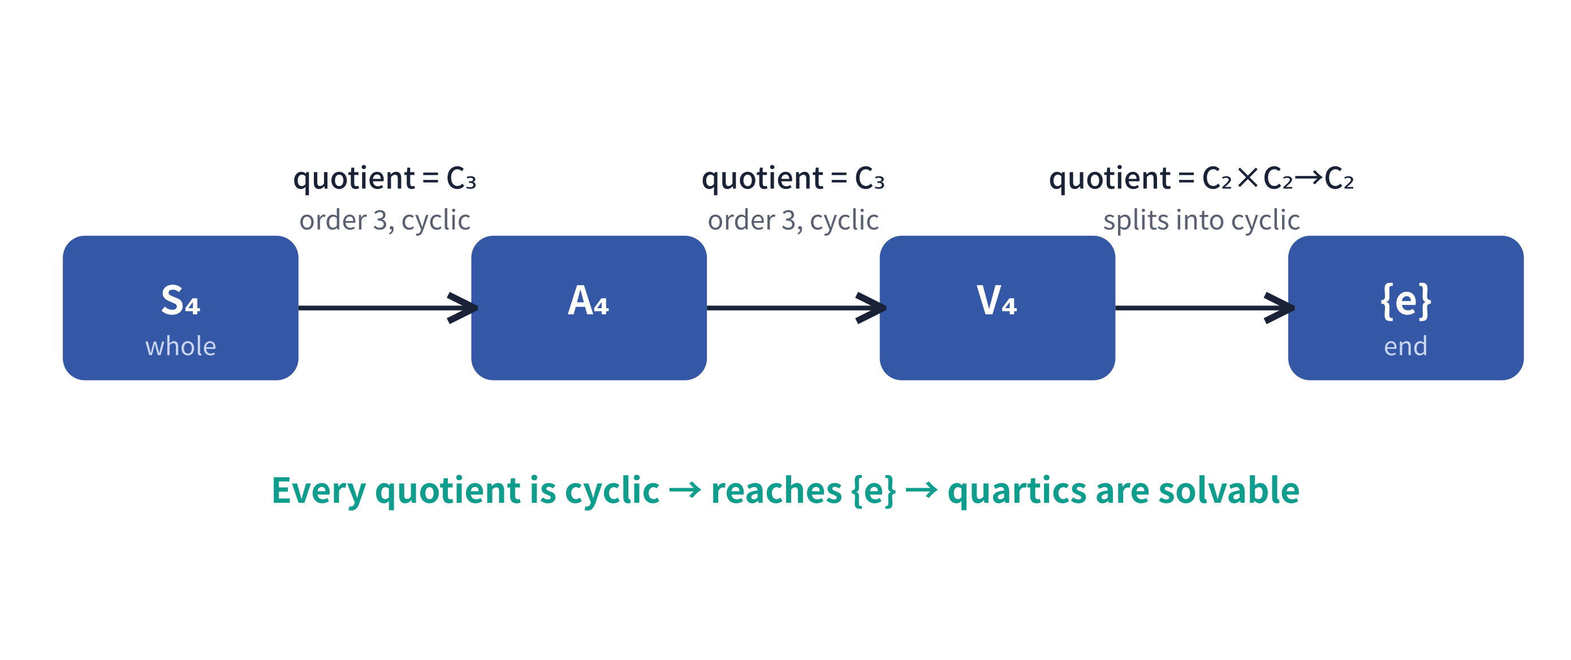
n ≤ 4
Up to degree 4 — the chain runs all the way
S₄ has a shrinking chain whose quotients are all cyclic. So formulas exist for degree 2, 3, and 4 equations.
5garashi.com Design Office
6

Slide 7
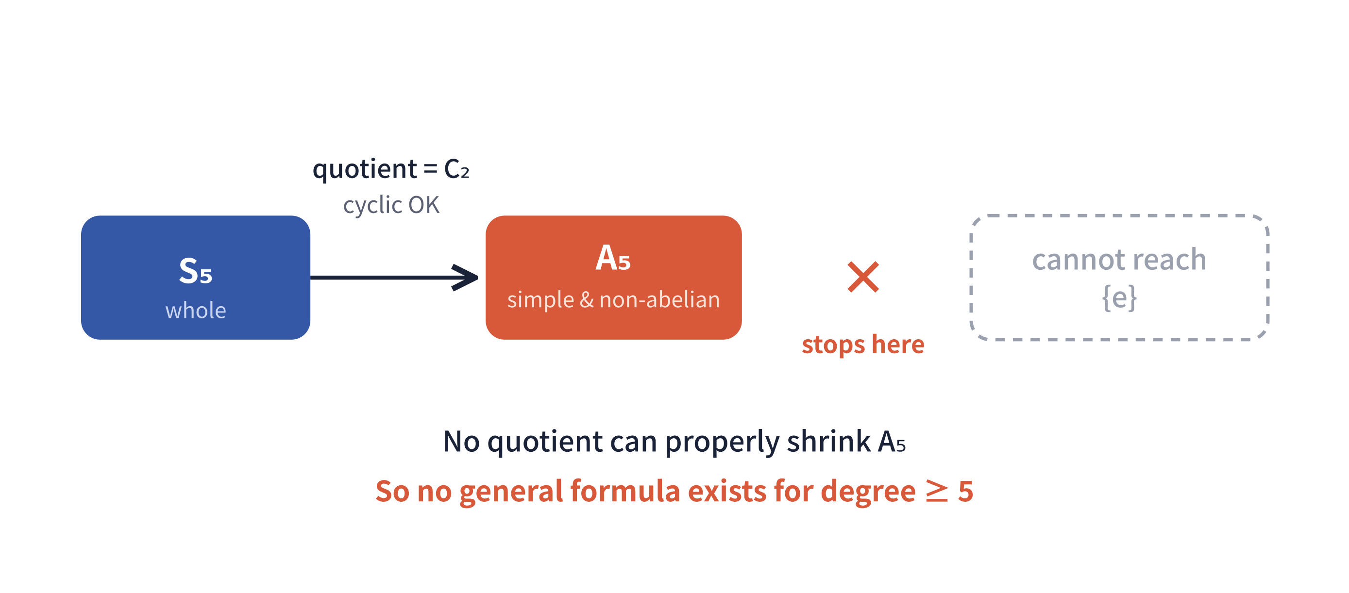
n ≥ 5
Degree 5 and up — stuck at A₅
A₅ is a “simple group”: the only subgroups usable to shrink A₅ one step (by taking a quotient) are {e} and A₅ itself.
A₅ does have other subgroups, but dividing by them yields no group, so they cannot be used to shrink it.
5garashi.com Design Office
7

Slide 8
Why it stops at A₅
Image: an indivisible number
Two options to shrink A₅
A prime is divisible only by 1 and itself.
A simple group
is similar: the smallest unit, divisible only by {e} and itself.
A₅ (n≥5) is
an indivisible block that is not even cyclic. So it cannot in principle be split into cyclic steps.
group before / group after = quotient (factor group)
The only usable “after” groups for A₅ are {e} and A₅ itself.
Group after = {e} → quotient A₅/{e} = A₅
But A₅ is non-abelian, so it is not cyclic.
Group after = A₅ itself → quotient A₅/A₅ = {e}
This quotient is the trivial (cyclic) group, but it just goes A₅ → A₅, so nothing shrinks.
5garashi.com Design Office
8

Slide 9
Conclusion
n ≤ 4
the chain reaches {e} → a solution formula exists
n ≥ 5
Aₙ becomes simple and non-abelian, so no step can shrink Sₙ further.
The chain stops partway and never reaches {e} → no solution formula exists
Abel–Ruffini theorem: no general formula using the four operations and radicals exists for equations of degree 5 or higher.
5garashi.com Design Office
9

Slide 10
The skeleton of the argument and the pillars of Galois theory
Argument block | Corresponding pillar | Page
Characterizing the Galois group | permutation = automorphism; the whole set = the Galois group | P3
Group shrinks, field grows | field → group correspondence Galois extension (field containing all conjugates of the adjoined elements) order = degree links group and field cyclic extension = adjoining a radical | P4
Solvability (shrinking chain) | solvable group ⟺ solvable by radicals | P5
Conclusion (breaks at A₅) | simplicity of A₅ → unsolvable | P7–9
5garashi.com Design Office
10

Slide 11
One-page recap
Capture symmetry as a group
the Galois group = permutations preserving the value of rational expressions built from the roots
Field and group correspond inversely
the larger the field, the smaller the group
Solvable = the chain reaches {e}
can it shrink to {e} with cyclic quotients at each step
The degree-5 wall is A₅
simple and non-abelian, so the chain breaks
5garashi.com Design Office
11

Slide 12
Appendix
What it means to solve an equation with radicals and arithmetic
Group shrinking and field growth, through a concrete example
5garashi.com Design Office
12

Slide 13
Appendix 1
Solving equations by defining new roots
In the rationals (field Q), the roots √2, −√2 of x²−2=0 do not exist. To solve it we must define (adjoin) √2.
Adjoining √2 lets us write (x−√2)(x+√2)=0, fixing the roots. Over Q we know there are two roots but cannot tell their values apart: √2 and −√2 are indistinguishable from Q. So they can be swapped without Q noticing. All such swaps form the Galois group.
x² − 2 = 0
roots: √2, −√2
Gal(K/Q) = { e, (1 2) }
order-2 group swapping √2 and −√2. K=Q(√2).
x³ − 1 = 0
roots: 1, ω, ω²
Gal(K/Q) = { e, (ω ω²) }
1 is known; the unknowns ω, ω² give order 2.
x³ − 2 = 0
roots: α, αω, αω² (α=³√2)
Gal(K/Q) = S₃
adjoin two things: ω (contains imaginary √−3) and a cube root.
5garashi.com Design Office
13

Slide 14
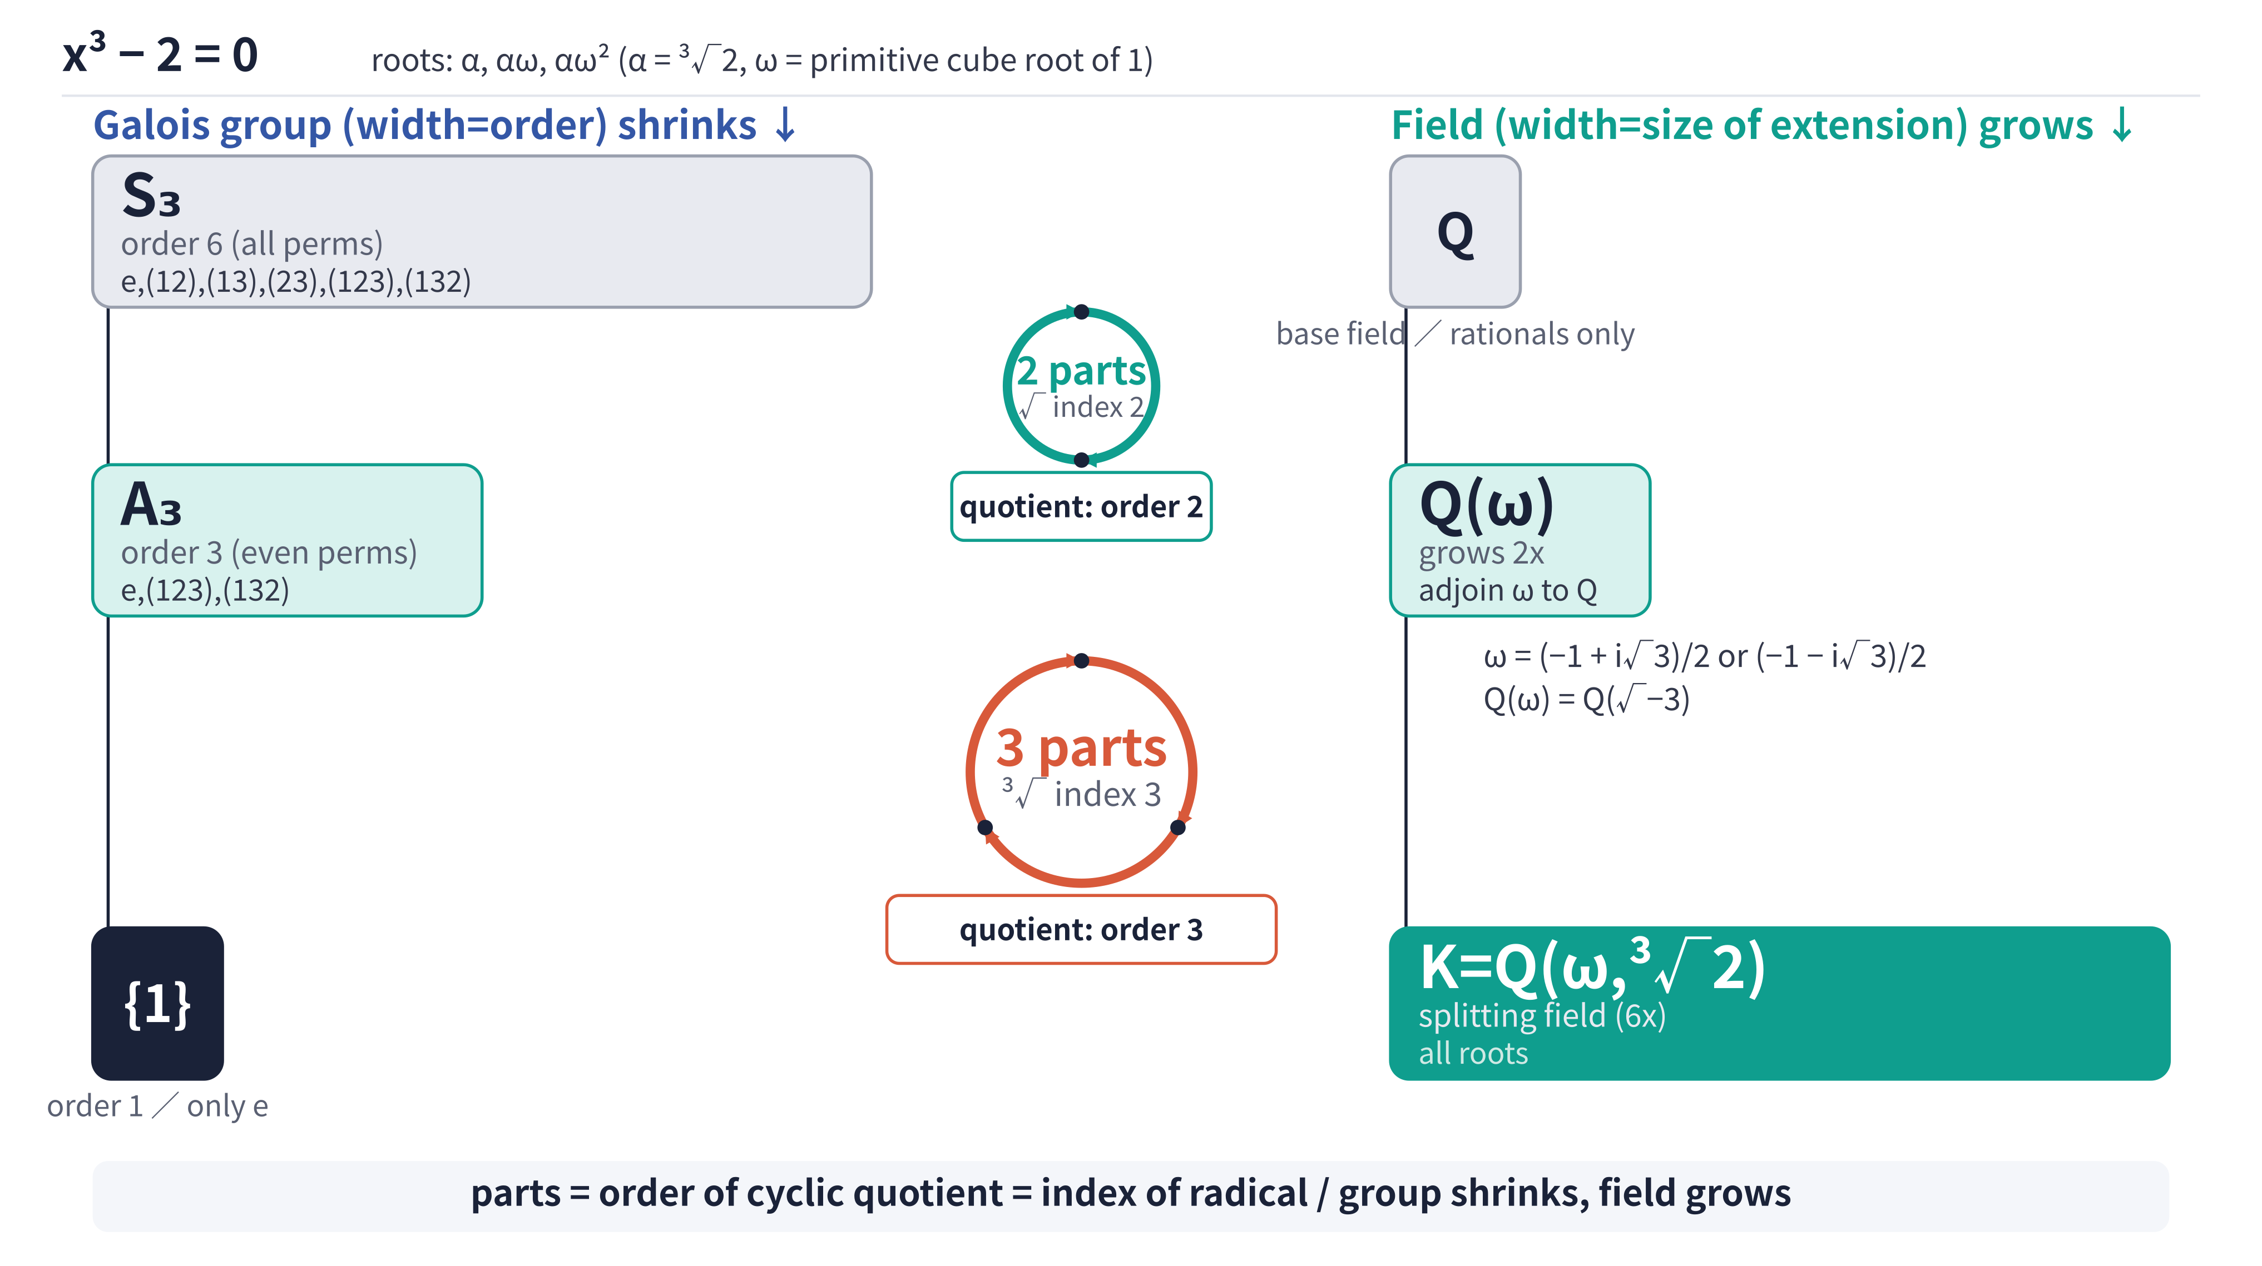
Appendix 2
Image: one turn — the group shrinks and the field grows
The order of the quotient equals the number of permutation steps needed to cycle once through the radical’s conjugate candidates and return — i.e. the figure’s number of “parts.”
5garashi.com Design Office
14

Slide 15
Appendix 2
The Adjoined Element's Conjugates and the Cyclic Quotient's Generator Correspond
* Assumes a single-step radical extension (adjoining one radical extends the field by one step)
Assume: L = M(α), αⁿ ∈ M, ζₙ ∈ M
Then Gal(L/M) is the cyclic group Cₙ, with generator σ satisfying σ(α) = ζₙα
Rotation of the Conjugates
1-to-1
Cycling of the Quotient Group
What Is the 1-to-1 Correspondence, Exactly?
α
advance by gH
H
σ
σ
The coset gᵏH corresponds to
α's image ζᵏα
ζⁿ⁻¹α
ζα
Each coset gᵏH corresponds to the
action sending α to ζᵏα
gⁿ⁻¹H
gH
σ
σ
α | <-> | H
ζα | <-> | gH
ζ²α | <-> | g²H
⋮ | <-> | ⋮
ζⁿ⁻¹α | <-> | gⁿ⁻¹H
(gᵏH)(α) = ζᵏα
⋯
ζ²α
⋯
g²H
σ
The generator σ advances one step at a time
σ(ζᵏα) = ζᵏ⁺¹α
(indices computed mod n)
G/H = <gH> ≅ Cₙ
(G = Gal(L/M), H = {id})
Summary:
① The generator σ: α↦ζα cycles the conjugates.
② The generator gH cycles the quotient group G/H.
③ Its k-th power sends α to ζᵏα — the same cyclic structure appears both ways.
5garashi.com Design Office
15

Slide 16
Appendix 2
The shrinking chain for x³−2 and the solvability conclusion
Two steps to solve x³−2=0
STEP 1: adjoin ω
STEP 2: adjoin ³√2
field: Q → L = Q(ω)
group: S₃ → A₃ (order 3)
quotient order 2 = square root (√−3)
field: L → K = Q(ω, ³√2)
group: A₃ → { e }
quotient order 3 = cube root
Once the group shrinks to { e }, no unknowns remain and the adjoined elements express the roots.
Generalization: what "solvable by radicals" means
At each step, the quotient of the larger group by the smaller (normal) subgroup must be cyclic. The order of that cyclic group equals the index of the radical adjoined at that step.
Being solvable by radicals means this shrinking-and-growing repeats until the group reaches { e } and the field K reaches the splitting field.
Up to degree 4, such a chain exists for any coefficients, so all are solvable by radicals. From degree 5 up, some equations have no such chain; those that cannot reach { e } are not solvable by radicals.
5garashi.com Design Office
16

Slide 17
Appendix 3
Common early stumbling points (1/2)
1
Roots are not missing — they may just be inexpressible by radicals (main → P9)
For degree ≥ 5, roots always exist if we allow complex numbers. The question is not whether roots exist, but whether they can be written using only the four operations and radicals.
"No solution formula" does not mean there are no roots — it means no uniform procedure expresses the roots by radicals alone.
2
Some individual quintics are solvable (main → P9)
"No formula for the quintic" does not mean every quintic is unsolvable. Some quintics are solvable by radicals (e.g. x⁵−1=0).
The point is that for the general quintic with literal coefficients, no uniform formula in the four operations and radicals exists.
3
The Galois group is not all permutations of the roots (main → P3)
The Galois group is not every rearrangement of the roots, but only the swaps that preserve the value of rational expressions built from the roots.
Roots indistinguishable from the rationals may be swapped, but swaps that break relations like sums or products are not allowed.
5garashi.com Design Office
17

Slide 18
Appendix 3
Common early stumbling points (2/2)
4
"The group shrinks" means fewer allowed swaps (main → P4)
Adjoining a new element to the field makes previously indistinguishable numbers distinguishable, so fewer swaps are allowed.
field grows → more known numbers → more numbers to fix → fewer allowed swaps → the Galois group shrinks.
5
The quotient’s order corresponds to which n-th root is adjoined (main → P4 ・ App.2 P15)
The quotient’s order equals the number of permutation steps to cycle once through the radical’s conjugate candidates and return.
For a square root the candidates are √a, −√a (2 of them): √a → −√a → √a returns after 2 steps.
For a cube root the candidates are ³√a, ω³√a, ω²³√a (3 of them): ³√a → ω³√a → ω²³√a → ³√a returns after 3 steps.
6
The adjoined element is not always a root itself (App.1 P13 ・ App.2 P15)
The element adjoined when shrinking is not necessarily a root of the equation; a helper number needed to express the roots may be adjoined first.
Example: in ax²+bx+c=0, the √(b²−4ac) in the quadratic formula is not a root itself but a radical adjoined to express the roots.
For x³−2 too, among the roots α,αω,αω² (α=³√2), ω is not a root, yet expressing all three needs ω.
Solving by radicals = adjoining the needed numbers in order until the group shrinks to {e}.
5garashi.com Design Office
18

