Slide 1
STABILIZER
Statistically Sound Performance Evaluation
Salehen Shovon Rahman Saad Mahboob
Grant Wallis

Slide 2

Rationale
Here’s an algo faster than std::sort!
Should you believe this person?

Slide 3
Rationale
Performance is wildly contingent upon various factors
Program layout biases measurement
Refactoring
Link order
Environment variable
Sometimes more impactful than gcc/clang optimization flag, -O3!
There are three kinds of lies: lies, damned lies, and performance benchmarks.
— Mark Twain

Slide 4
Possible culprits
The culprits
Cache
TLB
Branch predictors
However
The cache, the TLB, the branch predictors all refer to an association
Conclusion: blame the association “function”

Slide 5
Problem
We want sound performance analysis!
But to have sound performance analysis, we need a null hypothesis (to assess performance difference, we need to reject the null hypothesis)
Without some variance, sound analysis is not possible!

Slide 6
Solution
Randomize program layout
Hence comes STABILIZER
Sample as many runs times to acquire a normal (Gaussian) distribution

Slide 7
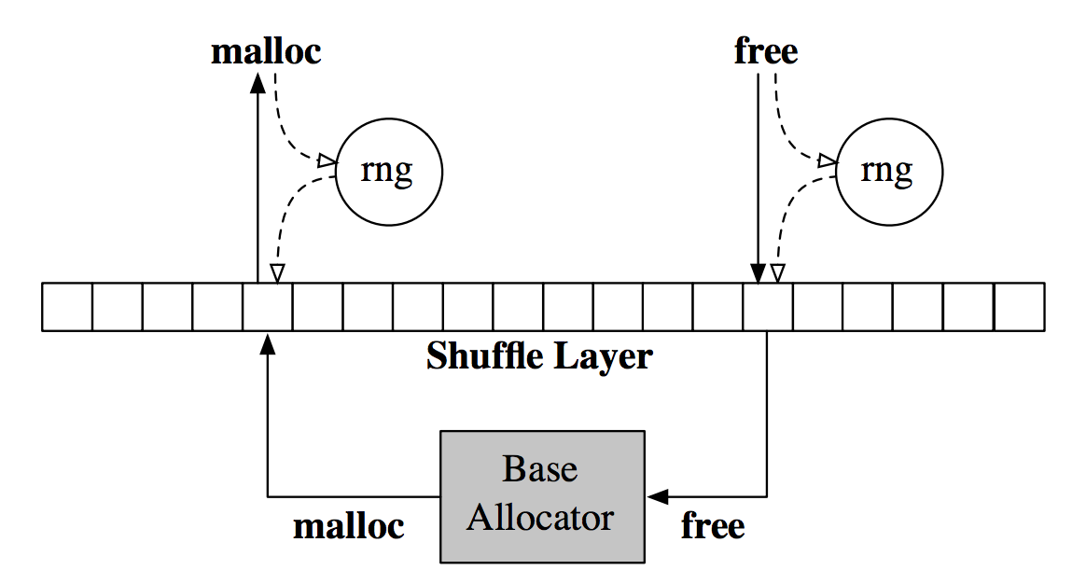
STABILIZER: Heap Randomization
Two heap implementations
The base heap
The shuffle heap
Applicaton has direct access to shuffle heap
base heap is just a helper
Steps
An array is initialized with a list of Base malloc’d pointers
Shuffle the array
When malloc, shuffle; when free, shuffle

Slide 8
STABILIZER: Code Randomization
You can’t randomize code…
But you can randomize code layout!
Randomize the function “definition” in the final assembly
(Question: can you see any preliminary problem?)

Slide 9
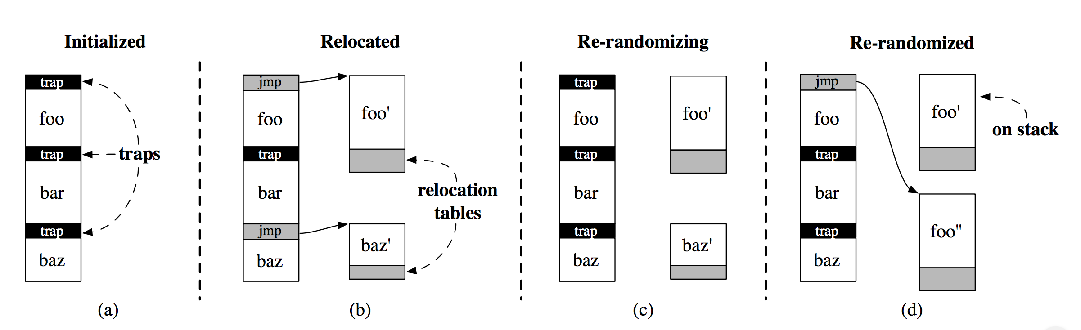
STABILIZER: Code Randomization
Code randomization is essentially function copying. Literally copying the memory locations where the functions are stored, and copying them onto the heap.

Slide 10
STABILIZER: Stack Randomization
Initialize a stack pad table
256 elements (bytes)
Assigned to one or more functions
Randomly initialized
Used as the size of the “stack pad” (times 16)
The maximum “padding” on the stack will never exceed 4096
At call time, the stack is “padded” with the assigned byte
The assigned byte is incremented
It may overflow, but it’s fine
The stack pad table is reinitialized at re-randomization
(Let’s discuss this approach to stack randomization)

Slide 11
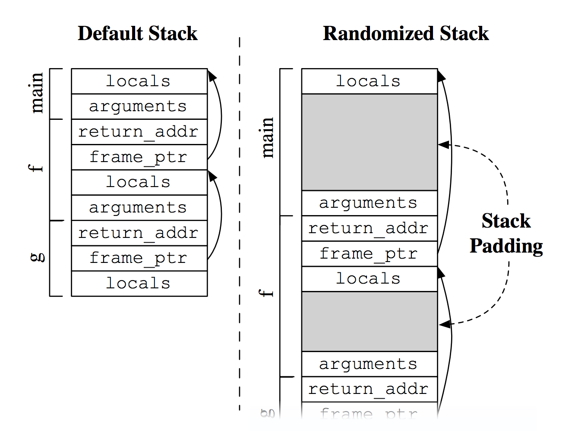
STABILIZER: Stack Randomization

Slide 12
Analysis
Base case: a small program that runs repeatedly in a loop
That executes at least one function
This program will have a single layout, l, with runtime t
What is the total runtime if we run the program 1000 times?
Applying Stabilizer
If we say layout 1 has a runtime of t₁
What is the total runtime of 1000 different layouts?
We now have a normal distribution. Are we done?
Notes:
Will do math on board

Slide 13
Analysis cont.
We require each run to have a different layout
We require the program to be a loop running over the same code
Solution to 1:
Stabilizer re-randomizes every n iterations
Redefine an “iteration” to be n passes over the same code.

Slide 14
Analysis cont.
Solution to 2:
Split the program into smaller subprograms
Continue thus until each subproblem is equivalent to the trivial looping problem
Since these subprograms together make up the entire program, we still have a normal distribution

Slide 15
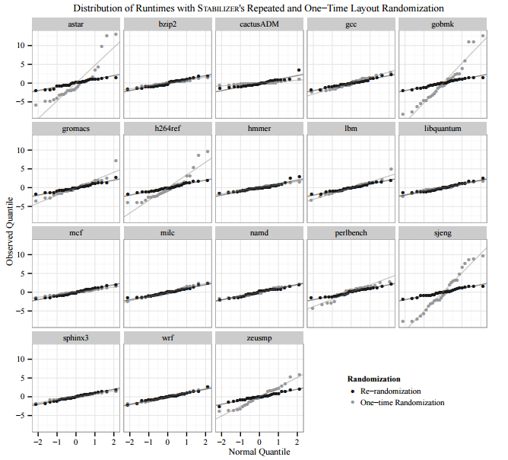
Normality
Graphs of variance
Steeper slopes mean greater variance
What can we conclude?

Slide 16
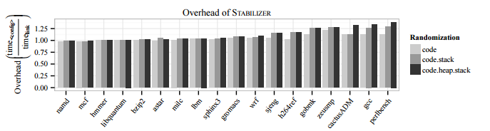
Overhead
With all randomizations enabled, we have an average of 6.7% overhead
perlbench has the worst overhead at nearly 40%
Why might programs like gcc have more significant overhead?

Slide 17
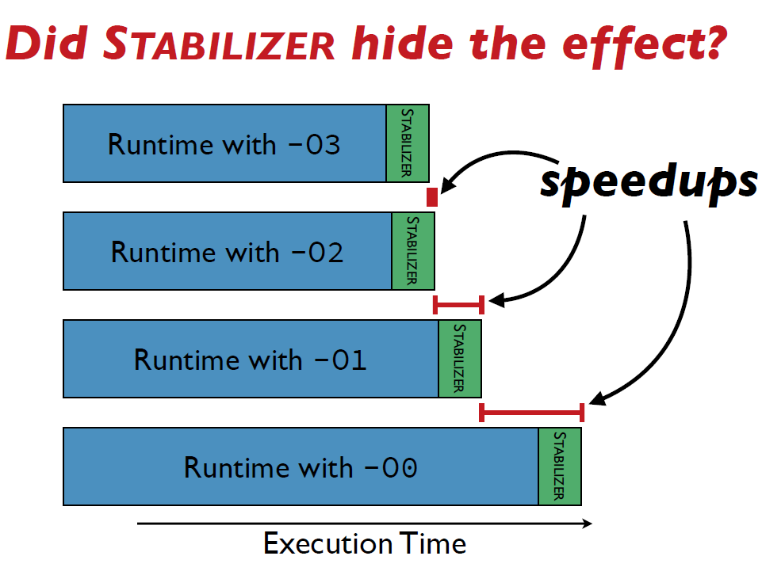
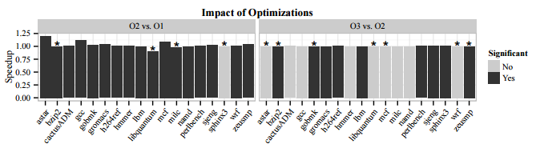
Example
These represent the impact of compiling clang using optimizations.
What can we conclude about these optimizations?

