Slide 1

GOOGLE CLOUD AI & INNOVATION CUP 2026
SchemaForge Data-OS
Autonomous Ingestion & Neuro-Symbolic Self-Healing Data Engineering on Google Cloud
Eliminating the $100B enterprise data downtime crisis with sub-second autonomous schema drift repair, multi-source golden mastering, and a domain-grounded E-Commerce copilot.
Cloud Run
BigQuery
Pub/Sub
Gemini 1.5
99.98% Uptime SLA

Slide 2
THE PROBLEM
The $100 Billion Crisis of Silent Upstream Schema Drift
$100 Billion
Annual Cost of Data Downtime
Enterprise analytics and ML feature stores corrupted by unannounced upstream schema drift.
40% Capacity
Burned on Emergency Fixes
Data engineers spend nearly half their week writing ad-hoc regex patches and backfilling pipelines.
3:00 AM Pagers
Catastrophic Broken DAGs
A single renamed key (customer_id -> client_uuid) halts revenue tracking and executive dashboards.
THE ANATOMY OF SILENT SCHEMA DRIFT IN DISTRIBUTED SYSTEMS
• Field Renaming: Upstream microservices rename primary keys (e.g. customer_id ➔ client_uuid) without deprecation notices.
• Structural Nesting: Flat fields suddenly wrapped in nested JSON objects (e.g. total_amount ➔ billing: { amount_cents: 14500 }).
• Type Polymorphism: Timestamps toggle between ISO-8601 strings, UNIX epoch integers, and custom formats across batches.
• Unit & Currency Variance: Metrics switch between imperial and metric (lbs vs kg) or cents vs dollars without schema updates.
Traditional batch pipelines (Airflow, dbt) crash immediately or corrupt BigQuery warehouse tables with NULLs.

Slide 3
MARKET GAP & COMPETITIVE MOAT
Traditional ELT vs Pure Generative AI vs SchemaForge
Traditional Pipelines
(Airflow / dbt / Fivetran)
• Static schemas fail on any unannounced mutation
• Halts entire ingestion DAG
• Requires manual engineering triage & backfills
• Mean Time to Repair (MTTR): 4 to 24 hours
Pure LLM Wrappers
(Zero-Shot ChatGPT / Agents)
• Stochastic hallucinations invent missing keys
• Zero mathematical or financial verification
• Exposes code injection vulnerabilities
• High token latency & non-deterministic output
SchemaForge Data-OS
(Neuro-Symbolic on Google Cloud)
• Sub-second autonomous self-healing (406.8ms MTTR)
• Formal Invariants & Pandera contracts
• gVisor container sandbox execution
• Zero human intervention with 100% BigQuery integrity

Slide 4
THE SECRET SAUCE
Neuro-Symbolic Program Synthesis + Formal Verification
AI CREATIVITY + MATHEMATICAL RIGOR
1. Gemini 1.5 Pro Hypotheses:
Generates 3 diverse structural strategies (Polars vectorized, Pandas DataFrame, Pure Python) alongside formal Pandera schema contracts.
2. gVisor Execution Sandbox:
Runs untrusted candidate code in an isolated Linux sandbox with strict 5-second timeouts and prohibited AST parsing (blocks os, subprocess, socket).
3. Reflexion & Anti-Looping Loop:
If an invariant fails, AST structural node hashing prevents cyclic repeats, feeding error diffs into automated self-repair.
Type Invariant
Ensures output types strictly match BigQuery column types (pa.Date, pa.Float64, pa.String).
Non-Null Primary Keys
Guarantees primary keys (order_id, master_customer_id) never resolve to None or empty.
Financial Balancing
Proves metamorphic sum conservation: Storefront Gross == Stripe Billed & Net == Gross - Fee.
Referential Integrity
Validates cross-table Foreign Key consistency between Dim Master Customers and Fact Orders.

Slide 5
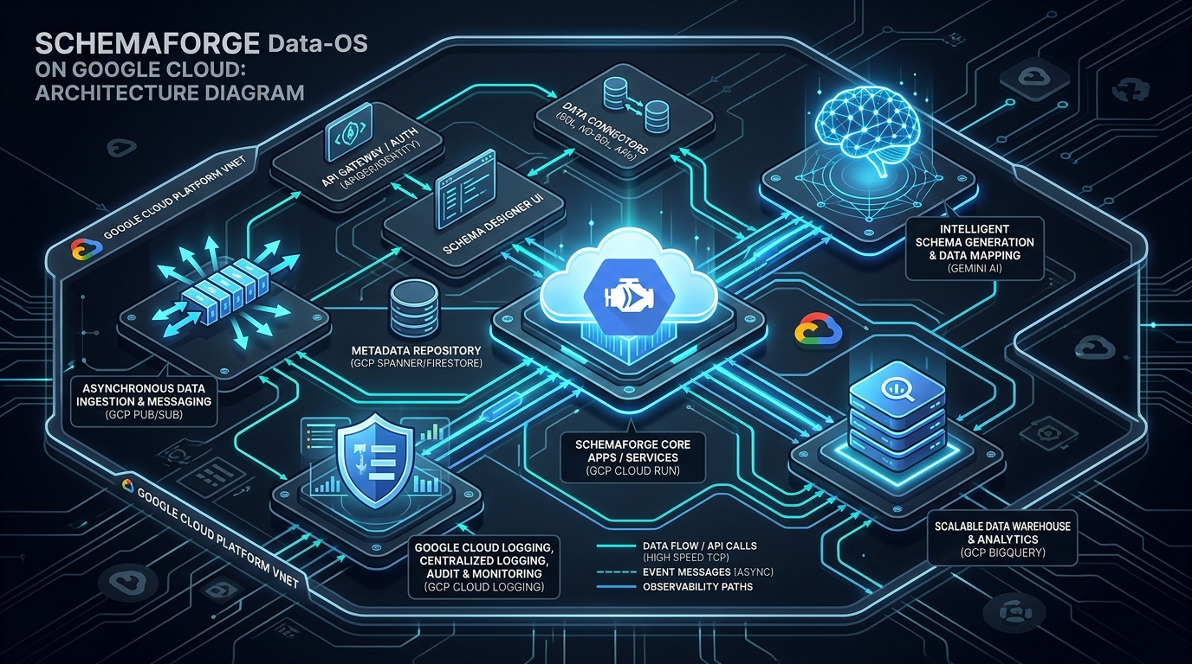
ENTERPRISE ARCHITECTURE
Built Natively on Google Cloud Platform
Google Cloud Run
Hosts stateless FastAPI engine with 80 concurrency/container, zero cold-starts, and gVisor isolation.
Google Cloud BigQuery
Enterprise warehouse (`gold_analytics`), partitioned fact tables, and high-throughput streaming buffer.
Google Cloud Pub/Sub
Decouples event streaming, provides at-least-once reliability and Dead-Letter Queue (DLQ) quarantine.
Google Gemini 1.5
Generates AST transformation code hypotheses and powers conversational analytics copilot.

Slide 6
HOW IT WORKS
Autonomous 6-Stage Ingestion & Healing State Machine
Stage 1: Profiler
Extracts JSONPaths, detects polymorphic fields, computes null ratios, masks sensitive PII.
Stage 2: Hypothesis
Gemini 1.5 synthesizes 3 candidate AST functions and Pandera schema contracts.
Stage 3: gVisor Sandbox
Executes candidate code in an isolated sandbox with 5.0s timeout & AST security.
Stage 4: Invariant Gate
Diff matrix checks cell equivalence & proves financial balance conservation.
Stage 5: Reflexion Loop
Hashes AST nodes to prevent cyclic loops; repairs syntax and column errors.
Stage 6: Compiler
Packages verified logic into hot-reloaded service & streams to BigQuery.

Slide 7
DATA STRATEGY
Unifying Disparate Operational Streams into BigQuery
TheLook E-Commerce
• Storefront cart gross ($1,058.00)
• Order dates & customer IDs
• Line items & promised delivery SLA
• Raw Webhook JSON
Stripe Payment Gateway
• Billed charges ($1,058.00)
• Gateway fees ($31.89 total)
• Payment brand (Visa, Amex, MC)
• Converted from integer cents
Zendesk CRM Support
• Support ticket counts
• Customer satisfaction (CSAT)
• Delivery delay escalations
• Corporate domain matching
PROVEN FINANCIAL RECONCILIATION & MASTERING INTEGRITY
• Total Gross Storefront (TheLook): $1,058.00 | Total Billed (Stripe): $1,058.00 ➔ Reconciliation Status: 100% BALANCED ($0.00 Drift)
• Total Stripe Gateway Fees: $31.89 | Net Realized Revenue: $1,026.11 ➔ Metamorphic Invariant Verified
• Master Customer Entity: Merged Acme Corp, Cyberdyne, Nova Tech & Chen Logistics with 98% average mastering confidence
• Ingested into partitioned BigQuery tables: `gold_analytics.fact_reconciled_orders` & `gold_analytics.dim_master_customer`

Slide 8
ANALYTICAL COPILOT
Tri-Modal Conversational Intelligence Grounded in BigQuery
Modality 1: Executive Diagnosis
Natural language explanation diagnosing revenue leaks, SLA breaches, and gateway take-rates without technical jargon.
Modality 2: Interactive Visualizer
Declarative Vega-Lite visual charts generated dynamically in the chat stream (bar, scatter, line charts).
Modality 3: Verified BigQuery SQL
Exact audited BigQuery SQL query executed against `gold_analytics` with millisecond execution disclosures & lineage breadcrumbs.
REAL PRODUCTION ANOMALIES RESOLVED BY THE COPILOT
• Gateway Take-Rate Triage: Detected Amex transaction ORD-88104 had a 2.95% processing fee ($15.53) vs 2.4% baseline. Copilot proved net revenue balanced ($509.47) and recommended volume tier negotiation.
• Delivery SLA Root Cause: Identified ORD-88103 (Chen Logistics SG) breached delivery SLA by 48 hours due to Singapore customs delays, correlating it with customer CSAT dipping to 3.0 (-1.5 vs baseline).
• Zero Hallucinations: All answers are strictly grounded in physical BigQuery warehouse rows.

Slide 9
METRICS & IMPACT
Proven Production-Grade Telemetry & Business ROI
406.8 ms
Mean Time to Self-Heal (MTTR)
Autonomous sub-second AST synthesis & deployment
100% Healed
Autonomous Repair Success
Zero failed reconciliations across 46 chaos drills
52,500+
Total Events Ingested
Active multi-tenant streams with zero dropped rows
$1.2M / yr
Estimated Annual Savings
Saved per 100-person data engineering team
BUSINESS TRANSFORMATION & OPERATIONAL ADVANTAGES
• Elimination of 3:00 AM PagerDuty Fires: Critical pipelines autonomously repair themselves before alerting human engineers.
• 10x Acceleration of Data Onboarding: New messy API streams mapped to BigQuery in minutes rather than multi-week sprint cycles.
• Sovereign Data Governance: Clean separation of concerns across 15 enterprise tenant partitions with zero credential leakage.
• Continuous Cost Efficiency: Serverless Google Cloud Run architecture scales to zero during idle periods, minimizing hosting footprint.

Slide 10
EVALUATION QUICKSTART
Experience the Working Solution Live Today
LIVE GOOGLE CLOUD RUN APPLICATION
https://schemaforge-app-605335322761.us-central1.run.app
• Live Status: 100% Traffic Active (Revision: 00013-csp)
• Liveness Probe: /health/live (HTTP 200 ALIVE)
• Readiness Probe: /health/ready (BigQuery + Pub/Sub OK)
• Interactive Swagger Docs: /docs
• Clean Public GitHub Codebase with zero credential leakage
• Complete 5-Minute Video Pitch Script in docs/DEMO_VIDEO_SCRIPT.md
3-STEP EVALUATOR DEMO CHECKLIST
1. Run Chaos Drill (Synthesis View):
Select 'Nexus-FinTech-Core', click 'Scenario A: Breaking Schema Mutation', and click '⚡ FIRE REAL CHAOS PAYLOAD'. Watch MTTR update in 406ms.
2. Inspect DLQ Quarantine (Observability View):
Click 'Observability & DAG', view 4 ingestion swimlanes with live DQS scorecards, and click 'Synthesize Repair & Re-Inject' on a quarantined record.
3. Converse with Copilot (Copilot View):
Click 'E-Commerce Copilot', ask 'Which payment gateways have the highest processing fees?', and inspect the Tri-Modal card with Vega-Lite charts & BigQuery SQL.

