Slide 1
Weekly Report
2021.01.29
Hongsik Kim
Mobile & Network Intelligence Laboratory

Slide 2
AI Explanable AI
Implementation of Patent (non-public)
Kaggle Competition

Slide 3
Kaggle Competition
Conway’s Game of Life 2020
repeatDelta 방법론 적용
t+3
t+2
t+1
t
<model for n-sub>
<prediction example>
t+2
t+1
t
<model for non-n-sub>
<prediction example>

Slide 4
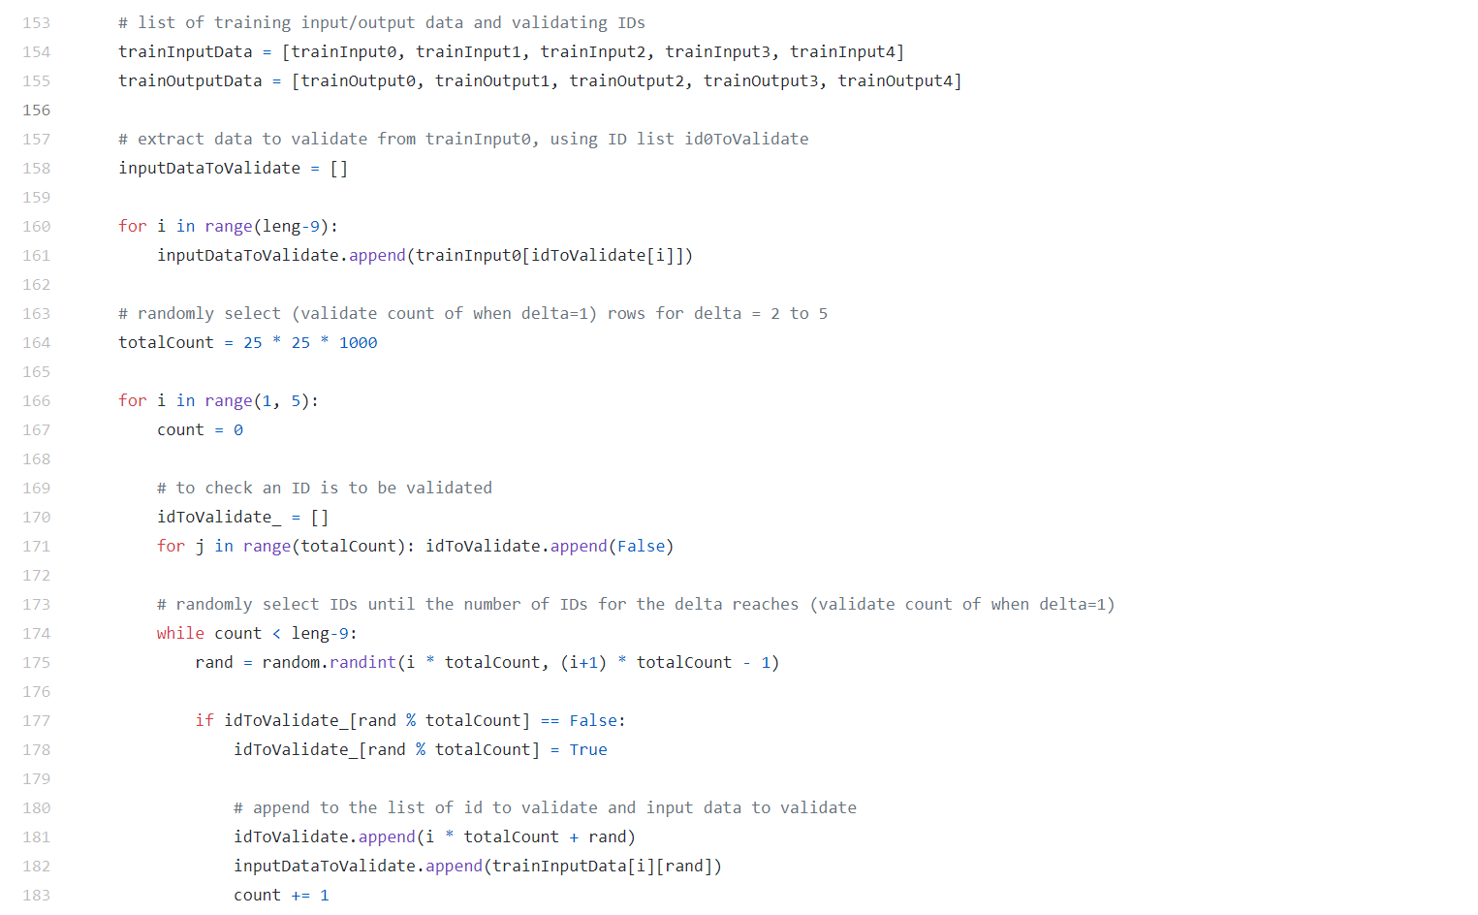
Kaggle Competition
Conway’s Game of Life 2020
repeatDelta 방법론에 대한 구현 진행 중

Slide 5
Github
https://github.com/WannaBeSuperteur/2020/tree/master/

