Slide 1
Weekly Report
2020.12.18
Hongsik Kim
Mobile & Network Intelligence Laboratory

Slide 2
AI Explanable AI
Kaggle 진행 상황
논문: THE DESIGN AND IMPLEMENTATION OF LANGUAGE LEARNING CHATBOT WITH XAI USING ONTOLOGY AND TRANSFER LEARNING (ing)

Slide 3
Current Status
주간 진행 사항
Kaggle 진행
Conway’s Reverse Game of Life 2020
https://www.kaggle.com/c/conways-reverse-game-of-life-2020
논문 학습
THE DESIGN AND IMPLEMENTATION OF LANGUAGE LEARNING CHATBOT WITH XAI USING ONTOLOGY AND TRANSFER LEARNING (ing)
https://arxiv.org/ftp/arxiv/papers/2009/2009.13984.pdf

Slide 4
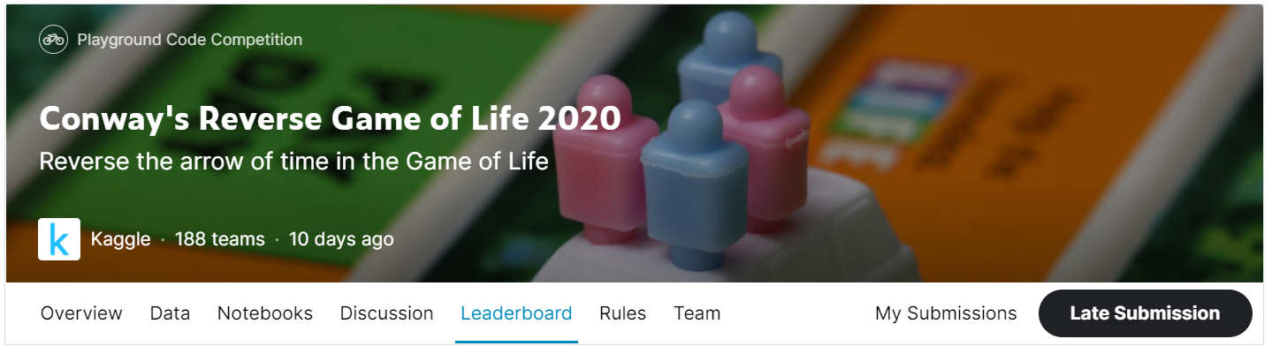
Kaggle Competition
Conway’s Reverse Game of Life 2020
https://www.kaggle.com/c/conways-reverse-game-of-life-2020

Slide 5
Kaggle Competition
Improvement
max(loss when prediction is all 0 – loss when applying each threshold)
Goal: 0.14689 (predict as all 0) – 0.12789 (top 40%) = 0.0190
Date | Improvement
12/03 | 0.0114
12/10 | 0.0140
12/17 (method 1) | 0.0106
12/18 (method 2) | 0.0118

Slide 6
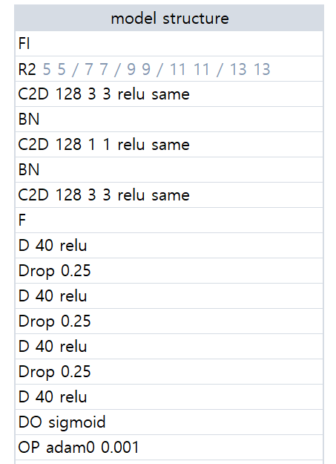
Kaggle Competition
Method 1 (using n-sub mode)
2D Convolution / 128 3x3 Filters / ReLU
Same padding
2D Convolution / 128 1x1 Filters / ReLU
Same padding
Batch Normalization

Slide 7
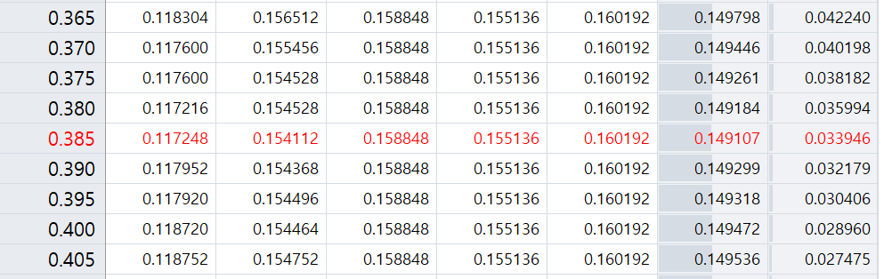
Kaggle Competition
Method 1 (using n-sub mode) – RESULT
loss when prediction is all 0 = 0.159667
min(loss when applying each threshold) = 0.149107 where threshold = 0.385
Improvement = 0.159667 – 0.149107 = 0.0106

Slide 8
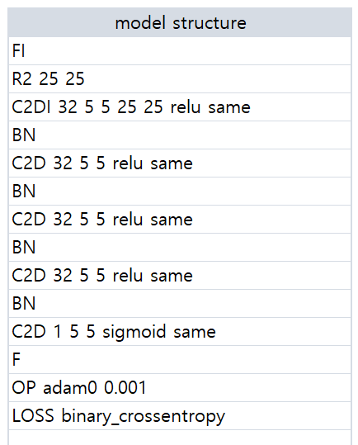
Kaggle Competition
Method 2 (not using n-sub mode)
2D Convolution / 32 5x5 Filters / ReLU
Same padding
Batch Normalization
Loss: binary_crossentropy

Slide 9
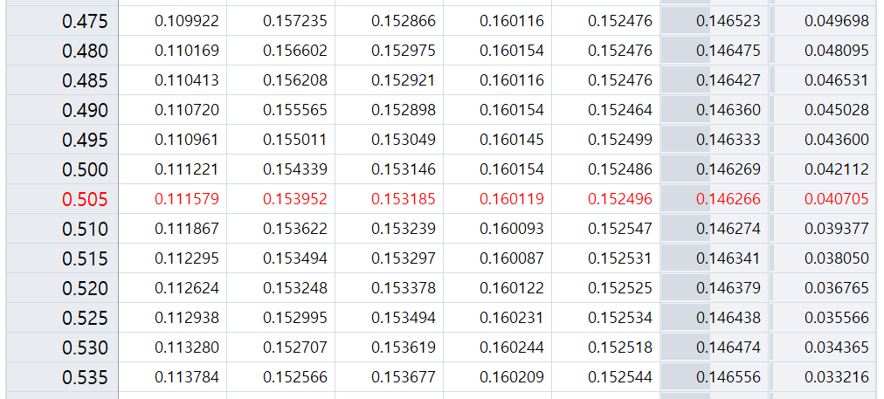
Kaggle Competition
Method 2 (not using n-sub mode) – RESULT
loss when prediction is all 0 = 0.158047 where threshold = 1.0
min(loss when applying each threshold) = 0.146266 where threshold = 0.505
Improvement = 0.158047 – 0.146266 = 0.0118

Slide 10
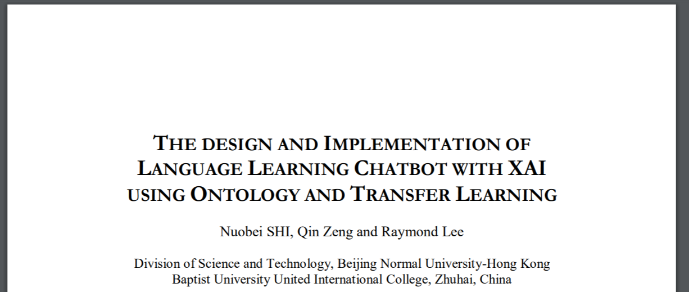
Paper: THE DESIGN AND IMPLEMENTATION OF LANGUAGE LEARNING CHATBOT WITH XAI USING ONTOLOGY AND TRANSFER LEARNING
Paper: THE DESIGN AND IMPLEMENTATION OF LANGUAGE LEARNING CHATBOT WITH XAI USING ONTOLOGY AND TRANSFER LEARNING
https://arxiv.org/ftp/arxiv/papers/2009/2009.13984.pdf

Slide 11
Github
https://github.com/WannaBeSuperteur/2020/tree/master/

