Slide 1
Weekly Report
2021.01.08
Hongsik Kim
Mobile & Network Intelligence Laboratory

Slide 2
AI Explanable AI
Paper: Higher-Order Explanations of Graph Neural Networks via Relevant Walks
Kaggle: Conway’s Reverse Game of Life 2020

Slide 3
Current Status
주간 진행 사항
논문 학습: Higher-Order Explanations of Graph Neural Networks via Relevant Walks
https://arxiv.org/pdf/2006.03589.pdf
Kaggle: Conway’s Reverse Game of Life 2020
https://www.kaggle.com/c/conways-reverse-game-of-life-2020

Slide 4
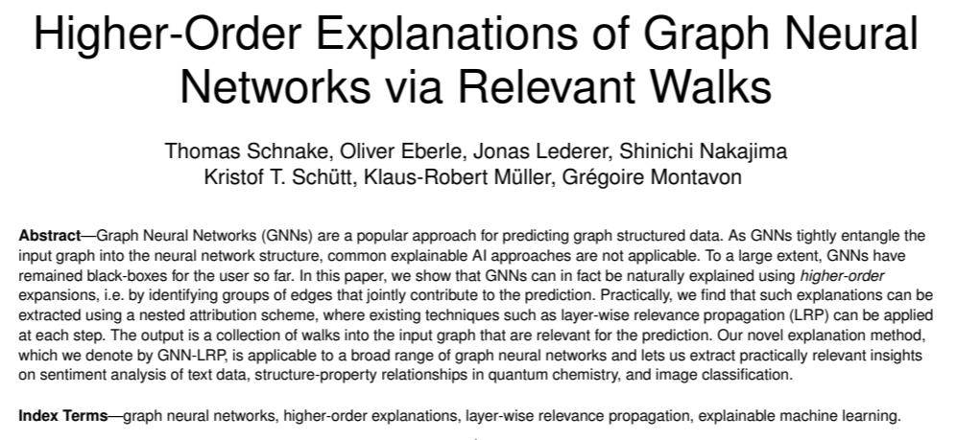
Paper: Higher-Order Explanations of Graph Neural Networks via Relevant Walks
https://arxiv.org/pdf/2006.03589.pdf

Slide 5
Paper: Higher-Order Explanations of Graph Neural Networks via Relevant Walks
GNN (Graph Neural Network)
그래프 자료구조를 input으로 하는 특별한 구조의 neural network
그래프 자료구조의 높은 이질성을 처리하기 위한 다양한 구조의 GNN이 존재
Input graph가 first layer에 위치하지 않으며, 여러 개의 layer에서 등장
GNN은 몇 개의 interaction block을 쌓는 방법으로 구성

Slide 6
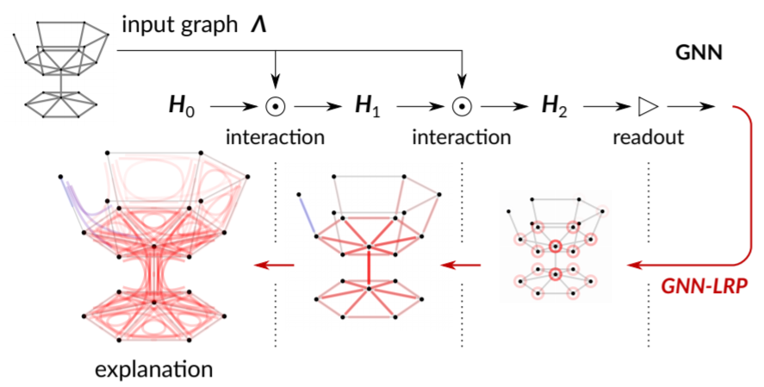
Paper: Higher-Order Explanations of Graph Neural Networks via Relevant Walks
GNN-LRP
GNN에 대해 설명하기 위한 LRP (Layer-wise Relevance Propagation) 방법론
설명 과정은 GNN의 output에서 시작, GNN의 예측과 관련된 walk을 uncover하는 방법으로 backward 방향으로 진행

Slide 7
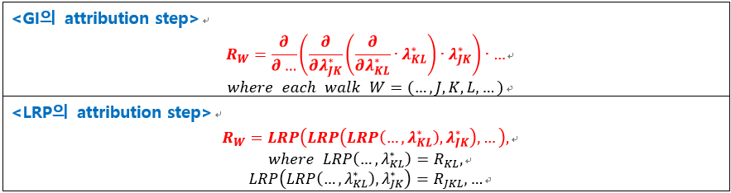
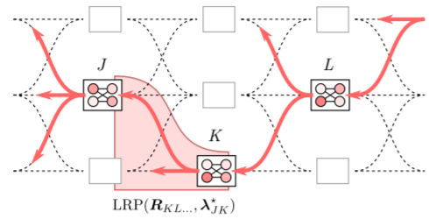
Paper: Higher-Order Explanations of Graph Neural Networks via Relevant Walks
GNN-LRP
GNN-GI에서 발전한 방법으로, GNN-GI의 attribution step을 LRP의 attribution step으로 변환

Slide 8
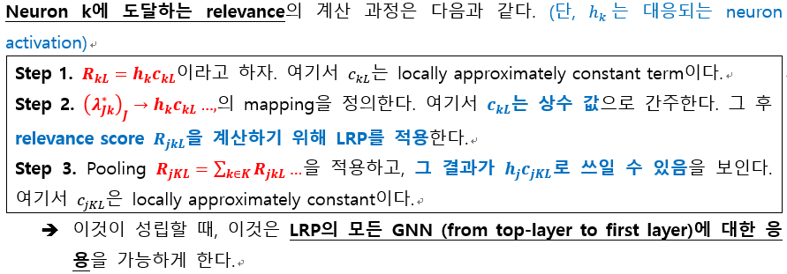
Paper: Higher-Order Explanations of Graph Neural Networks via Relevant Walks
GNN-LRP
Neuron k에 도달하는 relevance의 계산 과정:

Slide 9
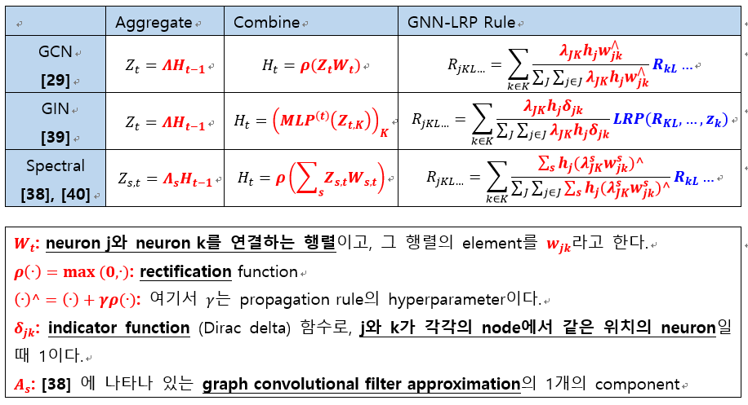
Paper: Higher-Order Explanations of Graph Neural Networks via Relevant Walks
GNN-LRP
서로 다른 종류의 GNN에 대한 GNN-LRP의 propagation rule

Slide 10
Paper: Higher-Order Explanations of Graph Neural Networks via Relevant Walks
Testing and Validating GNN-LRP
Graph의 class 구성
First Class | Barabasi-Albert graphs (of growth parameter 1) (BA-1)
Second Class | Slightly higher growth model, and new nodes attached preferably to low-degree nodes

Slide 11
Paper: Higher-Order Explanations of Graph Neural Networks via Relevant Walks
Testing and Validating GNN-LRP
Graph의 class 구성
First Class | Barabasi-Albert graphs (of growth parameter 1) (BA-1)
Second Class | Slightly higher growth model, and new nodes attached preferably to low-degree nodes

Slide 12
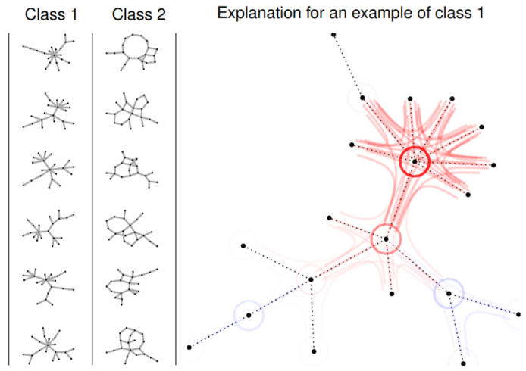
Paper: Higher-Order Explanations of Graph Neural Networks via Relevant Walks
Testing and Validating GNN-LRP
실험 결과
RED:
Relevant (positively contributing) walks
BLUE:
Negatively contributing walks
CIRCLES:
Stationary walk/walks

Slide 13
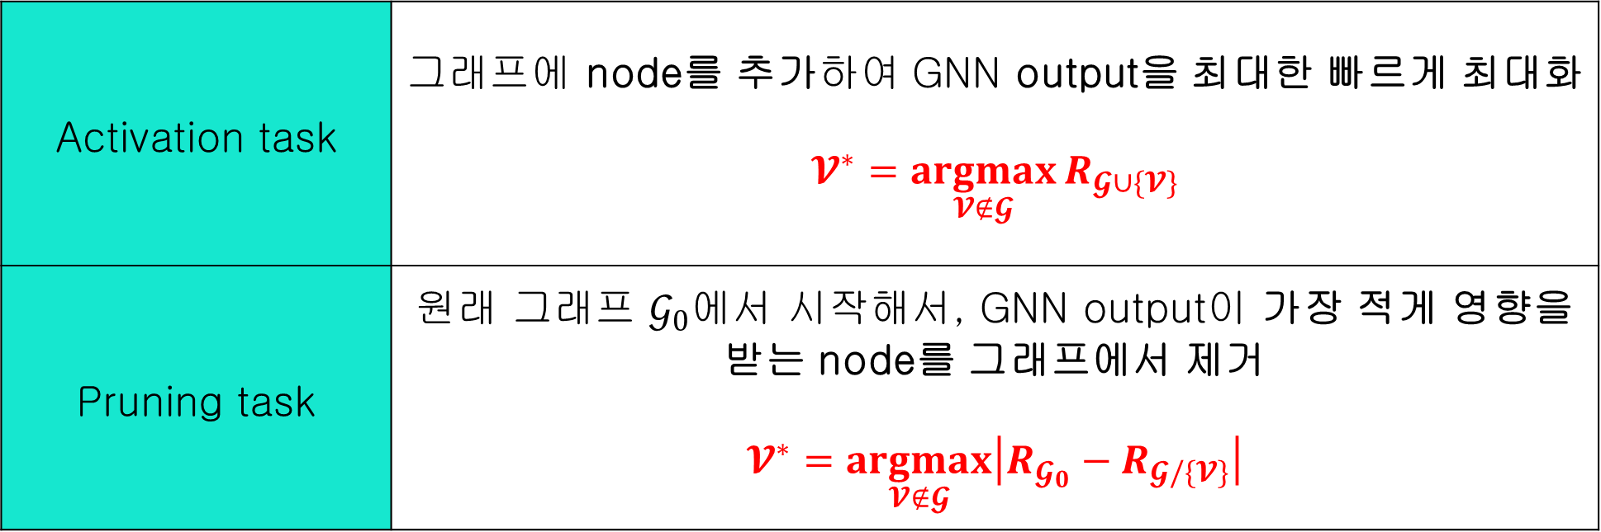
Paper: Higher-Order Explanations of Graph Neural Networks via Relevant Walks
Testing and Validating GNN-LRP
Node-flipping task
Activation task | 그래프에 node를 추가하여 GNN output을 최대한 빠르게 최대화 $$𝓥^{∗}=\underset{𝓥∉𝓖}{argmax}{R_{𝓖∪\{𝓥\}}}$$
Pruning task | 원래 그래프 $𝒢_{0}$에서 시작해서, GNN output이 가장 적게 영향을 받는 node를 그래프에서 제거 $$𝓥^{∗}=\underset{𝓥∉𝓖}{argmax}\left|R_{𝓖_{0}}−R_{𝓖/\{𝓥\}}\right|$$

Slide 14
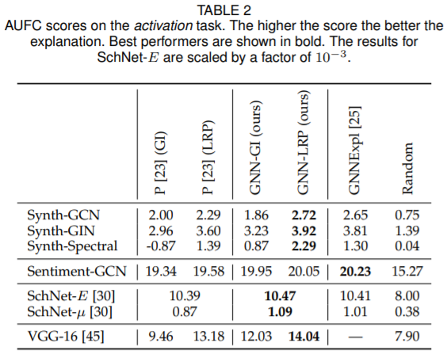
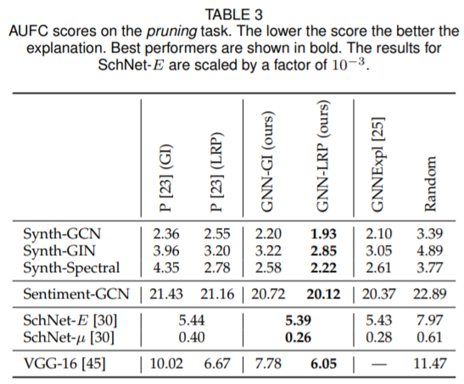
Paper: Higher-Order Explanations of Graph Neural Networks via Relevant Walks
Testing and Validating GNN-LRP
Node-flipping task에서의 AUFC score
ACTIVATION TASK
PRUNING TASK

Slide 15
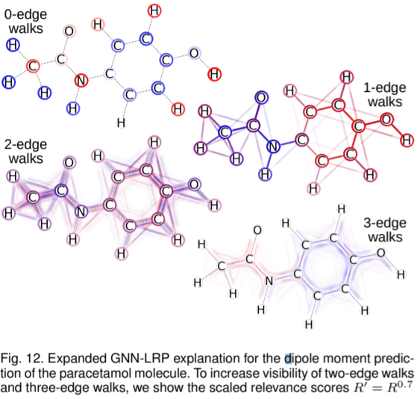
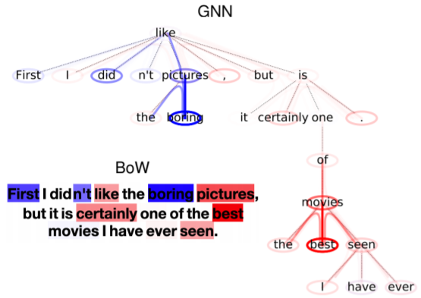
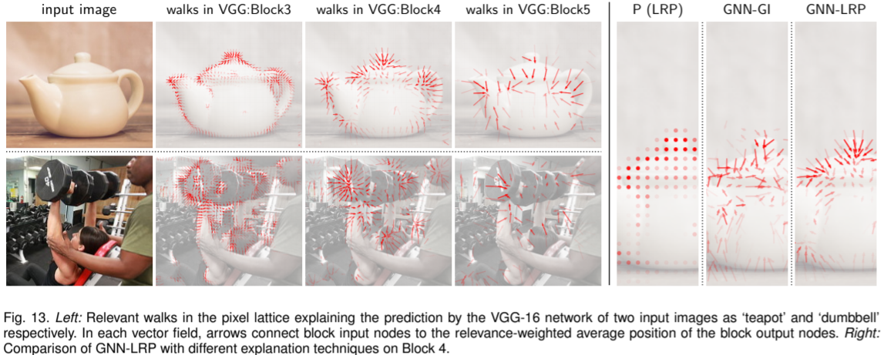
Paper: Higher-Order Explanations of Graph Neural Networks via Relevant Walks
Application
Sentiment Analysis
Quantum Chemistry
Image Classification

Slide 16
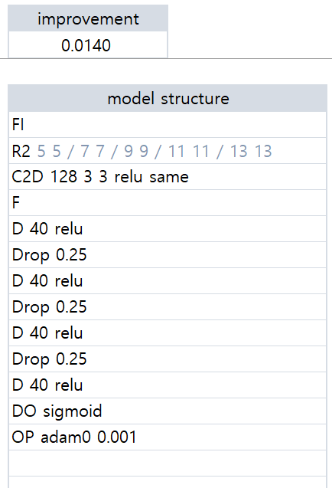
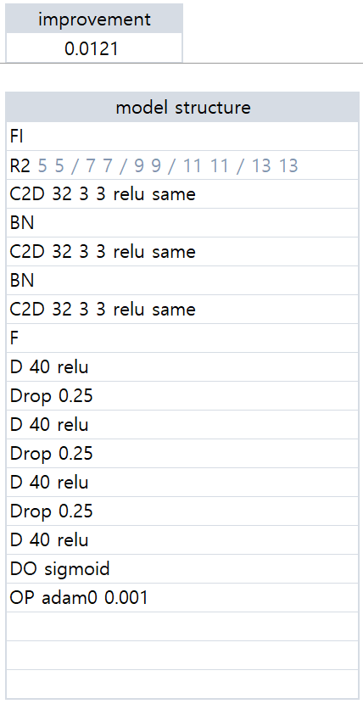
Kaggle Competition
Model Modification (improvement 0.0140 -> 0.0121)
32 / BN
128
32 / BN
32 / BN
12/10/2020
01/07/2020

Slide 17
Github
https://github.com/WannaBeSuperteur/2020/tree/master/

