Slide 1
START
1. Make WDs placement maps
5. Make Train/Test Input Data
(from WDs placement maps1)
9. Get output throughput map for Test Input Data5
2. Make throughput maps
6. Make Train Output Data
(from throughput maps2)
10. Find best throughput point in this output throughput map9
3. Read WDs placement maps1
7. Process Train Output Data6
11. Using 4 points around the point10 to process the best point
8. Train Model
Using Train Input and Output Data5,6
4. Read throughput maps2
END
Phase 1. Making data
Phase 2. Training using data
Phase 3. Finding the best point
Figure 1. Flow chart of HAP placement model

Slide 2
environment
The darker,
the larger the throughput
block contains a WD
Wireless Device
WDs placement map
Throughput Map
Mobile HAP
Best throughput point
Figure 2. The system architecture of model

Slide 3
wdList := (list of location of each WD) // in the form of [[x of WD0, y of WD0], [x of WD1, y of WD1], …] lr := 5.0 // learning rate timeList := [1.0, 1.0, …, 1.0] // list of allocated time, number of elements is (1+number of WDs) HAPpoint := (location of HAP) // the location (y-axis and x-axis) of HAP Iterate 1000 times: // using Gradient Descent Method tpChange := [] // common throughput change when allocated time for each WD is increased by a specific value thrput := getThrput(wdList, HAPpoint, timeList) // compute original common throughput for each member x in [HAP, wdList]: timeListCopy := timeList // copy timeList timeListCopy[x] += 1.0 // increase allocation of time for each member (HAP or WD) by 1.0 newThrput := getThrput(wdList, HAPpoint, timeListCopy) // compute common throughput when time allocation is changed difThrput := log2(newThrput/thrput) // find difference of throughput by log of throughput change append max(0.01*log2(difThrput), log2(difThrput)) to tpChange // like applying leaky relu to throughput change difference timeList[x] = timeList[x] * 2^(lr * tpChange[x]) // change allocated time for this HAP or WD
Algorithm 1. Finding throughput for a HAP location and each WD’s location

Slide 4
getThrput(wdList, HAPpoint, timeList): (HAP_y, HAP_x) := (Y axis of HAPpoint, X axis of HAPpoint) // location of HAP sumOfTime := sum(timeList) // sum of allocated time HAPtime := timeList[0]/sumOfTime // allocated time for HAP result := MAX // common throughput value to return for each WD: // find throughput for each WD (WD_y, WD_x) := (Y axis of wdList[i], X axis of wdList[i]) // location of each WD dist = sqrt((WD_y-HAP_y)^2 + (WD_x-HAP_x)^2) // distance between HAP and each WD chargeTime := timeList[1+i]/sumOfTime // allocated time for each WD throughput := chargeTime*log2(1+(100*(pi^4))/(49*(max(dist, 1.0)^4))*HAPtime/chargeTime) result := min(result, throughput) // common throughput means minimum of throughput return result
Algorithm 1. Finding throughput for a HAP location and each WD’s location

Slide 5
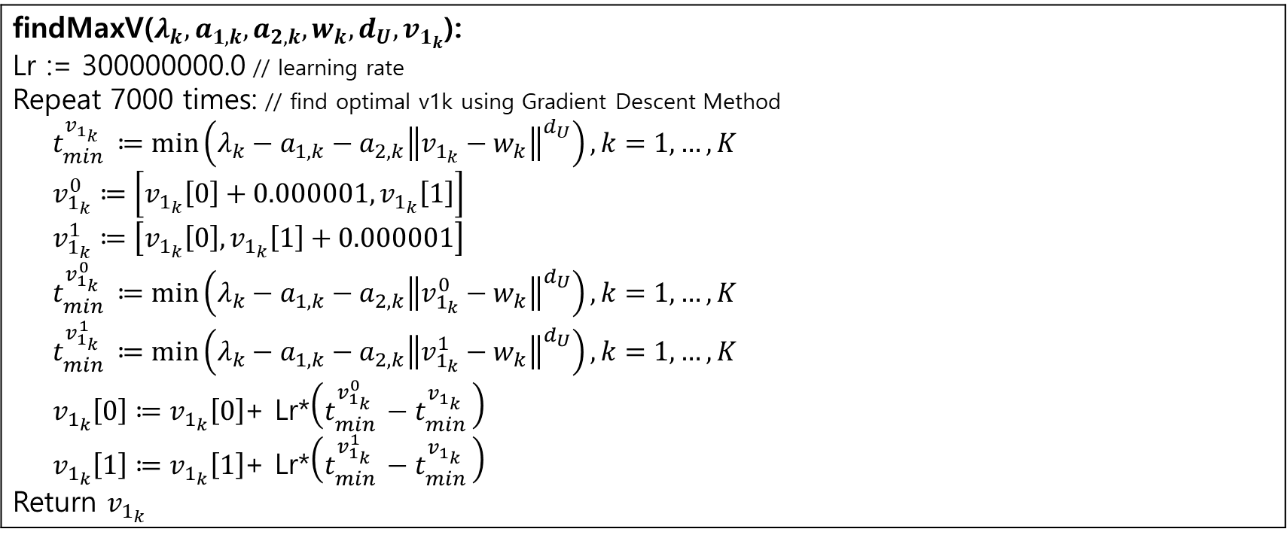
findMaxV($λ_{k}, a_{1,k}, a_{2,k}, w_{k}, d_{U}, v_{1_{k}}$): Lr := 300000000.0 // learning rate Repeat 7000 times: // find optimal v1k using Gradient Descent Method $t_{min }^{v_{1_{k}}}≔\min\left(λ_{k}−a_{1,k}−a_{2,k}{\left\|v_{1_{k}}−w_{k}\right\|}^{d_{U}}\right), k=1,…,K$ $v_{1_{k}}^{0}≔\left[v_{1_{k}}\left[0\right]+0.000001,v_{1_{k}}\left[1\right]\right]$ $v_{1_{k}}^{1}≔\left[v_{1_{k}}\left[0\right],v_{1_{k}}\left[1\right]+0.000001\right]$ $t_{min }^{v_{1_{k}}^{0}}≔\min\left(λ_{k}−a_{1,k}−a_{2,k}{\left\|v_{1_{k}}^{0}−w_{k}\right\|}^{d_{U}}\right), k=1,…,K$ $t_{min }^{v_{1_{k}}^{1}}≔\min\left(λ_{k}−a_{1,k}−a_{2,k}{\left\|v_{1_{k}}^{1}−w_{k}\right\|}^{d_{U}}\right), k=1,…,K$ $v_{1_{k}}\left[0\right]≔v_{1_{k}}\left[0\right]$+ Lr*$\left(t_{min }^{v_{1_{k}}^{0}}−t_{min }^{v_{1_{k}}}\right)$ $v_{1_{k}}\left[1\right]≔v_{1_{k}}\left[1\right]$+ Lr*$\left(t_{min }^{v_{1_{k}}^{1}}−t_{min }^{v_{1_{k}}}\right)$ Return $v_{1_{k}}$
Algorithm 2. Solving (20) in the original paper

Slide 6
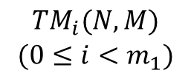
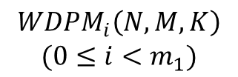
based on
based on
$$\begin{aligned}WDPM_{i}\left(N, M, K\right) \\ (0≤i<m_{1})\end{aligned}$$
$$\begin{aligned}TM_{i}(N, M) \\ (0≤i<m_{1})\end{aligned}$$
Dropout
(0.05)
Dropout
(0.05)
I
O
Input
(N*M)
(N, M) Conv2D
32, 3x3 Kernel
ReLU
MaxPooling2D
(size=2)
Conv2D
32, 3x3 Kernel
ReLU
Flatten
Dense
(40)
ReLU
Dense
(N*M)
Sigmoid
Output
Map
(N, M)
Figure 3. Architecture of Deep Learning Model for Common Throughput Maximization

Slide 7


















(The darker, The higher common throughput value)
$$m_{Max}−1$$
$$m_{Max}$$
$$m_{Max}+1$$
$$m_{Max}−1$$
$$m_{Max}$$
$$m_{Max}+1$$
$$m_{optimal}$$
$$n_{Max}−1$$
$$V_{n_{Max}−1, m_{Max}}^{i′′}$$
$$n_{Max}−1$$
$$V_{n_{Max}−1, m_{Max}}^{i′′}$$
$$n_{Max}$$
$$V_{n_{Max}, m_{Max}−1}^{i′′}$$
$$V_{n_{Max}, m_{Max}}^{i′′}$$
$$V_{n_{Max}, m_{Max}+1}^{i′′}$$
$$n_{Max}$$
$$V_{n_{Max}, m_{Max}−1}^{i′′}$$
$$V_{n_{Max}, m_{Max}}^{i′′}$$
$$V_{n_{Max}, m_{Max}+1}^{i′′}$$
$$n_{optimal}$$
$$BTP_{i}\left(N, M\right)$$
$$n_{Max}+1$$
$$V_{n_{Max}+1, m_{Max}}^{i′′}$$
$$n_{Max}+1$$
$$V_{n_{Max}+1, m_{Max}}^{i′′}$$
Figure 4. Decision algorithm for $n_{optimal}$ and $m_{optimal}$

Slide 8
START
For each test output throughput map
1-1. Compute throughput for the optimal HAP point of each test output throughput map
1-2. Compare the throughput1-1 with best throughput from the throughput map about test input
2. Compare the sum of throughput with sum of best throughput from the throughput map about test input
END
Figure 5. Flow chart of design of testing

Slide 9
START
For each test output
throughput map
1-1. Compute throughput for the optimal HAP point of each test output throughput map
1-2. Compare the throughput1-1 with best throughput from the throughput map about test input
2. Compare the sum of throughput with sum of best throughput from the throughput map about test input
END
Figure 5. Flow chart of design of testing

Slide 10
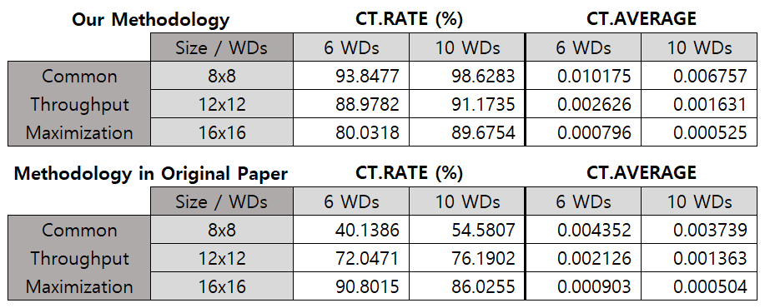
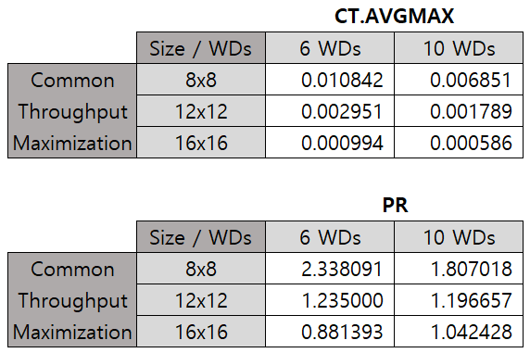
Figure 6. CT.RATE and CT.AVERAGE values of our methodology
and methodology in the original paper
Figure 7. CT.AVGMAX and PR values

Slide 11
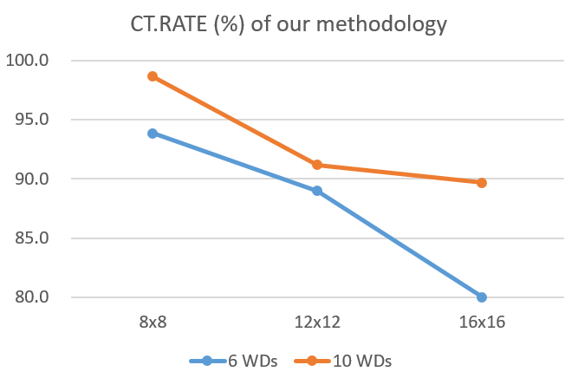
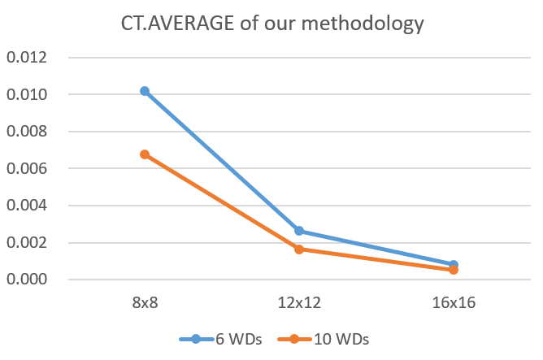
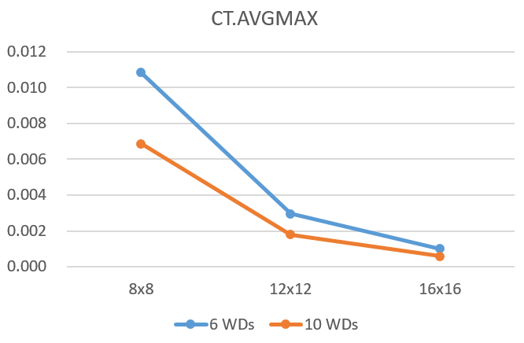
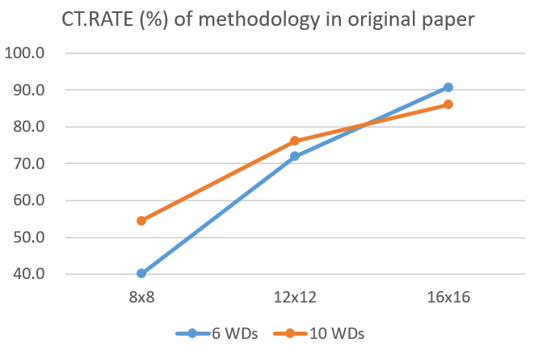
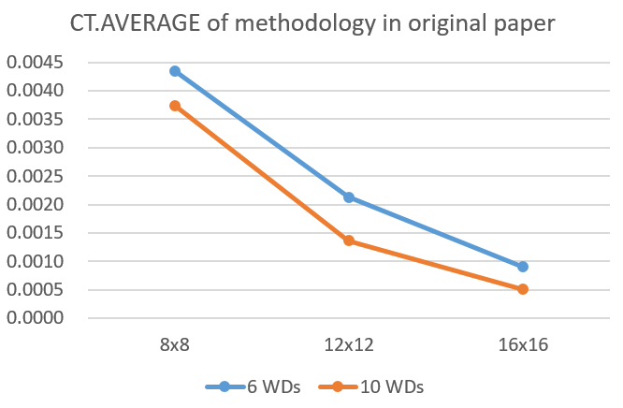
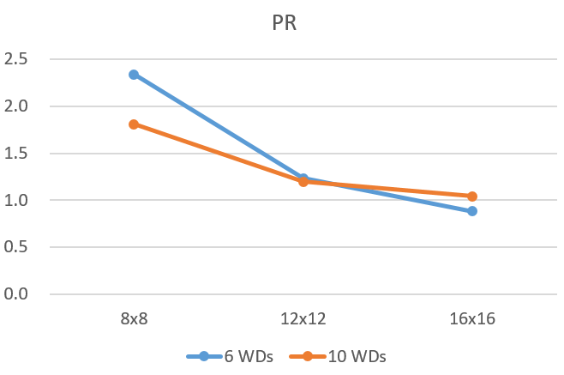
Figure 8. Line Chart Version of Figure 6 and Figure 7

Slide 12
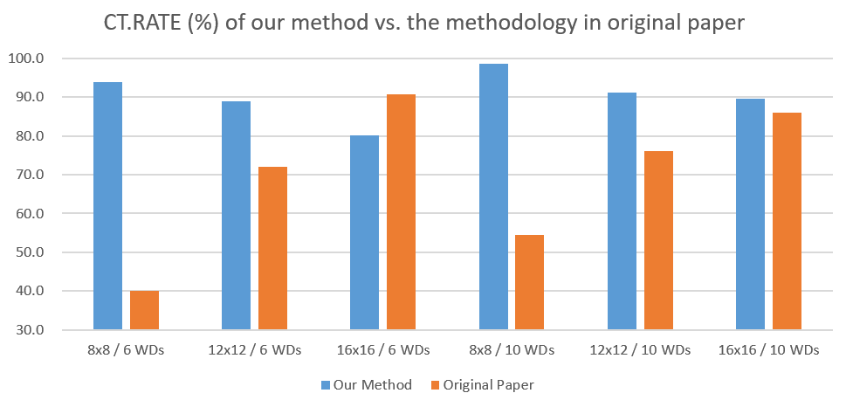
Figure 9. Comparison of CT.RATE (%) of our methodology and the methodology in original paper

Slide 13
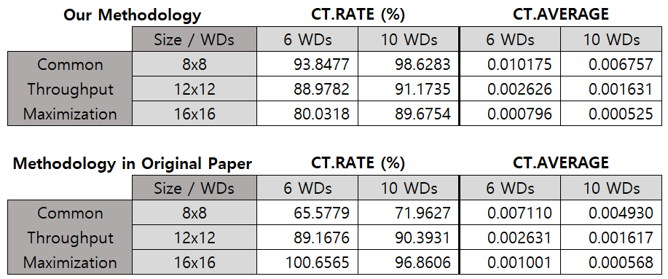
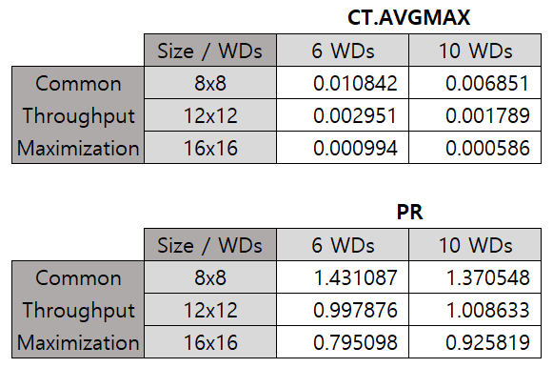
Figure 6. CT.RATE and CT.AVERAGE values of our methodology
and methodology in the original paper
Figure 7. CT.AVGMAX and PR values

Slide 14
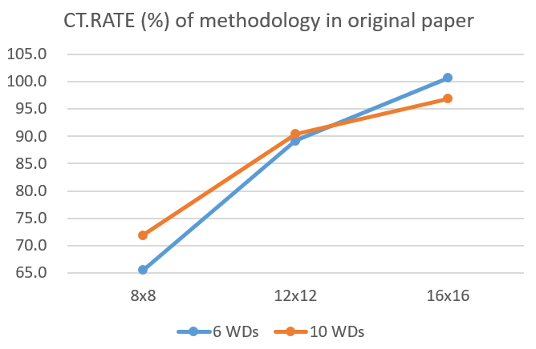
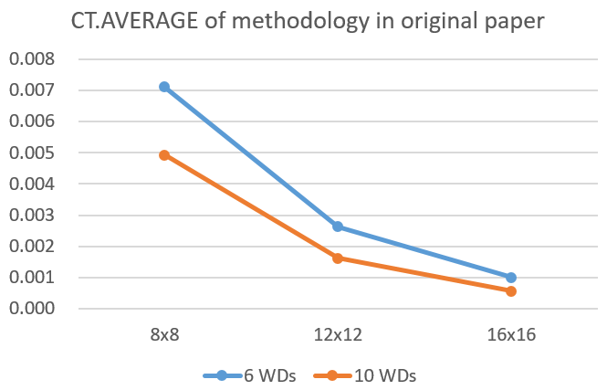
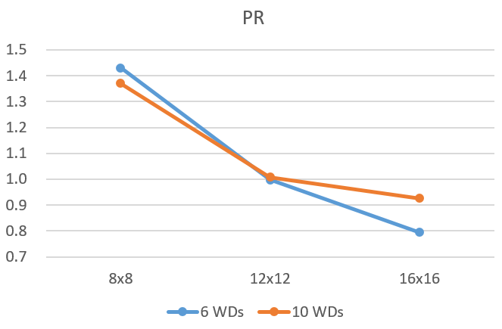
Figure 8. Line Chart Version of Figure 6 and Figure 7

Slide 15
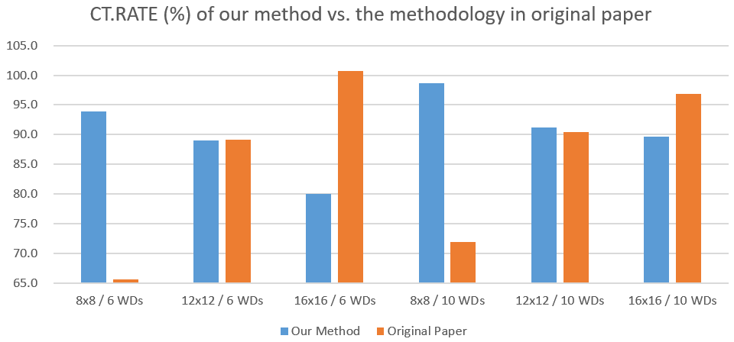
Figure 9. Comparison of CT.RATE (%) of our methodology and the methodology in original paper

Slide 16
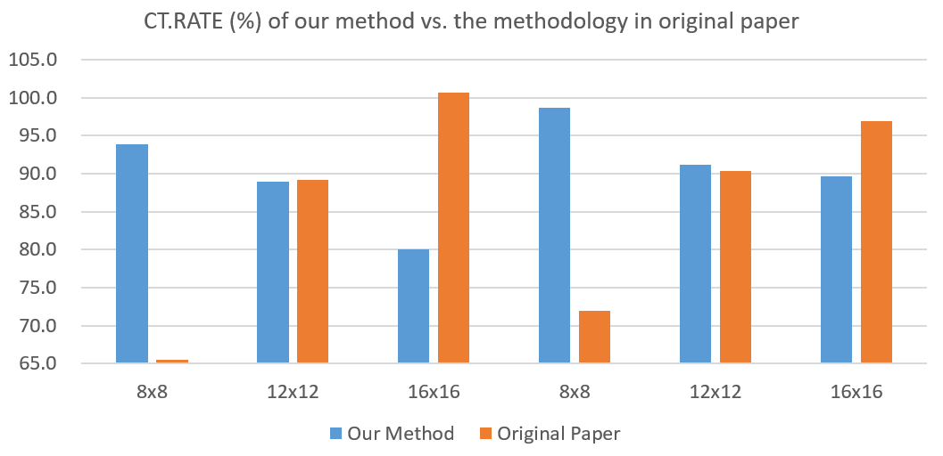
6 WDs
10 WDs
Figure 9. Comparison of CT.RATE (%) of our methodology and the methodology in original paper

Slide 17
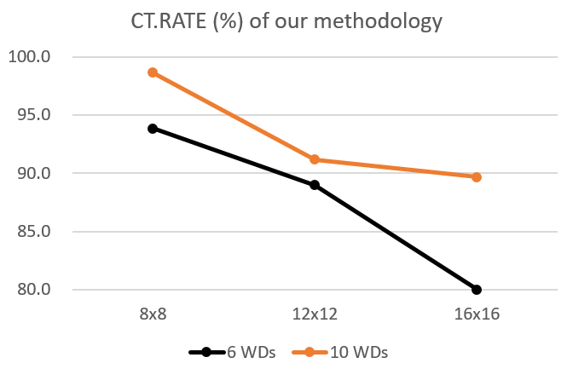
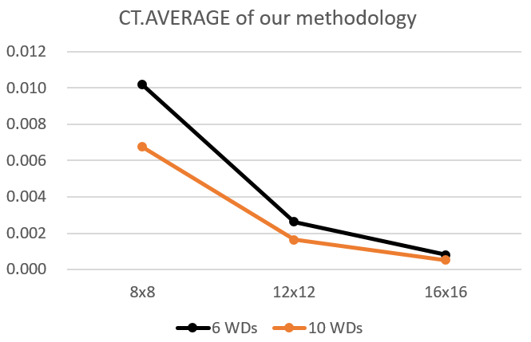
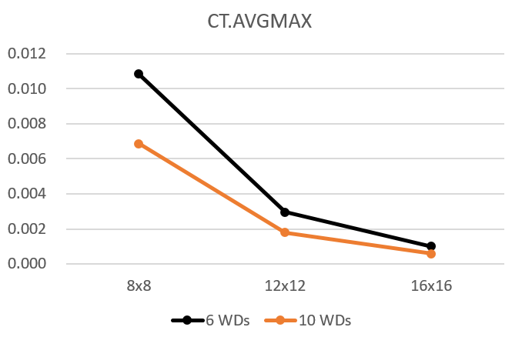
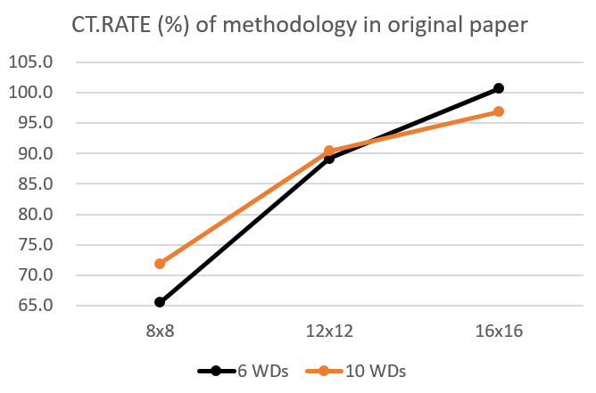
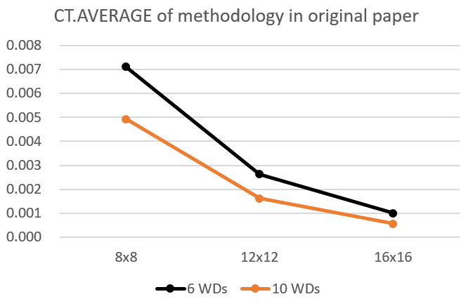
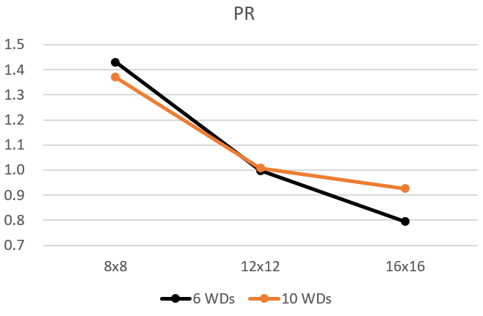
Figure 8. Line Chart Version of Figure 6 and Figure 7

Slide 18
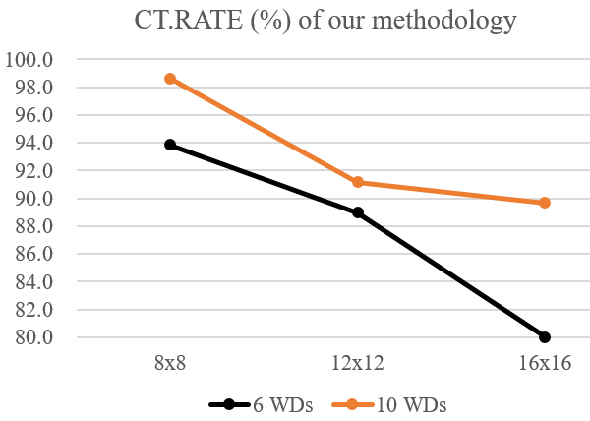
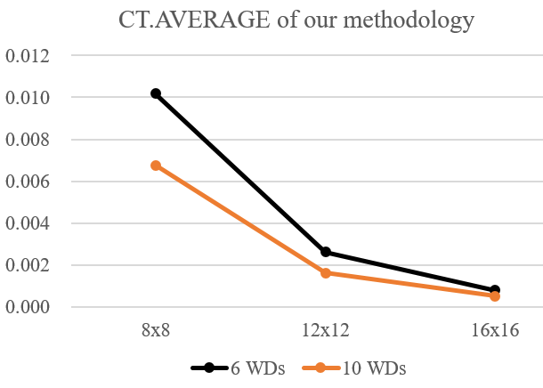
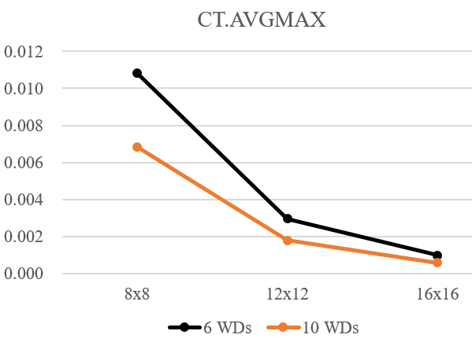
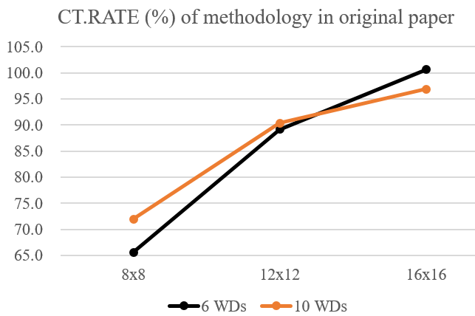
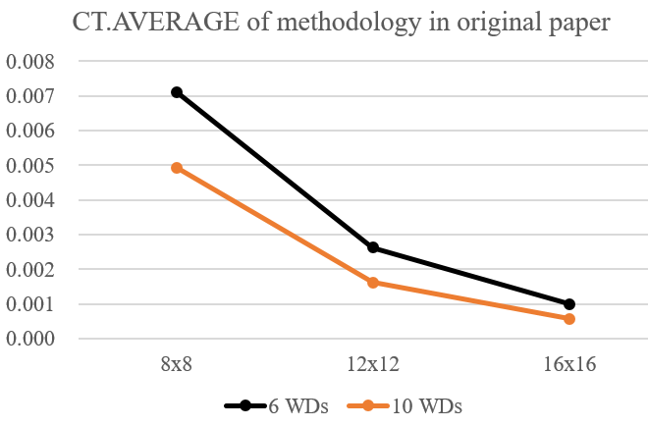
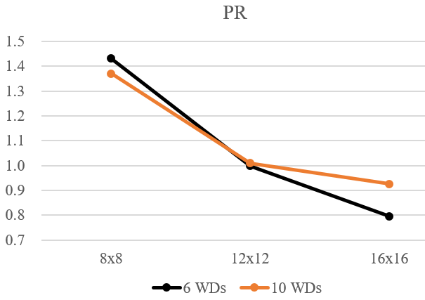
Figure 8. Line Chart Version of Figure 6 and Figure 7

Slide 19
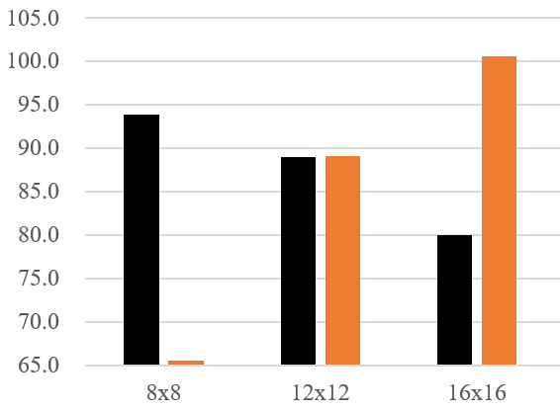
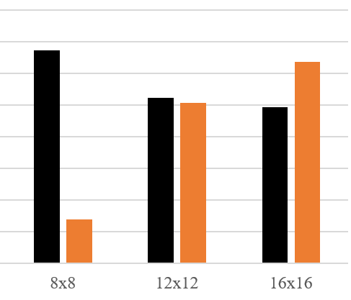
6 WDs
10 WDs
Figure 9. Comparison of CT.RATE (%) of our methodology and the methodology in original paper

Slide 20
START
1. Make WDs placement maps
5. Make Train/Test Input Data
(from WDs placement maps1)
9. Get output throughput map for Test Input Data5
2. Make throughput maps
6. Make Train Output Data
(from throughput maps2)
10. Find best throughput point in this output throughput map9
3. Read WDs placement maps1
7. Process Train Output Data6
11. Using 4 points around the point10 to process the best point
8. Train Model
Using Train Input and Output Data5,6
4. Read throughput maps2
END
Phase 1. Making data
Phase 2. Training using data
Phase 3. Finding the best point
Figure 1. Flow chart of HAP placement model

Slide 21
environment
block contains a WD
The darker,
the larger the throughput
Wireless Device
WDs placement map
Throughput Map
Mobile HAP
Best throughput point
Figure 2. The system architecture of model

Slide 22
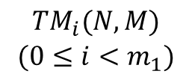
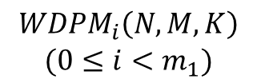
based on
based on
$$\begin{aligned}WDPM_{i}\left(N, M, K\right) \\ (0≤i<m_{1})\end{aligned}$$
$$\begin{aligned}TM_{i}(N, M) \\ (0≤i<m_{1})\end{aligned}$$
Dropout
(0.05)
Dropout
(0.05)
I
O
Input
(N*M)
(N, M) Conv2D
32, 3x3 Kernel
ReLU
MaxPooling2D
(size=2)
Conv2D
32, 3x3 Kernel
ReLU
Flatten
Dense
(40)
ReLU
Dense
(N*M)
Sigmoid
Output
Map
(N, M)
Figure 3. Architecture of Deep Learning Model for Common Throughput Maximization

Slide 23



















(The darker, The higher common throughput value)
$$m_{M}−1$$
$$m_{M}$$
$$m_{M}+1$$
$$m_{M}−1$$
$$m_{M}$$
$$m_{M}+1$$
$$m_{optimal}$$
$$n_{M}−1$$
$$V_{n_{M}−1, m_{M}}^{i′′}$$
$$n_{M}−1$$
$$V_{n_{M}−1, m_{M}}^{i′′}$$
$$n_{M}$$
$$V_{n_{M}, m_{M}−1}^{i′′}$$
$$V_{n_{M}, m_{M}}^{i′′}$$
$$V_{n_{M}, m_{M}+1}^{i′′}$$
$$n_{M}$$
$$V_{n_{M}, m_{M}−1}^{i′′}$$
$$V_{n_{M}, m_{M}}^{i′′}$$
$$V_{n_{M}, m_{M}+1}^{i′′}$$
$$n_{optimal}$$
$${BTP}_{i}\left(N, M\right)$$
$$n_{M}+1$$
$$V_{n_{M}+1, m_{M}}^{i′′}$$
$$n_{M}+1$$
$$V_{n_{M}+1, m_{M}}^{i′′}$$
Figure 4. Decision algorithm for $n_{optimal}$ and $m_{optimal}$

Slide 24
START
For each test output
throughput map
1-1. Compute throughput for the optimal HAP point of each test output throughput map
1-2. Compare the throughput1-1 with best throughput from the throughput map about test input
2. Compare the sum of throughput with sum of best throughput from the throughput map about test input
END
Figure 5. Flow chart of design of testing

