Slide 1
Weekly Report
2020.11.17
Hongsik Kim
Mobile & Network Intelligence Laboratory

Slide 2
WPCN: Paper
Analyzing Data: Deep Learning-Based Optimal Placement of a Mobile HAP for Common Throughput Maximization in Wireless Powered Communication Networks

Slide 3
Current Status
주간 진행 사항
데이터 분석: Deep Learning-Based Optimal Placement of a Mobile HAP for Common Throughput Maximization in Wireless Powered Communication Networks
논문의 detailed analysis를 작성하기 위한 준비 작업의 성격
상세 분석을 위한 재실험
재실험 결과 분석을 위한 코드 작성
재실험 결과 분석
논문 보충 방향

Slide 4
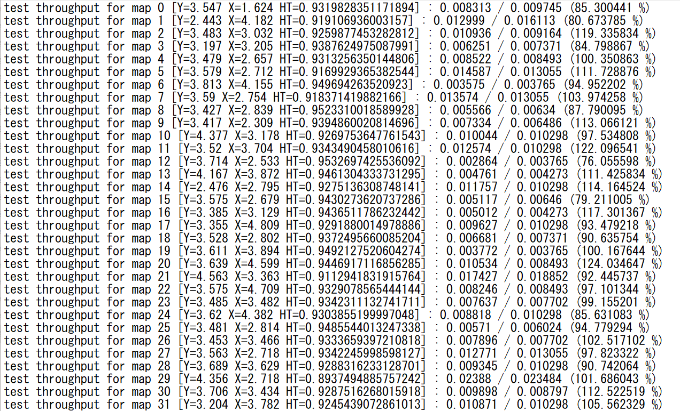
Current Status
Deep Learning-Based Optimal Placement of a Mobile HAP for Common Throughput Maximization in Wireless Powered Communication Networks
상세 분석을 위한 재실험

Slide 5
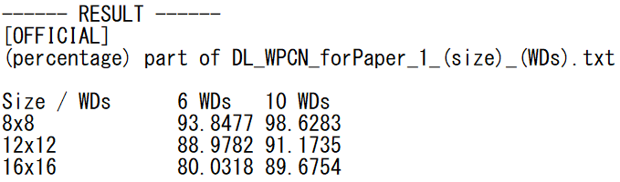
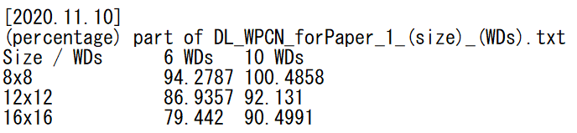
Current Status
Deep Learning-Based Optimal Placement of a Mobile HAP for Common Throughput Maximization in Wireless Powered Communication Networks
상세 분석을 위한 재실험 결과
기존
재실험

Slide 6
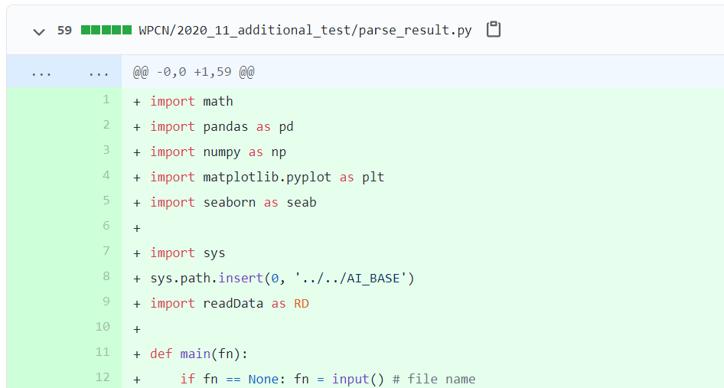
Current Status
Deep Learning-Based Optimal Placement of a Mobile HAP for Common Throughput Maximization in Wireless Powered Communication Networks
재실험 결과 분석을 위한 코드 작성

Slide 7
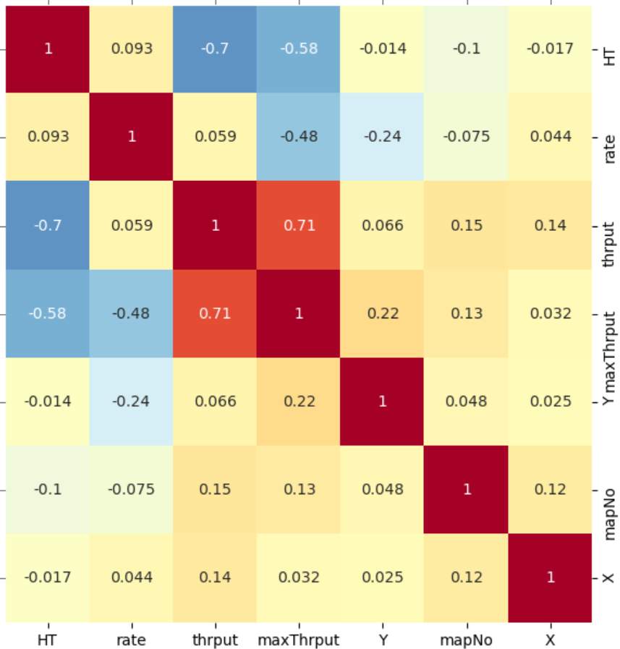
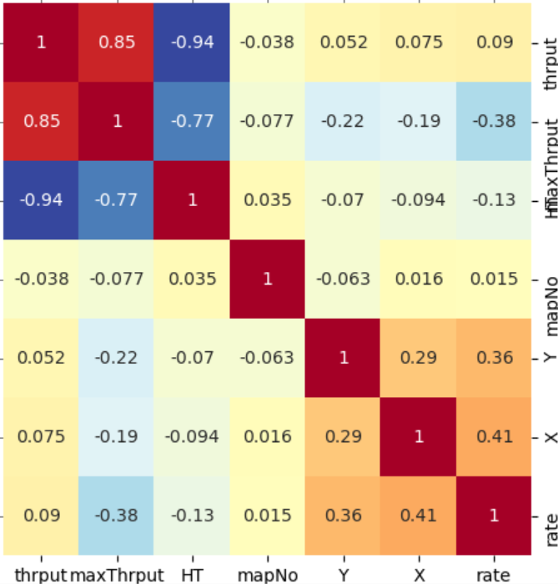
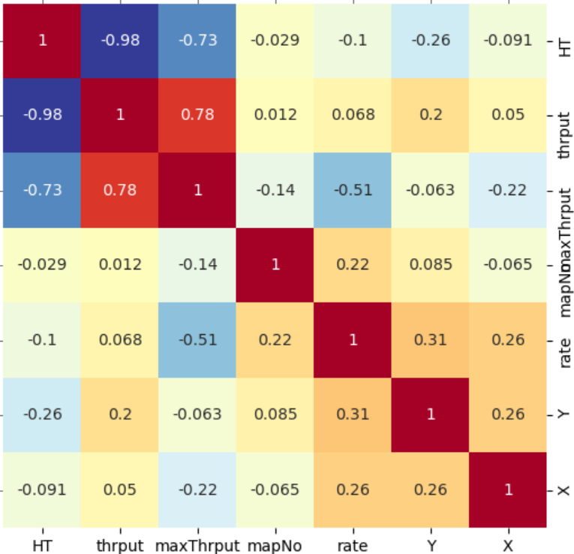
Current Status
Deep Learning-Based Optimal Placement of a Mobile HAP for Common Throughput Maximization in Wireless Powered Communication Networks
재실험 결과 분석 – Correlation Analysis (WDs=6)
 | Size=8 | Size=12 | Size=16
WDs=6

Slide 8
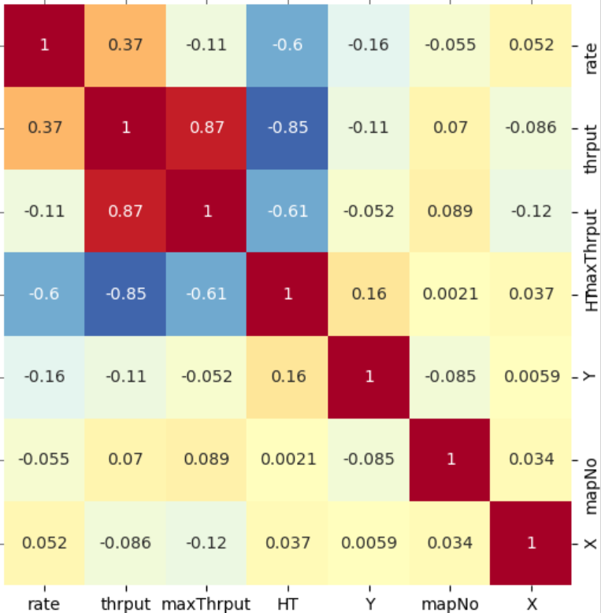
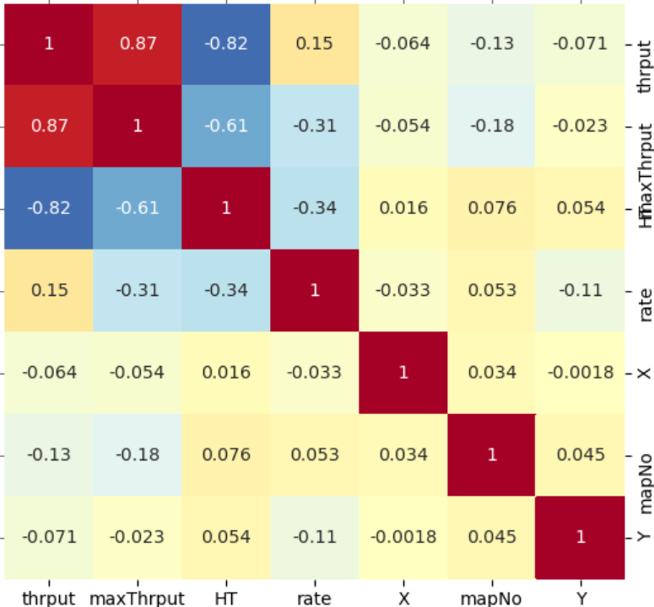
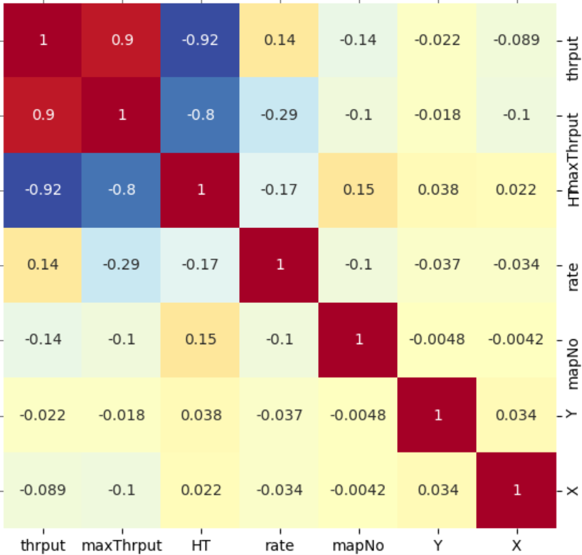
Current Status
Deep Learning-Based Optimal Placement of a Mobile HAP for Common Throughput Maximization in Wireless Powered Communication Networks
재실험 결과 분석 – Correlation Analysis (WDs=10)
 | Size=8 | Size=12 | Size=16
WDs=10

Slide 9
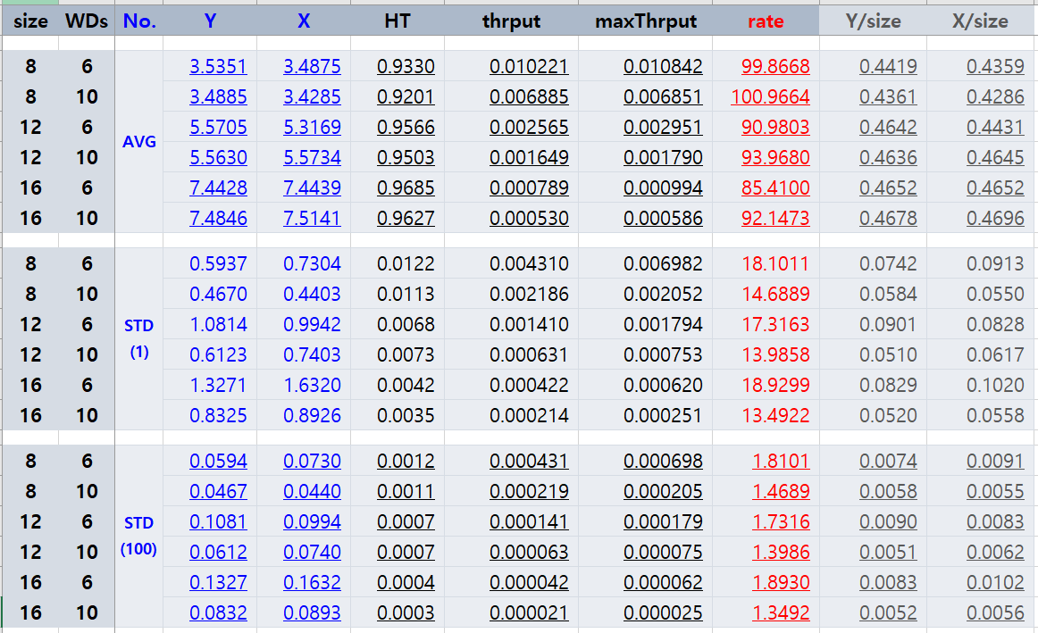
Current Status
Deep Learning-Based Optimal Placement of a Mobile HAP for Common Throughput Maximization in Wireless Powered Communication Networks
평균 및 표준편차 분석

Slide 10
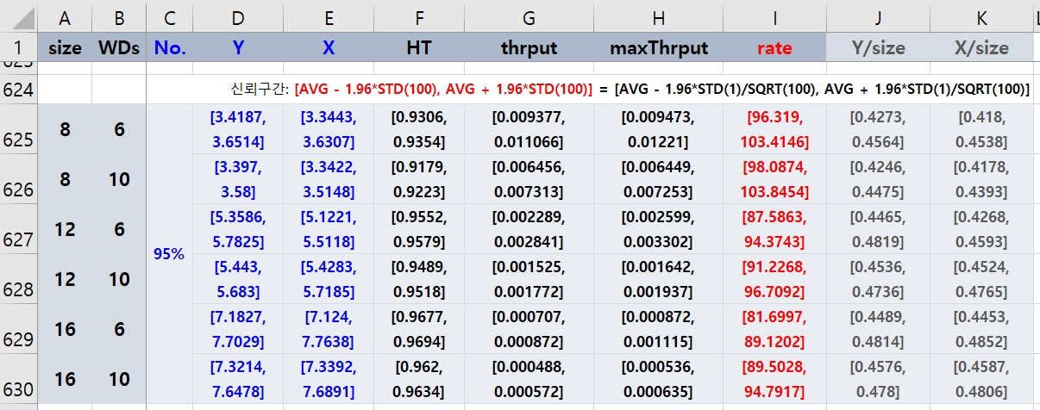
Current Status
Deep Learning-Based Optimal Placement of a Mobile HAP for Common Throughput Maximization in Wireless Powered Communication Networks
95% 신뢰구간 도출
HT, thrput, maxThrput은 모든 신뢰구간이 서로 겹치지 않음
Y/size와 X/size의 경우 신뢰구간의 일부가 겹침

Slide 11
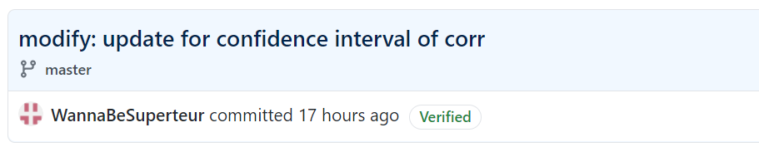
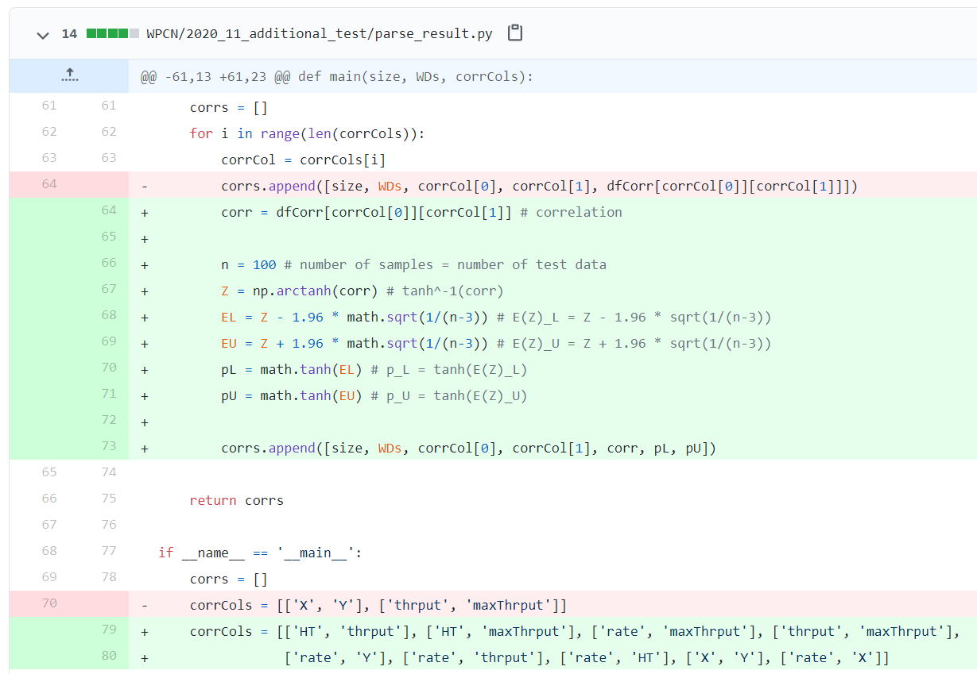
Current Status
Deep Learning-Based Optimal Placement of a Mobile HAP for Common Throughput Maximization in Wireless Powered Communication Networks
상관계수의 신뢰구간 도출을 위한 코드 작성
상관계수의 신뢰구간 도출 코드
상관계수를 알고 싶은 속성

Slide 12
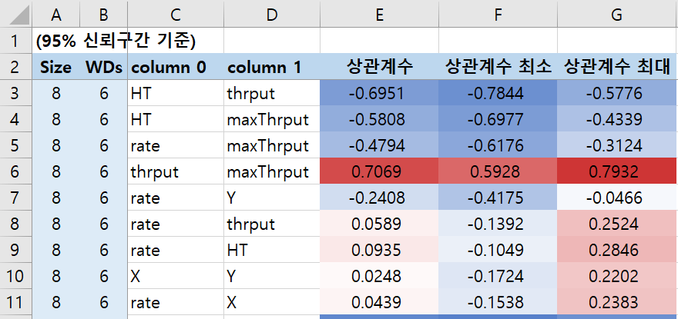
Current Status
Deep Learning-Based Optimal Placement of a Mobile HAP for Common Throughput Maximization in Wireless Powered Communication Networks
상관계수의 신뢰구간 도출

Slide 13
Current Status
Deep Learning-Based Optimal Placement of a Mobile HAP for Common Throughput Maximization in Wireless Powered Communication Networks
논문 보충 방향
기존 논문보다 성능이 낮은 12x12, 16x16 map에서도, 또는 12x12, 16x16 map 등 크기가 큰 map에서 성능이 좋은 알고리즘 적용
더 자세한 analysis를 위한 데이터 선택
더 많은 test data를 이용하여 신뢰구간의 길이를 줄이고 정확도 향상
XAI를 이용하여 (Size=12, WDs=6, No.=3) 데이터 해석

Slide 14
Github
https://github.com/WannaBeSuperteur/2020/tree/master/WPCN

