Slide 1
Weekly Report
2020.10.20
Hongsik Kim
Mobile & Network Intelligence Laboratory

Slide 2
WPCN: Paper
Implementation: Minimum Throughput Maximization for Multi-UAV Enabled WPCN: A Deep Reinforcement Learning Method
Reformatting Paper: Deep Learning-Based Optimal Placement of a Mobile HAP for Common Throughput Maximization in Wireless Powered Communication Networks

Slide 3
Current Status
주간 진행 사항
논문 구현: Minimum Throughput Maximization for Multi-UAV Enabled WPCN: A Deep Reinforcement Learning Method
Device와 UAV, cluster에 대한 이해
각종 함수 추가
리포맷: Deep Learning-Based Optimal Placement of a Mobile HAP for Common Throughput Maximization in Wireless Powered Communication Networks
IEEE Transaction 포맷 이용
LaTeX용 알고리즘 서식 이용

Slide 4
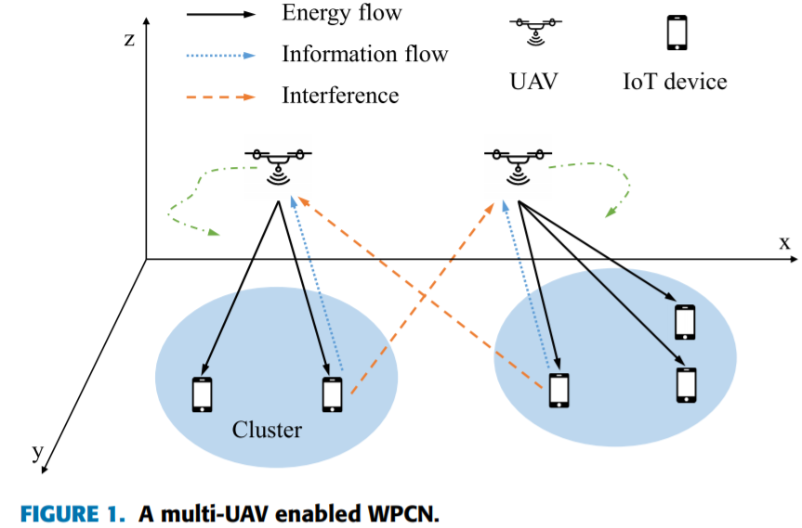
Current Status
논문 구현: Minimum Throughput Maximization for Multi-UAV Enabled WPCN: A Deep Reinforcement Learning Method
Device와 UAV, cluster에 대한 이해
1 UAV = 1 Cluster
1 Cluster = some IoT Devices

Slide 5
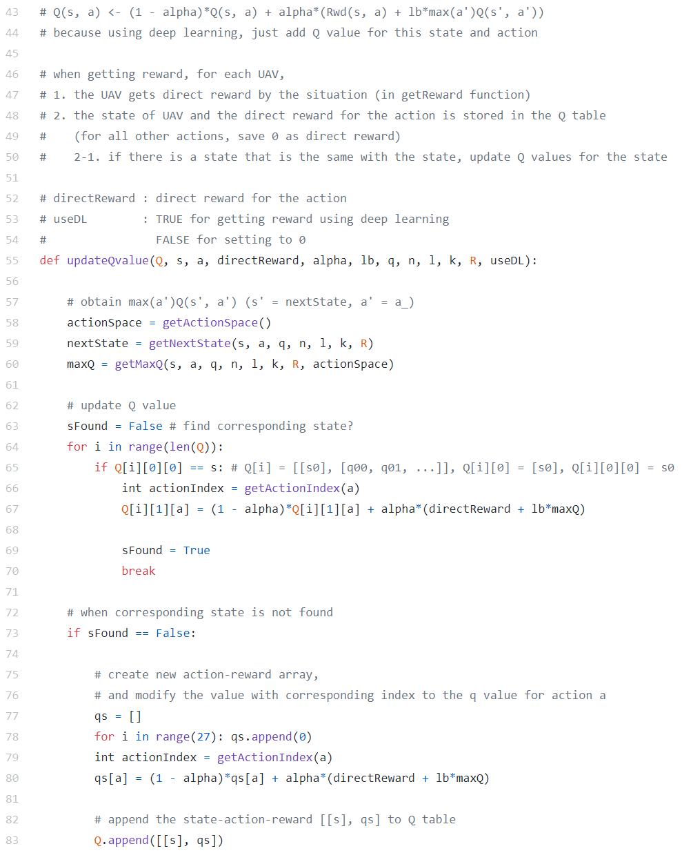
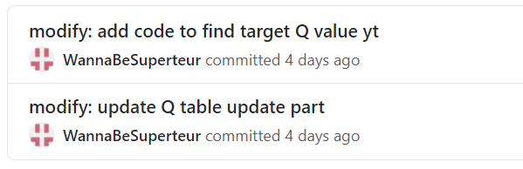
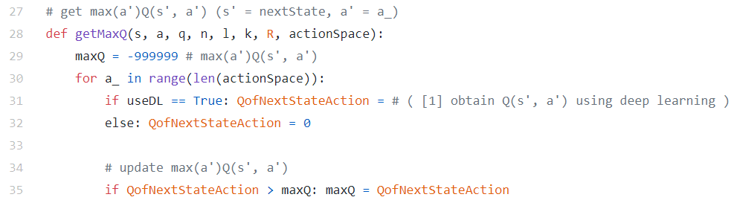
Current Status
논문 구현: Minimum Throughput Maximization for Multi-UAV Enabled WPCN: A Deep Reinforcement Learning Method
각종 함수 추가 – Q Table Update

Slide 6
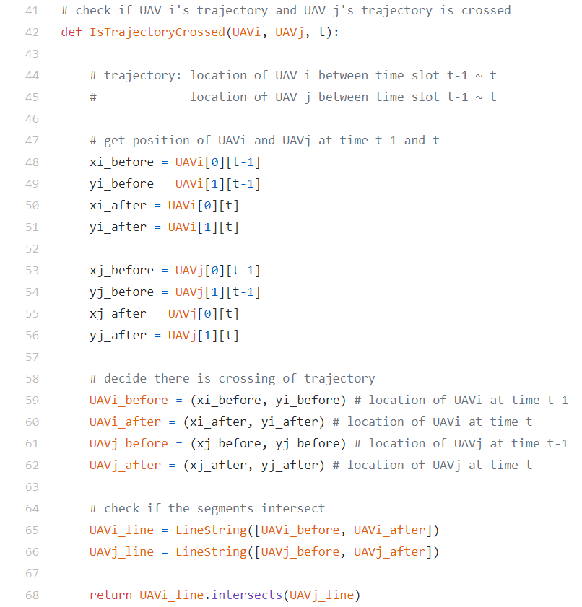
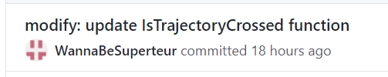
Current Status
논문 구현: Minimum Throughput Maximization for Multi-UAV Enabled WPCN: A Deep Reinforcement Learning Method
각종 함수 추가 – Check if trajectory is crossed
Time t
Time t
Time t-1
UAV A
UAV B
Time t-1

Slide 7
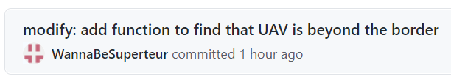
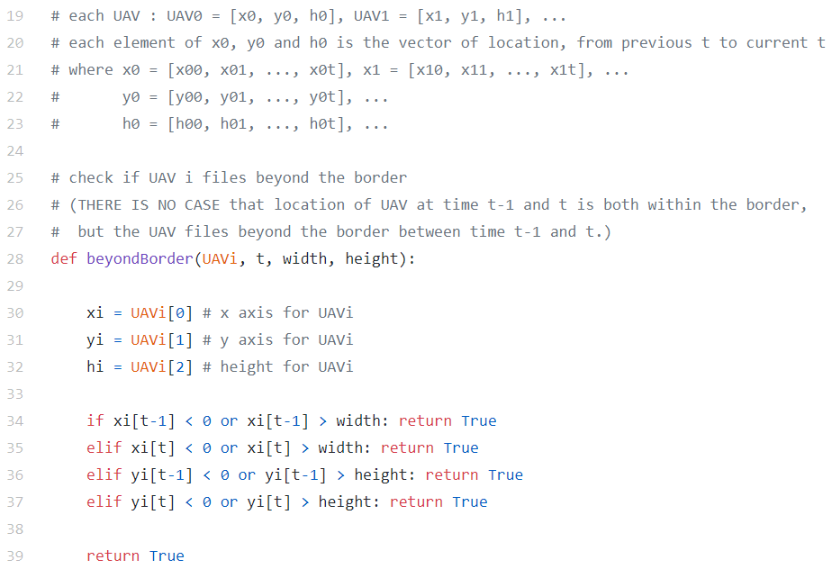
Current Status
논문 구현: Minimum Throughput Maximization for Multi-UAV Enabled WPCN: A Deep Reinforcement Learning Method
각종 함수 추가 – Check if UAV is beyond the border
Time t
border
Time t-1
UAV A

Slide 8
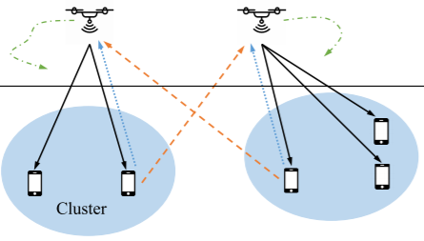
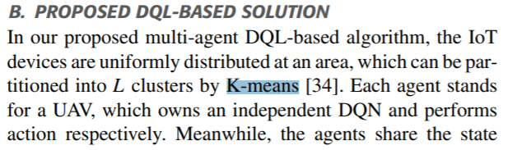
Current Status
논문 구현: Minimum Throughput Maximization for Multi-UAV Enabled WPCN: A Deep Reinforcement Learning Method
각종 함수 추가 – K-means Clustering을 위한 함수 작성 중
1 UAV = 1 Cluster
Each cluster contains some devices

Slide 9
Current Status
리포맷: Deep Learning-Based Optimal Placement of a Mobile HAP for Common Throughput Maximization in Wireless Powered Communication Networks
IEEE 형식으로 지정

Slide 10
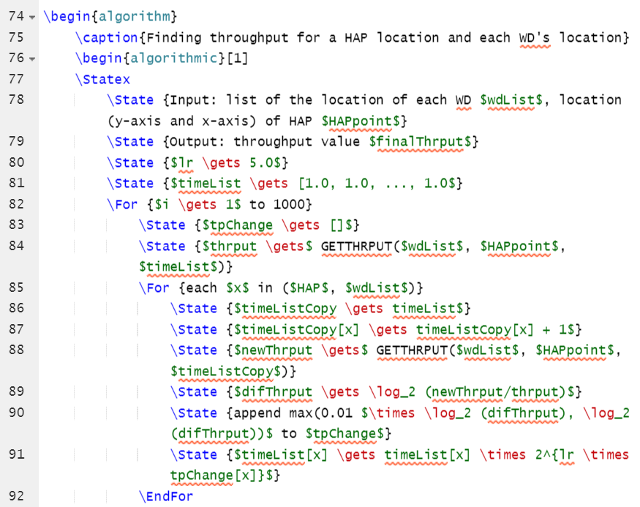
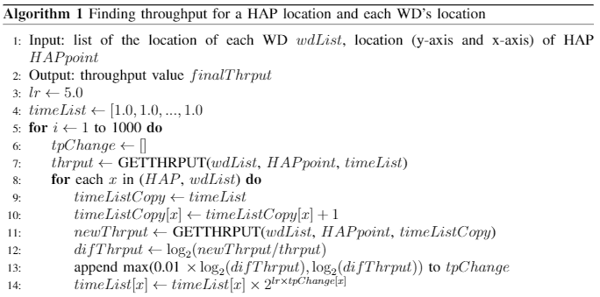
Current Status
리포맷: Deep Learning-Based Optimal Placement of a Mobile HAP for Common Throughput Maximization in Wireless Powered Communication Networks
LaTeX용 알고리즘 서식 이용

Slide 11
Github
https://github.com/WannaBeSuperteur/2020/tree/master/WPCN

