Slide 1
Weekly Report
2020.06.16
Hongsik Kim
Mobile & Network Intelligence Laboratory

Slide 2
WPCN: Paper
Placement Optimization of Energy and Information Access Points in Wireless Powered Communication Networks Suzhi Bi, Member, IEEE and Rui Zhang, Senior Member, IEEE 개선 논문 작성을 위한 준비

Slide 3
Current Status
주간 진행 사항
Placement Optimization of Energy and Information Access Points in Wireless Powered Communication Networks 개선 논문 작성을 위한 준비
Throughput map (Optimization Info) 추가 생성
딥러닝을 적용한 방법으로 실험 추가 진행
기존 논문에 나타난 방법으로 실험 진행
Sum/Common Throughput의 평균값 확인
Throughput map의 visualization

Slide 4
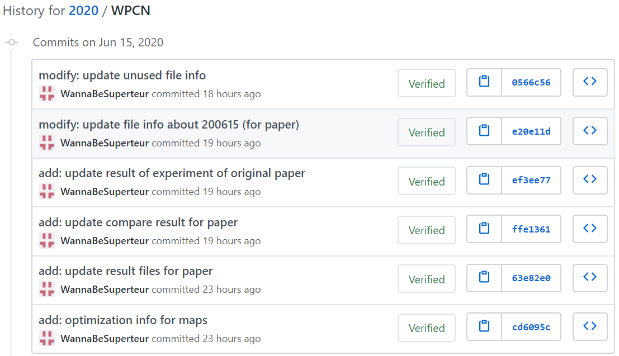
Current Status
주간 진행 사항

Slide 5
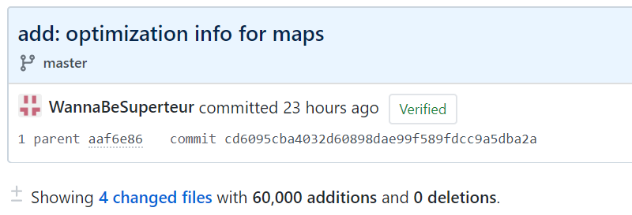
Current Status
Throughput map (Optimization Info) 추가 생성
optiInfoForMap/optiInfoForMap_1_forPaper_12_10.txt
optiInfoForMap/optiInfoForMap_1_forPaper_12_6.txt
optiInfoForMap/optiInfoForMap_1_forPaper_16_10.txt
optiInfoForMap/optiInfoForMap_1_forPaper_16_6.txt

Slide 6
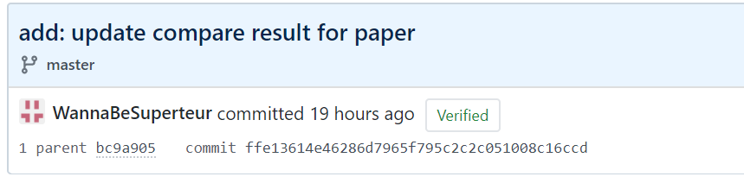
Current Status
Sum/Common Throughput의 평균값 확인
(avg test 기준) | Sum Throughput Maximization | Common Throughput Maximization
8x8, 6 wds | 1.249283 | 0.010842
8x8, 10 wds | 1.404146 | 0.006851
12x12, 6 wds | 1.099549 | 0.002951
12x12, 10 wds | 1.243424 | 0.001789
16x16, 6 wds | 0.990829 | 0.000994
16x16, 10 wds | 1.174157 | 0.000586

Slide 7
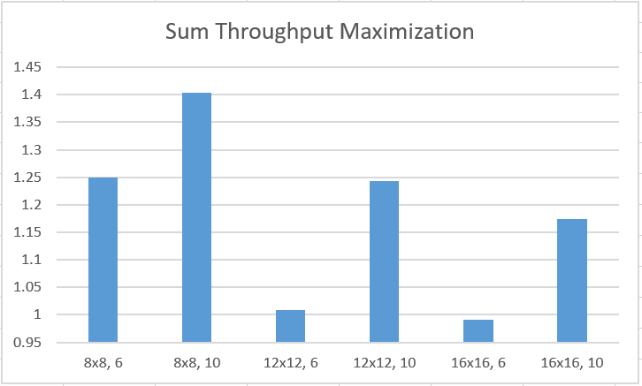
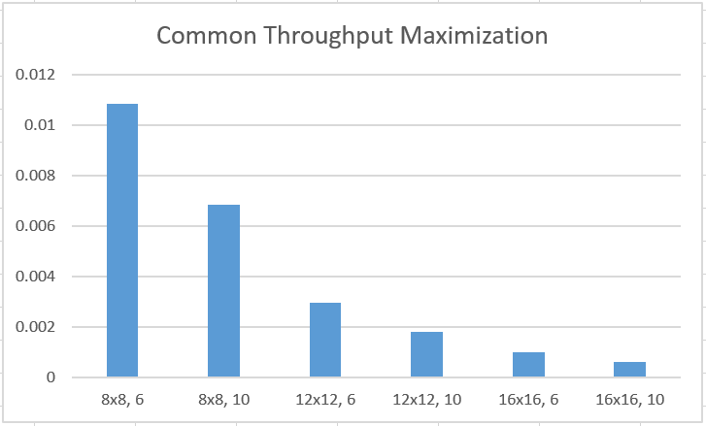
Current Status
Sum/Common Throughput의 평균값 확인

Slide 8
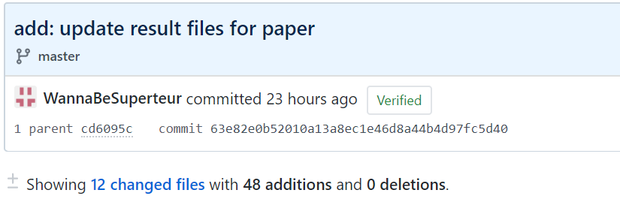
Current Status
딥러닝을 적용한 방법으로 추가 실험 진행
 | Sum Throughput Maximization | Common Throughput Maximization
8x8, 6 wds | 93.4160% (1.1670) | 93.8477% (0.010175)
8x8, 10 wds | 92.9900% (1.3057) | 98.6283% (0.006757)
12x12, 6 wds | 91.0936% (0.9196) | 88.9782% (0.002626)
12x12, 10 wds | 92.6367% (1.1519) | 91.1735% (0.001631)
16x16, 6 wds | 85.0531% (0.8427) | 80.0318% (0.000796)
16x16, 10 wds | 85.5824% (1.0049) | 89.6754% (0.000525)

Slide 9
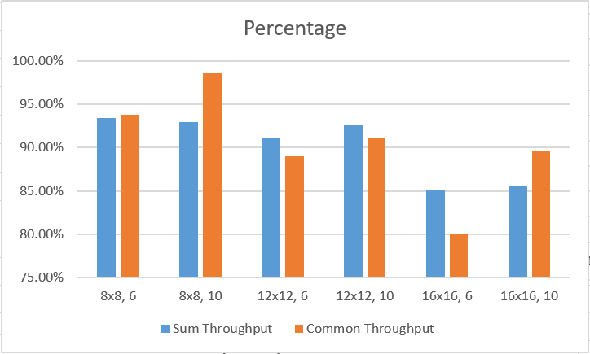
Current Status
딥러닝을 적용한 방법으로 추가 실험 진행

Slide 10
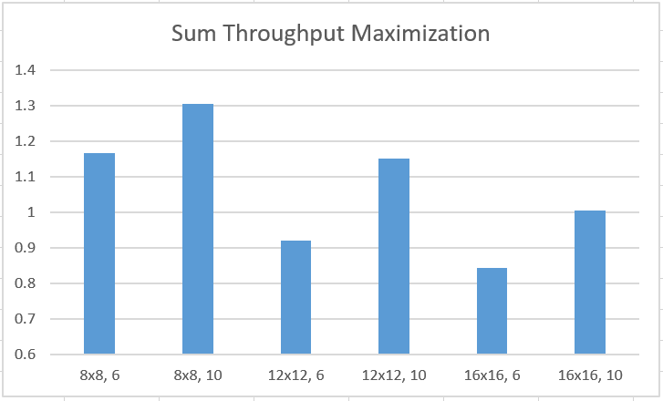
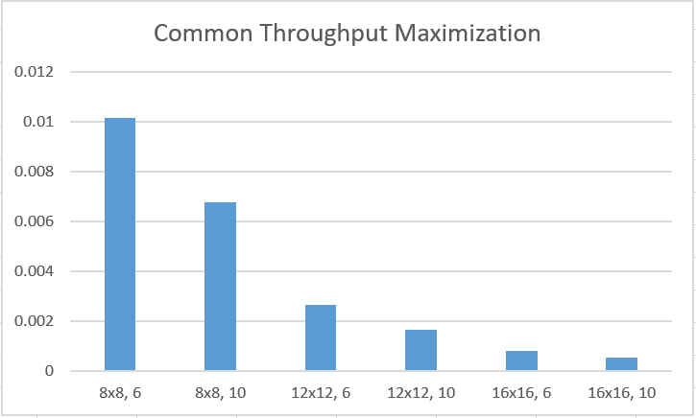
Current Status
딥러닝을 적용한 방법으로 추가 실험 진행

Slide 11
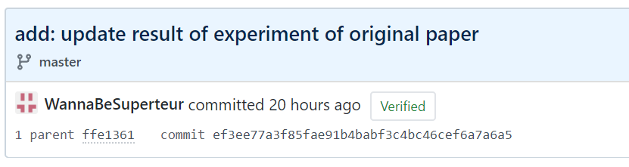
Current Status
기존 논문에 나타난 방법으로 실험 진행
 | Sum Throughput Maximization | Common Throughput Maximization
8x8, 6 wds | 46.1911% (0.5771) | 40.1386% (0.004352)
8x8, 10 wds | 51.6572% (0.7253) | 54.5807% (0.003739)
12x12, 6 wds | 24.1358% (0.2437) | 72.0471% (0.002126)
12x12, 10 wds | 36.1300% (0.4492) | 76.1902% (0.001363)
16x16, 6 wds | 15.4400% (0.1530) | 90.8015% (0.000903)
16x16, 10 wds | 23.6149% (0.2773) | 86.0255% (0.000504)

Slide 12
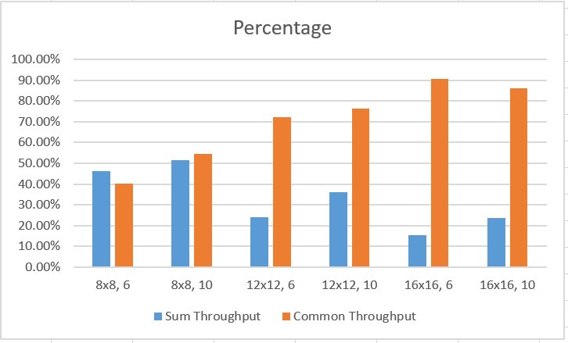
Current Status
기존 논문에 나타난 방법으로 실험 진행

Slide 13
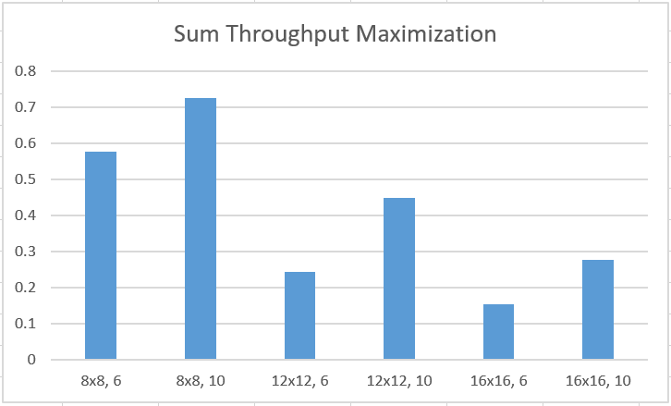
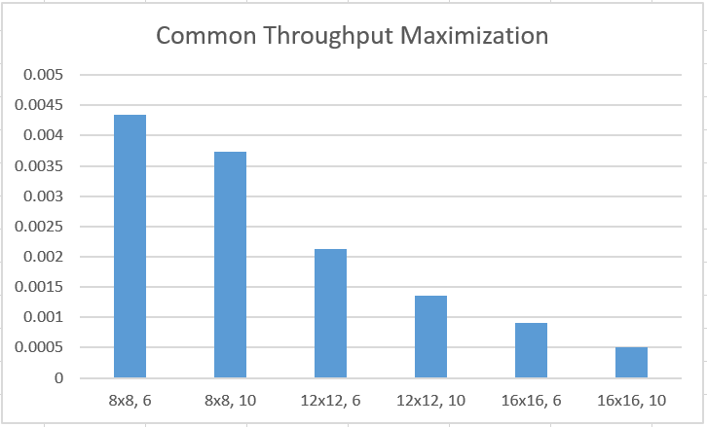
Current Status
기존 논문에 나타난 방법으로 실험 진행

Slide 14
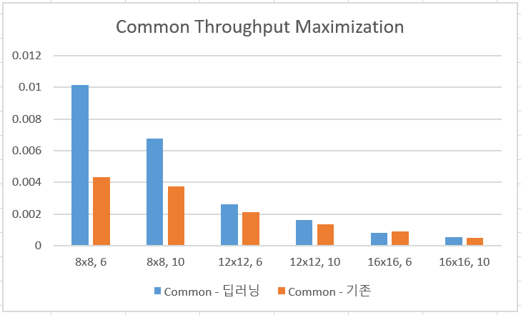
Current Status
딥러닝 적용 vs 기존 논문
Common Throughput Maximization에 대해서만 진행

Slide 15
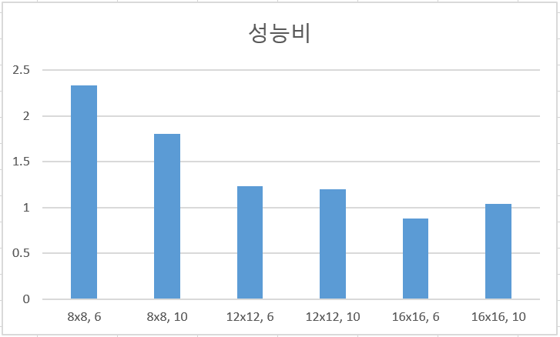
Current Status
딥러닝 적용 vs 기존 논문
Common Throughput Maximization에 대해서만 진행
성능비: 딥러닝 throughput / 기존 논문 throughput

Slide 16
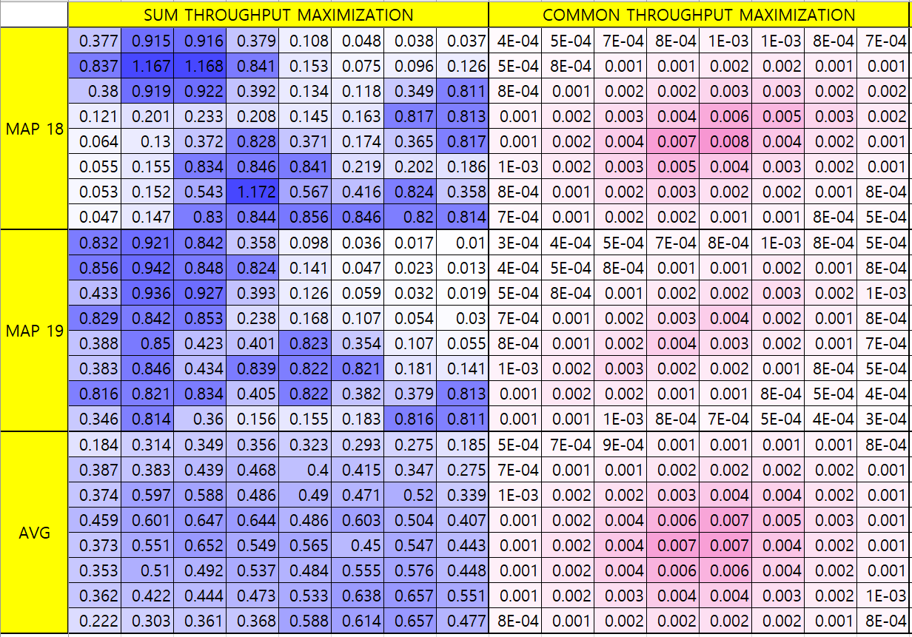
Current Status
Throughput map의 visualization
8x8 size, 6 wireless devices (1.1670 / 0.010175)

Slide 17
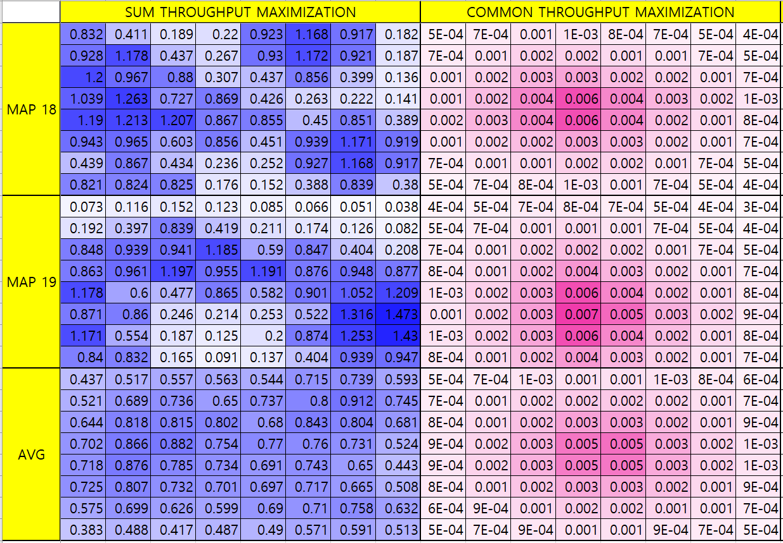
Current Status
Throughput map의 visualization
8x8 size, 10 wireless devices (1.3057 / 0.006757)

Slide 18
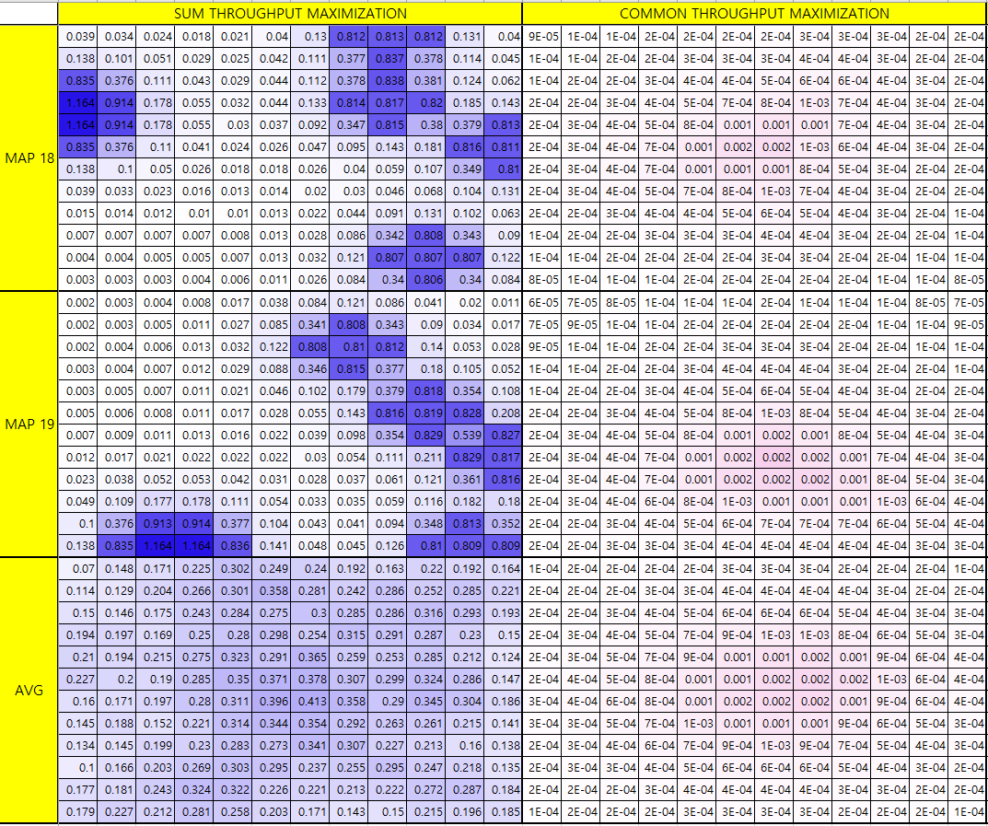
Current Status
Throughput map의 visualization
12x12 size, 6 wireless devices (0.9196 / 0.002626)

Slide 19
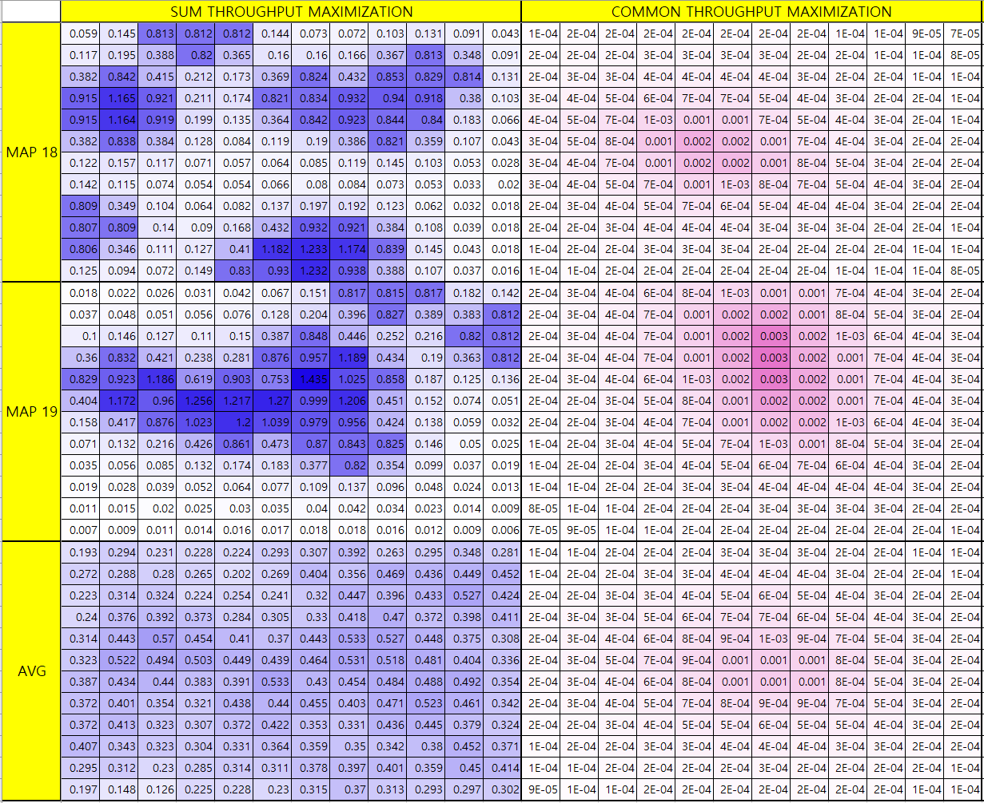
Current Status
Throughput map의 visualization
12x12 size, 10 wireless devices (1.1519 / 0.001631)

Slide 20
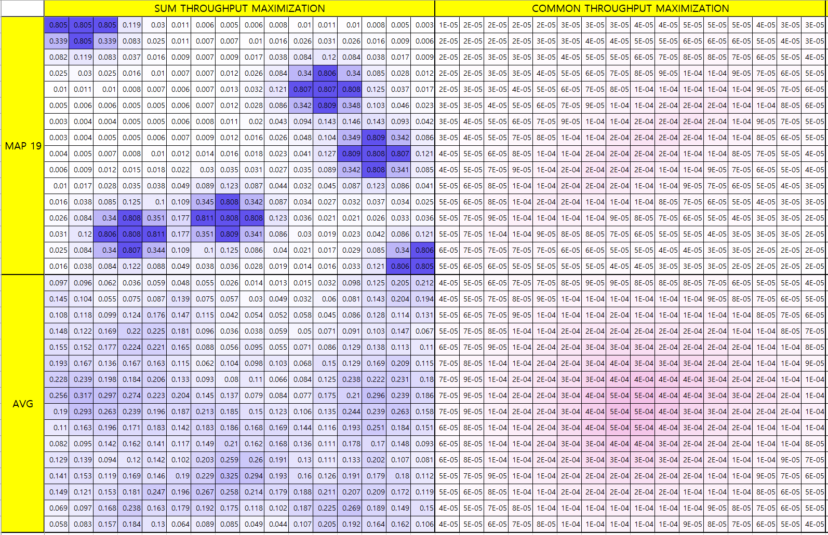
Current Status
Throughput map의 visualization
16x16 size, 6 wireless devices (0.8427 / 0.000796)

Slide 21
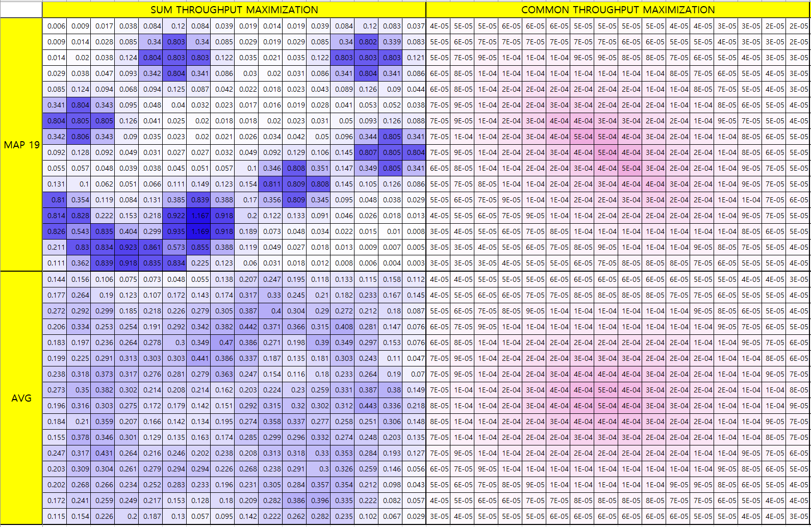
Current Status
Throughput map의 visualization
16x16 size, 10 wireless devices (1.0049 / 0.000525)

Slide 22
Github
https://github.com/WannaBeSuperteur/2020/tree/master/WPCN

