Slide 1
Weekly Report
2020.09.08
Hongsik Kim
Mobile & Network Intelligence Laboratory

Slide 2
WPCN: Implementation of UAV
UAV-Aided Wireless Powered Communication Networks: Trajectory Optimization and Resource Allocation for Minimum Throughput Maximization 논문 구현

Slide 3
Current Status
주간 진행 사항
UAV-Aided Wireless Powered Communication Networks: Trajectory Optimization and Resource Allocation for Minimum Throughput Maximization 논문 구현

Slide 4
Current Status
UAV-Aided Wireless Powered Communication Networks: Trajectory Optimization and Resource Allocation for Minimum Throughput Maximization 논문 구현
https://ieeexplore.ieee.org/stamp/stamp.jsp?tp=&arnumber=8836548

Slide 5
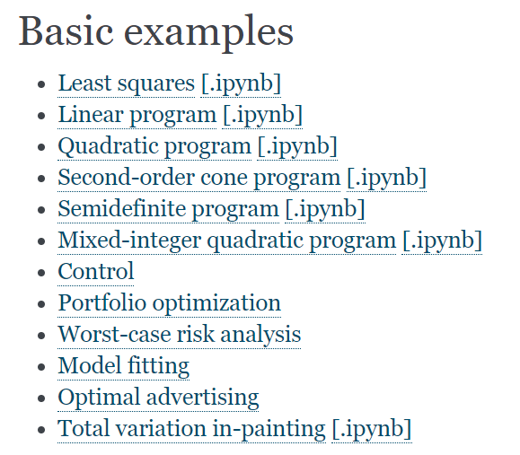
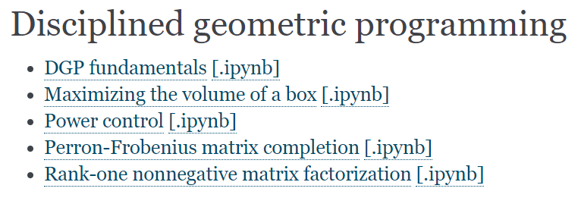
UAV-Aided Wireless Powered Communication Networks
CVX 알고리즘(Python)에 대한 Examples 학습
https://www.cvxpy.org/examples/index.html#basic

Slide 6

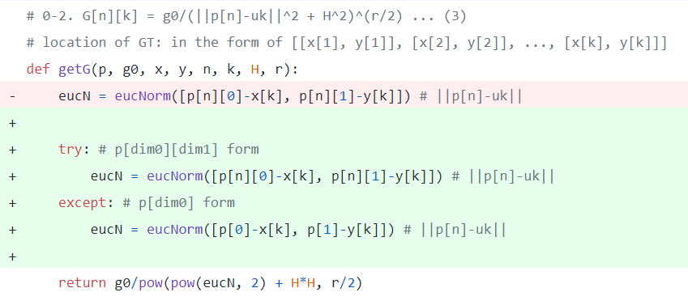
UAV-Aided Wireless Powered Communication Networks
함수 실행 시 Specific Value에 대해서만 검사
p가 [[. .] [. .] …] 형식일 때
p가 [. .] 형식일 때

Slide 7
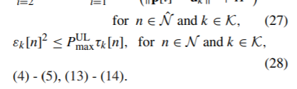
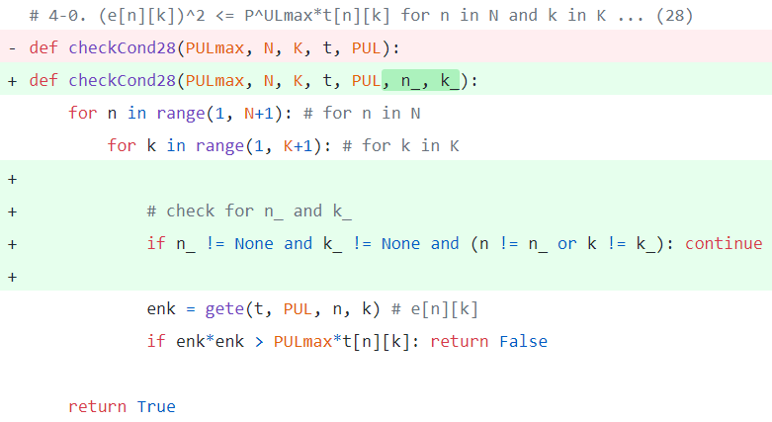
UAV-Aided Wireless Powered Communication Networks
함수 실행 시 Specific Value에 대해서만 검사
n, k의 값이 정해져 있다면
일치하지 않는 값이면 건너뛰기

Slide 8


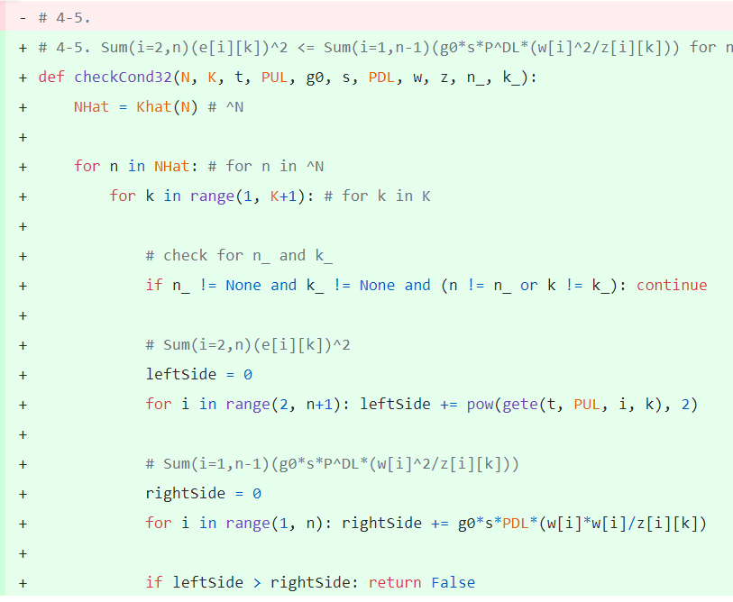
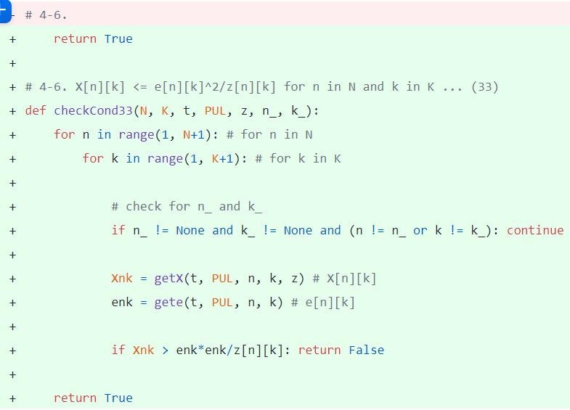
UAV-Aided Wireless Powered Communication Networks
조건 32, 조건 33 추가

Slide 9
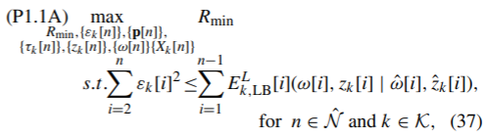
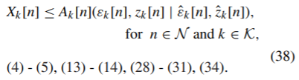
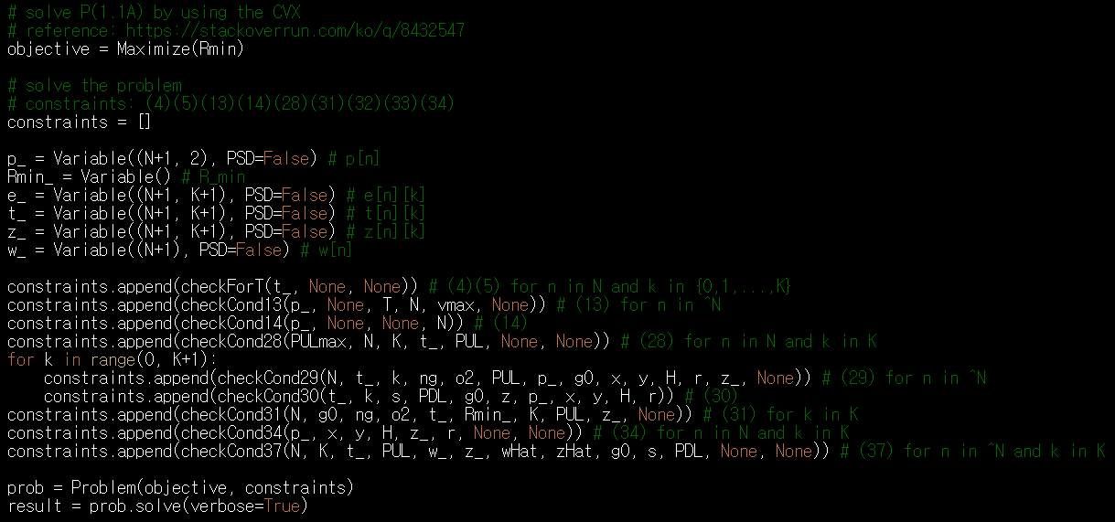
UAV-Aided Wireless Powered Communication Networks
Solving P1.1A by using the CVX

Slide 10
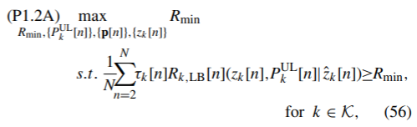
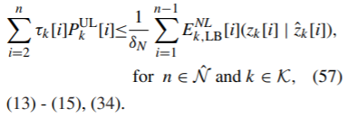
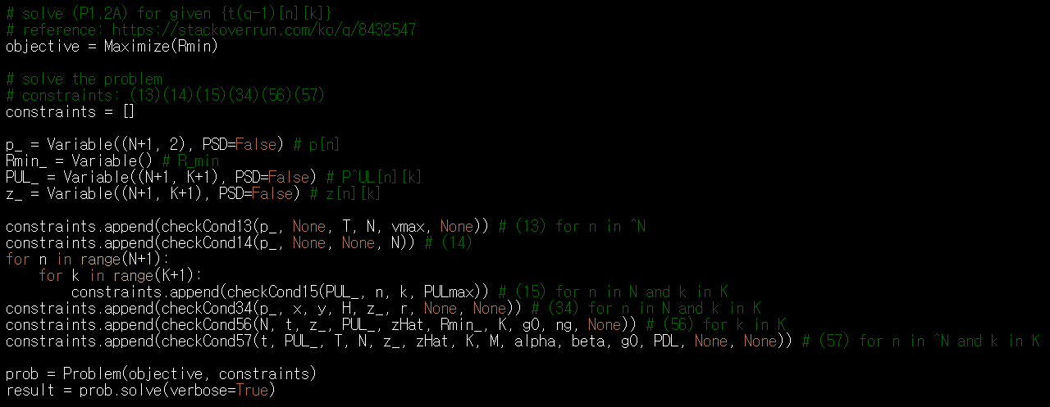
UAV-Aided Wireless Powered Communication Networks
Solving P1.2A

Slide 11

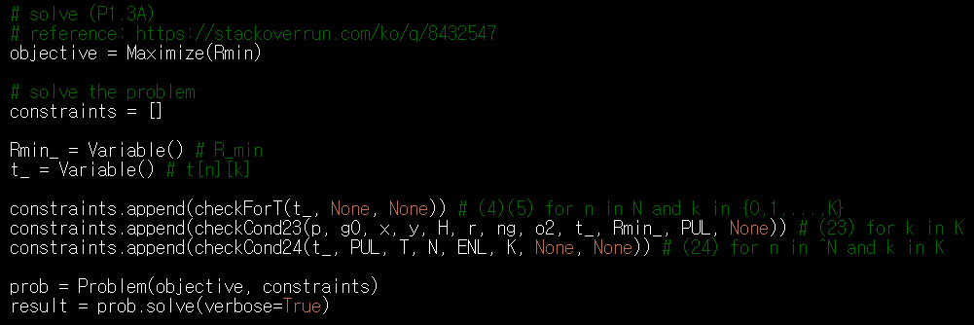
UAV-Aided Wireless Powered Communication Networks
Solving P1.3 (Time Resource Allocation)

Slide 12
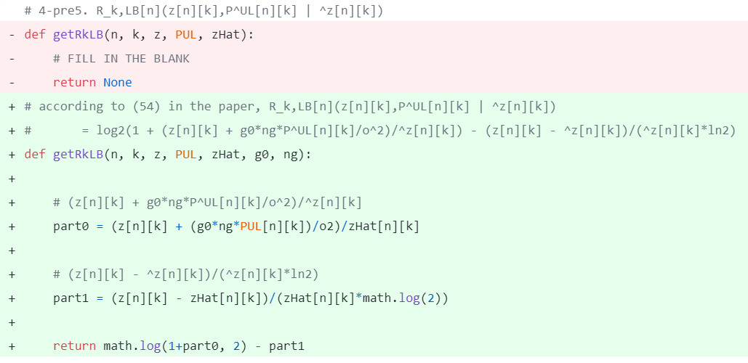
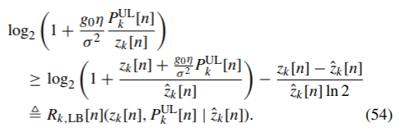
UAV-Aided Wireless Powered Communication Networks
getRkLB 함수

Slide 13
Github
https://github.com/WannaBeSuperteur/2020/tree/master/WPCN

