Slide 1
Weekly Report
2020.08.14
Hongsik Kim
Mobile & Network Intelligence Laboratory

Slide 2
AI Explanable AI
Kaggle 진행 상황
논문: Opportunities and Challenges in Explainable Artificial Intelligence (XAI): A Survey

Slide 3
Current Status
주간 진행 사항
Kaggle 진행
Santa 2019: Revenge of the Accountants 제출
Random Acts of Pizza 시작
XAI 관련 논문
Opportunities and Challenges in Explainable Artificial Intelligence (XAI): A Survey

Slide 4
Kaggle Competition
Santa 2019: Revenge of the Accountants
최적화 문제
https://www.kaggle.com/c/santa-2019-revenge-of-the-accountants
Random Acts of Pizza
https://www.kaggle.com/c/random-acts-of-pizza

Slide 5
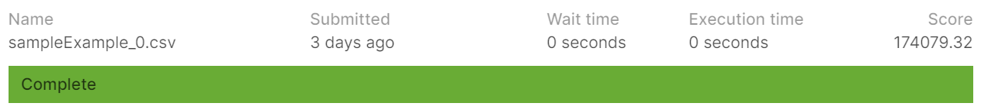
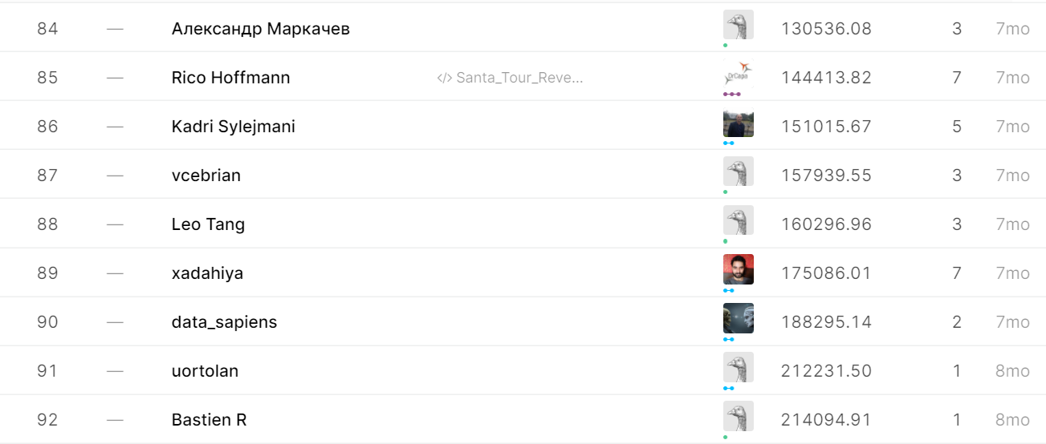
Kaggle Competition
Santa 2019: Revenge of the Accountants

Slide 6
Kaggle Competition
Random Acts of Pizza 접근 전략
Pandas 등 외부 라이브러리 적극 활용
Notebook, Discussion 적극 활용
다양한 데이터 분석 방법을 이용하여 attribute preprocessing 시도
Column 간 co-occurrence 분석을 이용한 차원 축소
Decision Tree / Random Forest
Naïve Bayes Model
Overfitting을 방지하기 위해 랜덤하게 노이즈 삽입
“다양한 데이터를 다루면서 통찰력을 얻는다.”

Slide 7
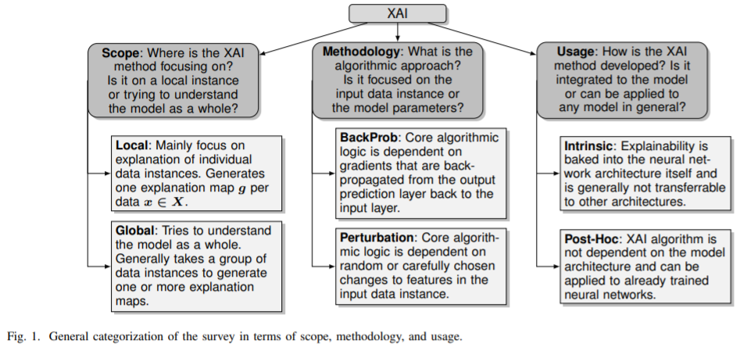
Paper: Opportunities and Challenges in Explainable Artificial Intelligence (XAI): A Survey

Slide 8
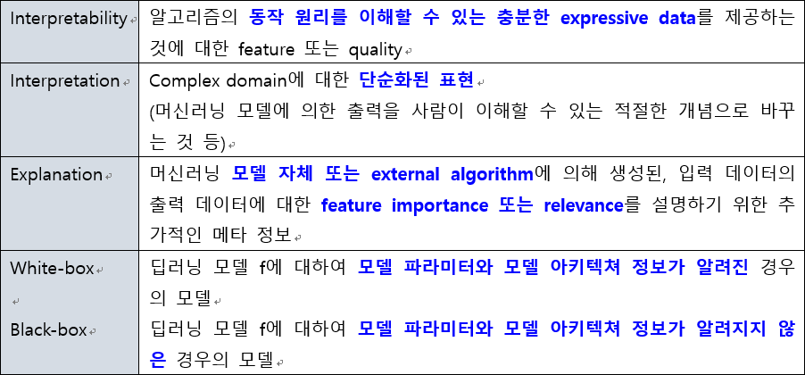
Paper: Opportunities and Challenges in Explainable Artificial Intelligence (XAI): A Survey
Definitions

Slide 9
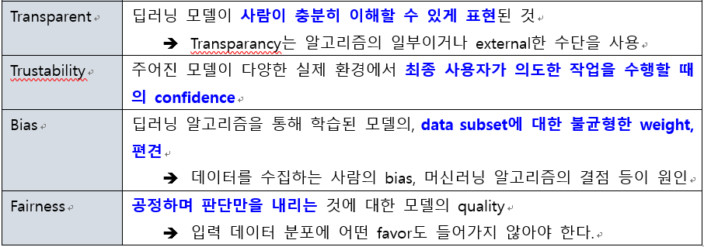
Paper: Opportunities and Challenges in Explainable Artificial Intelligence (XAI): A Survey
Definitions

Slide 10
Paper: Opportunities and Challenges in Explainable Artificial Intelligence (XAI): A Survey
Scope of Explanation
LOCAL explanation
Activation Maximization
Saliency Map Visualization
LRP (Layer-wise Relevance Backpropagation)
LIME (Local Interpretable Model-Agnostic Explanations)
SHAP (SHapely Additive exPlanations)
GLOBAL explanation
Global Surrogate Models
Class Model Visualization (LOCAL – Activation Maximization)
LIME (LOCAL – LIME)
CAVs (Concept Activation Vectors)
SpRAy (Spectral Relevance Analysis) …

Slide 11
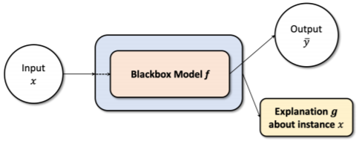
Paper: Opportunities and Challenges in Explainable Artificial Intelligence (XAI): A Survey
LOCAL explanations
일반적으로 1개의 input instance x에 대하여 모델 f의 결정에 대한 설명 g를 생성하는 것이 목표
Activation Maximization
주어진 hidden unit activation을 최대화하는 input pattern을 찾는 방법
Saliency Map Visualization
입력 이미지에 대한 출력 분류의 gradient를 계산하는 방법

Slide 12
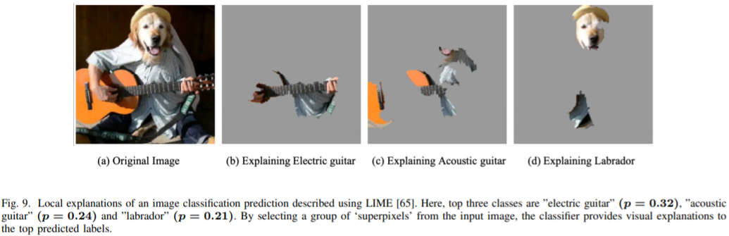
Paper: Opportunities and Challenges in Explainable Artificial Intelligence (XAI): A Survey
LOCAL explanations
LRP (Layer-wise Relevance Backpropagation)
Deep Neural Network의 output prediction을 decompose하여 개별적인 feature에 대한 relevance score를 계산하는 방법
LIME (Local Interpretable Model-Agnostic Explanations)
원본 이미지에서 output class에 대한 인접한 superpixel의 중요도를 계산하는 방법

Slide 13
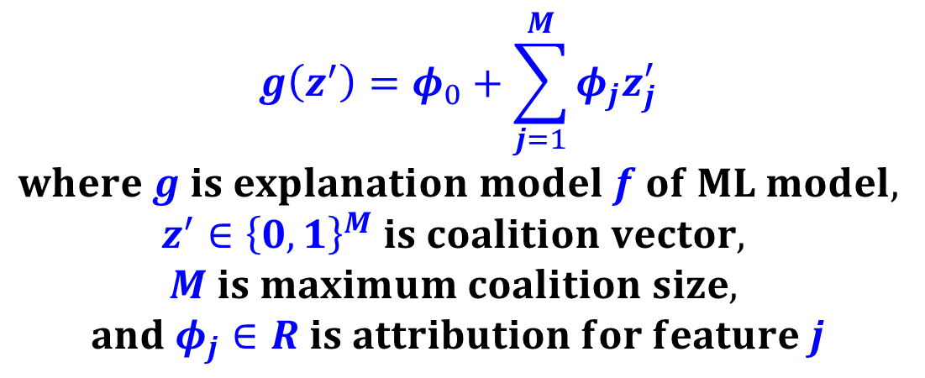
Paper: Opportunities and Challenges in Explainable Artificial Intelligence (XAI): A Survey
LOCAL explanations
SHAP (SHapely Additive exPlanations)
Shapley value를 이용한, model explainability를 위한, 게임 이론에 의한 optimal solution
$$g\left(z^{′}\right)=φ_{0}+\sum_{j=1}^{M}{φ_{j}z_{j}^{′}}$$
$$where g is explanation model f of ML model,$$
$$z^{′}∈{\left\{0,1\right\}}^{M} is coalition vector,$$
$$M is maximum coalition size,$$
$$and φ_{j}∈R is attribution for feature j$$

Slide 14
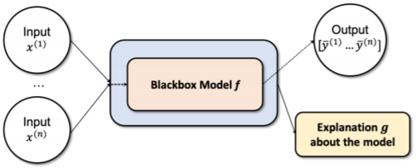
Paper: Opportunities and Challenges in Explainable Artificial Intelligence (XAI): A Survey
GLOBAL explanations
입력 배열을 요약하여 black box model의 전반적인 특성을 설명
Global Surrogate Models
비선형 AI 모델의 예측을 추정하기 위한 방법으로 XAI의 How에 해당하는 부분을 답변
Class Model Visualization
[LOCAL]의 Activation Maximization에서 Class Model Visualization을 하면 global method로 사용 가능

Slide 15
Paper: Opportunities and Challenges in Explainable Artificial Intelligence (XAI): A Survey
GLOBAL explanations
LIME
[LOCAL]의 LIME 모델은 submodular pick 알고리즘 (SP-LIME)을 통해 확장될 수 있으며, 이때 global correlation을 이해할 수 있음
CAVs (Concept Activation Vectors)
신경망의 내부 상태를 사용자 친화적인 concept domain에서 interpret할 수 있는 global explainability method
SpRAy (Spectral Relevance Analysis)
모델의 의사결정 과정을 global하게 알기 위하여, LRP의 local explanation에서 특정한 클러스터링 알고리즘을 설명

Slide 16
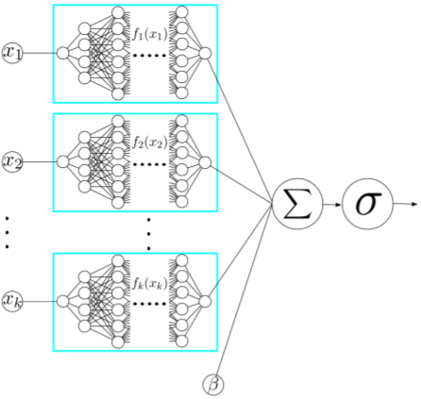
Paper: Opportunities and Challenges in Explainable Artificial Intelligence (XAI): A Survey
GLOBAL explanations
Global Attribution Mapping
feature들이 well defined semantic을 가지고 있을 때 attribution들을 weighted conjoined rankings로 간주할 수 있음
Neural Additive Models (NAMs)
여러 개의 신경망을 학습시키고, 이때 각 신경망은 single input feature에 해당

Slide 17
Paper: Opportunities and Challenges in Explainable Artificial Intelligence (XAI): A Survey
Differences in the methodology
Perturbation-based
DeConvolution nets for Convolution Visualizations
Prediction Difference Analysis
Randomized Input Sampling for Explanation (RISE)
Randomization and Feature Testing
BackPropagation- or Gradient-Based
Saliency Maps
Gradient class activation mapping (CAM)
Salient Relevance (SR) Maps
Attribution Maps

Slide 18
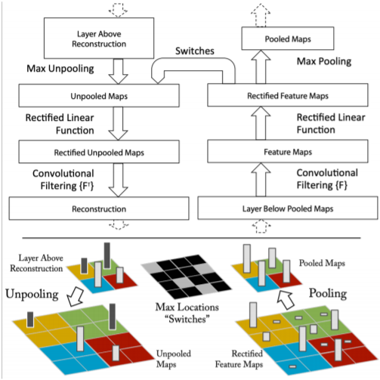
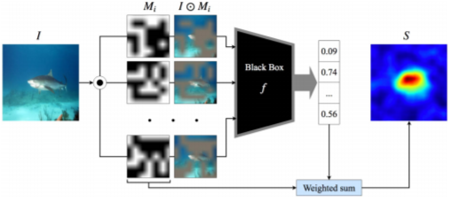
Paper: Opportunities and Challenges in Explainable Artificial Intelligence (XAI): A Survey
Perturbation-based methodologies
DeConvolution nets for Convolution Visualizations | Randomized Input Sampling for Explanation (RISE)

Slide 19
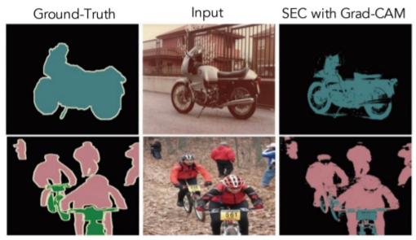
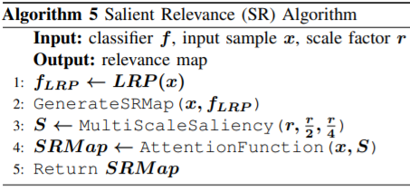
Paper: Opportunities and Challenges in Explainable Artificial Intelligence (XAI): A Survey
BackPropagation- or Gradient-Based methodologies
Gradient class activation mapping (CAM)에서의 Segmentation method | Salient Relevance (SR)의 알고리즘

Slide 20
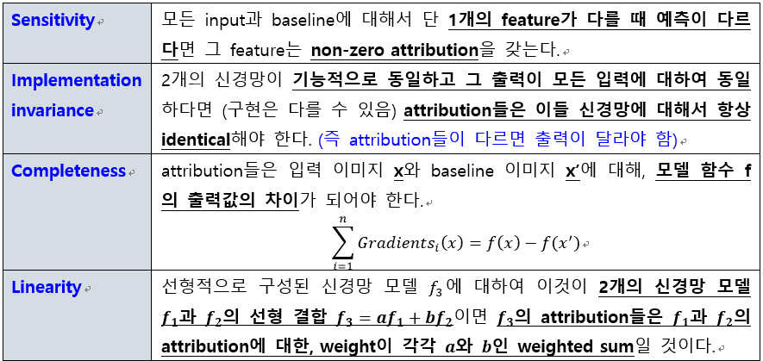
Paper: Opportunities and Challenges in Explainable Artificial Intelligence (XAI): A Survey
Gradient-Based methodology에 대한 요구 사항

Slide 21
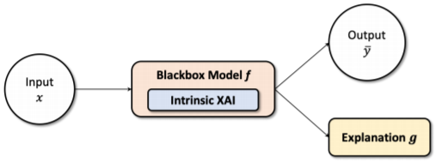
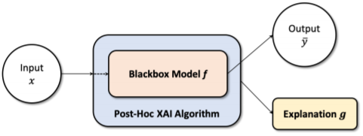
Paper: Opportunities and Challenges in Explainable Artificial Intelligence (XAI): A Survey
Model Usage/Implementation
Model Intrinsic
모델의 explainability는 자기 자신인 블랙박스 모델 f와 분리될 수 없으며, 이때 모델 f는 naturally explainable
Post-Hoc
오른쪽 그림의 post-hoc model explainability 알고리즘이 모델 f에 적용되었고, 이때 모델 f는 explainable externally

Slide 22
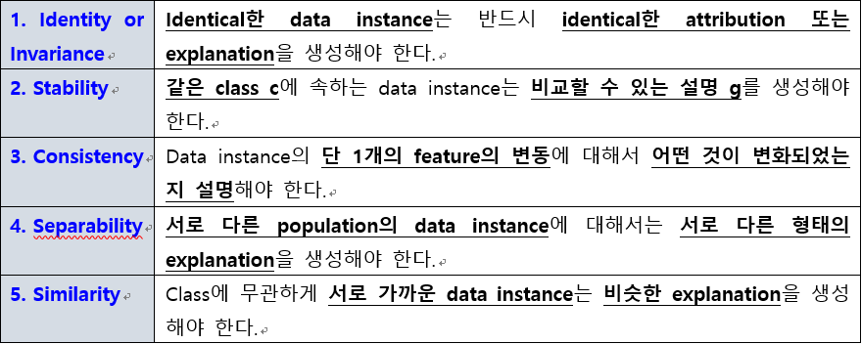
Paper: Opportunities and Challenges in Explainable Artificial Intelligence (XAI): A Survey
Constraints

Slide 23
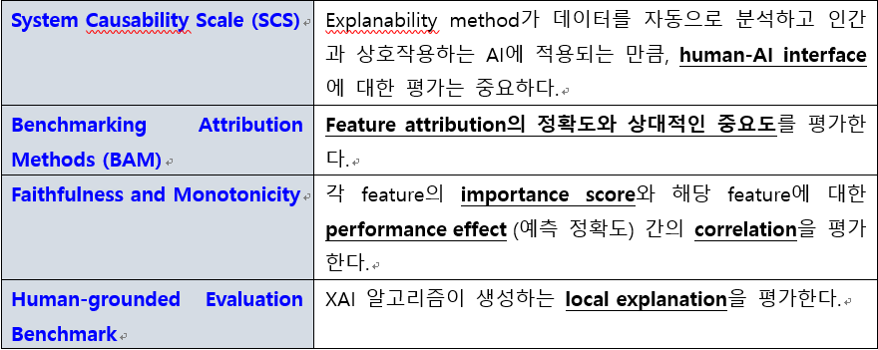
Paper: Opportunities and Challenges in Explainable Artificial Intelligence (XAI): A Survey
Evaluation Schemes

Slide 24
Github
https://github.com/WannaBeSuperteur/2020/tree/master/

